Slide 1

2019 Kinesiology, Athletics, and Dance Position Proposal Presentation
Dean / Athletic Director of Kinesiology, Athletics, and Dance
Division Assistant
Program Services Coordinator (Approved FY19)
Office Assistant II (Approved FY19)

Slide 2
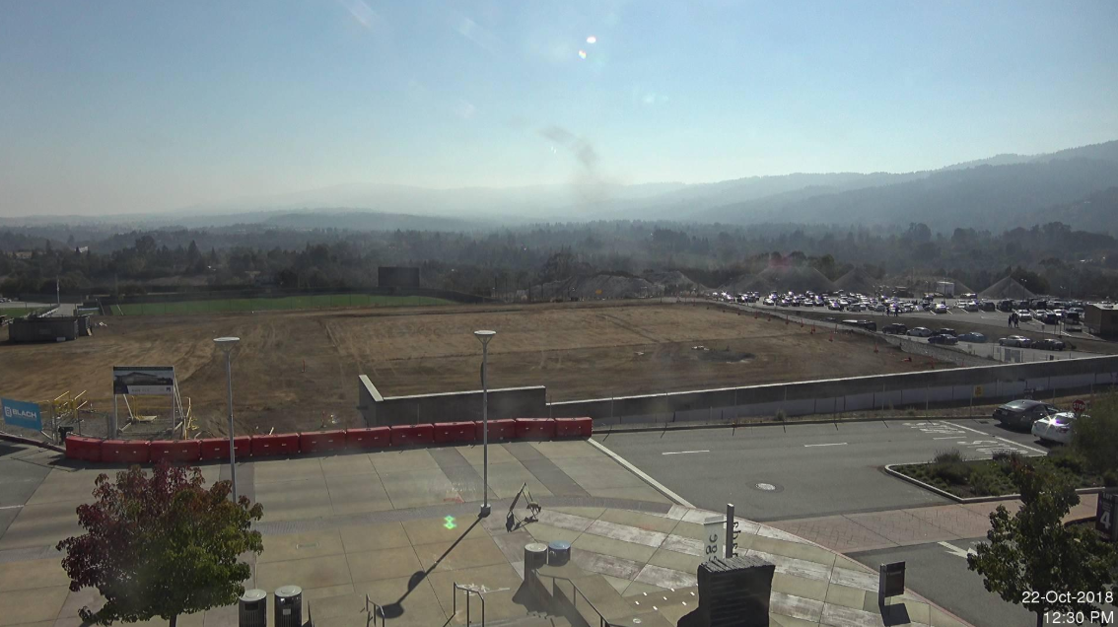
KAD 2017
KAD Students, Student Athletes, Faculty, Coaches, and Staff displaced
Main Theatre
College of San Mateo
Redwood High School
Notre Dame De Namur
Dean Anniqua Rana transfers to CSM
Division of ALL dismantled
KAD Department reports directly to Office of Instruction
Library and Learning Center Department becomes Academic Services and Learning Technologies Division
Notes:
The B1 Kinesiology & Wellness project consists of the demolition of an existing athletics building of approximately 41,000 SF, followed by the construction of a new 85,000 SF Kinesiology and Wellness building on the same site, and the transformation of the existing Parking Lot 4 to a new south squad landscaped plaza.
The new building will be the home of the Cañada College Physical Education Department. The new building will be a two story structure with rooftop activities and will house both academic and enterprise facilities, including classrooms for wellness activities, an extensive area for fitness equipment, a completion basketball gymnasium, lock and shower facilities, offices and auxiliary facilities. An instructional aquatics pool and a competition pool will be constructed on the flat part of the site to the east of the structure, complete with spectator areas and auxiliary buildings for associated support facilities and equipment.

Slide 3
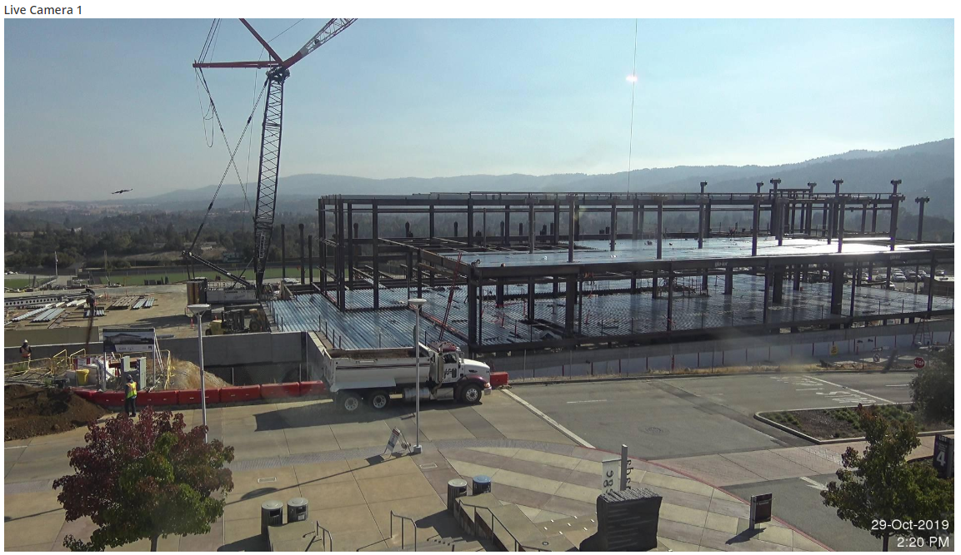
KAD 2017 - Present
KAD reports to multiple Vice Presidents
Gregory Anderson, VPI
David Johnson, VPI
Phillip King, VPSS
Tammy Robinson, VPI
Swing space remains a challenge to our students
KINE Dept – Displaced to the MT, FLDS, and 5-221
ATH Dept – Displaced to the FLDS, CSM, Redwood HS, NDNU, 5-221, and B9
DANC Dept – Displaced to the MT, 5-221, and B9
DEPT Office – Displaced to B9 Floor 2, B9 Floor 1
Notes:
Stress loss of communication

Slide 4
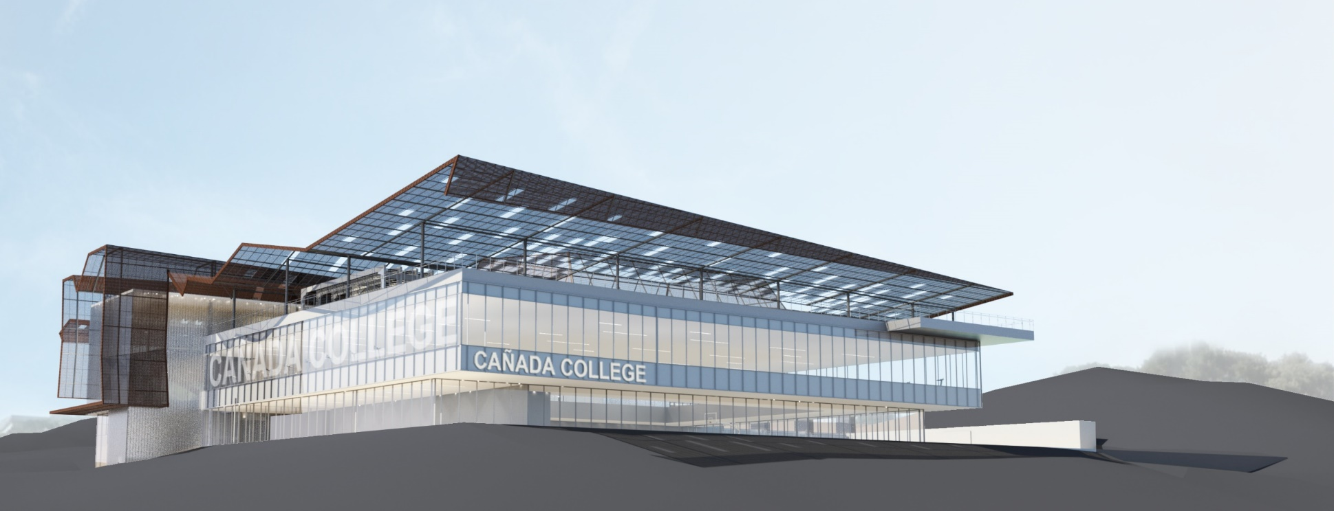
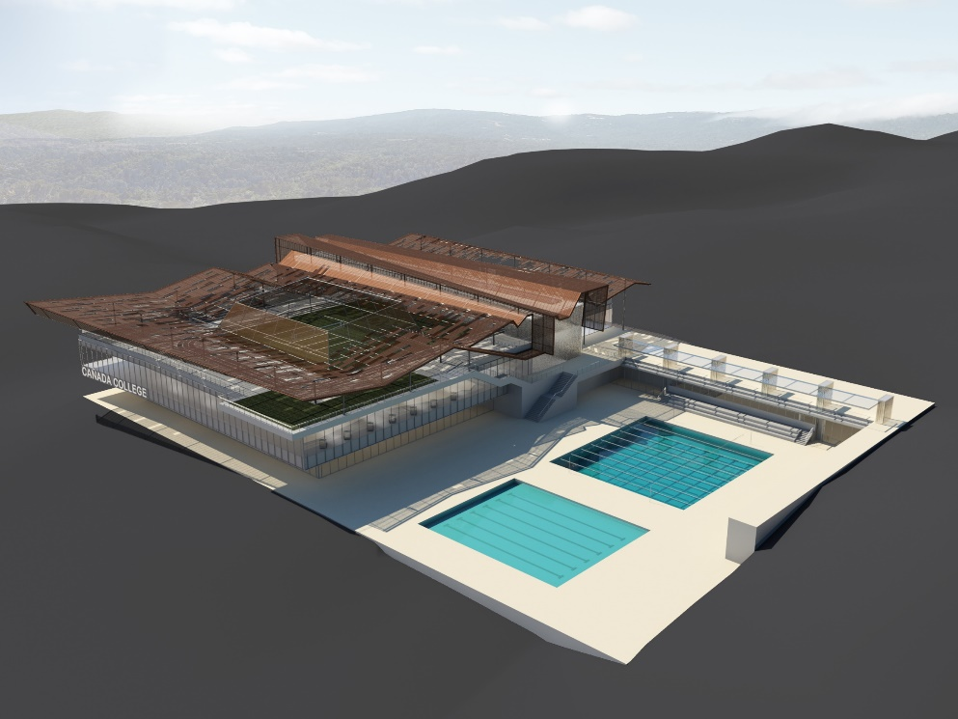

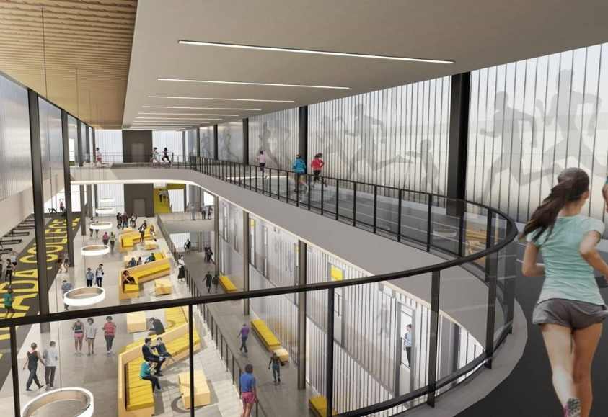
Year 2021 and Beyond
Notes:
The new building will be the home of the Cañada College Kinesiology, Athletics, and Dance Department.
B1 is a two story structure with rooftop activities and will house both academic and enterprise facilities
Included are classrooms for wellness activities, an extensive area for fitness equipment, a completion basketball gymnasium, lock and shower facilities, offices and auxiliary facilities.
An instructional aquatics pool and a competition pool will be constructed on the flat part of the site to the east of the structure, complete with areas and auxiliary buildings for associated support facilities and equipment.

Slide 5
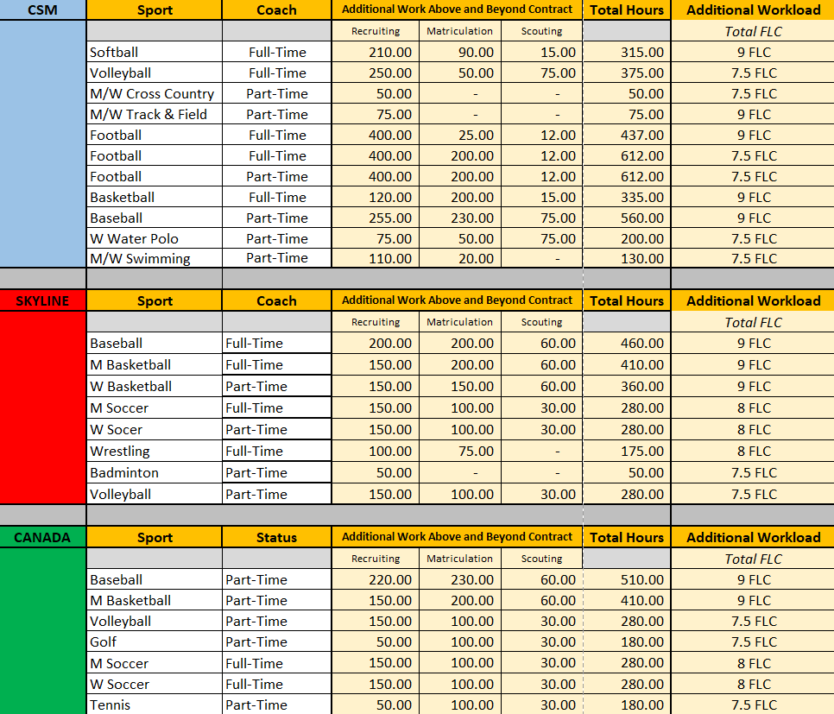
Full-Time and Part-Time Head Coaches Workload
Notes:
Compare CAN ratio of FT v. PT Coaches to CSM & SKY

Slide 6
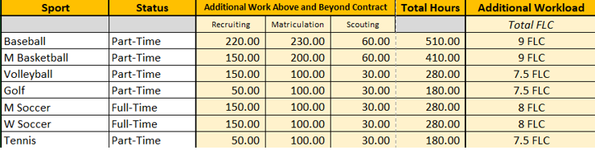
Workload for Cañada Athletic Coaches
Coaches paid at “Lab Rate”
Seasonal Representation on Participatory Governance Committees
PT Coaches responsible for FT duties such as Title IX Compliance, Division, and College representation
Notes:
Include Dance Adjunct and workload…similar to Coaches

Slide 7
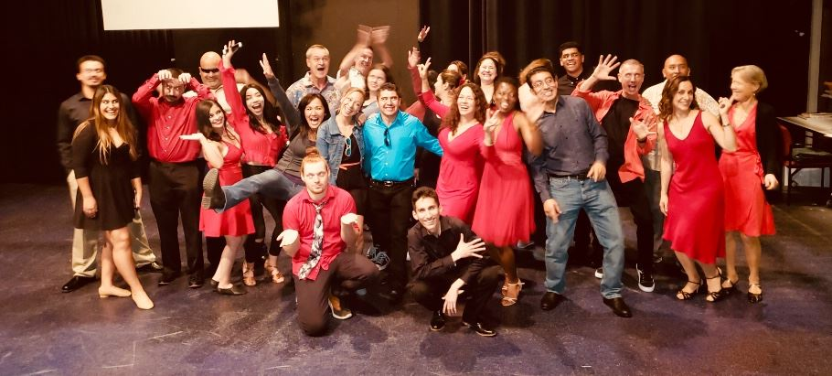
Workload for Cañada Dance Adjunct Faculty
Dance Dept cross collaboration and support of important programs such as the Promise Scholars Program (link)

Slide 8
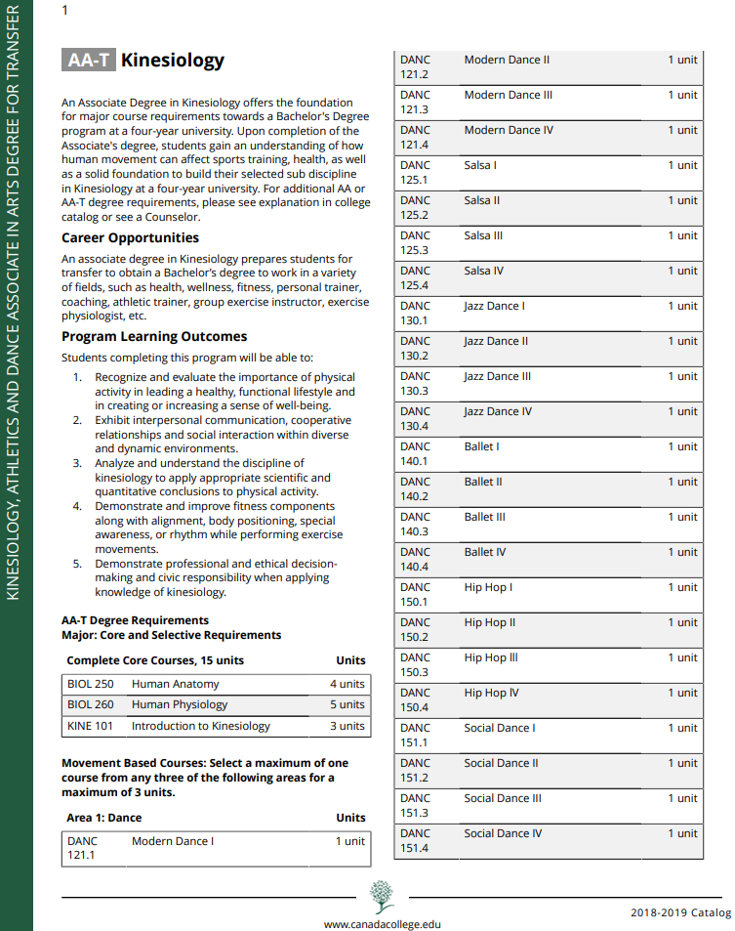
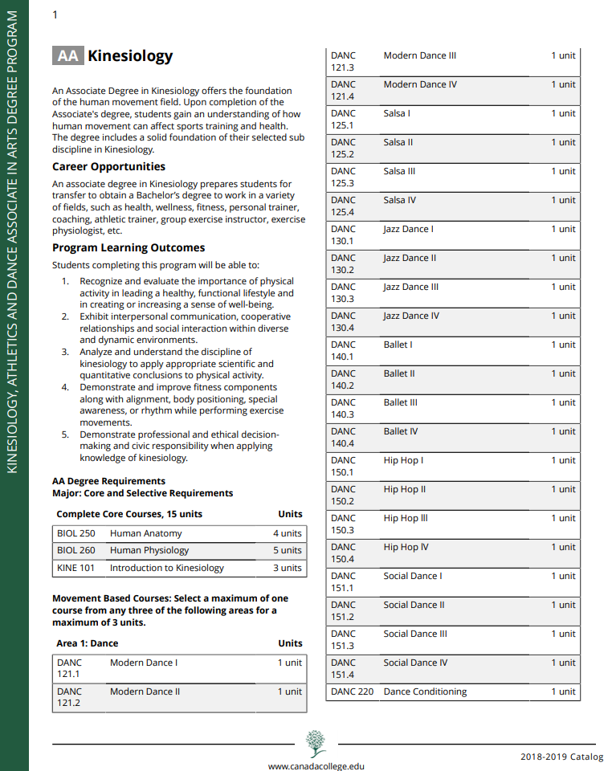
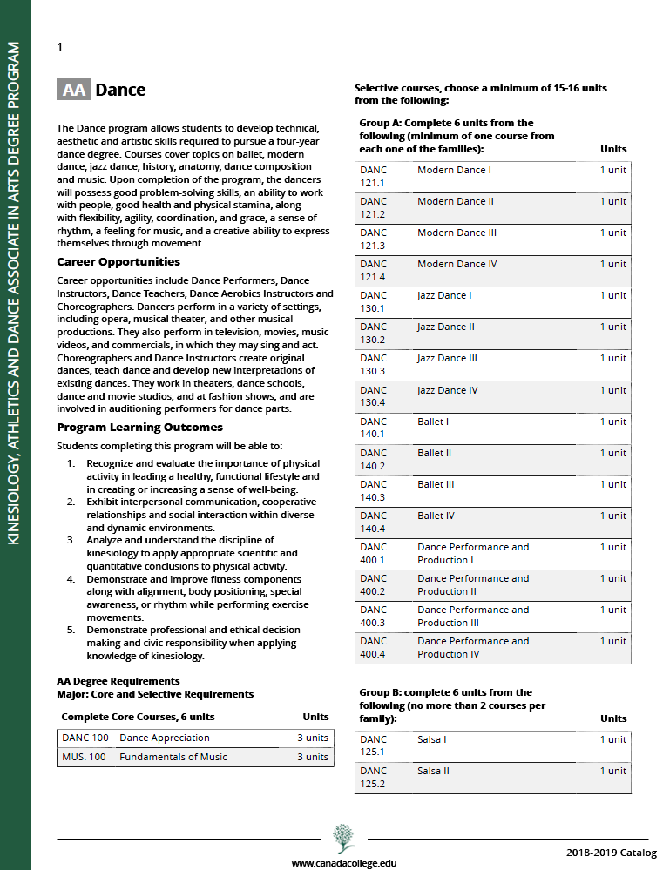
KAD Degree Programs
AA-T Kinesiology
AA Kinesiology
AA Dance
Notes:
AA DANC:
Career opportunities include Dance Performers, Dance Instructors, Dance Teachers, Dance Aerobics Instructors and Choreographers. Dancers perform in a variety of settings, including opera, musical theater, and other musical productions. They also perform in television, movies, music videos, and commercials, in which they may sing and act. Choreographers and Dance Instructors create original dances, teach dance and develop new interpretations of existing dances. They work in theaters, dance schools, dance and movie studios, and at fashion shows, and are involved in auditioning performers for dance parts.
AA-T KINE:
An associate degree in Kinesiology prepares students for transfer to obtain a Bachelor’s degree to work in a variety of fields, such as health, wellness, fitness, personal trainer, coaching, athletic trainer, group exercise instructor, exercise physiologist, etc.

Slide 9
How Do We Get There
Administration
Skills
Athletics
Dean / Athletic Director
Notes:
Administration
Work with faculty to develop curriculum and effective methods of instruction,
Plan and administer the division budget;
Develop, recommend and implement the division’s class schedule;
Provide articulation/liaison with other colleges, student and community groups;
Athletics
Represent the college in matters related to intercollegiate athletics;
Represent the athletic program to the community and other relevant organizations;
Oversee the eligibility processes and observing of CCCAA regulations and NCAA transfer guidelines;
Supervise and manage all athletic events.
Skills
Ability to organize and coordinate diverse instructional programs;
Organizational skills to facilitate the development and administration of curriculum, budget, staff development, and performance evaluation;
Commitment to participatory governance;
Understanding of the NCAA and CCCAA Constitution and Bylaws

Slide 10
How Do We Get There
Administrative Support
Liaison
Clerical
Division Assistant
Notes:
Administration
Work with faculty to develop curriculum and effective methods of instruction,
Plan and administer the division budget;
Develop, recommend and implement the division’s class schedule;
Provide articulation/liaison with other colleges, student and community groups;
Athletics
Represent the college in matters related to intercollegiate athletics;
Represent the athletic program to the community and other relevant organizations;
Oversee the eligibility processes and observing of CCCAA regulations and NCAA transfer guidelines;
Supervise and manage all athletic events.
Skills
Ability to organize and coordinate diverse instructional programs;
Organizational skills to facilitate the development and administration of curriculum, budget, staff development, and performance evaluation;
Commitment to participatory governance;
Understanding of the NCAA and CCCAA Constitution and Bylaws

Slide 11
How Do We Get There
Planning
Implementation
Coordination
Program Services Coordinator
Notes:
Administration
Work with faculty to develop curriculum and effective methods of instruction,
Plan and administer the division budget;
Develop, recommend and implement the division’s class schedule;
Provide articulation/liaison with other colleges, student and community groups;
Athletics
Represent the college in matters related to intercollegiate athletics;
Represent the athletic program to the community and other relevant organizations;
Oversee the eligibility processes and observing of CCCAA regulations and NCAA transfer guidelines;
Supervise and manage all athletic events.
Skills
Ability to organize and coordinate diverse instructional programs;
Organizational skills to facilitate the development and administration of curriculum, budget, staff development, and performance evaluation;
Commitment to participatory governance;
Understanding of the NCAA and CCCAA Constitution and Bylaws

Slide 12
How Do We Get There
Administrative Support
Office Management
Clerical Support
Office Assistant II
Notes:
Administration
Work with faculty to develop curriculum and effective methods of instruction,
Plan and administer the division budget;
Develop, recommend and implement the division’s class schedule;
Provide articulation/liaison with other colleges, student and community groups;
Athletics
Represent the college in matters related to intercollegiate athletics;
Represent the athletic program to the community and other relevant organizations;
Oversee the eligibility processes and observing of CCCAA regulations and NCAA transfer guidelines;
Supervise and manage all athletic events.
Skills
Ability to organize and coordinate diverse instructional programs;
Organizational skills to facilitate the development and administration of curriculum, budget, staff development, and performance evaluation;
Commitment to participatory governance;
Understanding of the NCAA and CCCAA Constitution and Bylaws

Slide 13
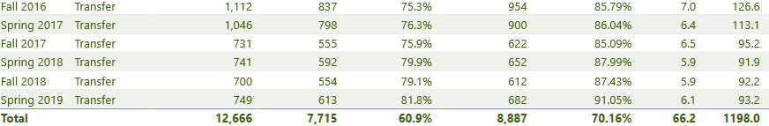
KAD Productivity & Effectiveness
*
*B1 Demolished!

Slide 14
KAD Productivity & Effectiveness
*
_
_
_
_
_
_
*B1 Demolished!

Slide 15
KAD Program Learning Outcomes
Recognize and evaluate the importance of physical activity in leading a healthy, functional lifestyle and in creating or increasing a sense of well-being
Exhibit interpersonal communication, cooperative relationships and social interaction within diverse and dynamic environments
Analyze and understand the discipline of kinesiology to apply appropriate scientific and quantitative conclusions to physical activity
Demonstrate and improve fitness components along with alignment, body positioning, special awareness, or rhythm while performing exercise movements
Demonstrate professional and ethical decision-making and civic responsibility when applying knowledge of kinesiology

Slide 16

How Can Our Campus Community Support KAD Student Success?
Dean/Athletic Director
Division Assistant
Program Services Coordinator
Office Assistant II

Slide 17
Kinesiology, Athletics, & Dance Division
Position Proposal 2019
Thank You

