Slide 1
Math Position Justification: Request for two new hires
October 31st, 2019

Slide 2
Currently
Campus PD: Faculty Learning Program
For Fall 2019:
FTEF is 12.3 (We currently have 7 FT instructors)
61% of units taught by FT faculty
5 new co-requisite sections.
Faculty Learning Program
Community of Practice
STEM Grants: Lead Personnel, PI, Math Jam, STEM Ctr.
STEM Grants / STEM Ctr
AB705
/ Support courses
CoP: training and curriculum

Slide 3
Math impacts the most students(2017/2018)
Number of FT faculty
Math | English | Biology | ESL
7 | 8 | 4 | 6
Notes:
We touch a lot of students.
Helping the college meets it’s goals.

Slide 4
Our Vision with Two New Hires
Two new hires would allow us to …
Hire one specializing in STEM-equity, another specializing in Statistics and Data-science
Strengthen curriculum through Communities of Practice around the different paths:
Statistics
Business Math
Calculus/STEM
Math courses designed for other Guided Pathways Interest Areas
Diversify our Math Faculty
Notes:
MSEIP - Helps students through STEM program
- self efficacy
- targeting 1st generation college students.
- faculty development (Make bullet points)
Key Equity Initiative
"College Goal 1. Student Completion/Success Provide educational and student services programs that highlight inclusivity, diversity, and equity in their mission to help students meet their unique educational goals and minimize logistical and financial barriers to success."

Slide 5
Our Vision with Two New Hires (cont.)
Two new hires would allow us to …
Develop and teach corequisite courses prompted by AB 705
Improve Student Completion and Success, close equity gaps:
Faculty will be trained to implement equity-minded classroom practices
Collaborate with support services such as STEM Center, Math Jam, Counseling, etc.
Learn better ways to support more heterogenous classrooms
Continue Community / Campus Involvement
Notes:
MSEIP - Helps students through STEM program
- self efficacy
- targeting 1st generation college students.
- faculty development (Make bullet points)
Key Equity Initiative
"College Goal 1. Student Completion/Success Provide educational and student services programs that highlight inclusivity, diversity, and equity in their mission to help students meet their unique educational goals and minimize logistical and financial barriers to success."

Slide 6
Stable, High enrolment in Calculus Path

Slide 7
Growing Statistics Pathway

Slide 8
FTEF Stable over the last decade

Slide 9
Enrollment is stable over the last decade

Slide 10
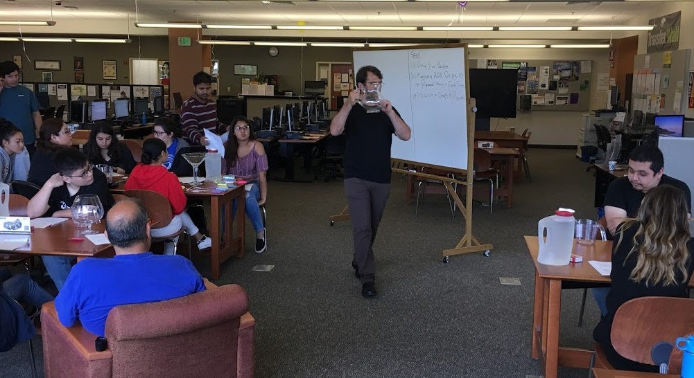
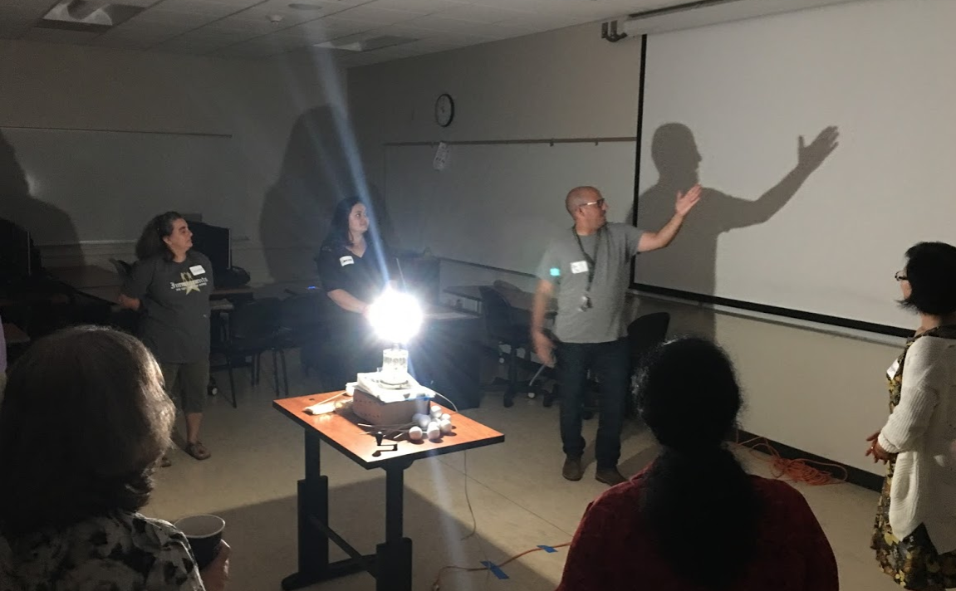
Community Connections
Award Winning Math Jam
On-boards students who are unfamiliar with college.
Faculty Learning Program
Collaboration with UC Berkeley and CSU Eastbay.

Slide 11
Developing Institutional Resources.
STEM C.O.P
Division-wide community that helps faculty collaborate and develop their teaching.
Pre Statistics C.O.P
Supports the development of Pre-Statistics faculty and curriculum.

Slide 12
Community Of Practice Testimonial
"Because of the Stats team I felt confident about teaching this course. The collaboration in ideas, how to teach with mostly group work, and hearing about how the other teachers handled projects, tests, and activities were instrumental to the success of my class.“ – Michelle Beatty

Slide 13
Summary
To improve we need stable, collaborative work
This requires investment
There are a LOT of opportunities, but few bodies to coordinate and lead, on top of teaching the load.
We have plans for incorporating new faculty into a culture of collaboration and improvement.
Quality teaching in Math is a SERIOUS Equity issue.

