Slide 1

PBC Task Force Report:
Scorecard & Institution Set Standard Update
Annual Plan Update & Recommendations
Report and Recommendations to PBC on May 6, 2020

Slide 2
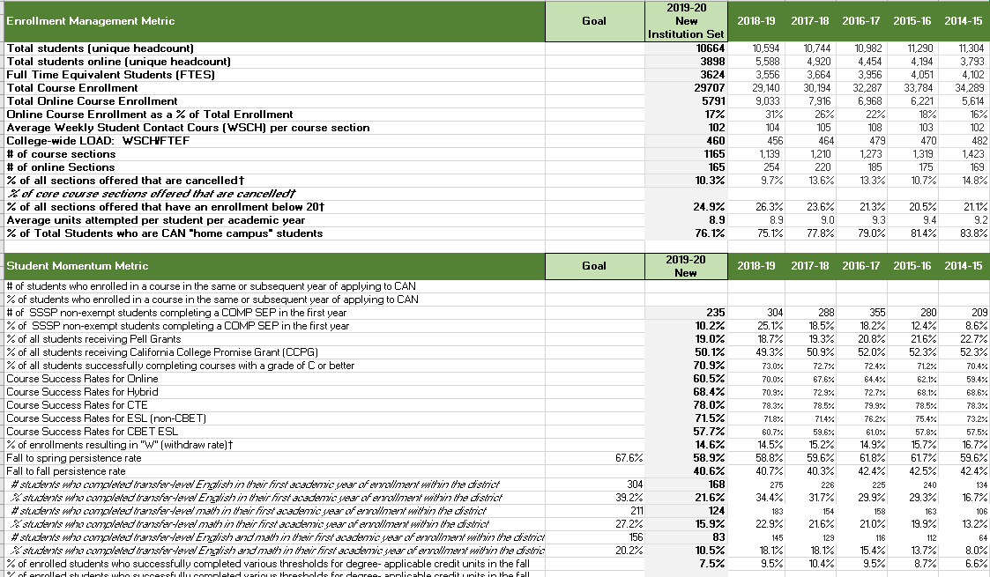
Scorecard & Institution Set Standards Update
Task Force Progress
Return in early fall with draft goals for PBC review and adoption

Slide 3
2020-21 Annual Plan
Transitioning to a new planning format
Implementing the approved recommendations from the PBC Task Force on Participatory Governance Committee Structure, Roles, and Composition

Slide 4
Implementing the Task Force Recommendations

Slide 5
Education Master Plan
Strategic Enrollment Management Plan (inclusive of Guided Pathways objectives)
Equity Plan
Online Education Plan
Professional Development Plan
Sustainability Plan
Technology Plan
Safety Plan
Honors Plan
College committee plans align with and support the achievement of college goals and objectives documented in the Education Master Plan (EMP) and Strategic Enrollment Management Plan (SEM)

Slide 6
Task Force Recommendations Approved last time:
PBC adopts proposed Definitions for Committee Structure.
College Committees use College Committee Bylaws Template.
College Committees use 3-year plan template to align with and support Education Master Plan (EMP) and Strategic Enrollment Management (SEM) Plan.
College Committees use participatory, representative membership.

Slide 7
Education Master Plan: 2017-2022
Strategic Enrollment Management Plan: 2020-2023
College Committee Planning: 2020-2023, implement 3-year plans per committee
Education Master Plan: 2017-2022
Year 1
2017-18
Year 2
2018-19
Year 3
2019-20
Year 4
2020-21
Year 5
2021-22
Launch
2022-2027
Strategic Enrollment Planning Strategic Enrollment Management Plan: 2020-23
Year 1
2020-21
Year 2
2021-22
Year 3
2022-23
College Committee Planning: 2020-2023
Align 3-year planning as appropriate per committee
Operational Plan, Annual

Slide 8
PBC Proposed Actions to Align and Integrate College Plans
PBC:
  Approve newly approved planning structure (April 29)
  Assign task of aligning EMP, SEM and other plans to Summer Leadership Retreat participants
  Leadership Retreat participants present “Year 4” operational plan to College Councils for feedback and refinement in early fall 2020
  PBC approves “Year 4” operational plan in fall 2020

Slide 9
Other possible slides below

Slide 10
College Goal #1
Student Completion/Success
To provide educational and student services programs that help students meet their unique academic goals; minimize logistical and financial barriers to success; and highlight inclusivity, diversity and equity.
EMP Strategic Initiatives to Accomplish Goal 1: | Year 4 (2020-21) Actions to be taken to Accomplish Goal 1:
Develop academic pathways and provide integrated support services that begin in high school, transition to college and complete with a certificate, degree and/or transfer.
Improve completion by developing and implementing a comprehensive college-wide approach to enrollment management, student retention, and course scheduling.
Develop and implement a 2-pronged Promise Program to address ‘scholarship and academic support’ in addition to ‘personal student financial support’ to minimize the barriers caused by enrollment fees, cost of textbooks, parking fees, transportation, child care, food and housing insecurity.
Expand and extend cohort bridge programs to students beyond their first year of study

Slide 11
College Goal #2
Community Connections
To build and strengthen collaborative relationships and partnerships that support the needs of, reflect and enrich our diverse and vibrant local community
EMP Strategic Initiatives to Accomplish Goal 2: | Year 4 (2020-21) Actions to be taken to Accomplish Goal 2:
Collaborate with Pre-K to Adult School partners to promote relationships, seamless transitions, and alignment of pathways.
Develop and support student internships, service learning opportunities, mentorships to improve connection of students to local organizations and employers.
Attract the community to the campus through high profile signature events.
Create a Cañada College alumni organization to promote success stories, to engage successful community members, and to explore development opportunities.
Establish structures and resources to initiate and build relationships with local businesses and industries for developing institutional partnerships.
Expand and enhance marketing of transfer and career technical education (CTE) opportunities.
Enhance and invest in 2+2 relationships with 4-year universities

Slide 12
College Goal #3
Organizational Development
Focus institutional resources on the structures, processes, and practices that invest in a diverse student population and prioritize and promote equitable, inclusive, and transformative learning.
EMP Strategic Initiatives to Accomplish Goal 3: | Year 4 (2020-21) Actions to be taken to Accomplish Goal 3:
Develop academic pathways and provide integrated support services that begin in high school, transition to college and complete with a certificate, degree and/or transfer.
Improve completion by developing and implementing a comprehensive college-wide approach to enrollment management, student retention, and course scheduling.
Develop and implement a 2-pronged Promise Program to address ‘scholarship and academic support’ in addition to ‘personal student financial support’ to minimize the barriers caused by enrollment fees, cost of textbooks, parking fees, transportation, child care, food and housing insecurity.
Expand and extend cohort bridge programs to students beyond their first year of study

Slide 13
Aligning & Integrating the EMP and SEM Goals and Objectives
DRAFT TEMPLATE

