Slide 1

PBC Task Force
Tasks:
Consider the Institutional Learning Outcomes and update them to better reflect the changes in the College Mission statement made on May, 2018.
Improve the Graduation Survey as a tool for assessing if the College is effectively helping students achieve the Institutional Learning Outcomes.
March 17, 2020

Slide 2
Task Force Recommendations
Achieve the intent of the changes to the mission statement by:
  Adding open response questions regarding barriers the student faced while at Cañada (Q.13-14).
  Disaggregating the results of the (revised) Graduation Survey to determine if any student sub-populations are disproportionately impacted by barriers to achieving their Education Goals.
Reduce the number of survey questions.
Clearly indicate that the student is assessing whether or not they improved their abilities during their time at Cañada College.
Update race/ethnicity and gender response options.
Future consideration: administer a similar survey to new, incoming students as well.

Slide 3
Draft Revised Graduation Survey:
The PBC ILO/Graduation Survey Task Force met on March 10, 2020 and developed the following, revised survey.

Slide 4


Slide 5
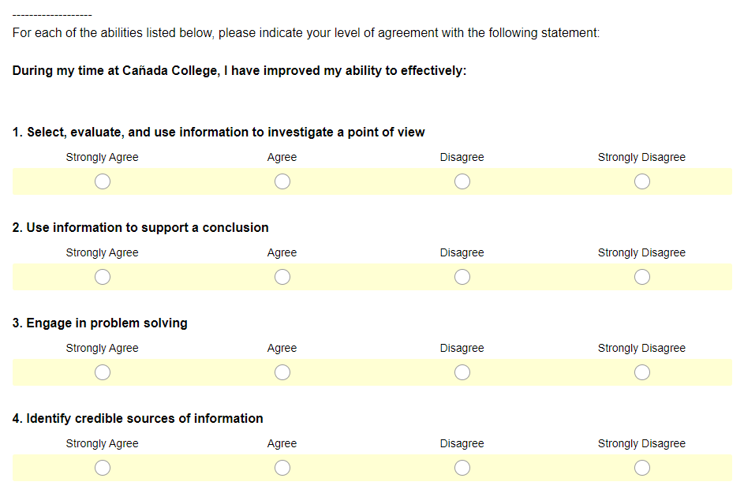

Slide 6
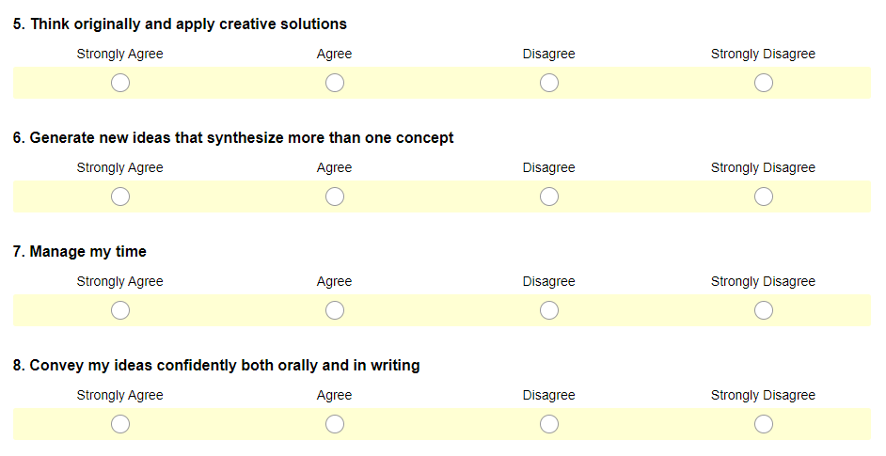

Slide 7
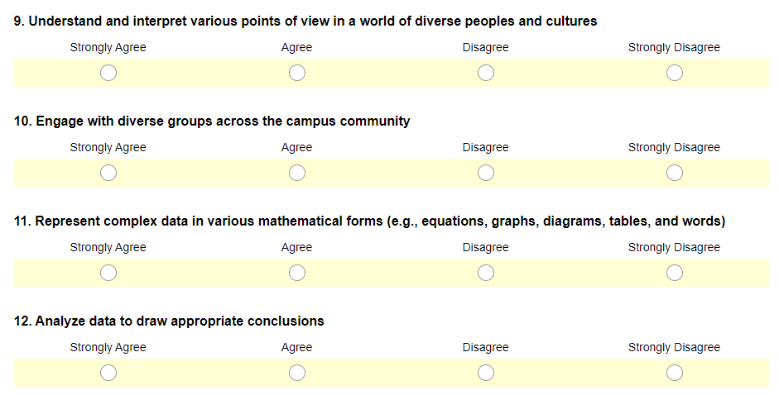

Slide 8
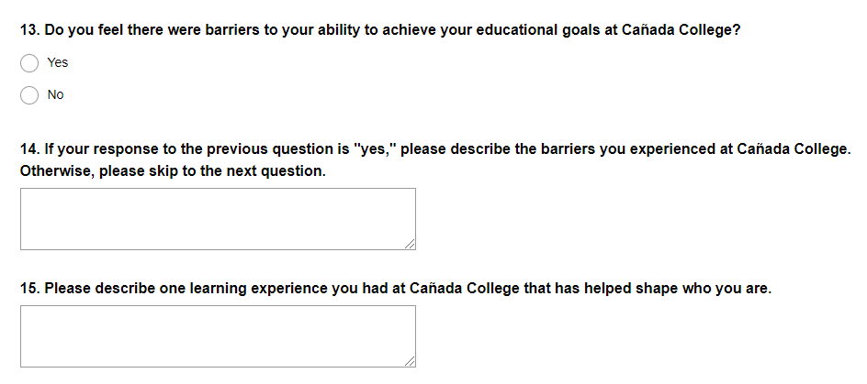

Slide 9
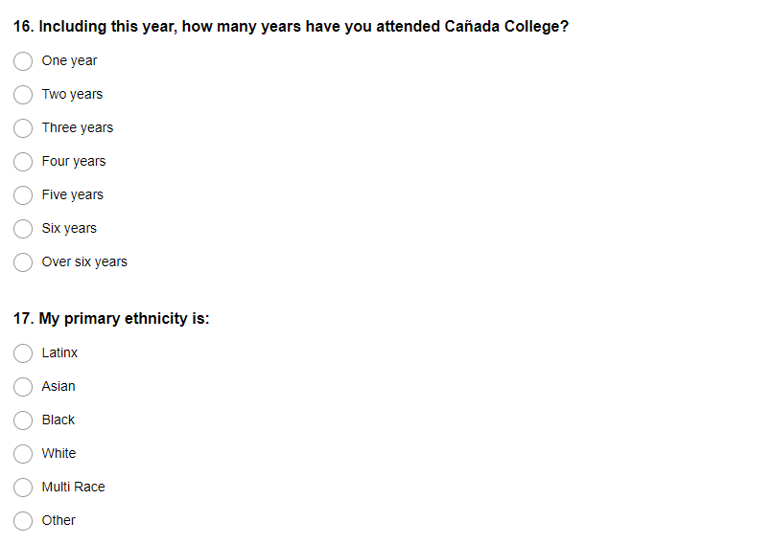

Slide 10
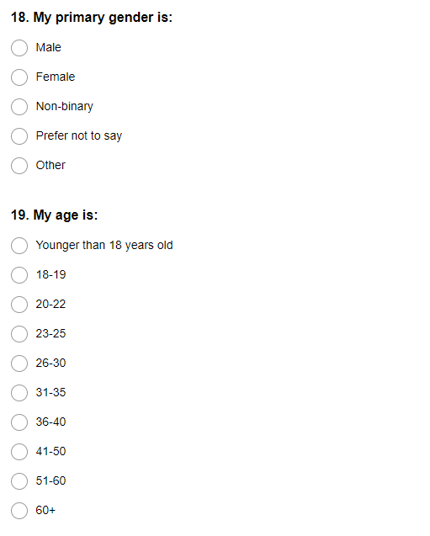

Slide 11
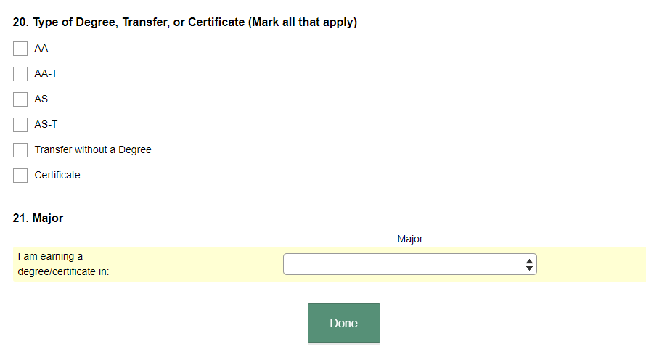

Slide 12
Existing Graduation: Slides 13-21 below

Slide 13
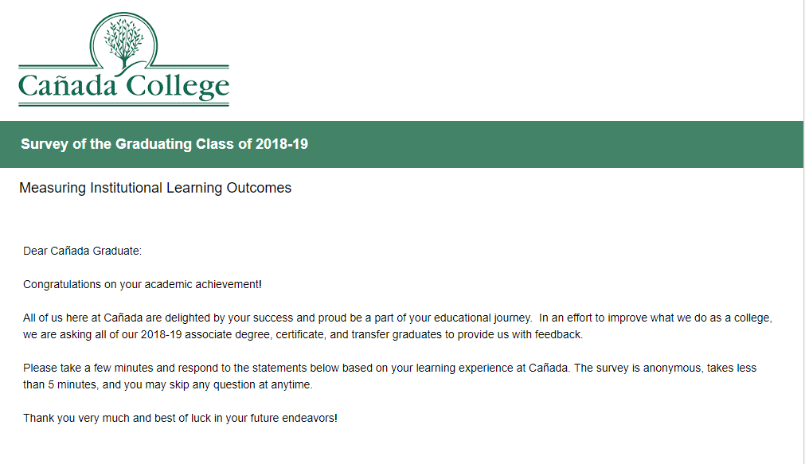

Slide 14
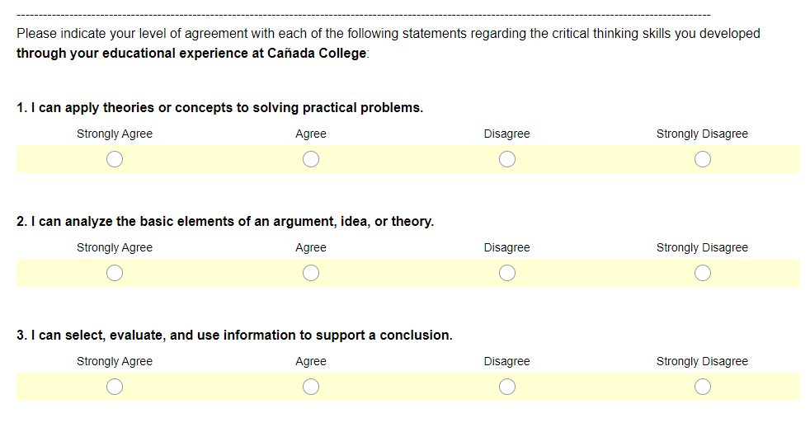

Slide 15
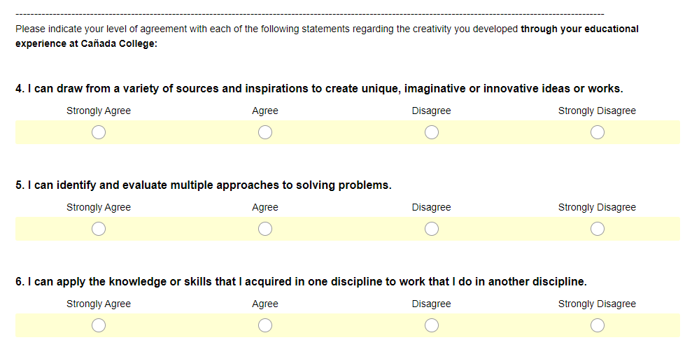

Slide 16
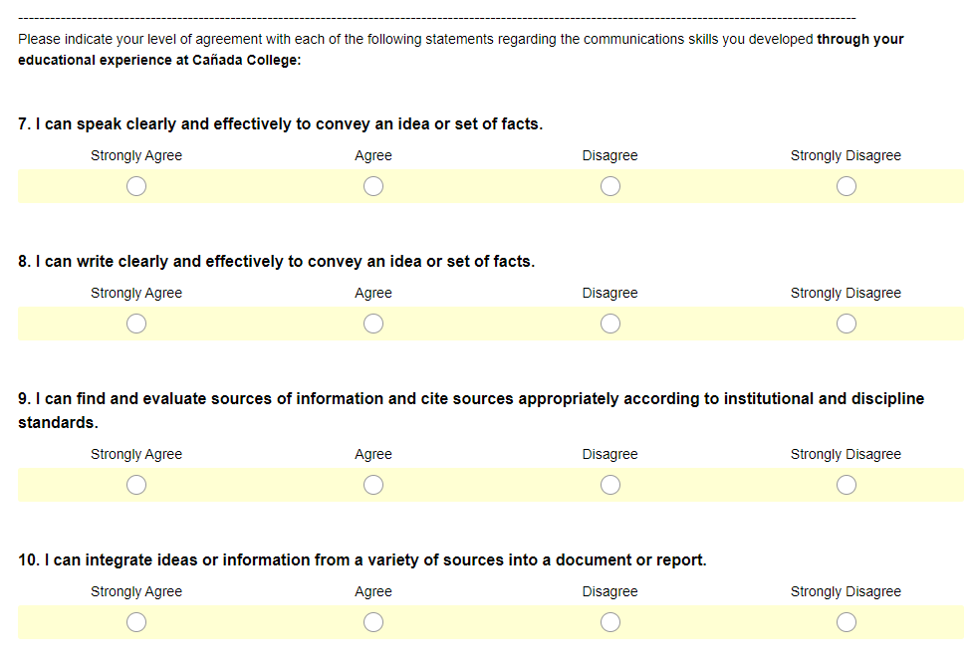

Slide 17
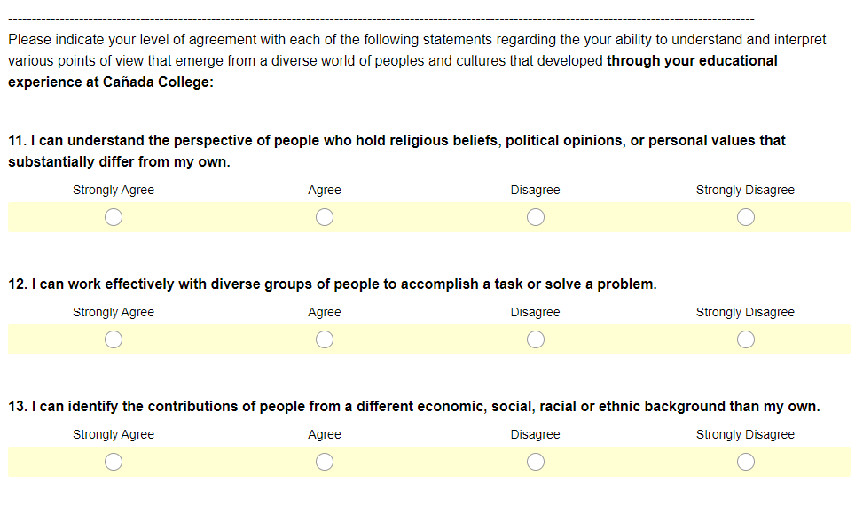

Slide 18
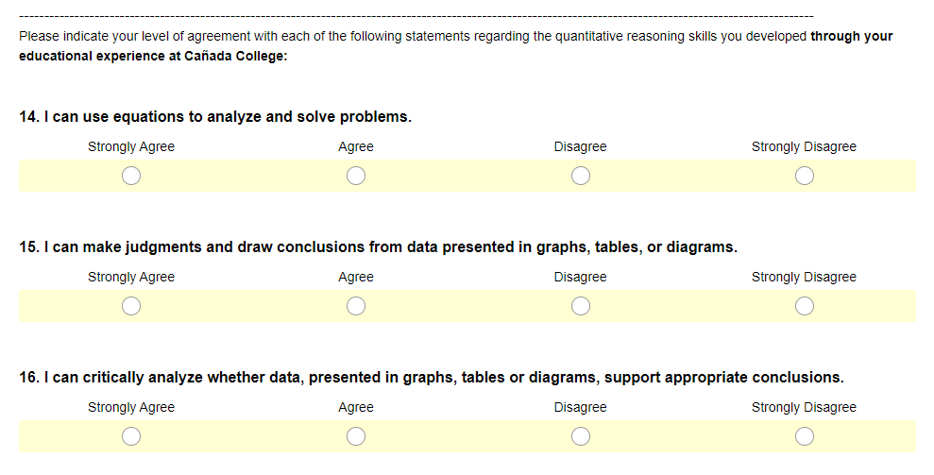

Slide 19
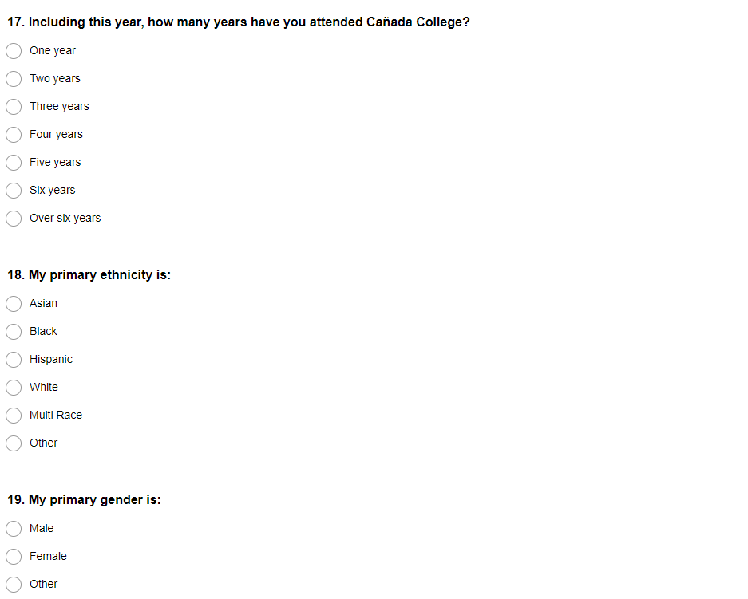

Slide 20
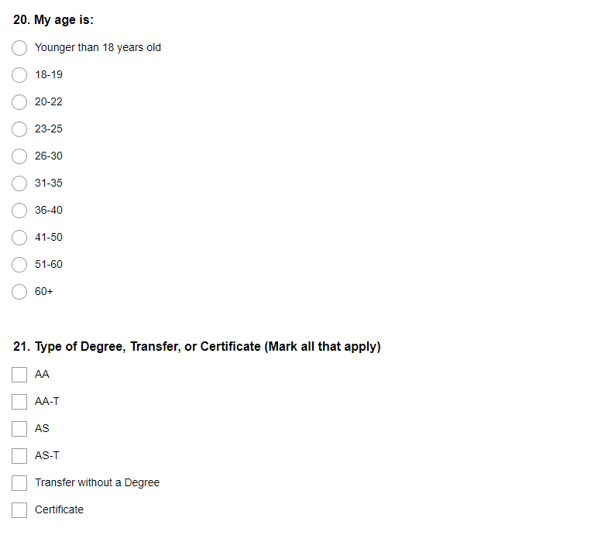

Slide 21
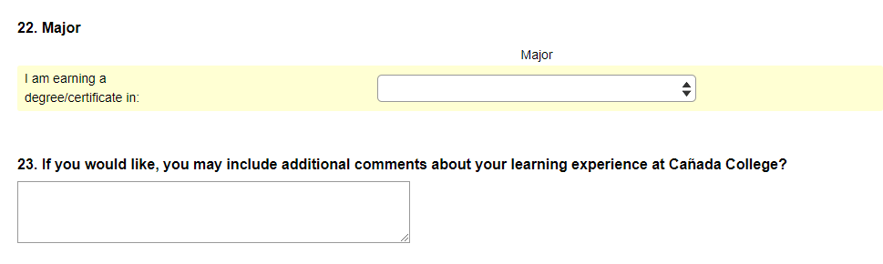

Slide 22
Background information considered by the Task Force

Slide 23
Existing ILOs
Critical Thinking
Select, evaluate, and use information to investigate a point of view, support a conclusion, or engage in problem solving.
Creativity
Produce, combine, or synthesize ideas in creative ways within or across disciplines.
Communication
Use language to effectively convey an idea or a set of facts, including the accurate use of source material and evidence according to institutional and discipline standards.
Community
Understand and interpret various points of view that emerge from a diverse world of peoples and cultures.
Quantitative Reasoning
Represent complex data in various mathematical forms (e.g., equations, graphs, diagrams, tables, and words) and analyze these data to draw appropriate conclusions.
The Institutional Learning Outcomes parallel our General Education Learning Outcomes which the Curriculum Committee APPROVED 11/18/11. The Institutional Learning Outcomes were revised and adopted by the ASGC (11/14/13) and Planning & Budgeting Council (11/20/13).

Slide 24
Changes to the Mission Statement
NEW MISSION STATEMENT (as of May, 2018):
Cañada College provides our community with a learning-centered environment, ensuring that all students have equitable opportunities to achieve their transfer, career education, and lifelong learning educational goals. The College cultivates in its students the ability to think critically and creatively, communicate effectively, reason quantitatively, and understand and appreciate different points of view within a diverse community.
OLD MISSION STATEMENT (prior to May, 2018):
Cañada College provides our community with a learning-centered environment, ensuring that students from diverse backgrounds have the opportunity to achieve their educational goals by providing transfer, career/technical, and basic skills programs, and lifelong learning. The college cultivates in its students the ability to think critically and creatively, communicate effectively, reason quantitatively to make analytical judgments, and understand and appreciate different points of view within a diverse community.

Slide 25
ILO Assessment
Cañada College assesses its Institutional Learning Outcomes (ILOs) on an annual basis in order to assure institutional effectiveness and promote continuous improvement. The college uses multiple means of assessment:
Data from the Community College Survey of Student Engagement (CCSSE)
Data from a survey of students petitioning to graduate with a degree or certificate
Analysis of student ePortfolios
The results of these assessments are discussed by our participatory governance bodies, including the Planning & Budgeting Council, and appropriate action plans are developed.

