Slide 1



Proposal for Transfer/Counseling/HTP Program Services Coordinator
An Instructional-Student Services Partnership for Student Success

Slide 2
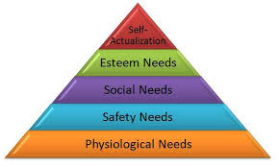
Why is position needed?
Lack of staffing to proactively reach out to students.
Counseling model relies on students to take initiative.
Missteps and lack of follow through impedes transfer success.
Administrative tasks limits time for program enhancements/growth.
Build infrastructure for Guided Pathways implementation.

Slide 3

Why do students fall short of Ed Goal?
Examples:
Student fails to update transfer application with Fall grades; application is rescinded.
Student attempts transfer Math 3x; must repeat outside of District and never transfers.
Student changes major several times and is ineligible for financial aid due to accumulating too many units.

Slide 4

What is the volume of activity?
15% of students do not have a current SEP
General counseling (non-program affiliated), had 6,948 appts. over the last 3 terms.
Fall ‘19, the Counseling Dept. has 197 “no show” appts.
465 students are on dismissal/reinstated/probation status
The Transfer Center is currently working with 2,290 transfer students (Cañada as primary campuses)
100+ TAG applications are processed each September
272 ADT applications were processed in SP/FA
Sum/Fall ‘19 scheduled Transfer Ctr. activities: 41 wksps., 28 Rep. visits, Transfer Day (61 Reps./300+ students)
75 HTP students – expected to grow to 100 in SP

Slide 5

What will the PSC do?
Establish protocols & procedures for Proactive Counseling & Case Management for:
Students w/o an SEP
Students who miss Appts
Students not seen by Counseling
Students with excessive W’s
Students w/o Program Affiliation
Transfer students - insure completion of each step
HTP Students- eligibility, enrollment & completion
Cohorts of Transfer students (GP)
Probationary, Reinstated, Dismissed, Early Alert students
Students with Undecided Major
Degree-eligible but failed to Petition

Slide 6
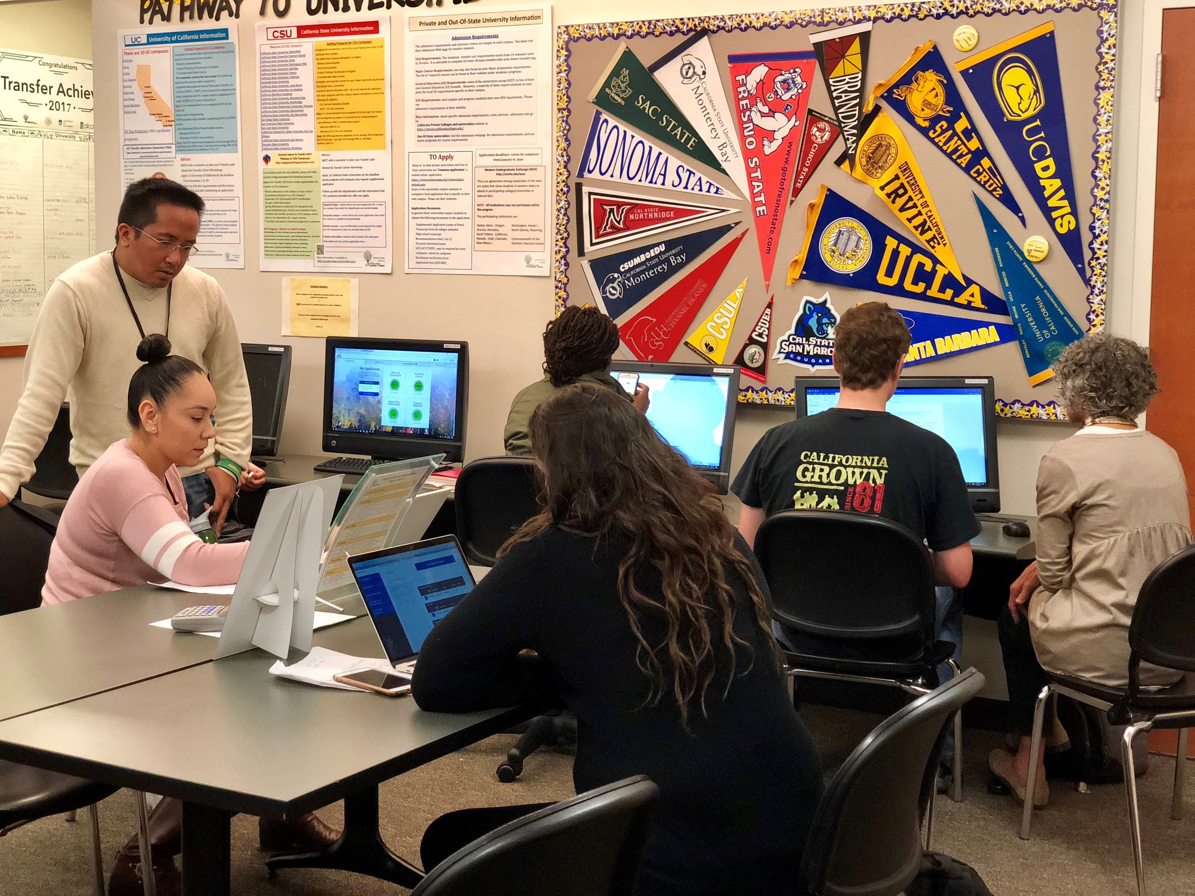
What more will PSC do?
Help Counseling transition to Guided Pathways model
Classroom visits & outreach on campus & in community
Help students navigate college petitions & transcript evaluation
Staffing hours for Transfer Center
Enhance collaboration of campus transfer services
Development of educational videos for students
Track HTP for completion and UCLA certification
Manage accurate identification of student’s major
Support Counseling, Transfer & HTP events.

Slide 7

How does Proposal align with College Goals?
Student completion & success is in every college plan:
Persistence
Transfer Rate (inc. 35%)
Degree & Certificate Attainment (inc. 20%)
Decrease the # of Accumulated Units (93 to 85)
Aligns with Guided Pathways – Student Cohorts, Casemanagement, student major/interest areas

Slide 8
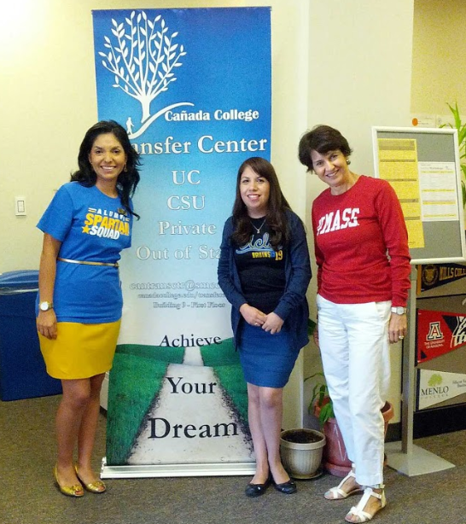
How will this position strengthen our Programs?
Reach students least likely to initiate contact
Improve use of Counselor’s schedule
Target time-appropriate services to students in group format
Improve data collection and distribution
Additional support for program initiatives
Pooling of resources and less duplication
HTP can reach a broader range of students

Slide 9

How will we accomplish this work without a PSC?
We cannot accomplish this work without the PSC position, or at best, the work will be accomplished haphazardly during our very few short spurts of unscheduled time.

