Slide 2
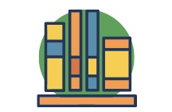
Overview of Services
We’ve got your back. And your books. And your college degree FREE!
INDIVIDUALIZED ACADEMIC SUPPORT
EXCLUSIVE WORKSHOPS & EVENTS
MONTHLY FOOD & TRANSPORTATION
INCENTIVES
2-3 YEARS of
FINANCIAL SUPPORT
TEXTBOOK SUPPORT
PRIORITY ENROLLMENT

Slide 3
A History of PSP at Cañada College
2017/2018
Promise Scholarship- 47-60 students
2018/2019
Promise Scholars Program “rebrand” and early adoption of key elements of the CUNY ASAP
Start of district-wide alignment
327 students
2019/2020
Promise Scholars Program year 2
497 students (incoming and continuing)
Notes:
including comprehensive and personalized advisement, career counseling, tutoring, waivers for tuition and mandatory fees, MTA MetroCards, and additional financial assistance to defray the cost of textbooks.

Slide 4
Overview CUNY ASAP
Key Elements:
COST-FREE
COMPREHENSIVE AND PERSONALIZED ADVISEMENT
FULL-TIME STUDY AND AVAILABLE MAJORS
INDIVIDUALIZED COURSE SCHEDULE
CONNECTED COMMUNITY
ACADEMIC SUPPORT SERVICES
CAREER DEVELOPMENT
Program Requirements:
Enroll full time each semester and maintain good academic standing
Complete any developmental needs in reading, writing, or math within the 1st year
Meet regularly with advisor, career, employment specialist, tutors, and attend required enrichment activities
Complete the (FAFSA) & the New York State Tuition Assistance Program (TAP) application each year to remain eligible**

Slide 5
Overview CUNY ASAP Replication
The CUNY ASAP team engages with replication partner colleges through live convenings hosted at CUNY, as well as through regular remote consultations and on-site trainings of key program staff such as advisors. Partner colleges also have access to a set of electronic materials, resources and tools that support ASAP replication.
CUNY ASAP’s Central Office houses a Technical Assistance Team, who partner directly with institutions committed to replicating the ASAP model with a high level of fidelity. The technical assistance that partner colleges receive covers all areas of program planning and implementation including:
College Integration
Program Staffing
Marketing & Communications
Development of Academic Pathways
Use of Data for Program Management
Program Evaluation
Outreach and Recruitment
Administration of Financial Supports
Advisement

Slide 6
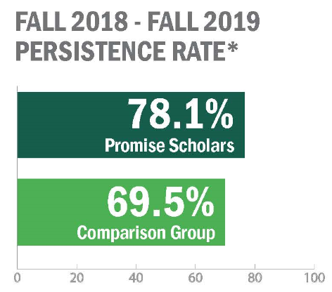
PSP Cohort 1 Persistence Results
ELEMENTS OF ASAP ADOPTED IN FIRST YEAR
Early Engagement and Community Building
Tuition and Student fees waiver
Textbook Assistance
Transportation Support
Dedicated Counseling
Priority Enrollment
Group Advisement/Counseling sessions “workshops”
Faculty Feedback- via “mid-semester” progress reports
Program Integration with other College Offices
ELIGIBILITY REQUIREMENTS
Recently graduated first-time college student
Full-time
Complete FAFSA/CA Dream Act application
Notes:
including comprehensive and personalized advisement, career counseling, tutoring, waivers for tuition and mandatory fees, MTA MetroCards, and additional financial assistance to defray the cost of textbooks.

Slide 7
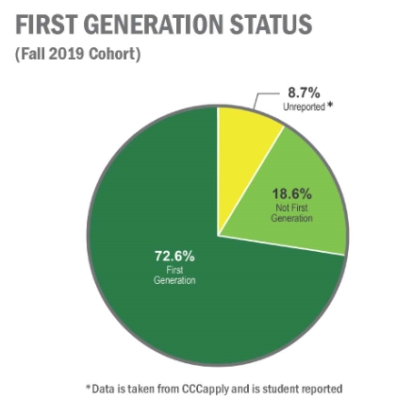
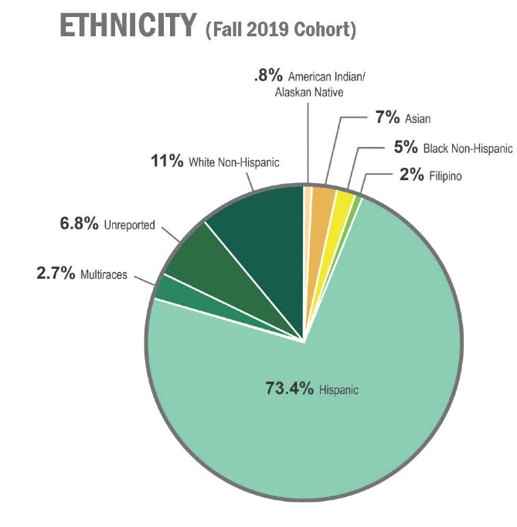
Incoming Cohort Demographics
GENDER
49.09% FEMALE
49.3% MALE
1.61% UNREPORTED
Notes:
including comprehensive and personalized advisement, career counseling, tutoring, waivers for tuition and mandatory fees, MTA MetroCards, and additional financial assistance to defray the cost of textbooks.

Slide 8
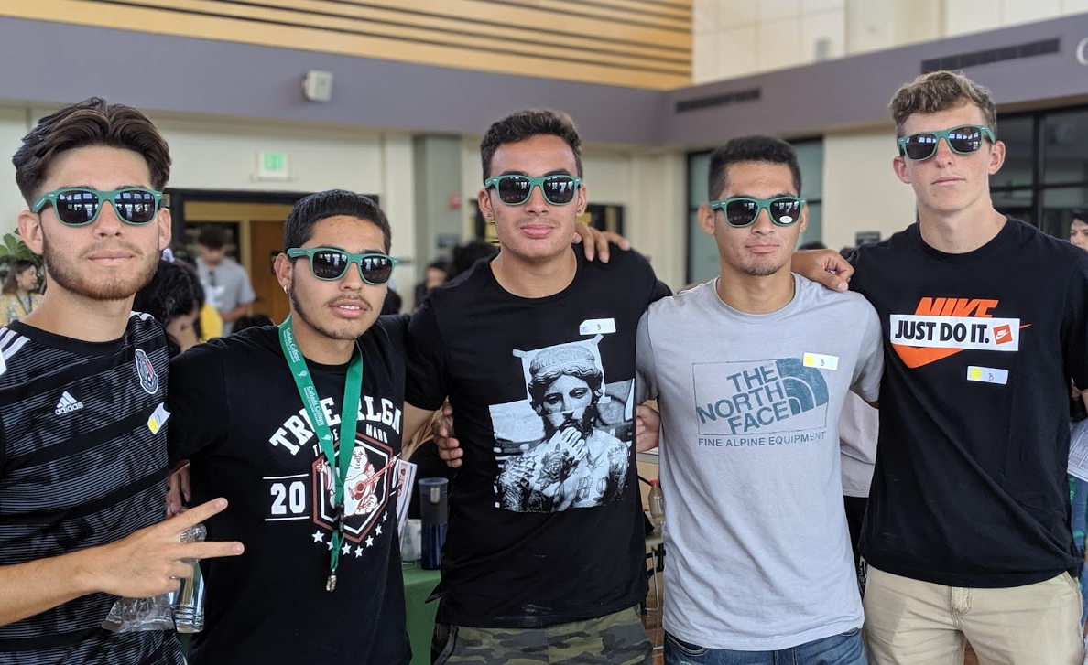
PSP Cohort 2 ASAP Replication
NEW ELEMENTS OF ASAP ADOPTED IN SECOND YEAR
Eligibility Criteria Established and Clearly Messaged
Graduate in 3 Years
Program Branding
Intake- Student Success Plan
Tutoring
Career and Employment Services
Set Benchmarks for the Program
Establish Data System
CHANGES IN ELIGIBILITY
Removal of recent graduate requirement
FAFSA/CA Dream Act application completion
Students must have an intention to “Earn AA/AS & Transfer OR Earn AA/AS w/out Transfer OR Earn 2yr Certif w/out Transfer OR Earn Voc Certif w/out Transfer”
Notes:
including comprehensive and personalized advisement, career counseling, tutoring, waivers for tuition and mandatory fees, MTA MetroCards, and additional financial assistance to defray the cost of textbooks.

Slide 9
PSP and Institutional Priorities
Increase the number of students who complete associates degrees, credentials, certificates, or specific job skill sets by 20% by 2021-22.
Increase the # of students transferring to a UC or CSU by 30% by 2021-22.
Decrease the average # of units accumulated by students earning associate degrees from 93 to 85 by 2021-22.
Increase the % of exiting CTE students who report being employed in their field of study from 65% to 72% by 2021-22.
Reduce Equity Gaps across all of the above measures by 40% by 2021-22 and fully close them for good by 2026-27
Notes:
Founded in 2015 The College Promise Campaign is a national, non-partisan initiative to build broad public support for funding the first two years of higher education for hard-working students, starting in America’s community colleges.

Slide 10
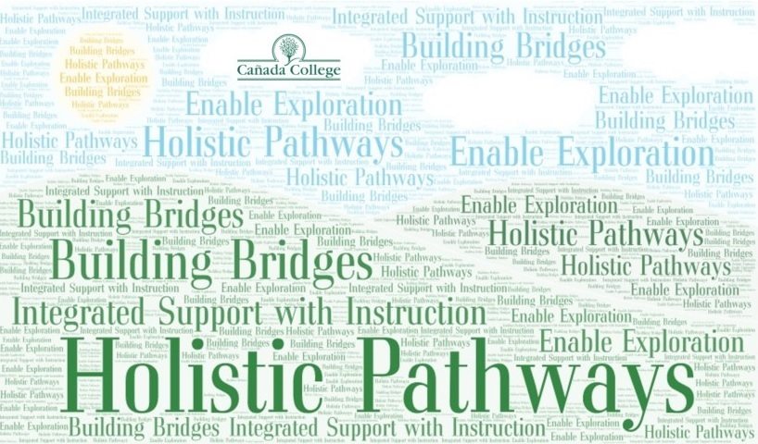
PSP and Guided Pathways
Notes:
Founded in 2015 The College Promise Campaign is a national, non-partisan initiative to build broad public support for funding the first two years of higher education for hard-working students, starting in America’s community colleges.

