Slide 1
PBC Position Request Prioritization
Poll Results
November 6, 2019

Slide 2
PBC Members voting (21)
Jeanne Stalker, PBC Co-Chair
Diana Tedone-Goldstone, PBC Co-Chair
Nick Carr, KAD
Paul Naas, BDW
Doniella Maher on behalf of Salumeh Eslamieh, HSS
Michael Hoffman, STEM
Nick Martin, Student Services Faculty
Aleen Ghanem, ASCC
Ada Ocampo, Classified Rep
Rachel Corrales, Classified Rep
Chantal Sosa, Classified Rep
Rosalind Young, Classified Rep
VPI Robinson
VPSS Pérez
VPAS Mendoza
Dean Hartman
Dean Carranza
Dean Engel
Dean Cabrera
Megan Rodriguez, PIO
Jeri Eznekier, Classified Rep (not present at the meeting, voted online prior to the end of the meeting)

Slide 3
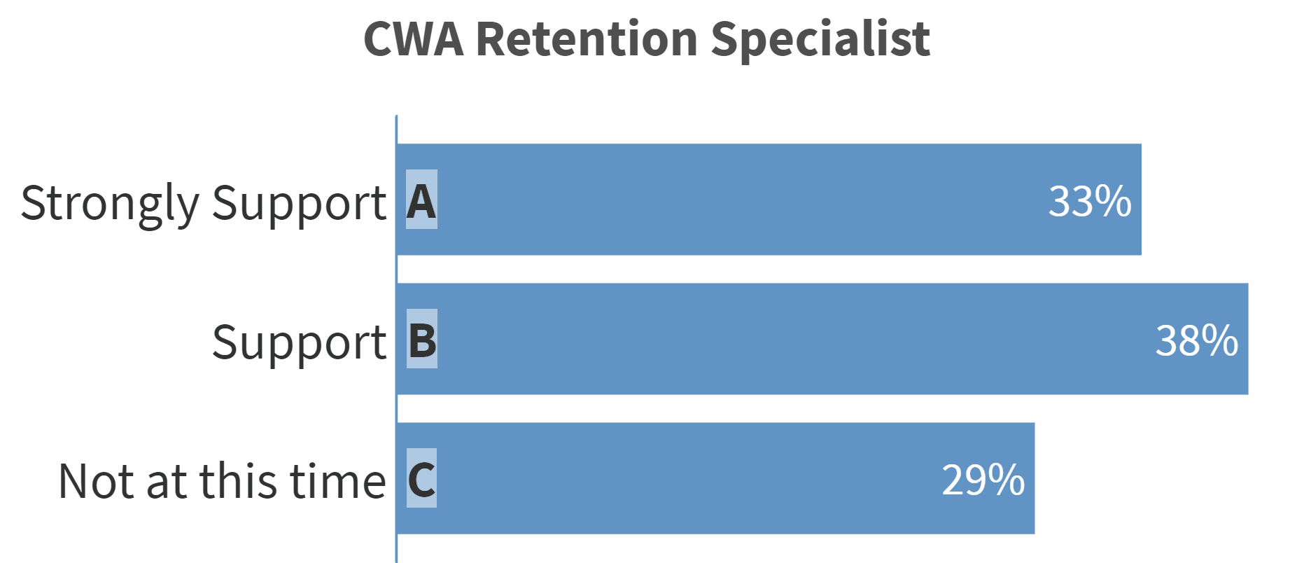

Slide 4
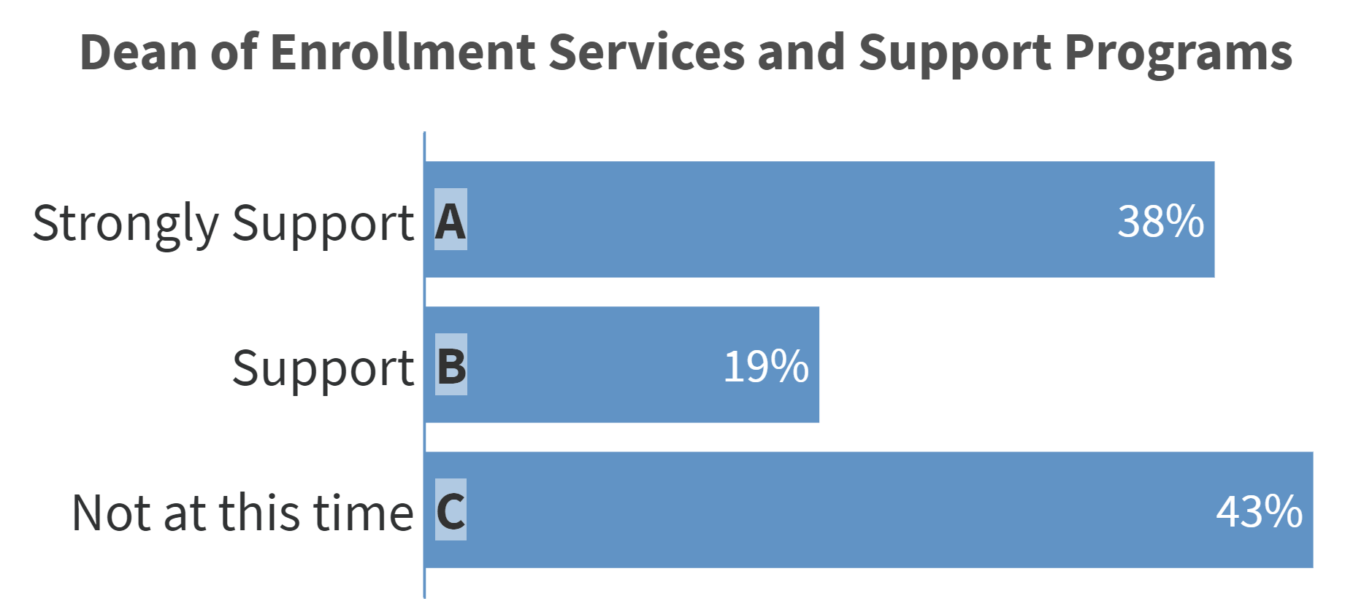

Slide 5
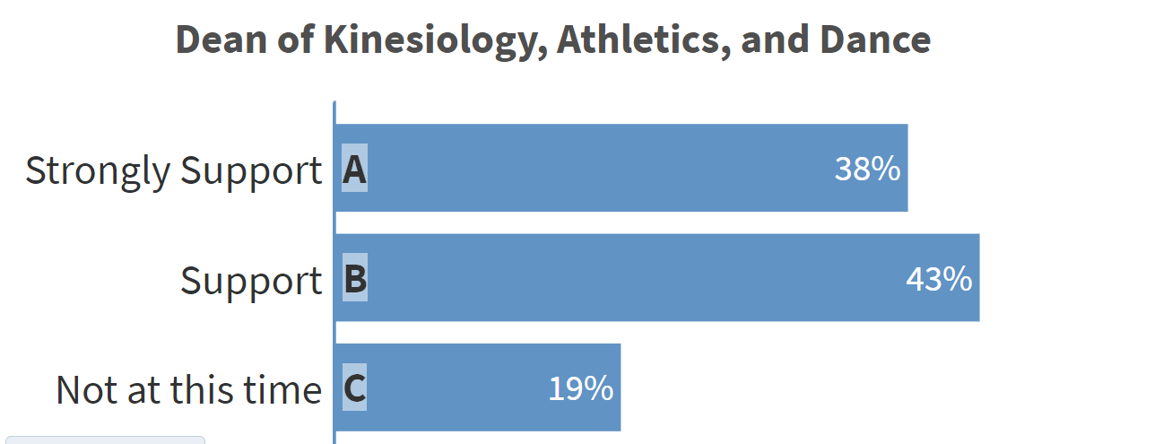

Slide 6
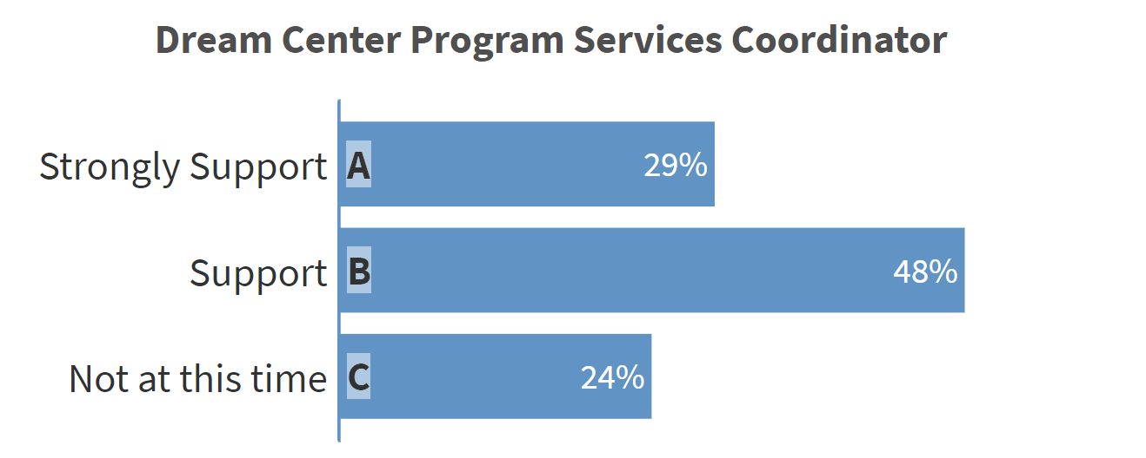

Slide 7
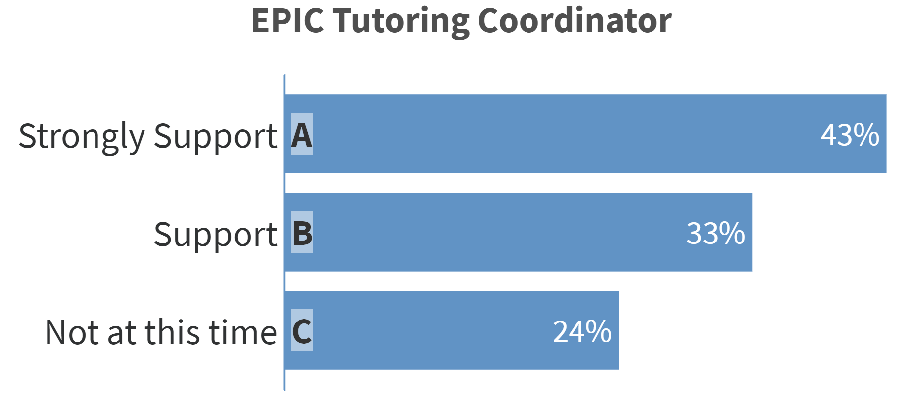

Slide 8
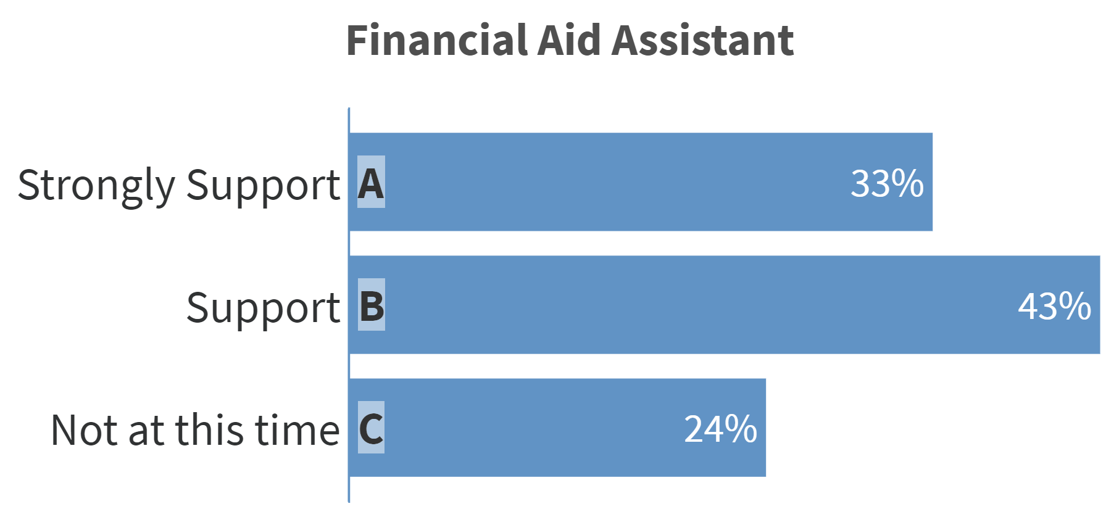

Slide 9
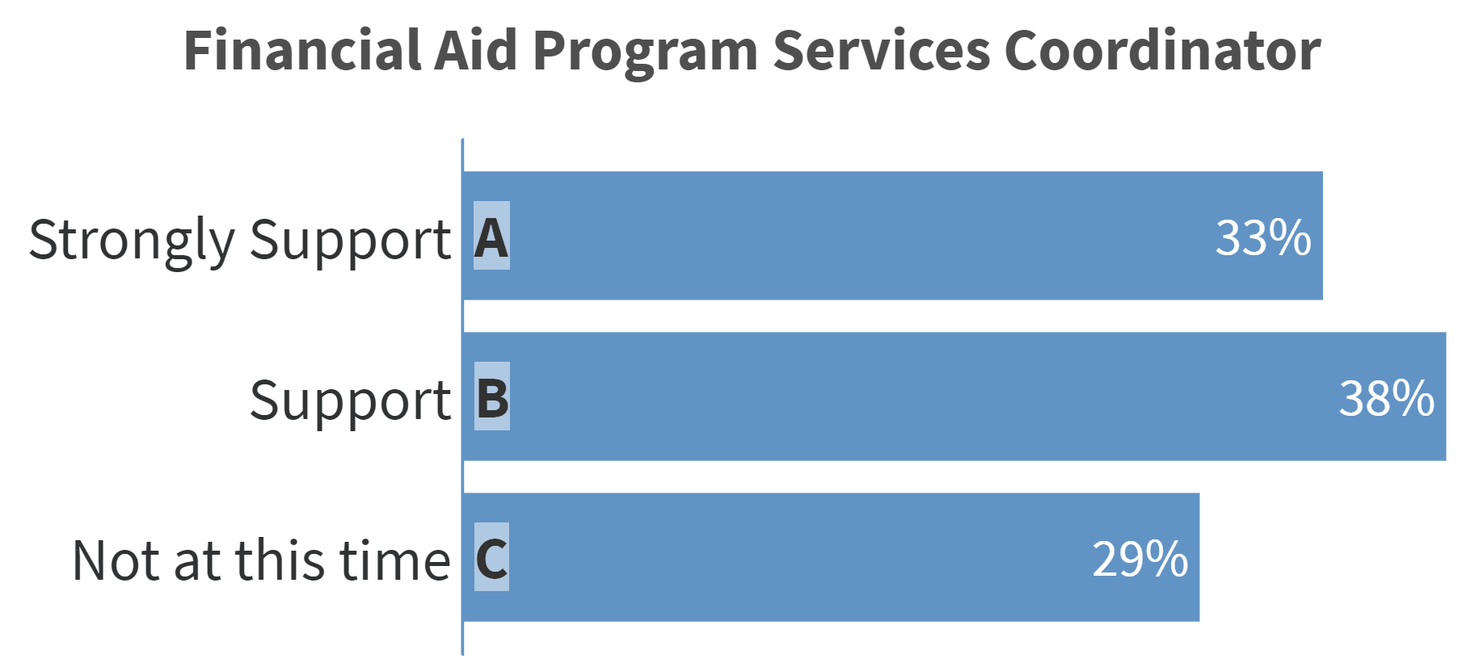

Slide 10
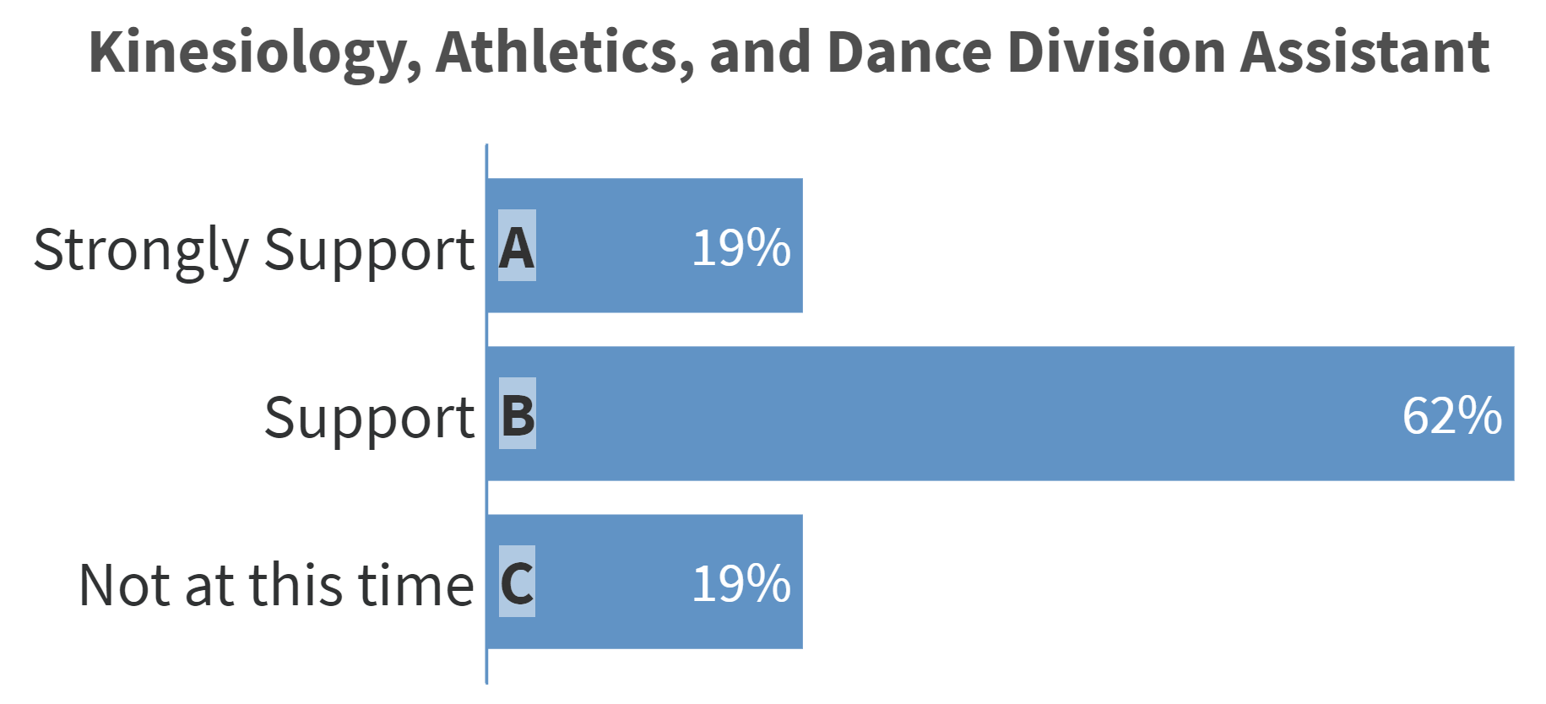

Slide 11
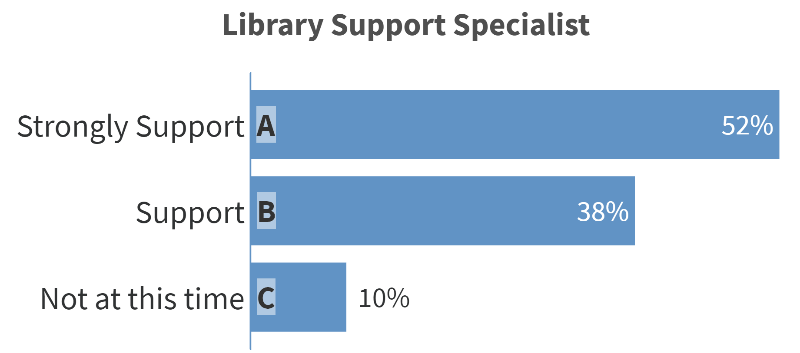

Slide 12
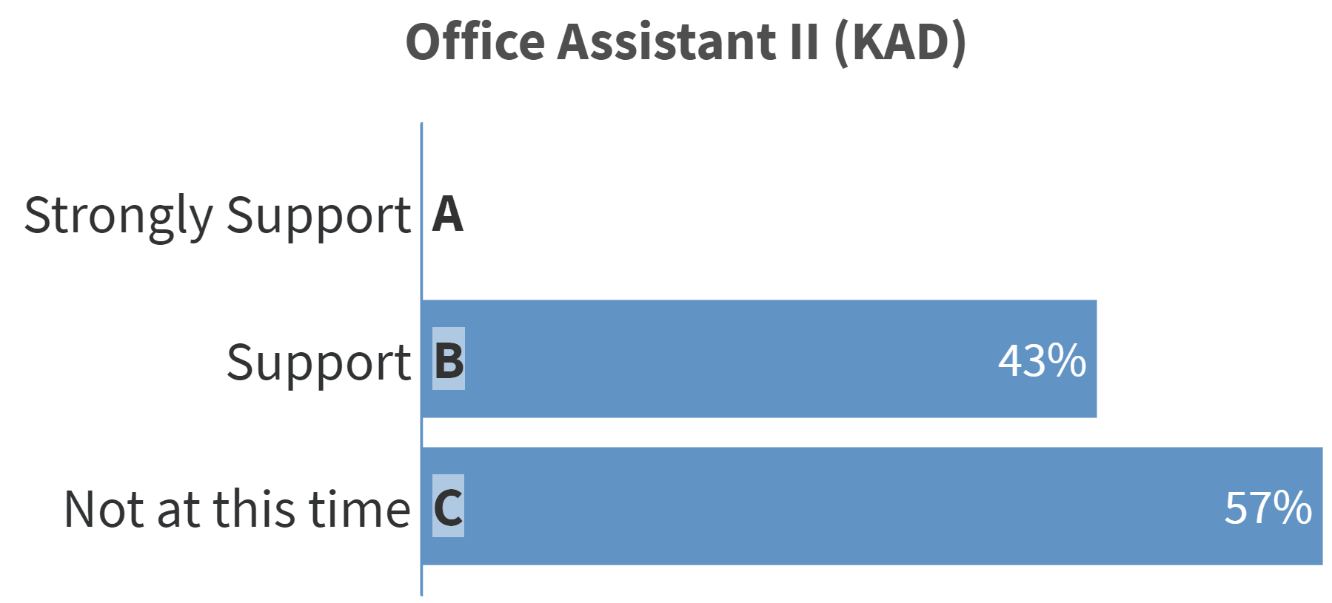

Slide 13
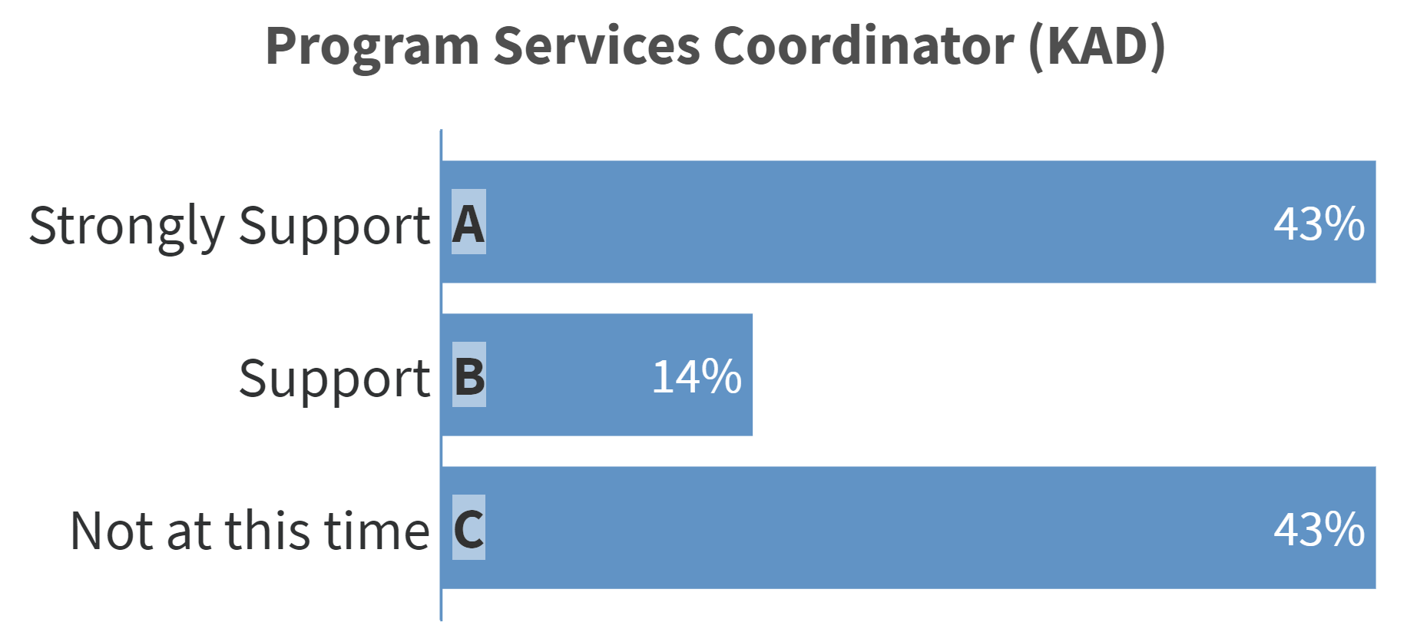

Slide 14
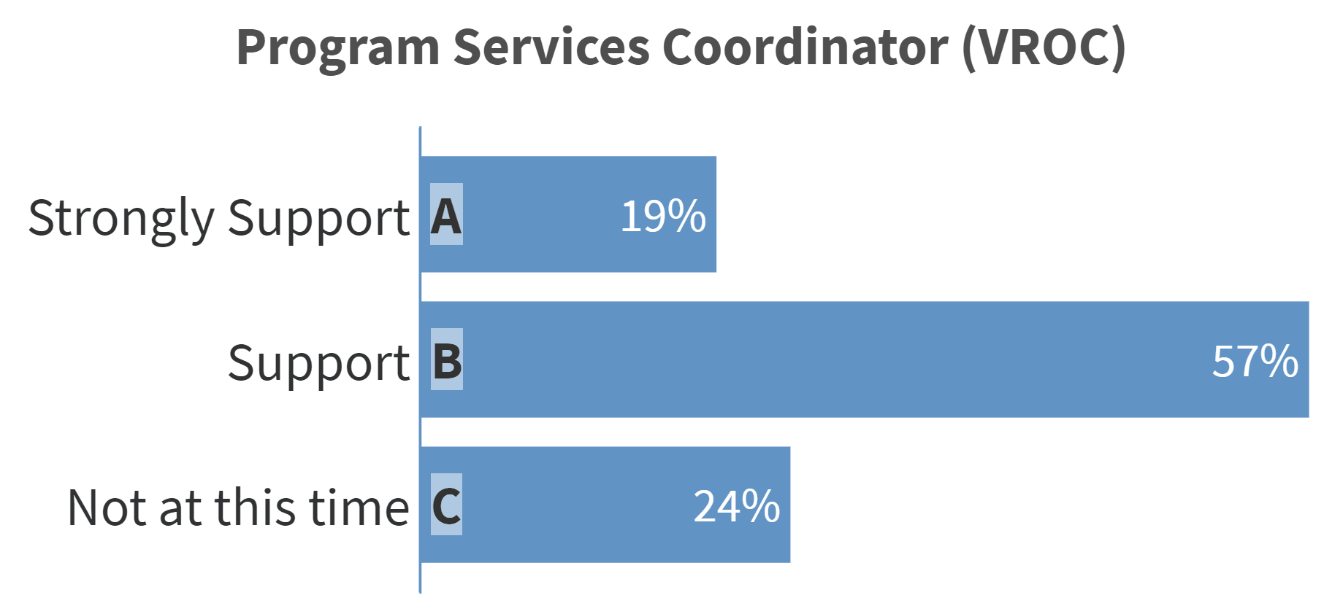

Slide 15
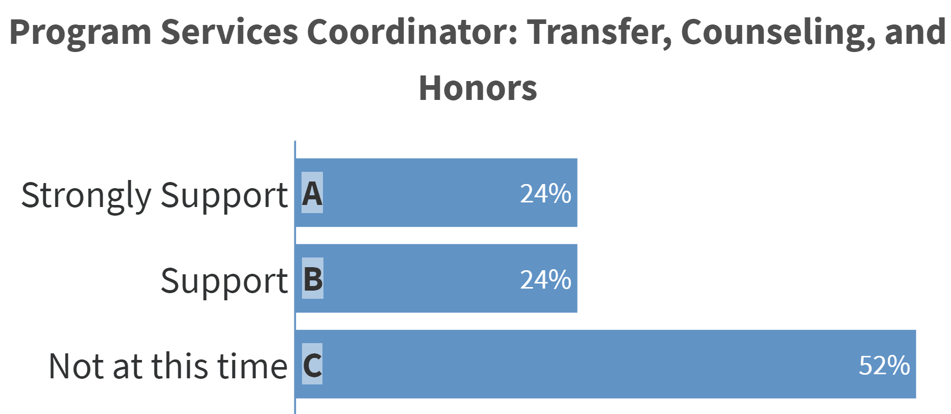

Slide 16
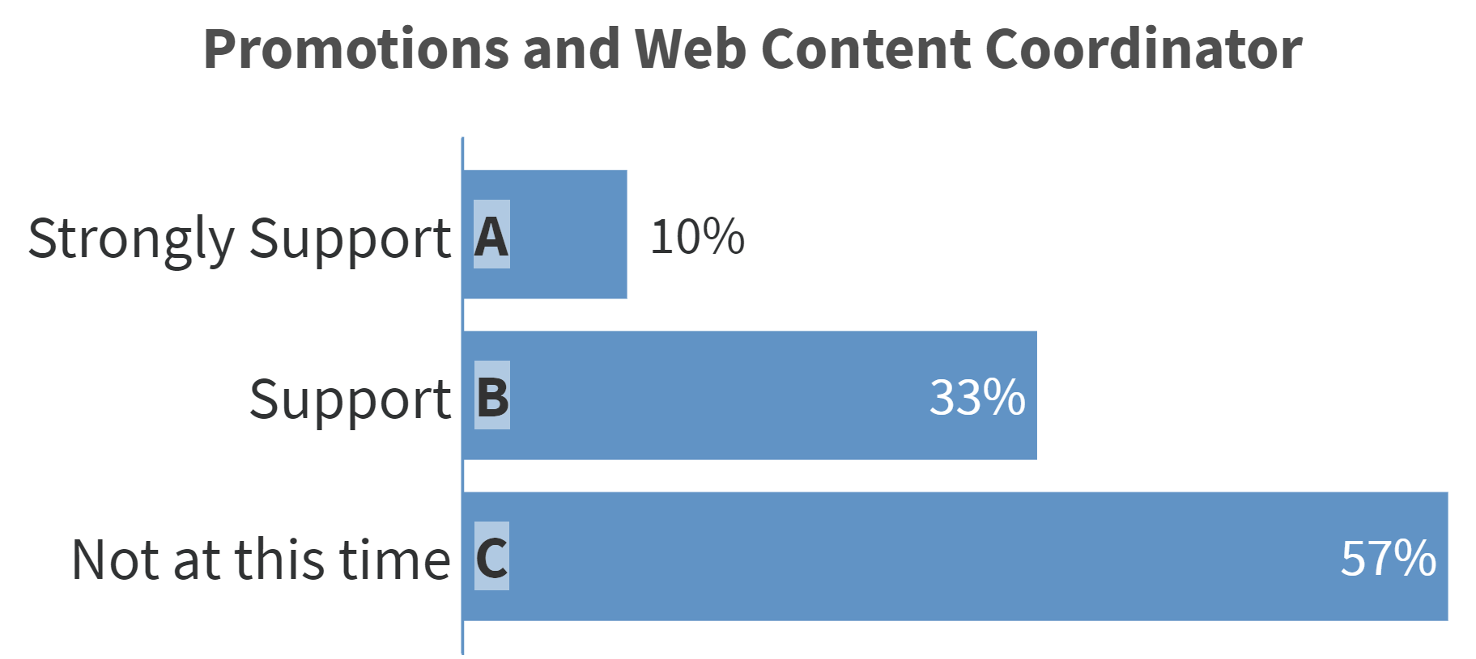

Slide 17
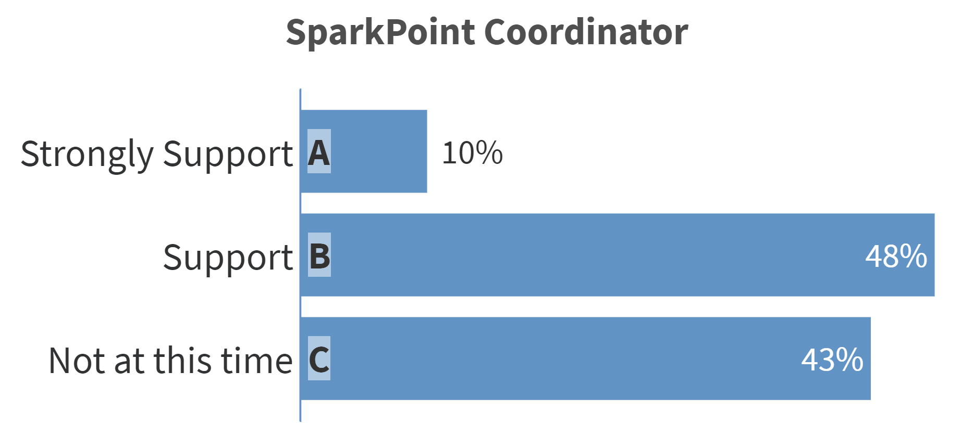

Slide 18
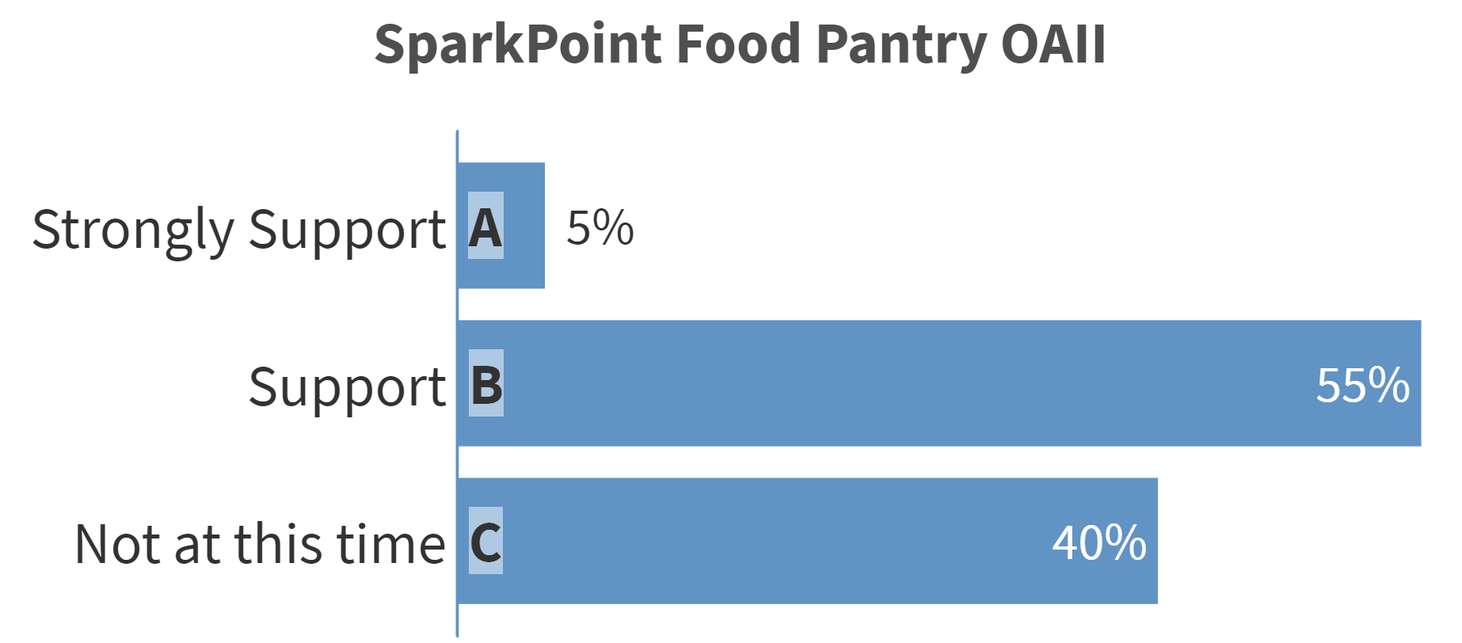

Slide 19
