Slide 1


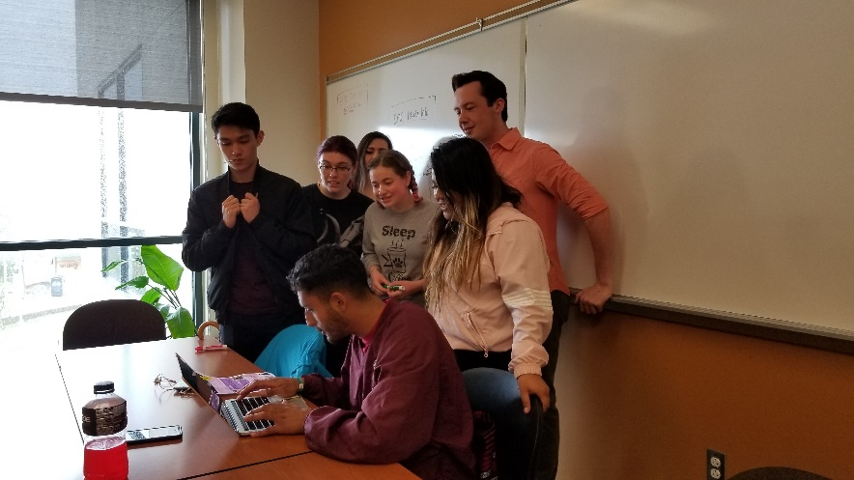
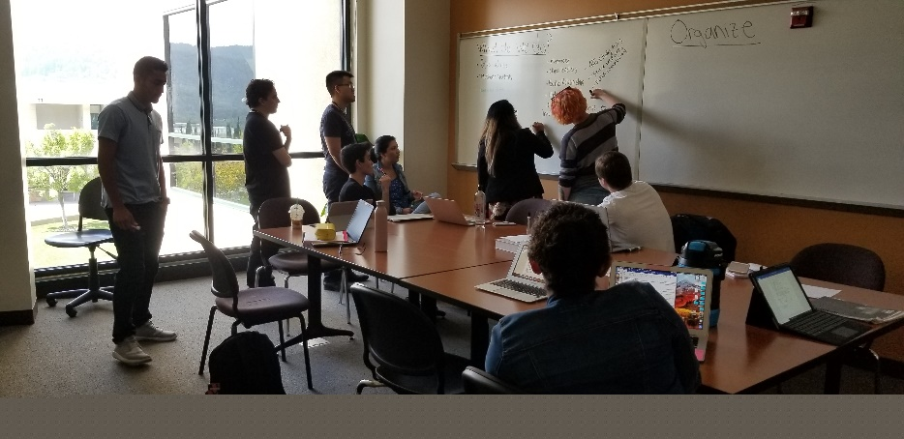


New Position
Proposal:
STEM Retention Specialist
October 31, 2019

Slide 2

What is the need?
Students need consistent guidance to academic supports and college services.
  “I didn’t know these services were offered, and now it’s too late.”
  “I wish I could talk to the same person each time about my progress.”
If we build it, they will NOT automatically come.
  “I didn’t realize this program was for students like me.”
Some activities can light a spark and change their college experience.
  “Once I visited Cal Poly, I knew that’s what I wanted to do and classes became my top priority.”
Notes:
Key to involvement is relationship. Often, the RS is the key person of that relationship.
Student Voices: ”I didn’t know these services were offered, and now it’s too late.”
First-gen students and those unfamiliar with a college environment can feel overwhelmed by choices. A RS can steer them to academic services and extracurricular activities that fit their progress at Cañada.
Peer mentors can have a major impact on students, and that’s a good way to expand the impact of an RS.
The RS can help them navigate programs and give them that nudge to participate in activities that can change their college experience.
Key to involvement is relationship. Often, the RS is the key person of that relationship.

Slide 3
STEM Retention Specialist as relationship builder
Serve as primary contact person with students, enrollment to transfer.
Pre-term bridge programs: help recruit students, plan and present sessions.
Incorporates peer mentors in building relationships with students; uses mentors to aid communication with students
Notes:
Serve as primary contact person with students, from initial enrollment through first year of classes
Recruit students for pre-term bridge programs. Planning and executing these sessions.
Recruit, train, and supervise peer mentors; assign new students to peer mentors

Slide 4
STEM Retention Specialist as college navigator
Connect students with appropriate counselor; follow up to ensure student registers for their SEP classes
Direct students to appropriate resources and programs (ex. Promise, EOPS, TRiO, MESA, tutoring)
Refer students to Financial Aid and Sparkpoint services; assist with scholarship applications
Connect students with faculty
Notes:
Connect students with appropriate counselor; follow up to ensure student has an SEP and registers for those classes
Direct students to appropriate resources and programs (ex. EOPS, TRIO, MESA)
Refer students to Financial Aid services; assist with scholarship applications and getting other needed financial resources
for next slide: Retention is misnomer: RS really is about persistence and getting students all the way to graduation and completion

Slide 5
Retention Specialist interaction increases student persistence
Notes:
So we measured persistence> .significant difference in fall to spring and fall to fall.
Does NOT include any type of concurrent enrollment students. Control N = 270, RS group – 160.
BUT WAIT! Which students are the ones that got the benefit of RS attention?
This function is particularly important in providing equity for first-time, first-generation students who may be less familiar with college environments.
.

Slide 6
First Generation students make up the majority of RS cases

Slide 7
RS helps provide equity for our students.
Ethnic minority students make up the majority of RS cases.
Notes:
So, most of the students served by Retention Specialists are either First Gen or Minority or both. This position fits with the Equity goal of our college, by providing help to those students that need it most.

Slide 8
Retention Specialist is the pillar
of Guided Pathways FYE support structure.
Financial Aid
Programs: EOPS, TRiO. …
EPIC sessions with cohort
College success class/workshops
Scholarship applications
Speaker series for career exploration
First term
2nd term
2nd year
HS student
Gets SEP
Registers for classes
ColtsCon
Jams
Referred to counselor
Assigned to peer mentor
Selects interest Area
Enrolls
Retention
Specialist
Summer internship
Job shadowing
Student clubs
College visits
Internship applications
Updated SEP
Notes:
RS fits in with Guided Pathways structure and Promise program.
Why now? Why not wait until the GP structure is completely planned?
Because our STEM Center is running out of time on grants. We have gone from 3 RS down to 1 and that position is shrinking.
We have lost Sally, lost Chris; Gonzalo’s position is budgeted in the grant for 50% this year and only 25% next year, then zero.
We need to maintain the momentum of STEM programs – tutoring, peer mentors, University visits, study groups, clubs – success with scholarships and internships. This RS position is central to keeping all of these services running and FILLED with students.
Key is RELATIONSHIPS, and you cannot just pause those for 2 years with students while the college restructures.

Slide 9
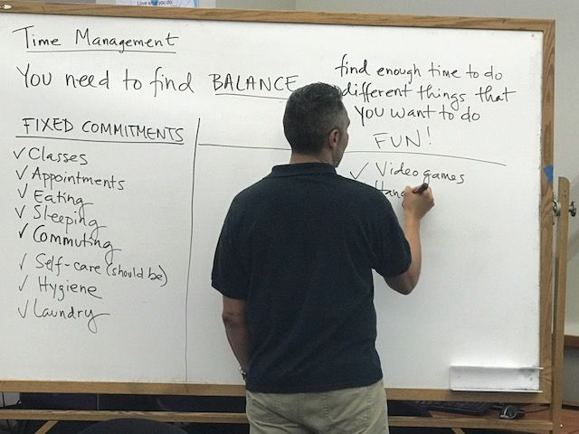
Thank you!
What are your questions?

Slide 10
RS interventions occur more often with ethnic minority students
Notes:
extra slide with info on ethnic breakdown, if requested.

