Slide 1

Position Proposal: Web & Content Promotions Coordinator

Slide 2


The Need
Supports entire college community
Maintains up-to-date content on website
  Required for Accreditation
Leads College’s social media accounts, including web and video content
Assists in increase volume of campus wide marketing requests

Slide 3
The Scope of Work
Meets with division and department to regularly update content on their sites
Responsible for social media content, including: Facebook, Instagram, YouTube, Twitter and LinkedIn
Develop attractive video content for enrollment management support
Composes text for a variety of articles, reports, brochures, manuals, catalogs, class schedules, social media and other materials
Maintains all content on college the blog/news site
Works closely with the Web Programmer Analyst and Visual Communications Coordinator to design, develop and build original web pages and content
Project support as needed

Slide 4
Supporting Our College Goals & Mission
The Promotions & Web Content Coordinator position aligns with and supports the College mission by working with faculty, staff, and students to develop, implement and grow impactful, cost-effective digital and print communication strategies and campaigns to enhance public awareness of the educational and enrichment opportunities at the College.
Supports college goals through:
Promoting student completion/success
Helps to build community relationships by connecting through social media
This is accomplished through:
  Creation of engaging and attractive content for web, social media and internal/external college communications

Slide 5





Growth in Social Media
The 2017 Social Admissions Report found that 63 percent of students use social media to research a college they are interested in and 60 percent have followed or liked a college they are considering.
-The National Association for College Admission Counseling (NACAC)

Slide 6
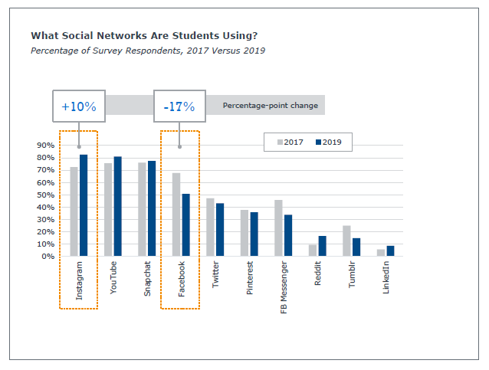
Growth in Social Media
EAB conducted a survey of more than 9,000 high school students:
Every college should have a social media presence
  2017: 79.6 % vs 2019: 86.1 %
The more interested I am, the more I interact with a school on social media
  2017: 52.2% vs 2019: 74.6%
Discovered a college on social media
  2017: 19.2 % vs 2019: 25.8%

Slide 7
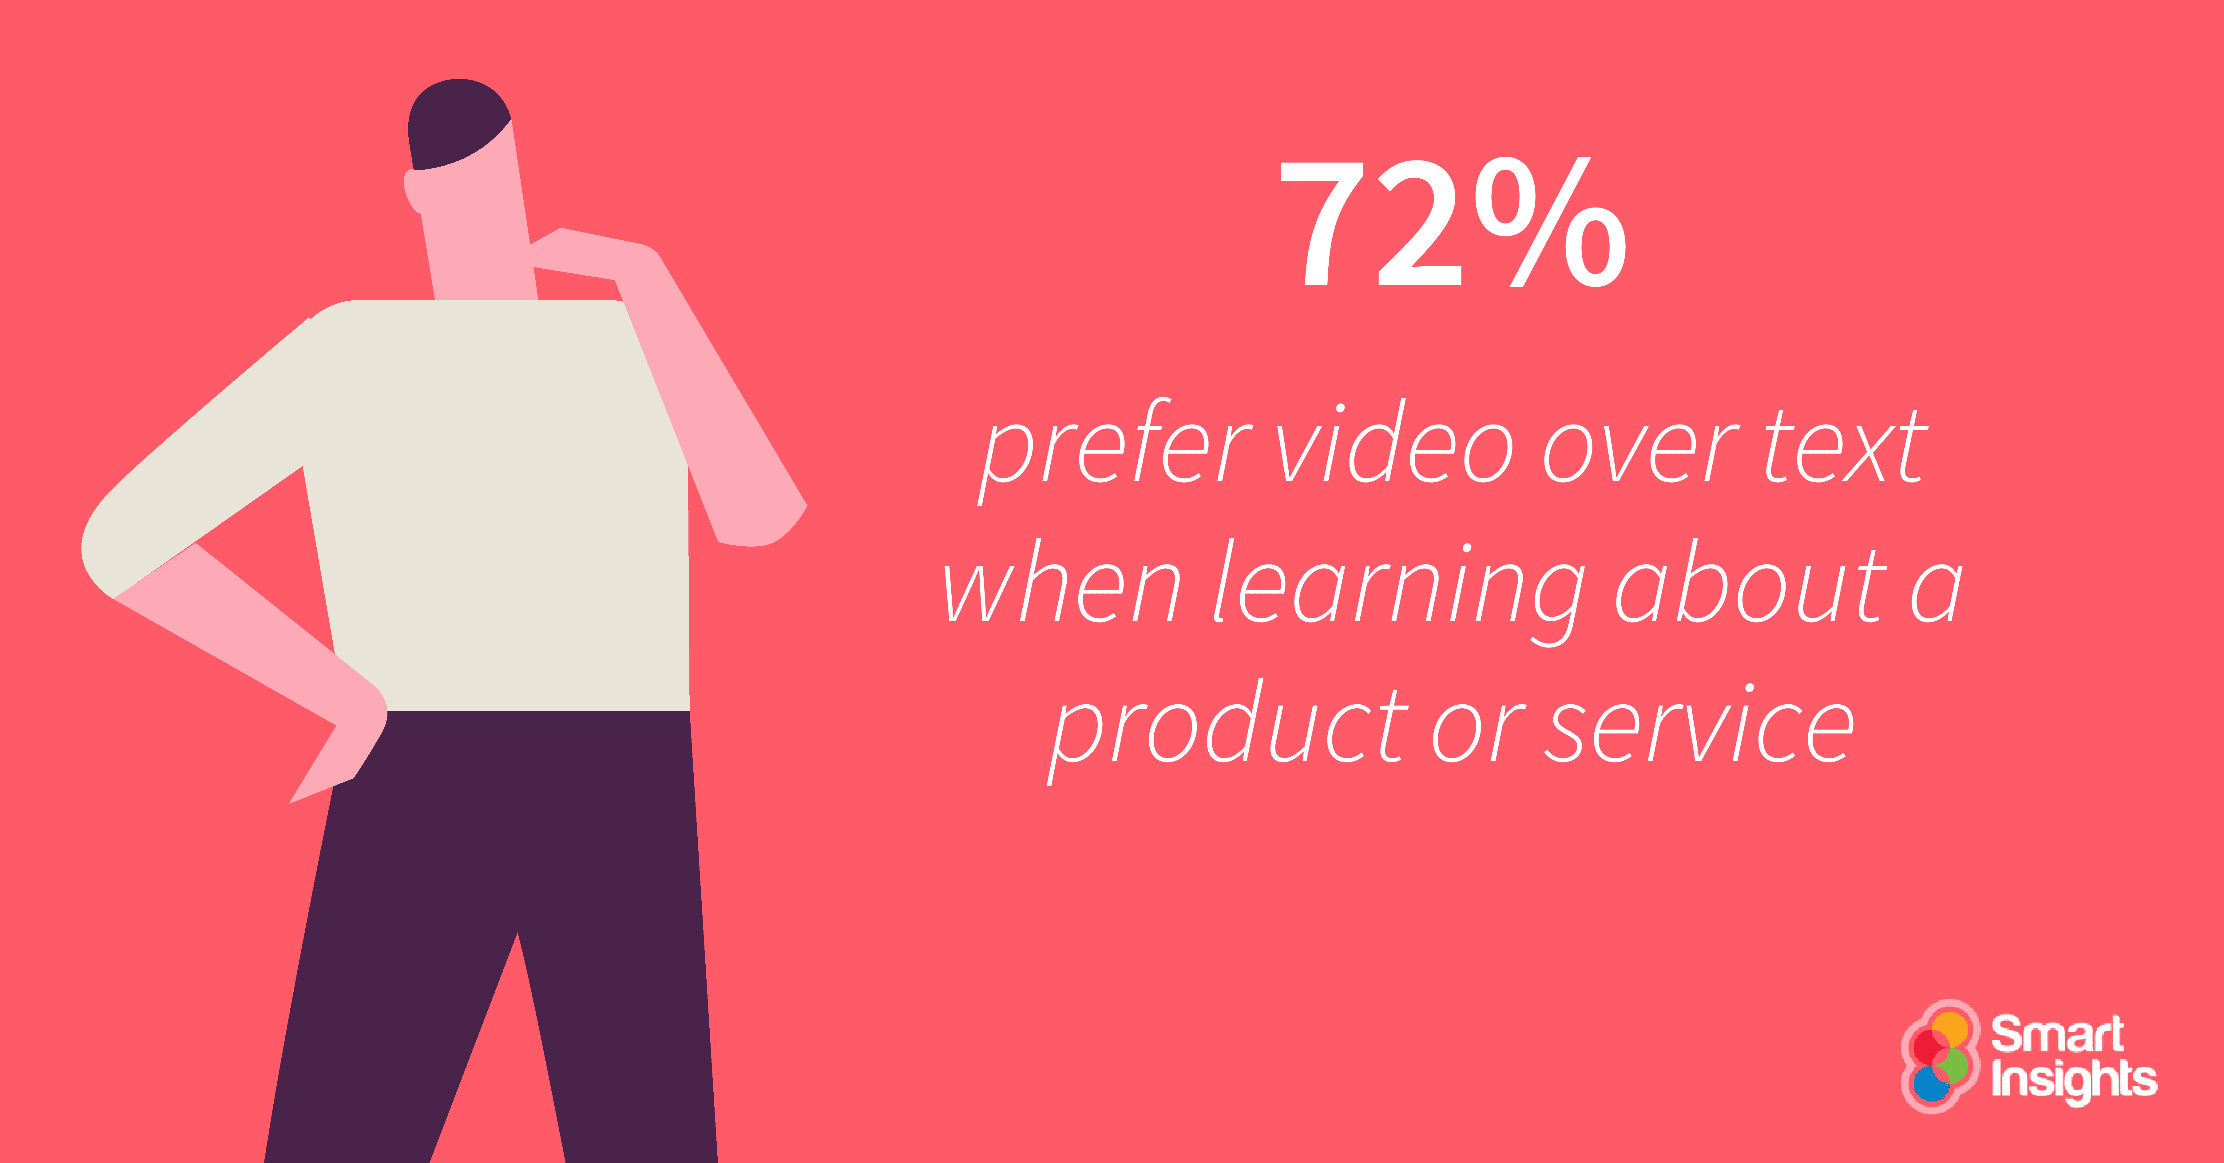
Growth in Social Media
Video marketing is trending as the must-do tactic for 2018
HubSpot reports that 78 percent of people watch videos online each week, and 55 percent watch videos every day.

Slide 8
The Benefits
Increase college visibility through social media
Keep content current for Accreditation
Address the campus community’s requests in a timely and efficient manner
31 percent increase in College Wide Marketing Requests over last year, including:
Graphics: 54 requests, 30.7%
Web: 51 requests, 29%
Communications: 39 requests, 22.2%
The Promotions & Web Content Coordinator, skilled in both graphic and web design, would have a role in helping the Marketing team address the campus community’s requests.

Slide 9
Without the Position
Continued increased work load and turnaround time for existing campus requests
College website will not receive the Accreditation recommended content upkeep needed to fully enhance and elevate public awareness of the educational and enrichment opportunities at our College
Missed enrollment and promotion opportunity to connect with prospective and current students to enhance awareness of programs and services offered at Cañada College

Slide 10
Questions?

