Slide 1
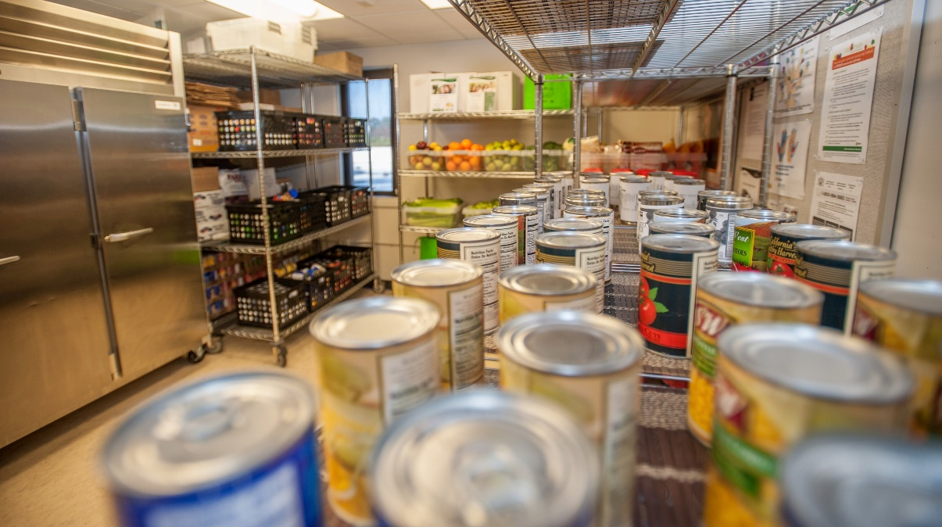
Mission
SparkPoint Pantry Office Assistant II
2020-2021 New Position Proposals
Presentations and Discussions
December 4, 2020

Slide 2

About the Cañada College Food Pantry
The Food Pantry is a partnership between SparkPoint, Cañada College and Second Harvest Silicon Valley.
Individuals can receive two grocery bags of food per person once a week
The Pantry is open on Tuesday, Wednesday and Thursday from 12:30 pm to 3:30 pm and Thursday evenings from 5:00 pm to 6:30 pm
Pantry coverage: 9 individuals (Primarily Ingrid, Joshua, Manny, Karla (student) with support form Julie, Klaressa, Yesenia, Adolfo and now even Saúl)
The last 2 academic years the pantry served had over 20,000 visits
Notes:
----- Meeting Notes (2/20/17 01:53) -----
3 jobs are needed
survey =
55% > $1,000
20% > $10,000
3-4 years to complete an Assoc. Degree

Slide 3

Highlights From Past Years - I
This position was approved through the 2018-19 AND the 2019-20 New Positions Proposal Processes based upon funding availability and current need.
Due to lack of funding, this position was not opened
Food insecurity – 2018, 2019 and 2020 Cañada College Awareness Summits
District-wide Basic Needs Taskforce
Notes:
----- Meeting Notes (2/20/17 01:53) -----
3 jobs are needed
survey =
55% > $1,000
20% > $10,000
3-4 years to complete an Assoc. Degree

Slide 4
Highlights From Past Years - II
The Pantry, ASCC and the Bookstore launched Grab n’ Go Meals & Hot and Cold Meals
The Grab n’ Go Meals evolved into the Food Grant Program
SparkPoint offered several successful monthly Community Markets
Study Snacks were launched in May 2019
Community partnerships - The CSM District-wide Community Markets has now distributed nearly 1,220,000 lbs of food leading to over $2.1 million dollars in grocery offsets.
Notes:
To date, over 1,147,000 lbs have been distributed leading towards nearly $2 million dollars in grocery offsets.

Slide 5
Alignment with Mission & Strategic Goals
Mission Statement
Provides healthy and nutritious food to students, access to SparkPoint services, and equitable opportunities for them to achieve their transfer, career education, and lifelong learning educational goals
Strategic Goals (Goal #1)
Minimizes financial barriers to success which leads students towards increased retention rates

Slide 6
Specific Needs
The 2018 Self-Sufficiency standard for a family of 4 was at $127,000 / year
87,797 lbs. of food distributed to both day and evening students
That’s $106,504 of savings going back to students to offset other living expenses
SparkPoint has funded salaries, benefits and general expenditures for the pantry for the past four years using a soft money that has ended
Our sister colleges have institutionalized Pantry Staffing
Skyline had a Staff Assistant and an OAII, CSM had part of a Staff Assistant
Both pantries are located adjacent to their Centers
Notes:
----- Meeting Notes (2/20/17 01:53) -----
3 jobs are needed
survey =
55% > $1,000
20% > $10,000
3-4 years to complete an Assoc. Degree

Slide 7
2018 SMCCCD Food and Housing Insecurity Survey
Survey results revealed the following challenges experienced by students with regard to their basic food needs due to income limitations:
55% indicated that the food they purchased, “just didn’t last and I didn’t have money to get more.”
28% of students reported, “cutting the size or meals or skipping meals” because there wasn’t enough money for food.
Beyond the literal lack of food, the level of psychological insecurity is high:
41% of students report that, “I am worried whether my food would run out before I got money to buy more.”
Notes:
----- Meeting Notes (2/20/17 01:53) -----
3 jobs are needed
survey =
55% > $1,000
20% > $10,000
3-4 years to complete an Assoc. Degree

Slide 8
Day to Day Duties of the Food Pantry
Provides food pantry support (customer service, ordering, stocking, inventory control, food rotation, outreach, screening for public benefits, tabling, maintaining the pantry and makes classroom presentations)
Manages data entry by entering food pantry efforts into the SparkPoint database, running reports and submitting monthly reports to Second Harvest Food Bank.
Maintains the Food Pantry to California Food Safety Standards
Trains and supervises the work of students assistants
Refers students to campus and community resources
Makes referrals to SparkPoint for financial coaching

Slide 9
Strengthening ALL Departments/Divisions
This position will increase students’ access to healthy & nutritious food.
Clients will benefit from increased food pantry hours, expanded CalFresh enrollment efforts, & increased connection to SparkPoint services
SparkPoint is experiencing an increase in panty use by student athletes, international students, evening students and staff and faculty
These expanded services will increase student retention by reducing student hunger and food insecurity as a barrier to student success.
Increased and sustainable staffing means increased access to food

Slide 10
If This Position is Not Filled
SparkPoint at Cañada College will be unable to adequately address growing food insecurity for our own students
Decreases/no growth in Community Markets, Pop-up Markets and Study Snacks
We may be prevented from re-hiring short-term staff (repeatability)
Qualified students may not enroll in CalFresh and offset expenses
We will have hungry students. This will impact: (KO)
Students ability to realize their academic potential
Term to completion, success, persistence & retention rates

Slide 11
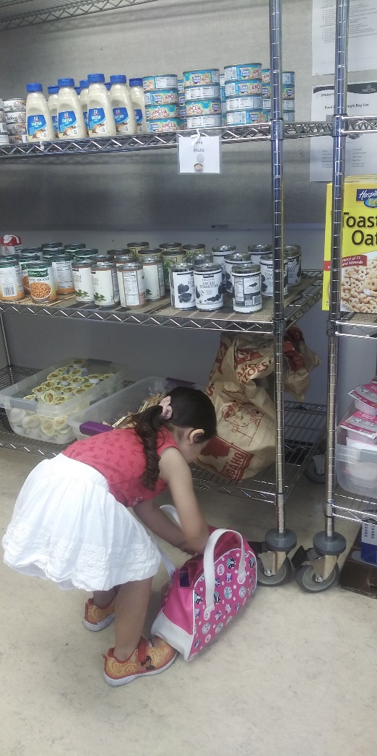
Future Cañada College Student
"She looks forward to coming to the pantry and she prepares her bag before she comes"
Today she helps her mom select groceries
In a few years, she is a Cañada College Student
Help make her dream a reality
This is all made possible by the wonderful and caring staff that works the pantry and makes a difference in students’ lives

Slide 12
Key Takeaways
The request is pending Cañada College being face-to-face in FA21 & SP22.
We anticipate increased food insecurity due to COVID 19 and our under-resourced students facing prolonged financial challenges
This position would connect students to additional food resources
SMCCCD has now focused a Basic Needs Task Force to address Food Insecurity across the District - #HereForYou (JH)
Pending CCCCO Hunger Free Allocations, the Food Pantry OAII position would be offset thereby reducing the expense for this position
$0-$28K per year over the past 3 years

Slide 13
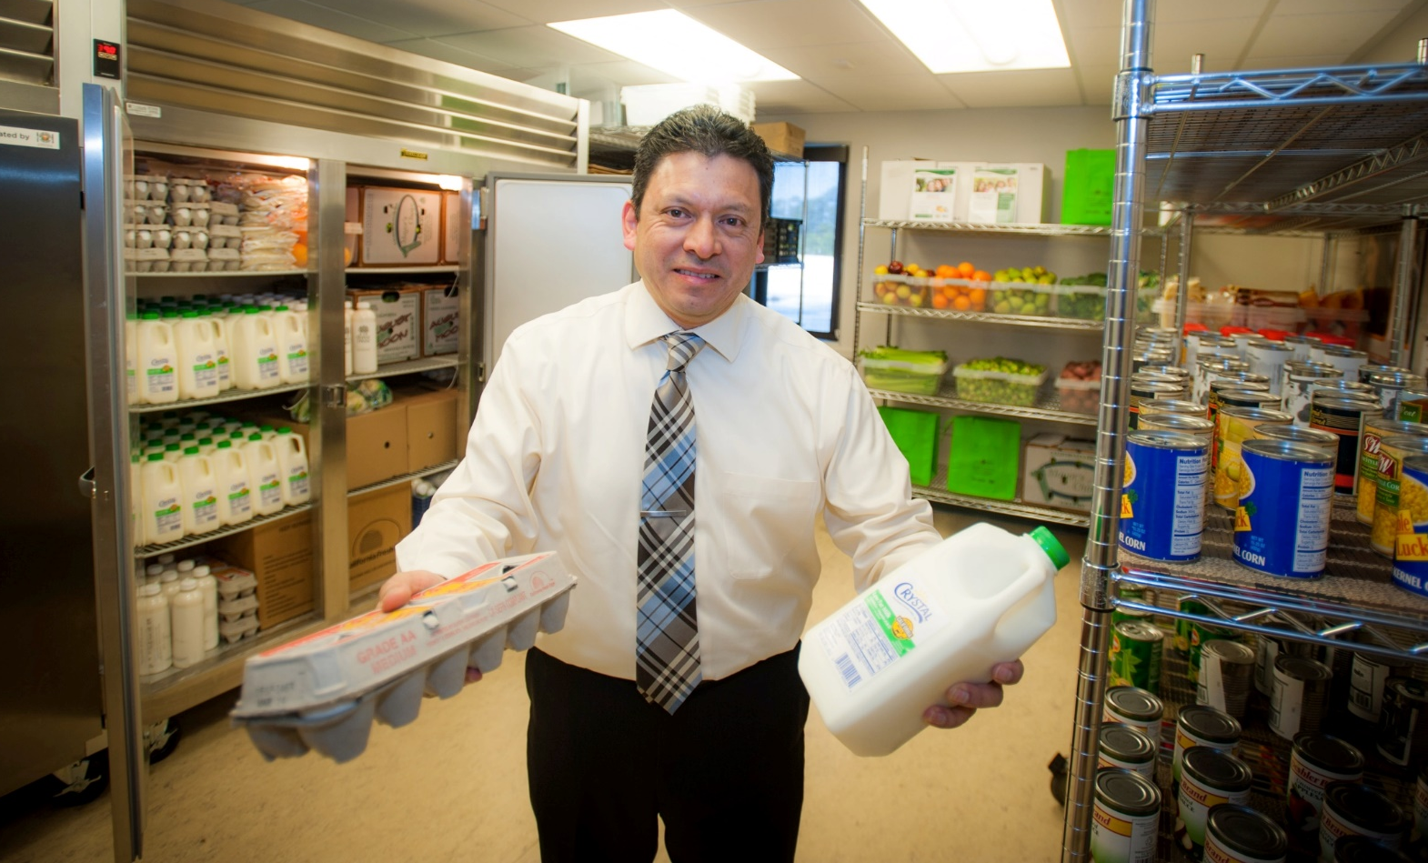
Supporting our Students!
#HereForYou

