Slide 1

Annual (operational) Plan for 2020-21
Proposed to PBC as of September 2, 2020

Slide 2
The College Annual Plan
Sets forth the activities to be implemented in one year to support the achievement of the five-year goals articulated in the Education Master Plan, which are in support of achieving the College Mission.
Is a synthesis of objectives, strategic initiatives, and activities of other college plans, grant deliverables, and recent mandates from the State Chancellor’s Office.

Slide 3
Education Master Plan: 2017-2022
Year 1
2017-18
Year 2
2018-19
Year 3
2019-20
Year 4
2020-21
Year 5
2021-22
Strategic Enrollment Planning Strategic Enrollment Management Plan: 2020-23
Year 1
2020-21
Year 2
2021-22
Year 3
2022-23
College Committee Planning: 2020-2023
Align 3-year planning as appropriate per committee
Annual Strategic Plan
(operational)
Annual Strategic Plan
(operational)
Annual Strategic Plan
(operational)
Where we are now

Slide 4
FOCUS THIS YEAR:
Prioritize support for students, faculty and staff during COVID-19 and remote campus operations
Apply guiding principles (or a framework) related to fulfilling the campus-wide commitment to becoming an anti-racist institution and fulfilling its mission of “ensuring that all students have equitable opportunities to achieve their transfer, career education, and lifelong learning educational goals.”

Slide 5
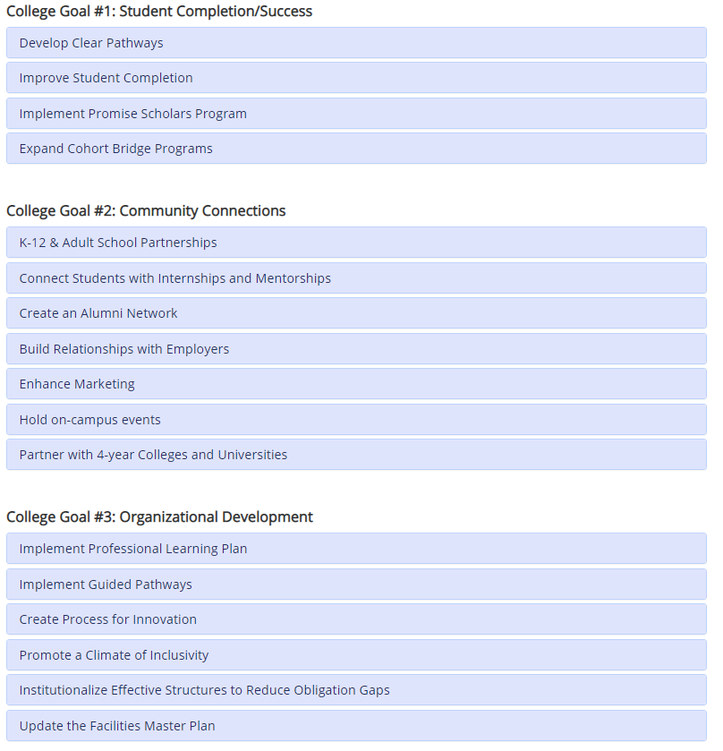
17 strategic initiatives
Education Master Plan (EMP)
Top 6
2020-21
Strategic Priorities
Considering COVID-19

Slide 6
Strategic Priority #1
Improve student completion via enrollment management, student retention and course scheduling

Slide 7
Strategic Priority #2
Collaborate with Pre-K to Adult School partners to promote relationships, seamless transitions, and alignment of pathways

Slide 8
Strategic Priority #3
Expand and enhance marketing

Slide 9
Strategic Priority #4
Implement the Professional Learning Plan and establish a robust college-wide professional learning program that engages campus constituents while creating opportunities for innovative practices that support student success and promote equity

Slide 10
Strategic Priority #5
Promote a campus culture that fosters a climate of inclusivity

Slide 11
Strategic Priority #6
Institutionalize effective structures and best practices of HSI (Hispanic-Serving Institutions) and AANAPISI (Asian American and Native American Pacific Islander-Serving Institutions) in order to reduce obligation gaps

Slide 12
New Priority
Hiring and retention of diverse employees

Slide 13
Discussion

