Slide 1

Antiracism
Task Force
PBC Presentation 3|17|2021
Mid-Semester Progress

Slide 2
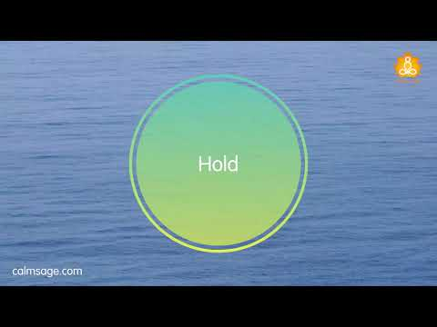
Student Opener
Adrian + Chili

Slide 3

Antiracism Framework
Our Why: Through song and images.
Please note that in this video there are words and images that can and might affect you.
If you need to take the next 50 seconds away from the computer, please take the time and space you need.
We hope these images and song can best share our Antiracism Framework wording, found on the bottom of the screen.
Michiko

Slide 4
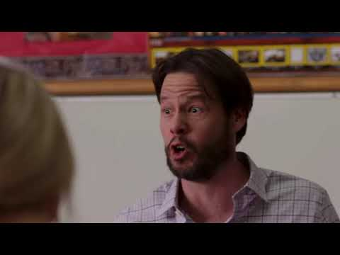
Antiracism Framework
Starting with a Common Language
This video is intended for levity.
It provides a “not ideal” example of what can happen if we’re asked about our Antiracism work and all we have in our pocket
are jumbled buzzwords.
Michiko
Notes:
This video is intended for levity.
It provides a “not ideal” example of what can happen if we’re asked about our Antiracism work and all we have in our pocket are jumbled buzzwords.

Slide 5
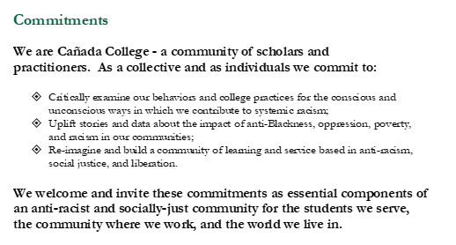
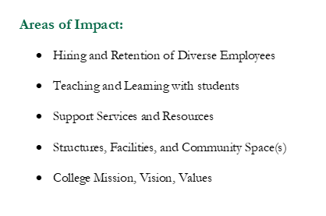
Antiracism Framework
Our How
Alex

Slide 6


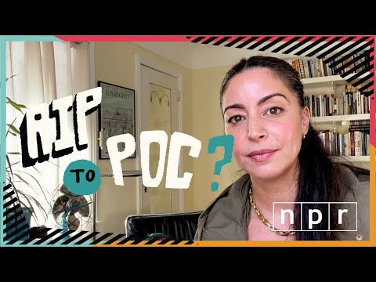

Chili, Ellen, Tammy
Engagement & Implementation
Colts-con - Anti racism training for all incoming/returning students
Flex day - Staff & Faculty training
Antiracism Workshops for new employees
Podcast

Slide 7
Communication Braiding
Adrian
Recognizing that collaboration is key.
Working alongside many communities on campus.
Expect upcoming updates to our website.

Slide 8

Your role - Please share feedback.
Manuel
Please share slide deck with councils and constituencies.
Direct feedback locations:
  canprie@smccd.edu
  https://canadacollege.edu/antiracism/

Slide 9
Questions?
Manuel

