Slide 1
Educational Master Planning at Cañada College
Planning and Budgeting Council
December 16, 2020
Prepared by the Office of Planning, Research & Institutional Effectiveness

Slide 2
What is an Educational Master Plan (EMP)?
An Educational Master Plan is defined as, “a part of the College’s Master Plan that defines the education goals of the College as well as the current and future curriculum to achieve those goals. The Educational Master Plan precedes and traditionally guides the Facilities Master Plan.”
Source: Community College League of California

Slide 3
Why do we develop an EMP?
The purpose of the Educational Master Plan (EMP) is to offer the essential data and foundation upon which the instructional program and support service needs can be addressed and met in the future. It will also assist in the creation or update of other important College plans. These include plans for technology, facilities (capital expenditures), personnel, finance, budget, and others.

Slide 4
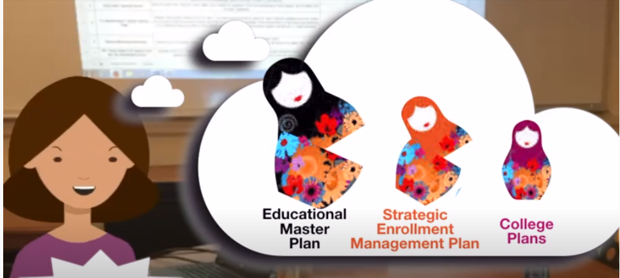

Slide 5
Education Master Plan: 2017-2022
Year 1
2017-18
Year 2
2018-19
Year 3
2019-20
Year 4
2020-21
Year 5
2021-22
Strategic Enrollment Planning Strategic Enrollment Management Plan: 2020-23
Year 1
2020-21
Year 2
2021-22
Year 3
2022-23
College Committee Plans
Equity Plan
Environmental Sustainability Plan
Online Education Plan
Professional Development Plan
Safety Plan
Technology Plan
Committee plans operationalize and help monitor the implementation of the goals and strategic initiatives established in the EMP and SEM by topic
Our next EMP should be adopted no later than spring of 2022
2020-21
Strategic Plan
(operational)
2021-22
Strategic Plan
(operational)
2022-23
Strategic Plan
(operational)

Slide 6
EMP Planning Timeline (proposed)
Form EMP Planning Task Force
Conduct Environmental Scan
Data Review
Review College Mission, Vision, Values
Develop new College Goals & Objectives
Refine Strategic Framework
Solicit Feedback on Draft EMP
Adopt New EMP (2022-27)
January 2021
Spring 2021
Spring 2021
Fall 2021
Fall 2021
Spring 2022
May 2022

