Slide 1

Program Review Work Group
Recommendations & Updates for the Planning & Budgeting Council (PBC)
April 21, 2021

Slide 2
Work Group Responsibilities
Recommend annual timeline and due dates for the program review process for IPC, SSPC, and PBC approval;
Facilitate and ensure regular messaging about the program review process is communicated to appropriate campus stakeholders on a timely basis;
Meet on a bi-weekly basis to support regular coordination occurs across instructional, administrative, and student services programs;
Report regularly to IPC, SSPC, and PBC

Slide 3
PBC Responsibilities
Serve as College Accreditation Oversight Committee
Ensure that the College meets the accreditation standards related to program review
ACCJC Standard 1.B:
  The institution engages in continuous, broad based, systematic evaluation and planning. The institution integrates program review, planning, and resource allocation into a comprehensive process that leads to accomplishment of its mission and improvement of institutional effectiveness and academic quality. Institutional planning addresses short- and long-range needs for educational programs and services and for human, physical, technology, and financial resources. (ER 19)

Slide 4
Recommendations & Updates
Recommendations for Approval
Timeline and Due Dates for 2021-22
Extension and deferral process
Work Group to return May 5 with recommendation re rubric for 2021-22
Update on Other Changes Received from Planning Councils
Updates made in Improve and on Program Review Website
  New Program Review Cycle & Schedules
  New, Re-Assigned & Removed Programs
  Updated Questions Received from Planning Councils
Clarification
Clarification of resource request process

Slide 5
Program Review Timeline
Mid-October
Programs submit complete program reviews/annual updates and all resource requests*
Dec - January
President announces approved positions
(contingent on funding)
November
Position Justification Presentations
Divisions provide information about prior‐ year grant‐funded positions
May - June
Budget Office notifies Programs of approved requests funded for following year
Beginning of August
Data Dashboards Available;
Improve Open
Feb-March
IPC Program Review Presentations
March - May
VPA presents 3-year revenue and expense projections to PBC
Late-October
Deans/VPs finish sending feedback to all programs
August
September
October
November
December
January
February
March
April
May
January - February
Divisions prioritize non-personnel resource requests
Early March
PBC prioritizes non-personnel requests.
Early November
All Dean/VP feedback is addressed and final edits are made in Improve.
August Flex Day
Workshops
Early December
PBC prioritizes personnel requests and presents President with prioritized list.
Mid-February
Deans, VPs and President submit prioritized non-personnel Division or Department resource requests to PBC.
May - June
VPA authorizes Divisions to make purchases starting July 1
*Resource requests include an Annual Update in non-comprehensive program review years.
Revised by Program Review Work Group, Spring 2021

Slide 6
Program Review Due Dates
(proposed for 2021-22)
Submit your complete Comprehensive Program Review or Annual Update before October 15, 2021.
Deans and VPs complete feedback of all program review materials and send out before October 29, 2021.
Review your supervisor's feedback and incorporate it into your program review before November 5, 2021.

Slide 7
Extension and deferral process (proposed)
All instructional programs, student services programs and administrative services are expected to follow the annual cycle and timeline for submitting comprehensive program review and annual updates as communicated on the college program review website each year. If programs do not submit the required documentation and related materials by the deadline, they will not be eligible to request resources for the following academic year. Programs should work with the appropriate dean/VP for an extension or deferral if warranted. The following policy is meant to clarify and simplify the process for getting short-term extensions and deferrals when needed.
  Comprehensive Program Review & Annual Update Extensions: Program review deadlines are set in order to allow time for many other college processes to take place during an academic year, so extensions are rare. Program review authors and the appropriate Dean/VP may deem that a short-term extension (no more than 5 days) of the deadline for a particular program is warranted. Program review authors should work with the dean/VP and follow-up with the respective planning council (i.e., IPC or SSPC) if an extension of more than 5 days is needed. A program view deferral might be recommended if a longer extension is needed.
  Comprehensive Program Review & Annual Update Deferrals: Program review authors unable to submit their comprehensive program review or annual update due to extenuating circumstances will be expected to complete their comprehensive program review or annual update during the following program review cycle. These extensions are rare and a rationale must be given.
  For all extensions and deferrals, the dean/VP must notify the PBC Program Review Work Group (canprogramreview@smccd.edu) as soon as possible with confirmation of the new deadline.

Slide 8
Resource Prioritization Rubric
 | Minimal (1) | Low (2) | Moderate (3) | Strong (4) | Score
Program review | Request not addressed in program review | Minimally addressed in program review | Moderately addressed in program review | Substantially addressed in program review
College Mission & Strategic Goals | Does not align with college mission and strategic goals | Minimally aligns with college mission and strategic goals | Moderately aligns with college mission and strategic goals | Fully aligns with college mission and strategic goals
College Plans | Does not support any of the College operational plans | Minimally supports one or more of the College operational plans | Moderately supports one or more of the College operational plans | Fully supports two or more of the College operational plans
Learning Outcomes (Student Learning Outcomes, Service Area Outcomes) | Does not support achievement of student learning or service area outcomes | Minimally impacts achievement of student learning or service area outcomes | Moderately impacts achievement of student learning or service area outcomes | Directly and significantly impacts achievement of student learning or service area outcomes
Critical Question Considered by PBC: Contributes to closing the equity gap | Does not contribute to closing the equity gap | Minimally impacts closing the equity gap | Moderately impacts closing the equity gap | Directly and significantly impacts closing the equity gap
Critical Question Considered by PBC: Contributes to supporting Latinx student success | Does contribute to supporting Latinx student success | Minimally impacts supporting Latinx student success | Moderately impacts supporting Latinx student success | Directly and significantly supporting Latinx student success

Slide 9
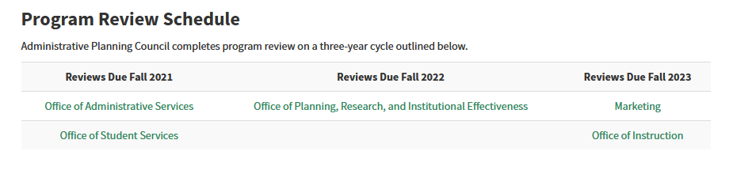
New Cycle for the Comprehensive Program Review Process
Administrative Program Review

Slide 10
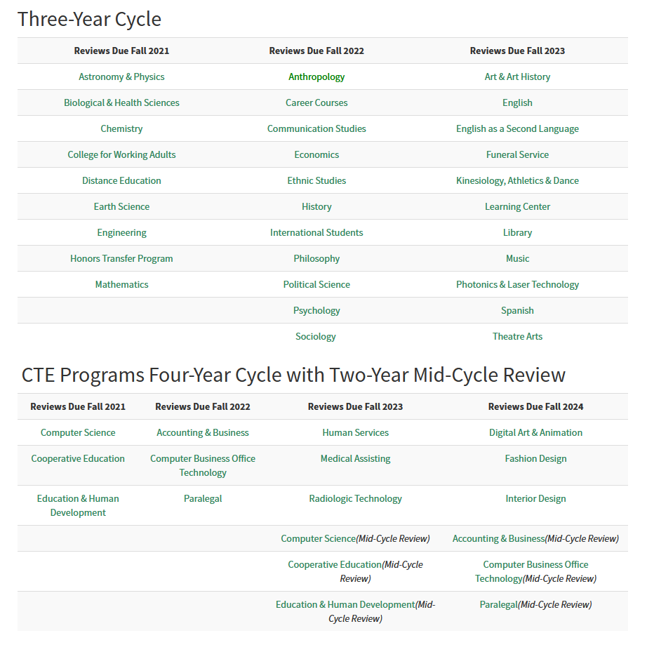
New Cycle for the Comprehensive Program Review Process
Instructional Program Review

Slide 11
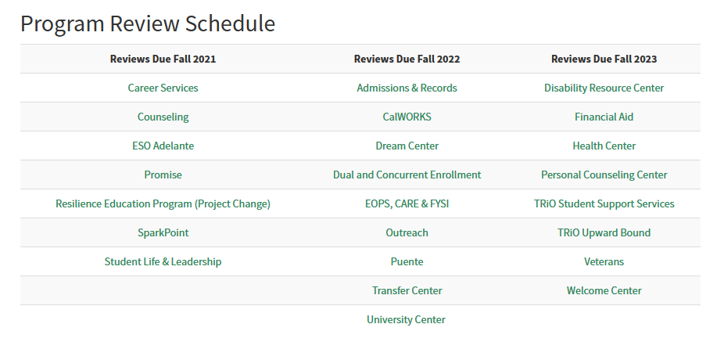
New Cycle for the Comprehensive Program Review Process
Student Services Program Review

Slide 12
Programs (new and re-assigned)
New Programs
  Ethnic Studies
Re-Assigned Programs
  International Students will now complete Instructional Program Review, instead of Student Services
  Outreach will now complete Student Services Program Review, instead of Administrative Program Review
Removed Programs
  STEM Center

Slide 13
Updated Student Services Questions (SSPC)
During Spring 2021 sub-group of SSPC convened and recommended changes to Student Services Program Review Questions that were approved on the 2/10/21 SSPC meeting
  Meeting minutes including the updated questions can be found here: https://www.canadacollege.edu/sspc/docs/1920/SSPC%20Minutes%202.10.21.pdf
The main goals of the revisions was to address student services program work in:
  Addressing and closing equity gaps
  Promoting antiracism
  And intentionally supporting our Latinx and Asian American, Native American, and Pacific Islander student populations (Reflecting on our status as an HSI and ANAPISI)

Slide 14
Instructional Program Review Questions (IPC)
Academic Senate revised program review questions in Spring 2020
  See April 23, 2020 and May 14, 2020 minutes and materials on A.S. website
  The revised set of questions from Spring 2020
Main goals in Spring 2020 revisions
  Better understanding of how instructional programs interact with other college services
  More specific questions related to equity issues in enrollment trends, course scheduling, and modality offerings
  Question related to documenting impact of unfulfilled past resource requests

Slide 15
Clarification of Resource Request Process
Working Towards Implementing a Singular Process for the College
Types of Requested Resources
  Requests for New Positions or Increasing FTE of Existing Positions
    Faculty
    Staff
    Management
  Requests for Operating Resources
    Hourly and Student Support
    Technology
    Supplies
    Equipment

