Slide 1
Student Equity & Achievement Plan:
Annual Report 2019-20
Planning & Budgeting Council
December 16, 2020
Prepared by:
David Reed, Dean of ASLT
Max Hartman, Dean of Counseling
Karen Engel, Dean of PRIE

Slide 2
Plan Alignment | Strategic Initiatives | Responsible Party | Related Metrics
Education Master Plan (EMP) & Strategic Enrollment Management Plan (SEM) initiatives supported by SEAP | SEAP Activities 2019-20 | Administrative Lead | Enrolled in the same Community College | Retained from Fall to Spring at the same college | Completed both Transfer-level math and English within the District in the First Year | Attained the Vision Goal Completion Definition | Transferred to a Four-Year Institution
EMP Goal 2 SEM Objective 4.2 | Increase the number of High School students successfully transitioning to Cañada | Director of High School Transitions & Dual Enrollment, Mayra Arellano | x
EMP Goal 2 SEM Objective 1.4 | Increase the number of Adult School and GED students transitioning successfully to Cañada | Dean of ASLT, David Reed; ACCEL Transitions Coordinator, Janet Ramirez | x | x
EMP Goal 2 SEM Objective 1.6 | Strengthen 2+2 partnerships with 4-year institutions | Director of Post-Secondary Success, Mary Ho |  |  |  |  | x
EMP Goal 2 SEM Strategy 1.4.1 | Create a more visible presence in downtown Redwood City | Director of Workforce Development, Julian Branch; Dean of ASLT, David Reed | x |  | x | x
EMP Goal 1 | Scale the Promise Scholars Program replicating the CUNY-ASAP model | Director of High School Transitions & Dual Enrollment, Mayra Arellano | x | x | x | x | x
EMP Goal 3 SEM Objectives 3.2 & 3.3 SEM Strategy 3.3.1 | Align role of Retention Specialists across campus through building and supporting a community of practice among them and supporting their efforts with data | Vice President Manuel Pérez |  | x
EMP Goal 3 SEM Strategy 3.1 | Identify and address barriers and inefficiencies in the matriculation process; build and implement a new Constituent Relationship Management (CRM) system | Dean of Counseling, Max Hartman | x
EMP Goal 3 SEM Strategy 3.3.2 | Expand and extend cohort programs (establish FYE programs aligned with Interest Areas) | Vice President Manuel Pérez | x | x
EMP Goal 3 SEM Strategy 3.3.1 | Establish "Success Teams" aligned with Interest Areas and Affinity Groups | Vice President Manuel Pérez |  | x | x | x
EMP Goal 3 SEM Strategy A-5 SEM Strategy 3.3.1 | Provide face-to-face and online student support services to meet the needs of all students | Vice President Manuel Pérez |  | x | x | x
EMP Goal 3 SEM Strategy 3.3.3 | Expand opportunities for students to explore careers | Vice President Manuel Pérez |  | x |  | x
EMP Goal 1 SEM Strategies 1.3.1 & 1.3.2 | Increase college and career exploration opportunities for students from feeder high schools | Vice President Manuel Pérez | x
EMP Goal 3 | Evaluate the success of students as a result of the College's implementation of AB 705 | Dean of PRIE, Karen Engel |  |  | x

Slide 3
Cañada College Demographics Fall 2019
Sources: Students – District data warehouse; Employees – CCCCO Data Mart; Community – U.S. Census American Community Survey, 1-year estimate

Slide 4
Access:
Enrolled at Cañada Within 1 Year of application 2-year college-wide change: -6%

Slide 5
Persistence:
Persistence of students enrolled in the fall and returned in the spring to the same college (excludes high school students)
2-year college-wide change: -9%

Slide 6
Completion of transfer level math and English:
First Time students at Cañada completing transfer level math and English by end of following term
2-year college-wide change: +9%
No disproportionately impacted groups
Earned credit certificate over 18 units, associate degree, CCC bachelor’s degree:
Award Counts (Number of students receiving any type of degree or certificate in a given academic year)
2-year college-wide change: -9%
No disproportionately impacted groups

Slide 7
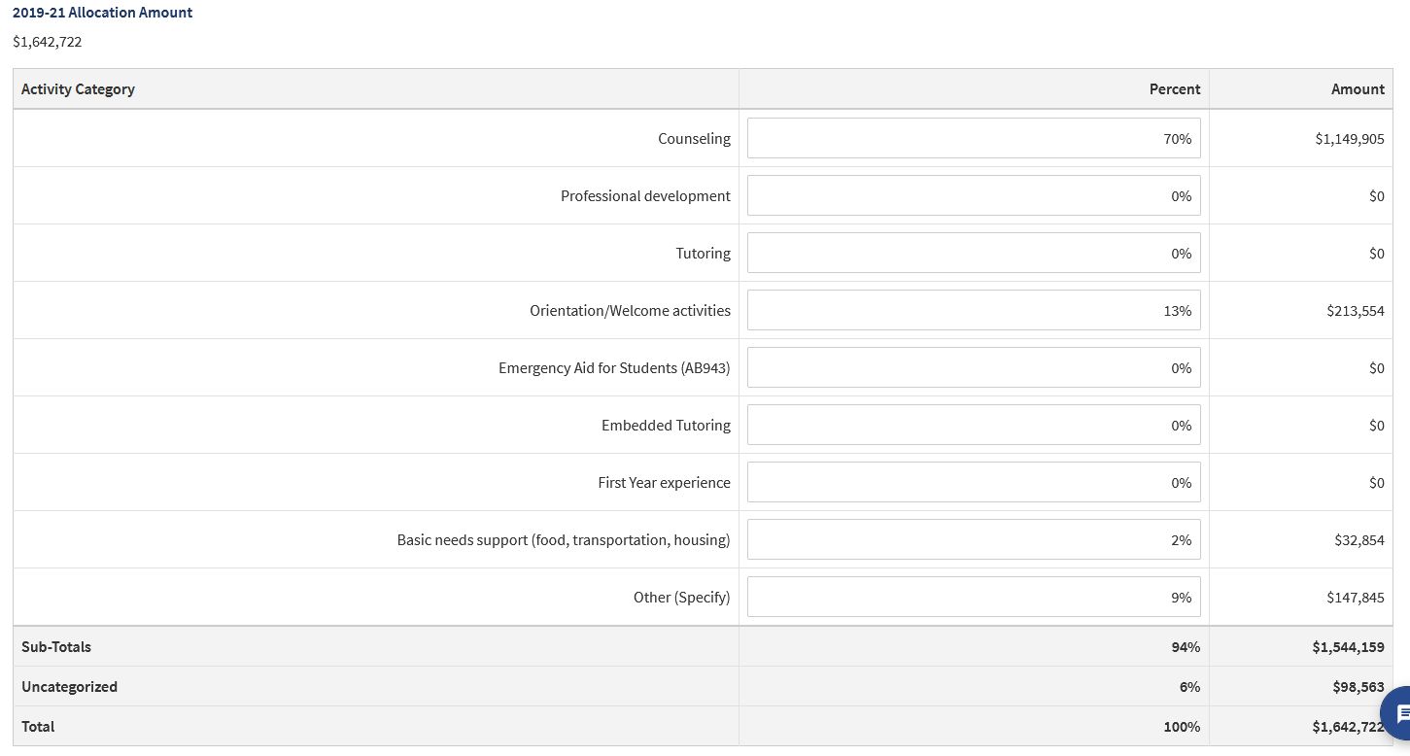
Spending by Category

