Slide 1


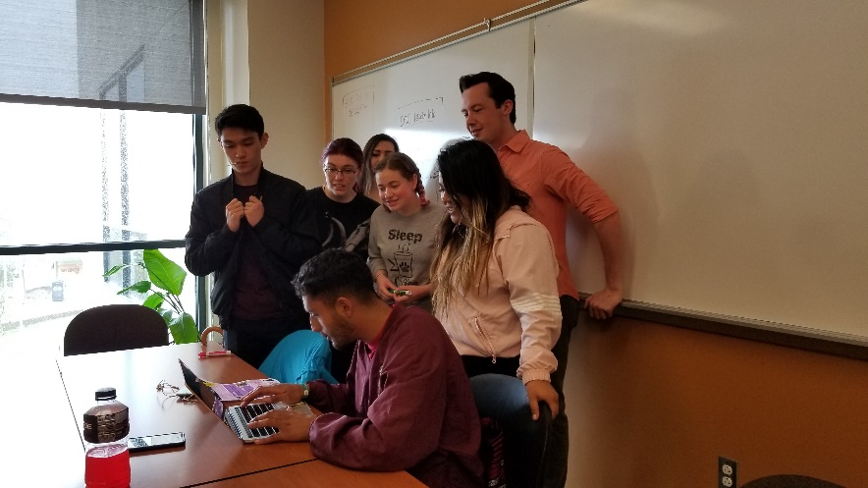
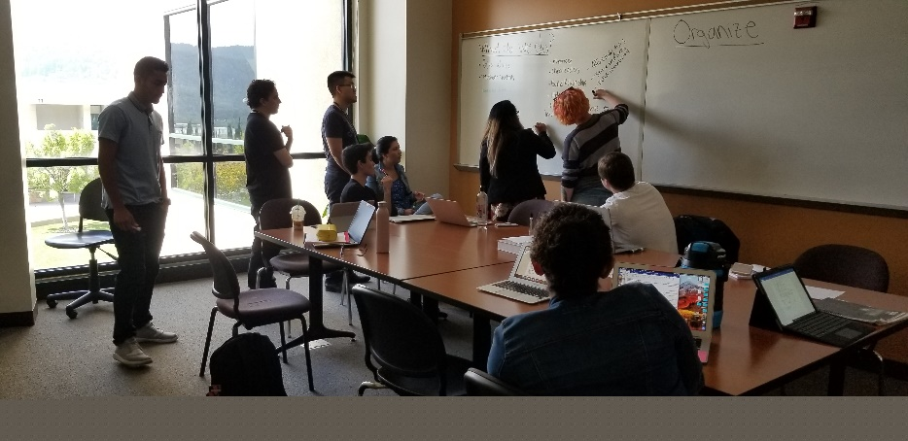


New Position
Proposal:
STEM Assistant Project Director
December 3, 2020

Slide 2

What is the need?
  The STEM Assistant Project Director (currently grant-funded) provides administrative and budgetary support for the staff and activities of the STEM Center:
  Managing budgets and coordinates expenditures, contracts, hiring packets, timesheets and other administrative duties with the college’s business office.
  Provides assistance with the STEM Center website and coordinates tech repair and purchases with the college’s IT department.
  Coordinates with the Learning Center APD (also grant-funded) to ensure a seamless experience for students, student workers, classified staff and faculty.

Slide 3
STEM Assistant Project Director Duties
Major duties of this position include:
Monitoring STEM Center expenditures and purchases materials, supplies, and equipment
Performing administrative duties such as hiring paperwork, contracts, Procard reconciliation, etc. in conjunction with the business officer.
Planning and implementing meetings, receptions, orientation programs, and other special events and outreach activities
Completing and auditing required eligibility and acceptance forms for STEM grants and related documentation; sets up and maintains confidential online and manual files of student participants, project documentation, available resources, regulatory information, and other project data
Creates budgets for grant proposals. Works with the college business officer on budget loads, fiscal closing and audits.
Tracking project outcomes for use in planning and reporting activities
Entering, formatting and retrieving data for a variety of reports, grant
applications, presentations, and documentation

Slide 4
What Happens if the Assistant Project Director position is not funded?
Currently, all administrative support for Floor 2 is grant-funded (ESO APD and STEM APD)
Without this position, administrative support for student activities, classified staff, student workers and faculty will need to be done by another staff person:
  ASLT division assistant?
  Business Office staff?

Slide 5
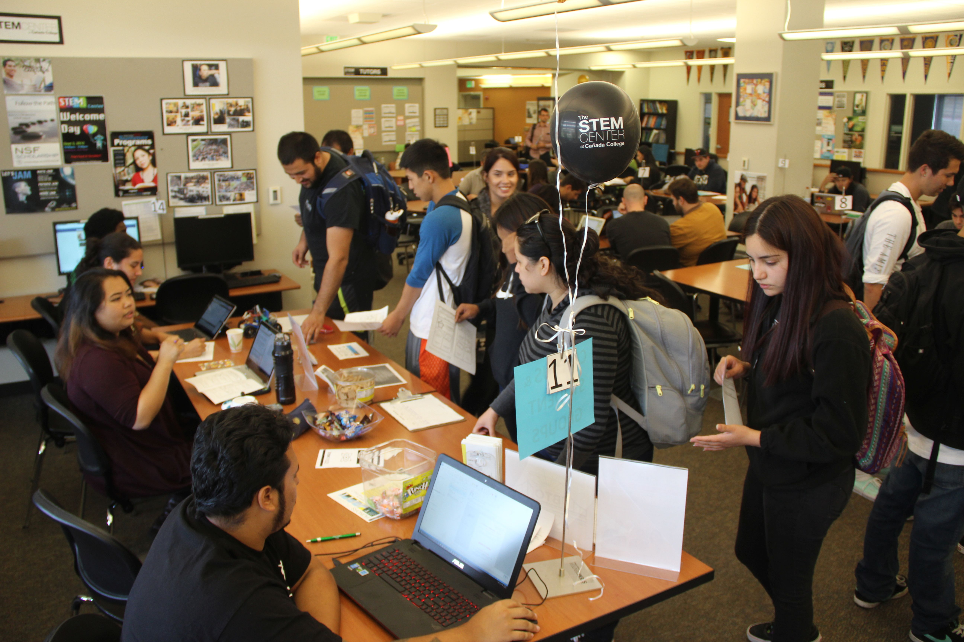
Thank you!
What are your questions?

