Slide 1


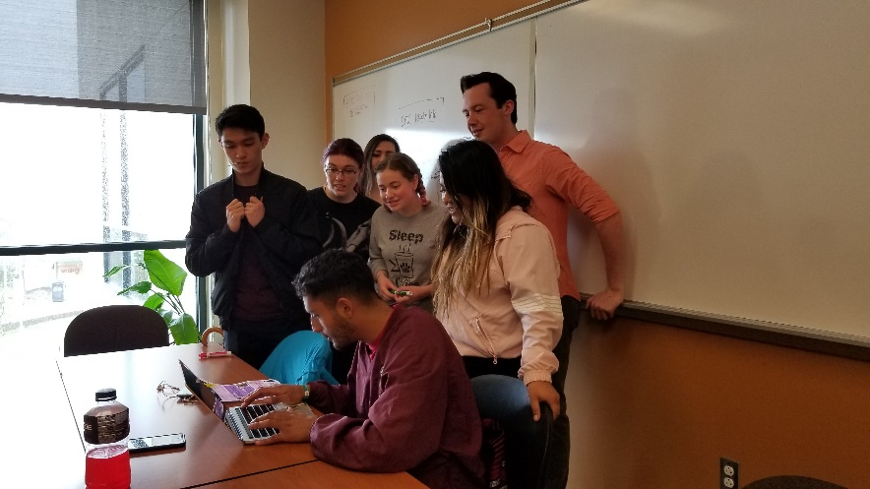
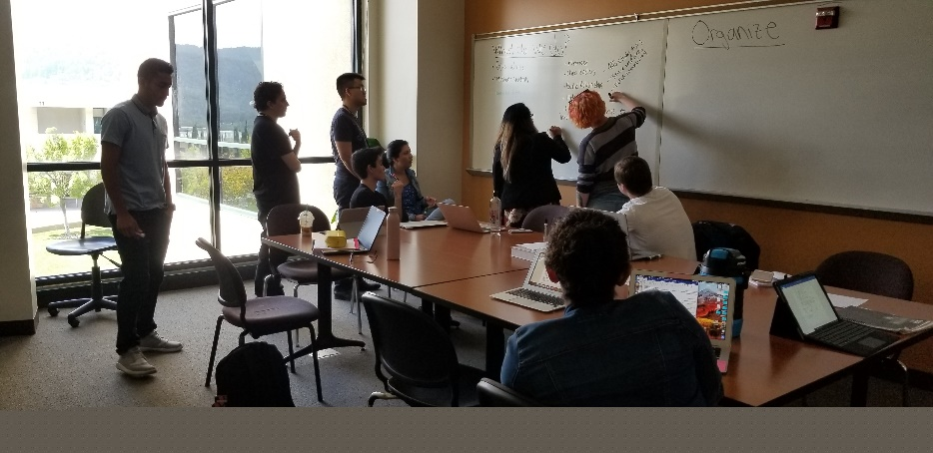


New Position
Proposal:
STEM Retention Specialist
December 3, 2020

Slide 2

What is the need?
Students need consistent guidance to academic supports and college services.
  “I didn’t know these services were offered, and now it’s too late.”
  “I wish I could talk to the same person each time about my progress.”
If we build it, they will NOT automatically come.
  “I didn’t realize this program was for students like me.”
Some activities can light a spark and change their college experience.
  “Once I visited Cal Poly, I knew that’s what I wanted to do and classes became my top priority.”

Slide 3
STEM Retention Specialist as relationship builder
Serve as primary contact person with students, enrollment to transfer.
Pre-term bridge programs: help recruit students, plan and present sessions.
Incorporates peer mentors in building relationships with students; uses mentors to aid communication with students

Slide 4
STEM Retention Specialist as college navigator
Connect students with appropriate counselor; follow up to ensure student registers for their SEP classes
Direct students to appropriate resources and programs (ex. Promise, EOPS, TRiO, MESA, tutoring)
Refer students to Financial Aid and Sparkpoint services; assist with scholarship applications
Connect students with faculty

Slide 5
Retention Specialist as persistence specialist
Notes:
.

Slide 6
First Generation students make up the majority of RS cases

Slide 7
RS helps provide equity for our students.
Ethnic minority students make up the majority of RS cases.
Notes:
So, most of the students served by Retention Specialists are either First Gen or Minority or both. This position fits with the Equity goal of our college, by providing help to those students that need it most.

Slide 8
STEM Retention Specialist as persistence specialist
Enrollment in Engineering Courses
 | 2015-16 | 2016-17 | 2017-18 | 2018-19 | 2019-20
Minority | 59 | 62 | 75 | 48 | 53
Total | 282 | 300 | 222 | 161 | 101
Enrollment In STEM Courses
Total | 6173 | 6387 | 6161 | 6214 | 5144
Minority | 2254 | 2263 | 2146 | 2101 | 1935

Slide 9
Retention Specialist is the pillar
of Guided Pathways FYE support structure
Financial Aid
Programs: EOPS, TRIO. …
EPIC sessions with cohort
College success workshops
Scholarship applications
Speaker series for career exploration
First term
2nd term
2nd year
HS student
Gets SEP
Registers for classes
COLTS-CON
Jams
Referred to counselor
Assigned to peer mentor
Selects interest Area
Enrolls
Retention
Specialist
Summer internship
Job shadowing
Student clubs
College visits
Internship applications
Updated SEP

Slide 10
Future Applications of the STEM Retention Specialist Position
STEM Retention Specialist will play a central role in the Science & Health Interest Area Success Teams (Guided Pathways)
  Forge meaningful relationships and foster a sense of belonging for students in an interest area
  Lead the messaging and outreach efforts of the peer mentors
  Ensure warm hand-offs between counseling/faculty and college resources
Science & Health Retention Specialist will be instrumental in aligning and coordinating with other Interest Areas
  Coordinating FYE programs will allow students to explore multiple interest areas as well as reduce redundancy and save money
  Ensure that students don’t fall through the cracks as they move
  between interest areas or take classes in multiple interest areas

Slide 11
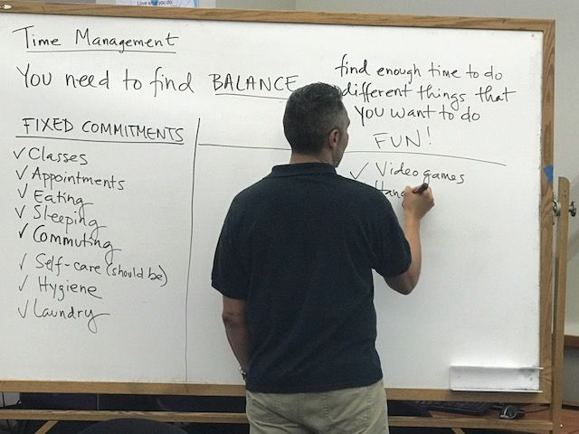
Thank you!
What are your questions?

