Slide 1

Chemistry Faculty Vacancies Replacement Request Presentation
Planning and Budgeting Council Meeting
November 17th, 2021 by
Jeanette Medina
11/17/2021 – Jeanette Medina

Slide 2
Request Justification
The current 2 fulltime faculty are scheduled to retire in the academic year 2021-2022. Professor Tricca in Fall 2021 and Professor Medina in Spring 2022.
The Chemistry Department serves a large number of science majors and students who transfer to career technological education programs. The Chemistry Department is highly productive as shown by the 2020-2021 Program Review data (see slides 3-6).
In the of Fall 2021, the Chemistry Department is operating at a fulltime obligation percent of 44.2%.
We believe it is crucial to replace these 2 fulltime vacancies as soon as possible to help the Department maintain its productivity, and ensure the continuity of ongoing projects and planned projects.
11/17/2021 – Jeanette Medina

Slide 3
Chemistry Department Courses at Glance
Course name and number | Associated Student Goal (not comprehensive)
Elementary Chemistry, CHEM 192 | Rad. Tech.; Respiratory Care pre-req.; transfer GE
General Chemistry Sequence, CHEM 210/CHEM 220 | Transfer requirement: ASTR, ENG, ENV, PHYS, etc.
Organic Chemistry Sequence, CHEM 231/CHEM 232 | Transfer requirement, in addition to above sequence, for many critical infrastructure majors in the Bay Area: BIOL, CHEM, BIOTECH, BIOCHEM, BIOENG, etc. Transfer requirement to Professional Degrees: Dentistry, Medicine, Pharmacy, Veterinary, etc.
Chemistry for Health Sciences, CHEM 410 | Pre-req. for critical infrastructure majors: Nursing, Allied Health, Kinesiology, Nutrition, etc.
11/17/2021 – Jeanette Medina

Slide 4
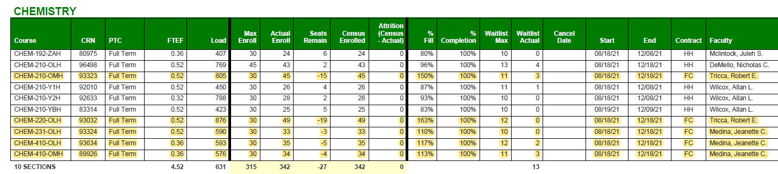
Fall 2021 Enrollments as of 8/30/21
Significant data:
The current FT Obligation percent is 44.2%.
Over half of the Fall 2021 sections are taught by Adjunct Faculty and FT overload.
11/17/2021 – Jeanette Medina

Slide 5
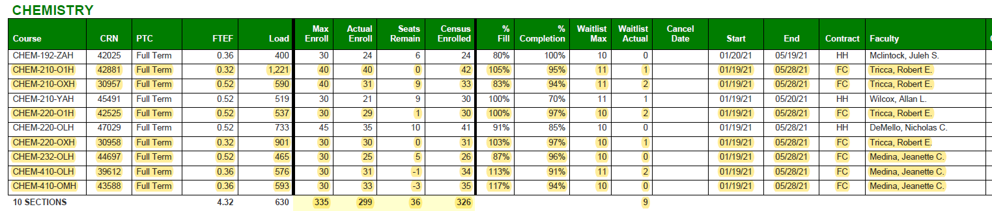
Spring 2021 Enrollments as of 4/12/2021
11/17/2021 – Jeanette Medina

Slide 6
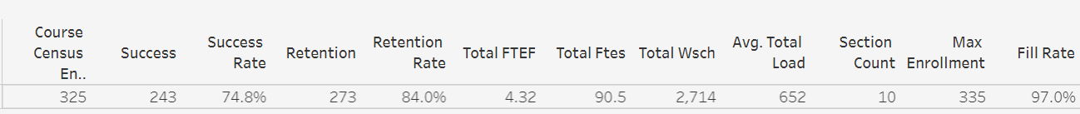
Spring 2021 Chemistry Department Performance*
*Taken from the 2020-2021 Program Review data packets
Compared to Spring 2021 College Performance*
*Taken from the 2020-2021 Program Review data packets
11/17/2021 – Jeanette Medina

Slide 7
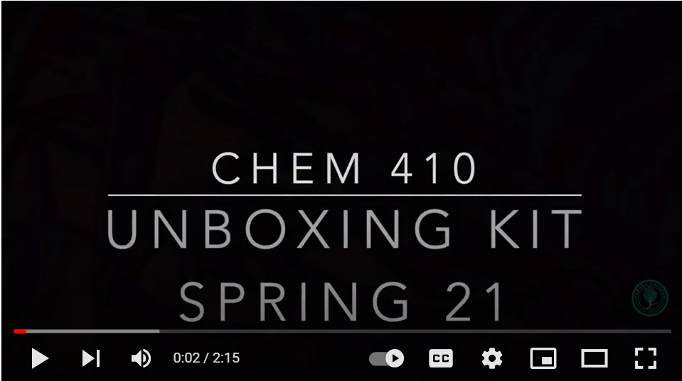
Planned Projects
Expand and improve the “take-home” chemistry laboratory kits piloted in Spring 2021 for the CHEM 410 online class to other courses. This initiative supports the teaching of practical laboratory skills required for students entering the Nursing programs. Successful implementation continues in Fall 2021.
This link is provided to students to introduce the contents of the lab kit: https://youtu.be/lzCOOzAM5H8
Explore possible course offering schedules to improve student accessibility and course enrollments.
Explore new strategies to improve student retention and completion.
Click on the box to open in browser
11/17/2021 – Jeanette Medina

Slide 8
Thank you for your consideration
11/17/2021 – Jeanette Medina

