Slide 1
College Goals and Metrics: Part I
Office of Planning, Research & Institutional Effectiveness
Prepared for the Planning & Budgeting Council (PBC)
November 17, 2021

Slide 2
Goals we have set
Accreditation
Institution Set Standards
Cañada College
Strategic Enrollment Management Plan
State Chancellor’s Office
Vision for Success
Student Equity & Achievement Plan
SMCCCD Board of Trustees: District Strategic Plan (new 2021)

Slide 3
District Goals
Key New Districtwide Strategies
District Goal #1 | Develop and Strengthen Educational Offerings, Interventions, and Support Programs that Increase Student Access, Success and Completion | Support the work of the District Anti-Racism Council … Increase enrollment of San Mateo County residents through coordinated efforts, including the implementation of the Free Community College initiative.
District Goal #2 | Establish and Expand Relationships With School Districts, 4-year College Partners, And Community-based Organizations to Increase Higher Education Attainment and Economic Mobility In San Mateo County | Continue to expand and support Middle College and Early College opportunities. Expand dual enrollment opportunities and make processes more efficient and accessible for secondary schools and their students.
District Foal #3 | Promote Innovation and Excellence in Instruction to Support Student Learning and Success | Expand program delivery options, including accelerated completion options, for all students including online students, e.g., College for Working Adults; short-term classes; intersession classes; cohort classes; and continuing, corporate and community education. Promote strategic development of online education to increase the development and delivery of quality, fully online certificate and degree programs. Ensure instruction is delivered in multiple modalities, including in-person, hybrid, and hyflex, to increase access to higher education and meet the needs of different student populations.
District Goal #4 | Ensure Necessary Resources are Available to Implement This Strategic Plan Through Sound Fiscal Planning And Management Of Allocations and Protection of Community-supported Status | Free Community College: Strategies of this plan include the accelerated expansion of Dual Enrollment, the Promise Scholars Program (PSP), and Open Educational Resources (OER) for Zero Textbook Cost (ZTC) degree programs, all within a Guided Pathways framework.

Slide 4
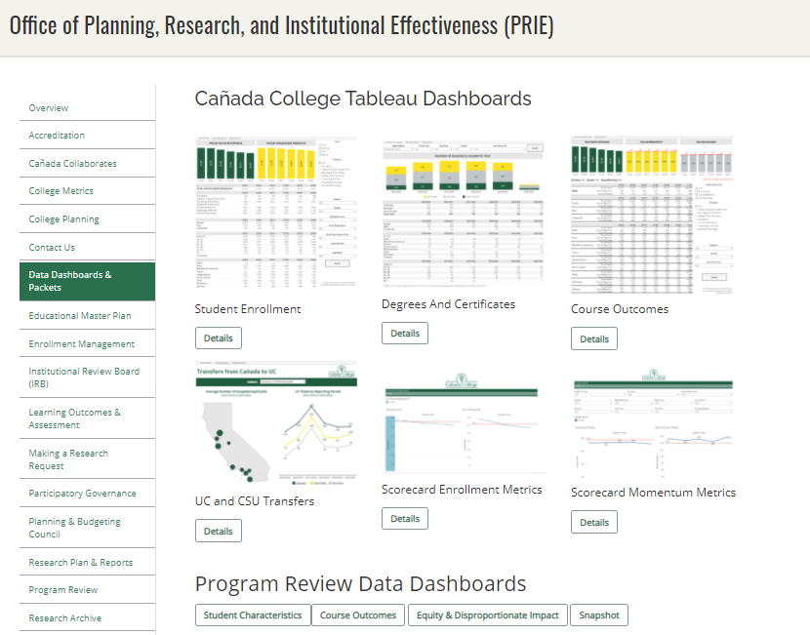
We track our progress via our newly adopted College Scorecard as well as our Data Dashboards

