Slide 1

Guided Pathways
Scale of Adoption Report to the California Community College Chancellor’s Office
Presented to the College Planning & Budgeting Council (PBC) on behalf of the Guided Pathways Steering Committee
March 16, 2022

Slide 2
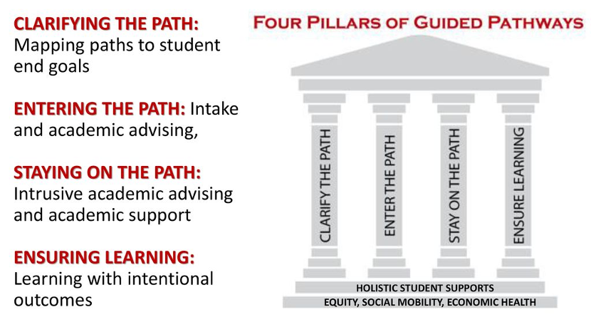
The Four Pillars

Slide 3
Area I: Clarifying the Path

Slide 4
Clarifying the Path: Mapping Paths to Student End Goals
Programs are organized and marketed in broad, career-focused academic communities.
Math courses are aligned with student’s field of study.
Programs are clearly mapped out for students.
Four Interest Areas
  Human Behavior & Culture,
  Science & Health
  Art, Design & Performance
  Business.
Students automatically placed into transfer-level math courses based upon Program of Study.
  SLAM - Math 200
  BSTEM - Math 241 & Math 225
  All offered with co-requisite support.
Program Mapper
  Active and available for all programs.
AT SCALE

Slide 5
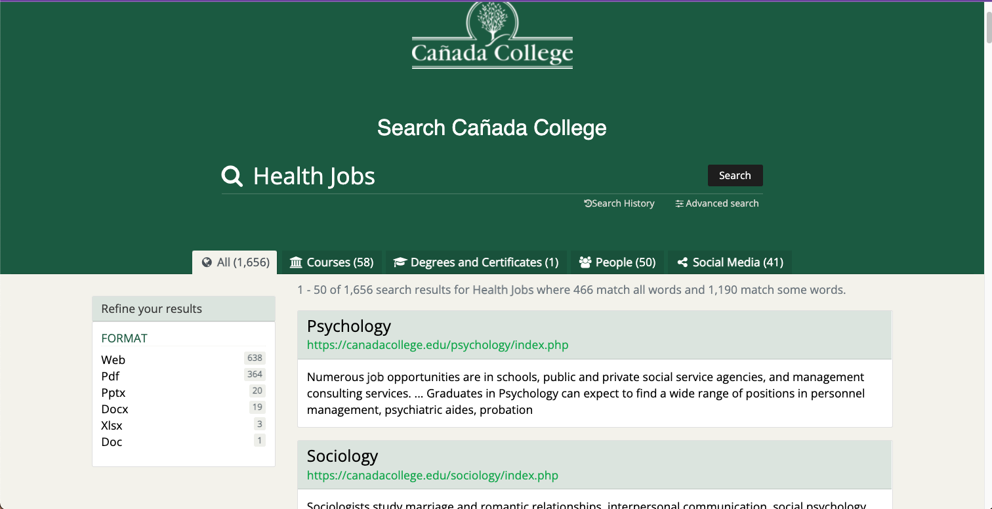
Clarifying the Path: Mapping Paths to Student End Goals
Information is provided regarding employment and further education opportunities.
Information is available on Program Mapper and Program Websites.
  Search improvements needed to make information easy to access.
Planning to Scale

Slide 6
Clarifying the Path: Mapping Paths to Student End Goals
Every program is well-designed to prepare students to enter employment and further education.
Employment and Salary Information included in Program Mapper
Have yet to build a college-wide infrastructure
  Reorganize Website
  Integration into FYE/Colts Con
  Faculty Education about Careers related to their service area.
  Career Exploration opportunities are available to students throughout their journey
Planning to Scale

Slide 7
Area II: Entering the Path

Slide 8
Entering the Path: Intake and Academic Advising
Special Supports for academically underprepared students.
Intensive supports for very-poorly prepared students.
Special Supports
  Co-requisite Support for “gateway” courses in English and Mathematics
  Math and Word Jams
  Writing and STEM Centers
  Embedded Tutors for each “gateway” course in Math and English.
Intensive Supports
  Retention Specialists in each IA
  Promise, EOPS, TRIO, STEM & Learning Center, & Puente
  Early Alert System
AT SCALE

Slide 9
Entering the Path: Intake and Academic Advising
Work with HS to motivate and prepare students.
Dual-Enrollment director has been hired.
3-year dual enrollment plan with HS district partners.
Scaling in Progress

Slide 10
Area III: Staying on the Path

Slide 11
Staying on Path: Intrusive academic advising and support
Advisors monitor student progress.
Students can easily monitor progress
College schedules courses as needed by students.
Success Teams for each IA
  Retention Specialists
  Early Alert System
Degreeworks
  Students can monitor their progress.
Course pattern
  Updated and available in catalog.
  More can be done to use Student Ed. Plan data to forecast course demand and schedule accordingly
AT SCALE

Slide 12
Staying on Path: Intrusive academic advising and support
Advisors and students are alerted when students fall off their program paths
Early Alert
  Faculty Driven alert system
  Challenges with coordinating with SKY and CSM Success Teams (supports)
Success Teams
  Data is available, but training is necessary for dealing with current data streams.
Scaling in Progress

Slide 13
Area IV: Ensuring Learning

Slide 14
Ensuring Learning: Learning with Intentional Outcomes
Faculty/programs assess learning outcomes for students
Assessments are used to improve teaching and learning throughout program.
College assess effectiveness of educational practice.
SLO’s are assessed in each program on a regular basis.
SLO’s inform program review.
PRIE conduct CCSSE/SENSE surveys
  Used to created targeted professional development.
AT SCALE

Slide 15
Ensuring Learning: Learning with Intentional Outcomes
The college assists students document their learning beyond transcripts.
Students have opportunities to apply and deepen their knowledge.
Faculty leads are documenting and collecting from faculty across disciplines
  Portfolios, projects, etc…
Career Education Programs
  Need to be scaled across Interest Areas
Scaling in Progress

Slide 16
Ensuring Learning: Learning with Intentional Outcomes
Instruction across programs engages students in active and applied learning.
Learning outcomes are aligned with further education and employment outcomes.
FLP and COP faculty development programs.
  Need to make programs more stable by removing grant dependence.
Career & Technical programs align PLO’s to career outcomes.
  Scaling this to other programs could be beneficial.
Planning to Scale

Slide 17
Student Engagement

Slide 18
Student Engagement
Cañada has actively engaged students in the planning and implementation of Guided Pathways. This includes
“Student Voices” focus group in Fall 2018,
student involvement in the sorting of programs into IA’s,
student input into the redesign of the college website, and
Students helped inform how Success Teams can best support students.

Slide 19
Course Alignment
How is the college exploring alignment of course offerings with student education plans?
The tool counselors use to create Student Education Plans (SEPs) - Degree Works - was recently thoroughly updated. Data from these SEPs could be used to help forecast the need for courses and to help enroll students in sections of courses with a cohort (by Interest Area or other special program).
The College/District continue to explore opportunities with Ad Astra to pilot the use of their Course Scheduling Module, which would allow course schedules to be built in a “sandbox” before being published on Web Schedule. This would allow us to find and resolve course scheduling conflicts across Divisions as well as across the District, potentially.

