Slide 1

Educational Master Plan
Considered for adoption by the
Planning & Budgeting Council (PBC)
May 18, 2022

Slide 2

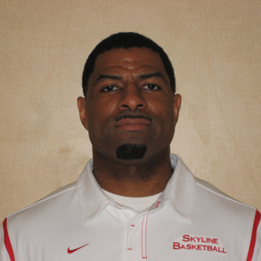
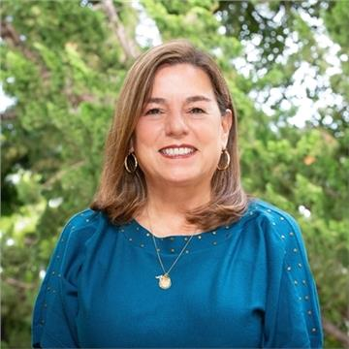
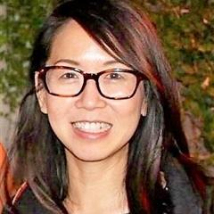

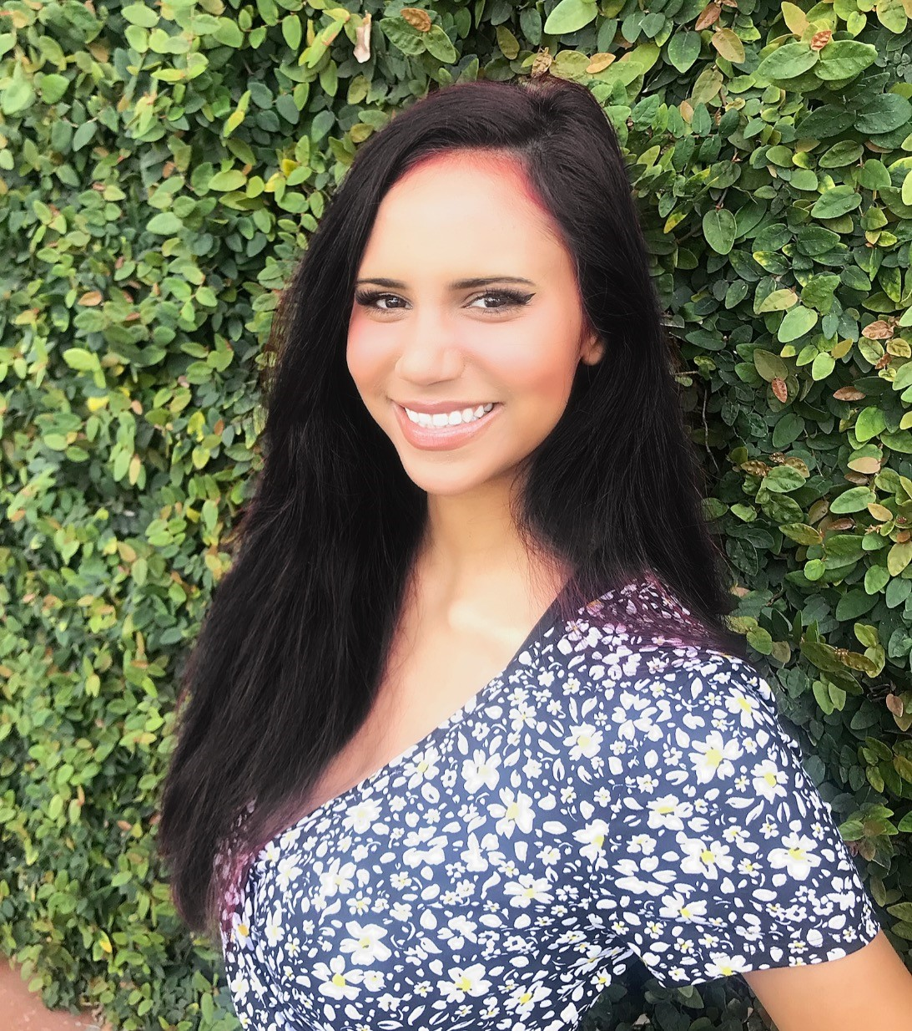
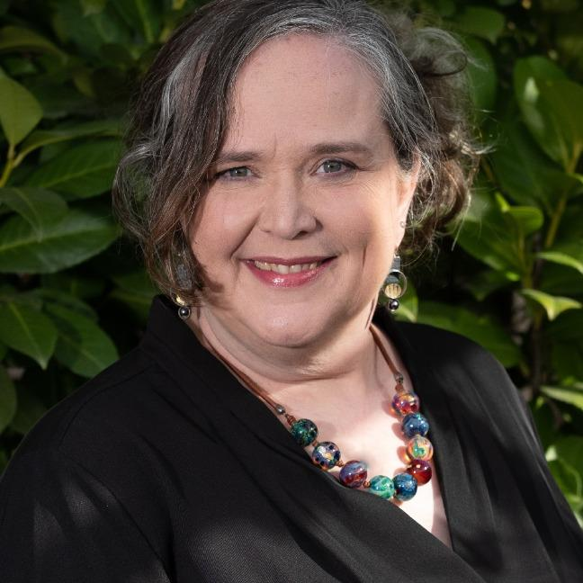
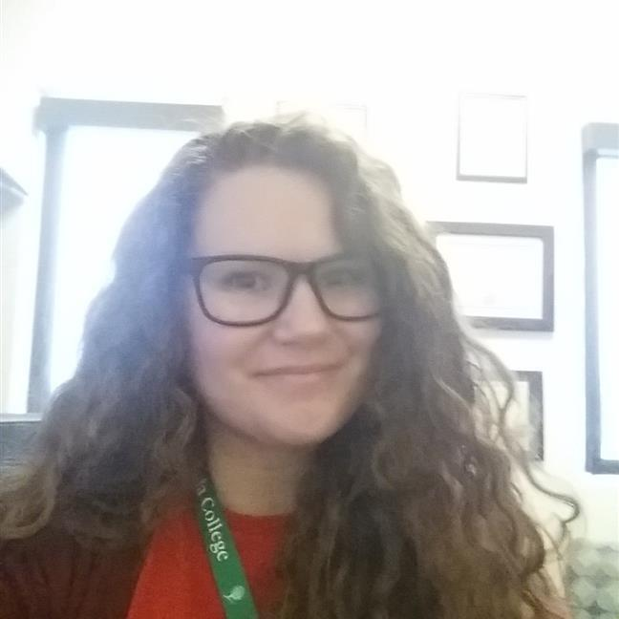
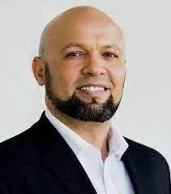
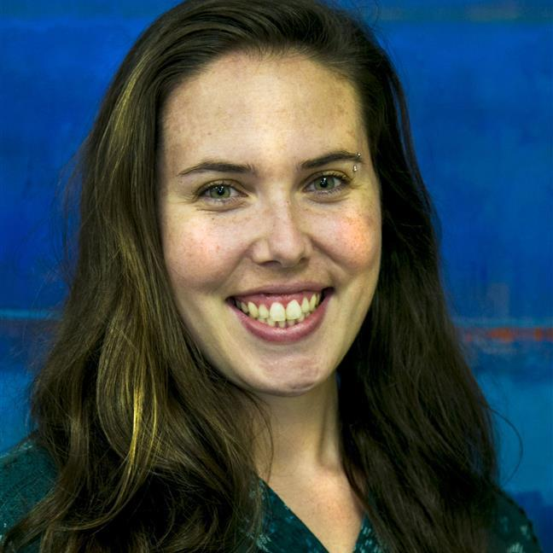
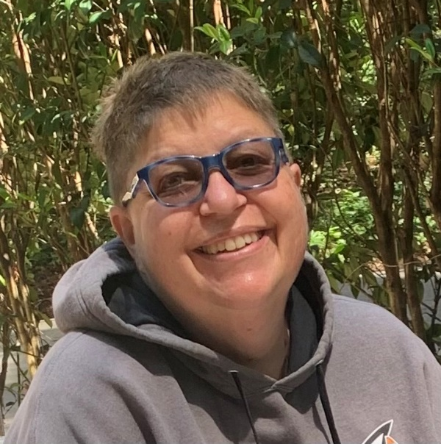
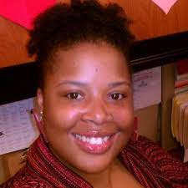
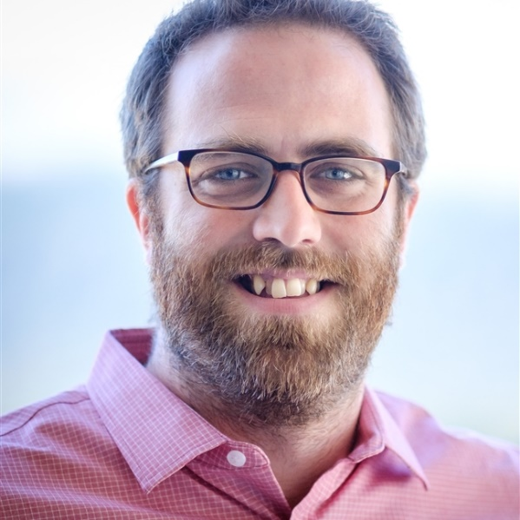
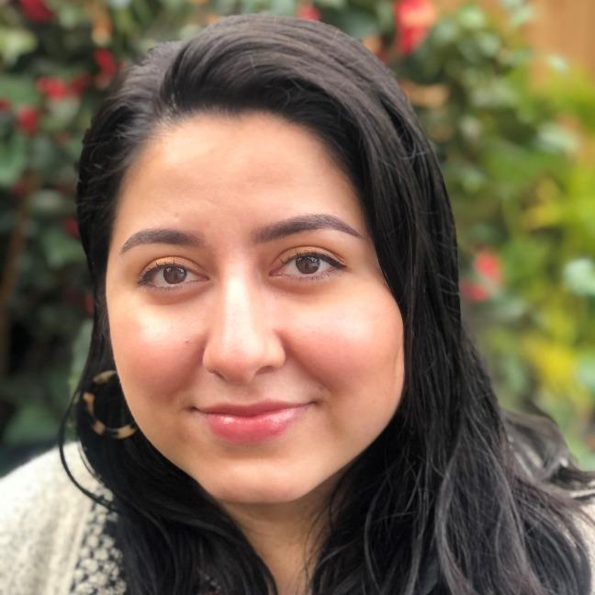
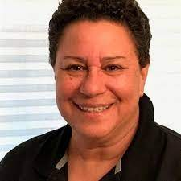
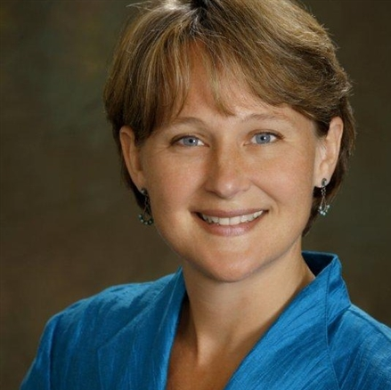
Jeanne Stalker Outreach & Welcome Center Rep.
Alicia Aguirre (HSS)
Coach Eddy Harris (KAD)
Mary Ho Transfer Services Rep.
Brittney Samora Delgadillo
(Student)
Jenna French (Counseling)
Hyla Lacefield, Dean
Mira Rubio (Student)
Cañada Educational Master Planning Task Force: 2021-22
Wissem Bennani, Interim Dean
Allison Hughes, Instructional Technologist
Roz Young, Tri Chair
Krystal Martinez, Instruct. Division Rep
David Eck, Tri Chair
Nimsi Garcia, Classified Rep.
Leonor Cabrera (BDW)
Karen Engel, Tri Chair

Slide 3
Educational Master Planning Process & Timeline
PBC names EMP Task Force Members
EMP Task Force evaluates 2017-22 EMP
SCUP Training in Strategic Planning
Mission, Vision, Values Update
Cañada Educational Master Plan Timeline
EMP TF considers “Internal Scan”
EMP TF considers “External Scan”
College Councils provide input on challenges and opportunities
Town Hall
Winter 2021
Spring 2021
September 2021
October 2021
EMP Retreat: Set goals and new strategies
Campus constituents provide input on draft EMP
PBC considers draft EMP
PBC adopts new EMP for 2022-27
October 2021
November 2021
December 2021
February 2022
February 2022
March 2022
April 2022
May 2022

Slide 4
Spring 2021 Summer 2021 Fall 2021 Winter 2021 Spring 2022
Spring 2021 Summer 2021 Fall 2021 Winter 2021 Spring 2022
EMP Task Force Meetings
Conduct Internal Equity Scan
SCUP Training
Process
Evaluation of old EMP
Draft new College Mission, Vision & Values Statements
Conduct Environmental (External) Scan
Conduct Internal Scan of the College
Draft new Goals and Strategies
EMP Full-Day Retreat
All-College Work Days
Summer Leadership Retreat
Opening Day
October Flex Day on Mission, Vision, Values
College Flex Day
October Flex Day on Mission, Vision, Values
College Flex Day
Community Forum

Slide 5
Data-informed planning…

Slide 6
Some student populations have declined dramatically:
Student Group | Overall 2-year change: -10% in headcount | Overall 5-year change: -20% in headcount
First generation students | -8% | -7%
Black Non-Hispanic students | -23% | -37%
Hispanic students | -14% | -28%
Low income students | -23% | -38%
ESL students | -54% | -70%
Age 20 - 24 | -13% | -23%
Recent high school graduates | +0.2% | +22%
Age less than 20 | +9% | +10%
Two-year change: Fall 2019 to; Five-year change: Fall 2016 to Fall 2021 comparison.
Notes:
Headcount Full Time Equivalent Students # of Sections Enrollment per Section (after census) 2-year change -7% -15% -3% -13% 5-year change -12% -21% -2% -16% 10-year change -22% -42% -16% -27% 20-year change (2001-2021) -10% -28% -32% -3%
Overall – enrollment of concurrently enrolled high school students is down 6%
Data source: San Mateo County Community College District Data Warehouse.

Slide 7
Our share of home campus students is declining…
Total: 6,223
Total: 6,048
Total: 4,334

Slide 8
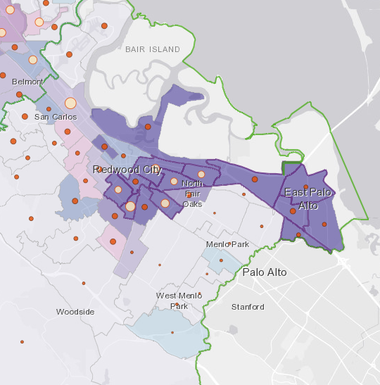
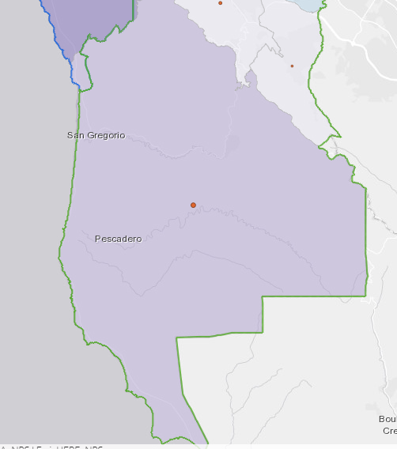
Communities we could serve better…

Slide 9
Mission
Vision
Cañada College engages and empowers students in transforming their lives and communities through quality education.
Cañada College provides equitable education such that students from diverse backgrounds are able to achieve their educational goals and benefit the world.

Slide 10
Values
Transforming Lives
Community Partnerships
Academic Excellence
Sustainability
Transparency and Authenticity
Student Centered
Cultural Empathy
Social Justice and Racial Equity
Antiracism
Equity
Inclusion
Diversity
Access
Liberation

Slide 11
Goals
Student Access, Success and Completion
Cañada College ensures student access to relevant and transformative student services and instructional programs that are inclusive, diverse, equitable, and antiracist. As an institution, Cañada contributes to the financial stability of students to empower them to pursue personal, academic, professional, and civic goals. Cañada College continuously assesses processes and removes barriers to student access, success, and completion.
Community Connections
Cañada College establishes equity-minded partnerships with other educational institutions, employers, governments, and community-based organizations that result in seamless pathways for high school students transitioning to college, college students transitioning to university, and all community members pursuing career, and lifelong educational opportunities.
Equity-Minded and Antiracist College Culture
Cañada College transforms its culture to be equity-minded and antiracist. Our teaching, learning, and services create a sense of belonging among all community members so they are able to recognize that their unique selves are valued, express themselves fully, and thrive. Our educational practices reflect the fundamental importance of individualized learning experiences, the shared building of knowledge, and promoting social justice at Cañada College.
Accessible Infrastructure and Innovation
College financial resources are well managed in support of the College’s values and to provide accessible physical and virtual spaces that promote continuous innovation and excellence in teaching and learning. Cañada’s investments in physical, technological and transportation infrastructure create sustainable, equitable access to the College and support equitable educational outcomes across the diverse members of the community we serve.

Slide 12
Strategy Topics Across the 4 Goals
Make registration easier
Connect students to the academic program(s) and classes they need
Ensure students (particularly part-time students) experience a sense of belonging and connection to the College that helps them persist and complete
Improve the financial stability of students
Support innovative teaching that creates more equitable and antiracist learning environments
Create and sustain an inclusive, antiracist, and equity-minded campus culture
Strengthen the college culture of continuous assessment and improvement in order to ensure all programs effectively serve students and close equity gaps
Better share what Cañada offers
Be the best college choice for local high school students
Strengthen K-16 pathways and transfer
Help students explore and find employment in fields of their choice
Help meet the basic needs of Cañada students and other community members
Ensure the physical campus is accessible
Provide adequate access to technology
Manage resources effectively

Slide 13

Data Inventory and Final Draft
Cañada College Internal Scan Summary
Cañada College Internal Scan Data Slides
Community Perceptions Questionnaire Results and External Scan Slides
San Mateo County Community College District External Scan
Cañada College Internal Equity Scan Report by Áse Power Consult
And many others… https://canadacollege.edu/emp/emp-data.php
Final Draft of the Educational Mater Plan for 2022-27 for adoption by the
Planning & Budgeting Council on May 18, 2022

Slide 14
Thank you

