Slide 1

Spring 2022 Enrollment at Cañada College
Prepared for the Planning and Budgeting Council
March 2, 2022
By the Office of Enrollment and Student Support Services and the Office of Planning, Research and Institutional Effectiveness (PRIE)

Slide 2
Outline
Context
Enrollment Landscape Data
Vaccination Attestation and Enrollment
Notable issues with Spring enrollment process
Possible areas for improvement

Slide 3
Data Sources: National Student Clearinghouse (US and CA); SMCCCD Data Warehouse (CAN)

Slide 4
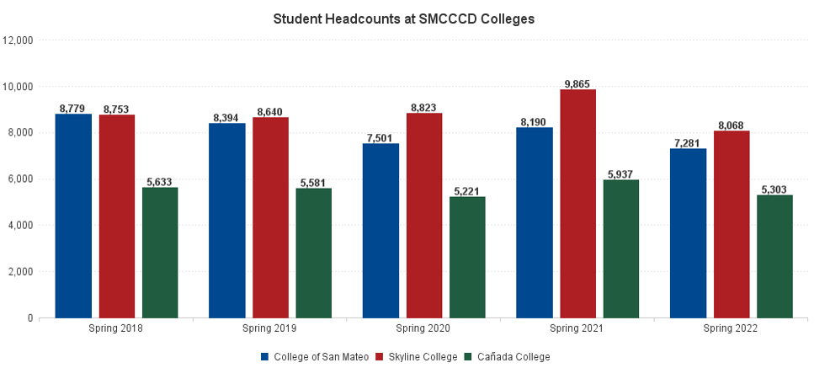
 | Headcount % change from Spring 2020 - Spring 2022
Cañada College | 2%
College of San Mateo | -3%
Skyline College | -9%

Slide 5
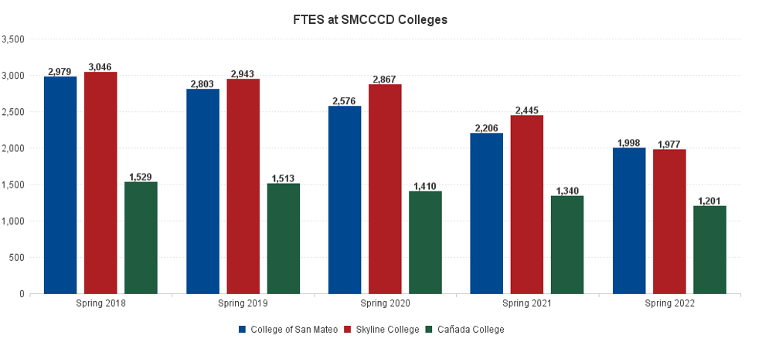
 | Full Time Equivalent Students (FTES) % change from Spring 2020 - Spring 2022
Cañada College | -15%
College of San Mateo | -22%
Skyline College | -31%

Slide 6
TOTAL HEADCOUNT at Cañada College | PRE-COVID % CHANGE (Fall 16 to Fall 19) |  | COVID % CHANGE (Fall 19 to Fall 21)
Unduplicated Headcount | (10.3%) |  | (10.0%)
Gender | PRE-COVID % CHANGE (Fall 16 to Fall 19) |  | COVID % CHANGE (Fall 19 to Fall 21)
Female | (12.9%) |  | (7.5%)
Male | (5.8%) |  | (13.9%)
Not Reported | (16.0%) |  | (4.6%)
Race/Ethnicity | PRE-COVID % CHANGE (Fall 16 to Fall 19) |  | COVID % CHANGE (Fall 19 to Fall 21)
American Indian/Alaskan Native | (11.1%) |  | (37.5%)
Asian | +1.2% |  | (9.3%)
Black - Non-Hispanic | (18.4%) |  | (22.6%)
Filipino | +4.8% |  | +42.2%
Hispanic | (18.1%) |  | (13.7%)
Pacific Islander | (18.4%) |  | +2.5%
White Non-Hispanic | (24.9%) |  | +0.1%
Multiraces | +7.5% |  | +22.6%
Unknown | +147.8% |  | (55.2%)
Age (calculated as of corresponding term) | PRE-COVID % CHANGE (Fall 16 to Fall 19) |  | COVID % CHANGE (Fall 19 to Fall 21)
Age Less Than 20 | +1.4% |  | +8.5%
Age 20 - 24 | (11.6%) |  | (13.1%)
Age 25 - 29 | (15.9%) |  | (20.9%)
Age 30 - 39 | (9.6%) |  | (19.8%)
Age 40 - 49 | (20.6%) |  | (13.0%)
Age 50 + | (18.8%) |  | (18.0%)

Slide 7
First Generation | PRE-COVID % CHANGE (Fall 16 to Fall 19) |  | COVID % CHANGE (Fall 19 to Fall 21)
First Generation | +0.6% |  | (7.6%)
Not First Generation | +8.5% |  | +4.2%
Unreported | (41.7%) |  | (37.9%)
Low Income | PRE-COVID % CHANGE (Fall 16 to Fall 19) |  | COVID % CHANGE (Fall 19 to Fall 21)
Low Income | (20.0%) |  | (22.5%)
Not Low Income | (0.1%) |  | +0.7%
ESL Students | PRE-COVID % CHANGE (Fall 16 to Fall 19) |  | COVID % CHANGE (Fall 19 to Fall 21)
ESL Students | (33.1%) |  | (54.3%)
Enrollment Status | PRE-COVID % CHANGE (Fall 16 to Fall 19) |  | COVID % CHANGE (Fall 19 to Fall 21)
Continuing Student | (11.0%) |  | (9.9%)
First-Time Student | +9.9% |  | (12.1%)
First-Time Transfer Student | (11.8%) |  | (28.6%)
Returning Student | (6.9%) |  | (17.9%)
Returning Transfer Student | (27.5%) |  | (17.2%)
Not Applicable, Currently K-12 | (22.5%) |  | +26.9%
Disabled Students | PRE-COVID % CHANGE (Fall 16 to Fall 19) |  | COVID % CHANGE (Fall 19 to Fall 21)
Disabled Students | +12.1% |  | (7.6%)
Recent High School Graduates | PRE-COVID % CHANGE (Fall 16 to Fall 19) |  | COVID % CHANGE (Fall 19 to Fall 21)
High School Grads | +21.9% |  | +0.2%

Slide 8
Cañada Unduplicated Headcount by Modality (NOTE: Some students are enrolled in multiple modalities.) | Fall 2021 | Spring 2022
FACE TO FACE | 401 | 1294
HYBRID | 209 | 772
ONLINE | 3175 | 2895
SYNCHRONOUS | 3226 | 1194
TOTAL | 5611 | 4570
Cañada Unduplicated Headcount by Type of Enrollment | Fall 2021 | Spring 2022
ENROLLED EXCLUSIVELY FACE-TO-FACE | 180 | 508
ENROLLED EXCLUSIVELY ONLINE | 1997 | 1922
ENROLLED EXCLUSIVELY HYBRID | 102 | 287
ENROLLED EXCLUSIVELY SYNCHRONOUS | 2043 | 554
ENROLLED IN FACE-TO-FACE AND AT LEAST ONE OTHER MODALITY, BUT NOT ENROLLED IN ALL MODALITIES | 219 | 766
ENROLLED IN ALL FOUR MODALITIES (FACE-TO-FACE, ONLINE, HYBRID, AND SYNCHRONOUS) | 2 | 20
ALL OTHER COMBINATIONS | 1068 | 513
ENROLLED IN TWO OR THREE DIFFERENT MODALITIES, BUT NOT ALL FOUR | 1287 | 1279

Slide 9
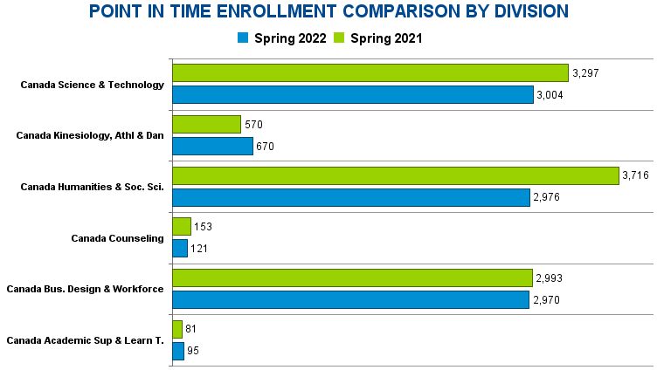

Slide 10
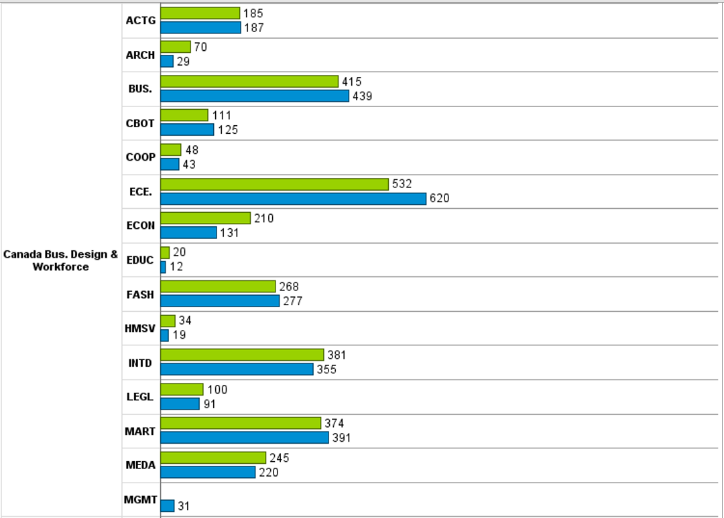

Slide 11
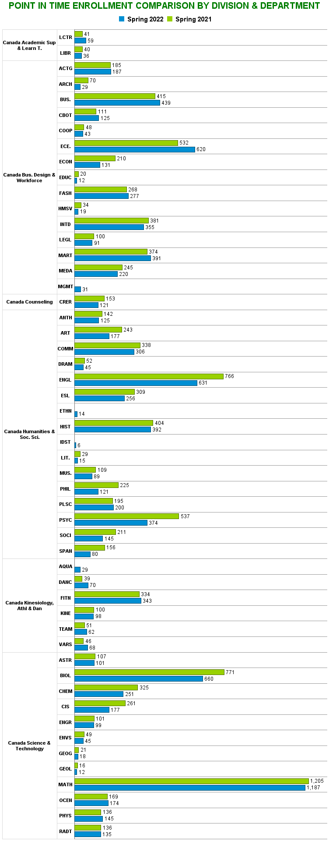

Slide 14
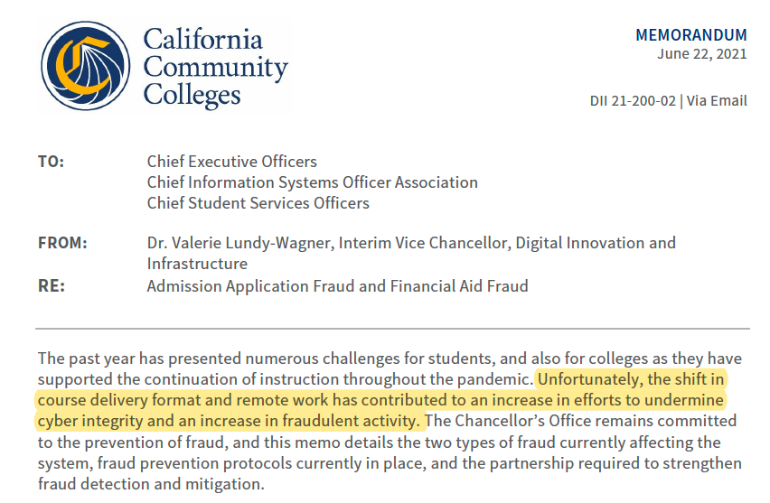
Notable issues with Spring enrollment process
    Link to the Fall 2021 Flex Day Session

Slide 15
Strategy to mitigate financial aid-related fraud
ITS extracts data and looks for "identifiers”
example: out of area address, no phone number, no home address, G# in certain sequence, no emergency address…
ITS add holds to stop disbursement and future registration
Financial Aid email students to confirm identity prior to the release of funds and registration holds
Report suspected Title IV (FA) fraud to the U.S. Department of Education’s Office of Inspector General (OIG)
Report Fraudulent activities every month to the CCCCO
Faculty
  It is vital that faculty drop inactive students by removing non-attending students by the Census date to significantly reduce the likelihood that financial aid is disbursed fraudulently.

Slide 16
Strategy to mitigate admission application fraud
Spam Filter Web Service
  Applications set with “Checked Fraud” are sent to the Suspension folder (User Interface) awaiting confirmation by A&R Staff
A&R staff review the applications in the SPAM folder
  Request additional documentation if necessary to confirm the status of the application
  Confirm the fraud status for each application

Slide 17
Strategy to mitigate admission application fraud
CCCApply Application SPAM Filter Folder Daily Verification Process:
(Confirm if the legal address is a “real address” on google maps for every student
  If “fake address” leave application in the SPAM Folder
  If identified as a “real address”, and has missing information
    A&R Staff. will reach out to the student both by email and phone call to inform them the application is incomplete:
      Email: will include the “Change of Personal Information” Form, which must be emailed back complete with a copy of a government picture ID.
      Once the form is received, the student application is updated and download into BANNER and student will receive the “Cañada College Welcome Letter
      Please Note: If the student doesn’t respond to either the email or phone message, a copy of the email is placed in a “Pending File” for follow-up or until the student reaches out to us

Slide 18
Self-Identified as a Homeless student
If the student selects the “I have no permanent address. I am currently homeless” box on the CCCAPPLY application, the application is downloaded directly into SWACCAP on BANNER.
Staff contacts the student and emails them the “Homeless Student Certification Form” which needs to be sent back to the Admissions Office to process.
We add the Cañada College address as their “Legal Address” and upload the application
We forward the completed “Homeless Student Certification Form” to both the Financial Aid and SparkPoint Teams, which they follow-up with student
An email confirmation is sent to student which also include both the Financial Aid and SparkPoint services information

Slide 19
Importance of Census
Helps FAO identify fraud!
Minimizes the amount of funds a student may have to repay!
Minimizes the amount of institutional liabilities!

Slide 20
Notable issues with Spring enrollment process
 | October | November | December | January
Number of fraudulent admission applications identified | 418 | 136 | 322 | 465
Number of fraudulent enrollments identified | 0 | 1 | 1 | 0
Number of fraudulent financial aid applicants (Not Registered for classes) | 90 | 77 | 49 | 2
Amount of federal, Cal Grant, and other local financial aid issued to fraudulent individuals | 0 | 0 | 0 | 0

Slide 21
Vaccination Attestation and Enrollment
Total student enrollment Spring 2022 (headcount) | 5267
Vaccination Approved | 2444
Vaccination Declined | 15
Decline to State | 25
Medical Exempt App | 2
Religious Exempt App | 21

Slide 22
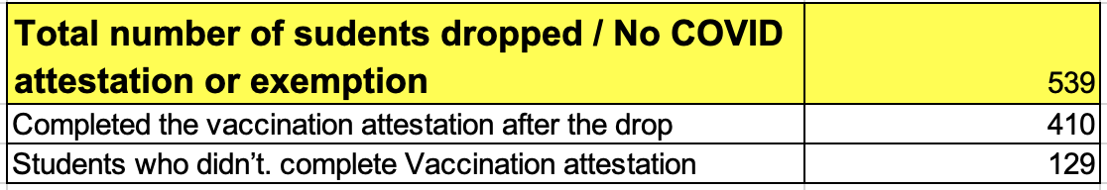
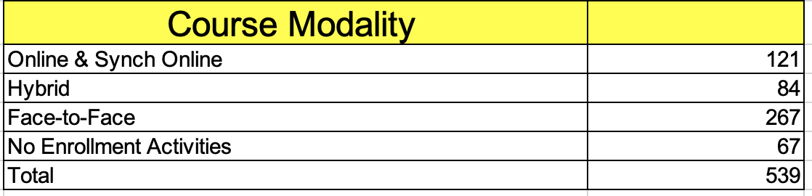
Vaccination Attestation and Enrollment
First COVID Drop Date | 11/19/21
Last COVID Drop Date | 1/15/22
What Happen to the dropped students?

Slide 23
Attestation for Summer & Fall 2022
Students currently approved for in-person services will be able to enroll in Summer and Fall 2022 automatically.
To register for in-person classes and receive in-person services, you must provide proof of vaccination or qualify for an exemption
If you do not provide proof of vaccination or if you are not approved for an exemption, you may only register for online courses and receive virtual and remote support services

Slide 24
Q&A

Slide 25
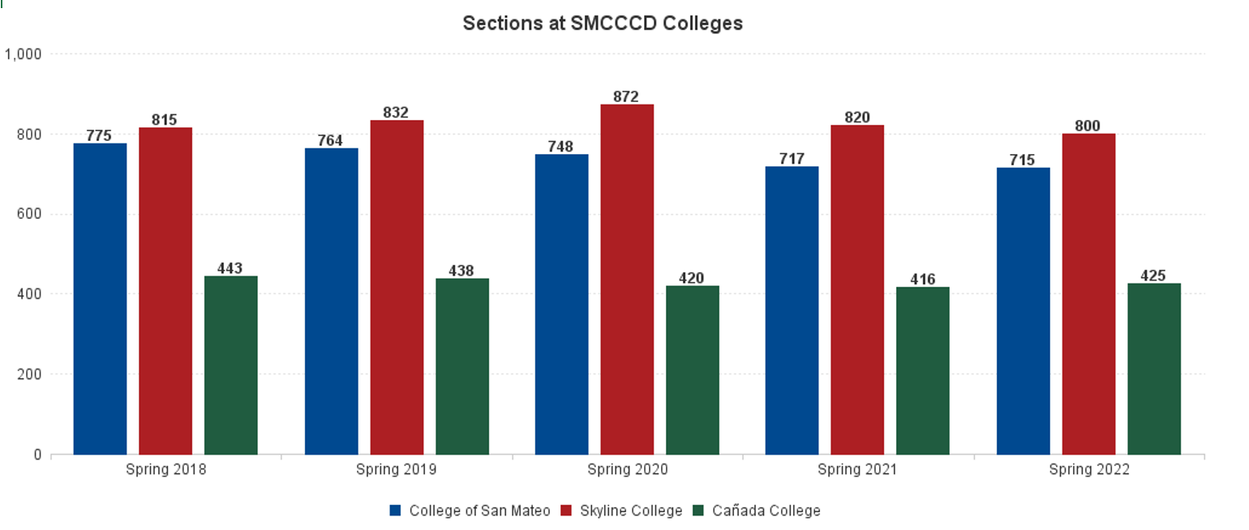

Slide 26
Cañada Unduplicated Headcount Percentages by Modality (NOTE: Some students are enrolled in multiple modalities, so the percentages will not sum to 100%.) | Spring 2021 | Fall 2021 | Spring 2022
FACE TO FACE | 2.8% | 7.1% | 28.3%
HYBRID | 3.6% | 3.7% | 16.9%
ONLINE | 63.6% | 56.6% | 63.3%
SYNCHRONOUS | 55.2% | 57.5% | 26.1%
Cañada Unduplicated Headcount Percentage by Type of Enrollment | Spring 2021 | Fall 2021 | Spring 2022
ENROLLED EXCLUSIVELY FACE-TO-FACE | 0.6% | 3.2% | 11.1%
ENROLLED EXCLUSIVELY ONLINE | 41.9% | 35.6% | 42.1%
ENROLLED EXCLUSIVELY HYBRID | 0.8% | 1.8% | 6.3%
ENROLLED EXCLUSIVELY SYNCHRONOUS | 33.7% | 36.4% | 12.1%
ENROLLED IN FACE-TO-FACE AND AT LEAST ONE OTHER MODALITY, BUT NOT ENROLLED IN ALL MODALITIES | 2.2% | 3.9% | 16.8%
ENROLLED IN ALL FOUR MODALITIES (FACE-TO-FACE, ONLINE, HYBRID, AND SYNCHRONOUS) | 0.0% | 0.0% | 0.4%
ALL OTHER COMBINATIONS | 20.8% | 19.0% | 11.2%
ENROLLED IN TWO OR THREE DIFFERENT MODALITIES, BUT NOT ALL FOUR | 23.0% | 22.9% | 28.0%

