Slide 1

Antiracism Task Force Recommendations, EMP and work with Áse Power Consult (APC)
Update for the
Planning & Budgeting Council (PBC)

Slide 2
Antiracism
Educational Master Planning
Support from Áse Power Consult

Slide 3
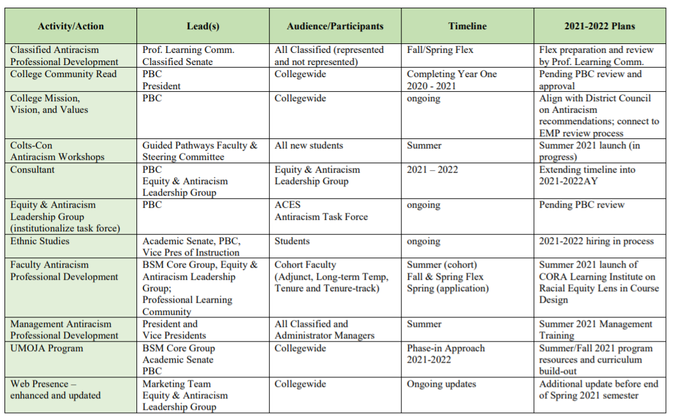
Cañada Antiracism Task Force Recommended Actions (approved by PBC)

Slide 4
Professional Development Sessions with Áse Power Consult Team:
October 13th
FLEX DAY
January 14th
FLEX DAY
One Session for Each:
Managers
Faculty
Classified Staff
One Session for Each:
Managers
Faculty
Classified Staff

Slide 5
Cañada Antiracism Task Force Recommended Actions (approved by PBC)

Slide 6
Cañada Antiracism Task Force Recommended Actions (approved by PBC)

Slide 7
Educational Master Planning (EMP) Task Force to lead review and propose revisions to our College Mission, Vision & Values
EMP Task Force Session #1 on Mission, Vision, Values
September 29, 2021
EMP Task Force Session #2 on Mission, Vision Values
October 6, 2021
College-wide Flex Day activity to consider EMP Task Force recommendations
October 13, 2021

Slide 8
Cañada Antiracism Task Force Recommended Actions (approved by PBC)

Slide 9
Cañada Antiracism Task Force Recommended Actions (approved by PBC)

Slide 10
Cañada Antiracism Task Force Recommended Actions (approved by PBC)

Slide 11
Cañada Antiracism Task Force Recommended Actions (approved by PBC)

Slide 12
Cañada Antiracism Task Force Recommended Actions (approved by PBC)

Slide 13
Major components of Áse Power Consult’s work
Listening sessions: classified staff, faculty, students, managers, open (2-3)
  Input on our college mission, vision and values
Online portal for submitting perspectives, suggestions, feedback
Cultural Audit (assessment of campus culture)
Internal Equity Scan
Professional Development for managers, faculty, and staff
Toolkits and resources to support our antiracism and diversity, equity and inclusion efforts
Recommendations for strengthening and being successful in our antiracism and diversity, equity and inclusion efforts

Slide 14
Educational Master Planning Process & Timeline
PBC names EMP Task Force Members
EMP Task Force evaluates 2017-22 EMP
SCUP Training in Strategic Planning
Mission, Vision, Values Update
EMP TF considers “Internal Scan”
EMP TF considers “External Scan”
College Councils provide input on challenges and opportunities
Town Hall
Winter 2021
Spring 2021
September 2021
October 2021
EMP Retreat: Set goals and new strategies
Campus constituents provide input on draft EMP
PBC considers draft EMP
PBC adopts new EMP for 2022-27
October 2021
November 2021
December 2021
February 2022
February 2022
March 2022
April 2022
May 2022

Slide 15
Educational Master Planning Process & Timeline
PBC names EMP Task Force Members
EMP Task Force evaluates 2017-22 EMP
SCUP Training in Strategic Planning
Mission, Vision, Values Update
EMP TF considers “Internal Scan”
EMP TF considers “External Scan”
College Councils provide input on challenges and opportunities
Town Hall
Winter 2021
Spring 2021
September 2021
October 2021
EMP Retreat: Set goals and new strategies
Campus constituents provide input on draft EMP
PBC considers draft EMP
PBC adopts new EMP for 2022-27
October 2021
November 2021
December 2021
February 2022
February 2022
March 2022
April 2022
May 2022

Slide 16
Educational Master Planning Process & Timeline
PBC names EMP Task Force Members
EMP Task Force evaluates 2017-22 EMP
SCUP Training in Strategic Planning
Mission, Vision, Values Update
EMP TF considers “Internal Scan”
EMP TF considers “External Scan”
College Councils provide input on challenges and opportunities
Town Hall
Winter 2021
Spring 2021
September 2021
October 2021
EMP Retreat: Set goals and new strategies
Campus constituents provide input on draft EMP
PBC considers draft EMP
PBC adopts new EMP for 2022-27
October 2021
November 2021
December 2021
February 2022
February 2022
March 2022
April 2022
May 2022

Slide 17
EMP Process Open to Everyone
Schedule, Agendas and Materials here:
https://canadacollege.edu/emp/meetings.php

