Slide 1
Position Request Presentation
November 16, 2022
Position: Admissions & Records Assistant III
Requested by Admissions & Records

Slide 2
Request
Permanent Full-Time Admissions & Records Assistant III will…
Support our students more efficiently
Increase student access and success
Support Cañada’s goal to build and expand our Dual Enrollment team
Manage projects more effectively
Provide more support to special programs
Participate in more outreach and in-reach events
Improve the A&R response time to requests from the campus community
Notes:
Student Support Services have increased over the years which require assistance from the Admissions Office, however, the staffing has remained the same

Slide 4
WEAKNESSES
Slow response times
Less flexibility due to inadequate staffing
Not enough cross training between staff
Minimal outreach

Slide 5
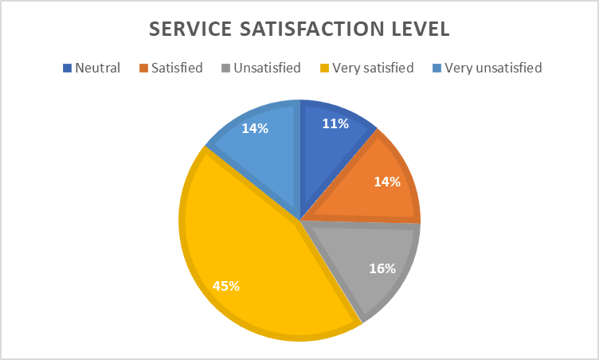
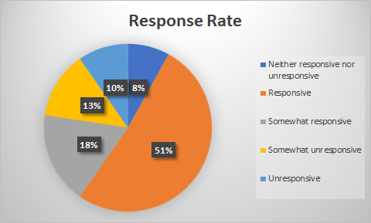
SAO: As a result of the implementation of “ContactUS form” students will be aware of the services provided by A&R. By using the "ContactUS" form, students will be more satisfied with A&R services.
SAO Student Survey Outcome
Were your satisfied with the overall quality of service you received from the Admissions and Records Office at Cañada College?
Around 30% Not Satisfied
How responsive were the Admissions and Records staff when you interacted with them?
Around 30% Unresponsive

Slide 6
Increased Workload for 2020-2022
Reviewed/Processed over 19,283 New & Returning Students
Both College and Concurrent Enrollment
Processed over 2,145 registration related petitions:
Residency Reclassification
Extenuating Circumstance
Late Add
Course Overlap
Course Repeat
Prerequisite Challenge & Equivalency
Student Records Merge
6 Unit or Less Non-Res Fee Waiver
1,300 “ContactUs” inquiries
Received roughly over 250k emails and phone calls
Evaluated 2,200 Grad Petitions
Awarded 1,736 Degrees & Certificates
Processed over 300 Enrollment Verifications
Processed over 150 Credit-by-Exam
Processed over 9,490 transcript requests & 350 CSU GE/IGETC Certifications
Processed over 300 final grade changes
Scanned over 1,900 incoming transcripts
Proofread over 2,200 student names for both Class 2021, 2022
Notes:
Pandemic impacted our student services
Which is why a huge increase on email/phone calls

Slide 7
SMCCD Dual Enrollment Expansion
Admissions & Records Assistant III position will support Cañada College’s goal to build and expand our Dual Enrollment team. Scanned over 1,600 incoming transcripts
The Admission & Records Assistant III is critical to the college’s efforts to expand the implementation of our local and statewide initiatives for Early College, specifically Assembly Bill 30 for College and Career Access Pathways (CCAP), California Community College Linked Learning Initiatives (CCCLLI), and SMCCCD initiatives for the expansion of Dual Enrollment and Early College opportunities for San Mateo County
Anticipated Growth
 |  |  |  | 2021-22 | 2022-23 | 2023-24
Cañada College |  |  |  | 250 | 500 | 1,000
SMCCCD |  |  |  | 3,600 | 5,000 | 7,000
% of San Mateo County 11th & 12th Graders |  |  |  | 24% | 34% | 48%
Notes:
Pandemic impacted our student services
Which is why a huge increase on email/phone calls

Slide 8
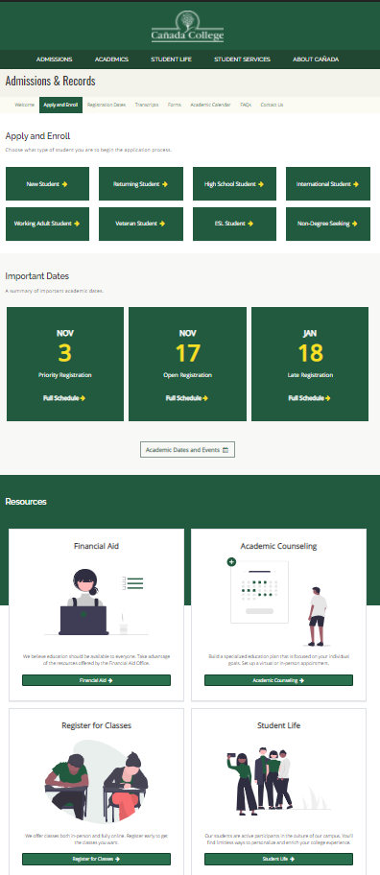
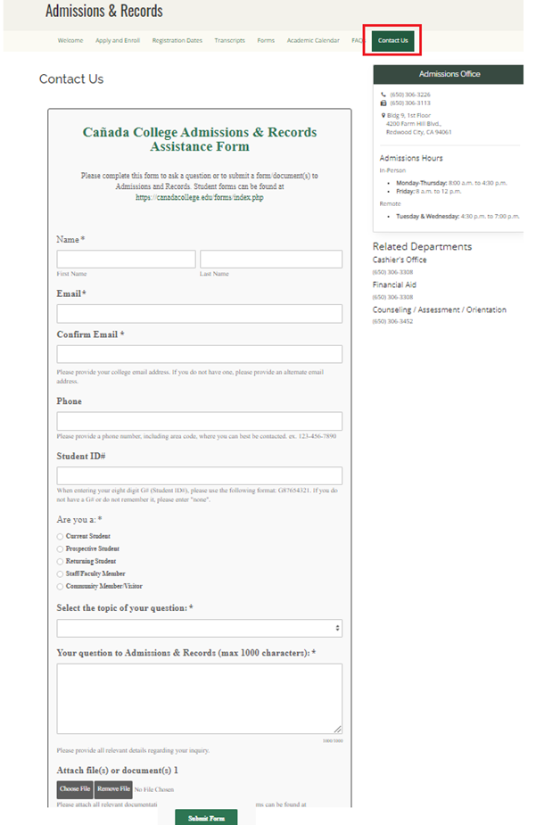
Rebranding A&R
Updated our Admissions & Records Website
Spanish website coming soon
Implemented a new A&R communication/petition submission process through "Contact Us" form
Created five "How to Videos" both in Spanish/English in Spring 2022
More visible at on/off campus student events
Partnered with Parchment for the printing and mailing of our diplomas, including digital diploma
Collaborated with the SSL K-12 new process
Extended our Late Registration evening hours

Slide 9
Rebranding A&R (Con’t)
Implemented the 6 unit or Less Non-Resident Fee Waiver
Currently involved in the 1.1 Make Registration Easier Task Group
Collaborated on the SB 893 Fee Waiver for SMC Residents SOP
Collaborated & implemented the VA Student SSL in CRM
Sent out the “ContactUs” customer service student survey
Improve A&R Services communication
More than just Admissions and Records....

Slide 10
Collaborate & Support Special Programs
Promise Scholars Program
Dual Enrollment
Eso Adelante Program
DREAM Center
Outreach/Dual Enrollment
SparkPoint
EOPS, CARES, CalWorks
TRIO Upward Bound
Foster Youth Success
College for Working Adults
Umoja & Puente
Notes:
Currently Support and collaborate Special Progrmas
Promise Scholars Program
Etc..
Will work closely with the DREAM Center to better assist our undocumented students, effective Spring 2022 term

Slide 11
Impact on Marginalized students
Supports College missions & strategic goals by:
Student First philosophy when working with our marginalized student population
Fostering student confidence to engage in academic and career training
Making the admissions process informative, accessible, inclusive and supportive
Streamlining the A&R process for our ESL students
Supporting and collaborating Student Services Programs
Promise Scholar, Dual Enrollment, EOPS, CARE, CalWORKs & FFYSI, TRiO, DRC, Umoja, Puente, etc.
A&R Liaison to Financial Aid, SparkPoint, VROC, Dreamers
Enacting our college commitments, as described in our college's Antiracist Framework (PBC, Adopted, 4/21/2021)

Slide 12
How does supporting Dual Enrollment close the equity gap?
Removing systematic barriers by providing onboarding support with a dedicated A&R III Assistant
CCCApply support, technological support, navigational support, processing Forms,
Supports with enrolling students in CCAP classes and sharing a final roster with Dual Enrollment staff; drops students from CCAP classes when advised by Dual Enrollment PSC
Continuation of Antiracist work to provide support to minoritized students
Intentional one-on-one assistance to our communities of color
Assist students and parents with completing additional documentation required by A&R, such as guardianship and change of information documents.
Increasing capacity to serve prospective CAN students from underserved communities
i.e. first-gen, undocumented students, low-income students, former foster youth, homeless students

Slide 13
How does this position close the equity gap?
Equity Gap
A&R liaison to Financial Aid, SparkPoint, Dreamers
Enacting our college commitments, as described in our college's Antiracist Framework (PBC, Adopted, 4/21/2021)
Increased outreach to our underserved communities
Faster processing times for A&R forms
Streamlining the admissions and registration process for our ESL students
Making the admissions process informative, accessible, inclusive and supportive

Slide 14
If filled…
Help our marginalized students and communities by providing services in a timely manner
Directly address student inequities
Less roadblocks
Support our students more efficiently
Less student complaints
Strengthen our relationship with students, and both campus/off campus community
Remain Title V compliant and stay current with our prior records
A&R website, how-to-videos, and social media up to date
Assist the Dual Enrollment team with the SMCCD anticipated growth

