Slide 1

Program Review
New Position Request Presentation
Position: Assistant Director for PSP
Requested by: Mayra Arellano

Slide 2

San Mateo County Community College District's Promise Scholars Program (PSP) helps first time, full time students earn certificates and associates degrees within two to three years by providing comprehensive financial, counseling, and academic supports. Students receive dedicated academic counseling, personalized career development, tutoring, enrollment fee waivers, textbook assistance, and transportation assistance to support their enrollment, completion, and transfer/career goals.
Mission
Notes:
Mayra

Slide 3
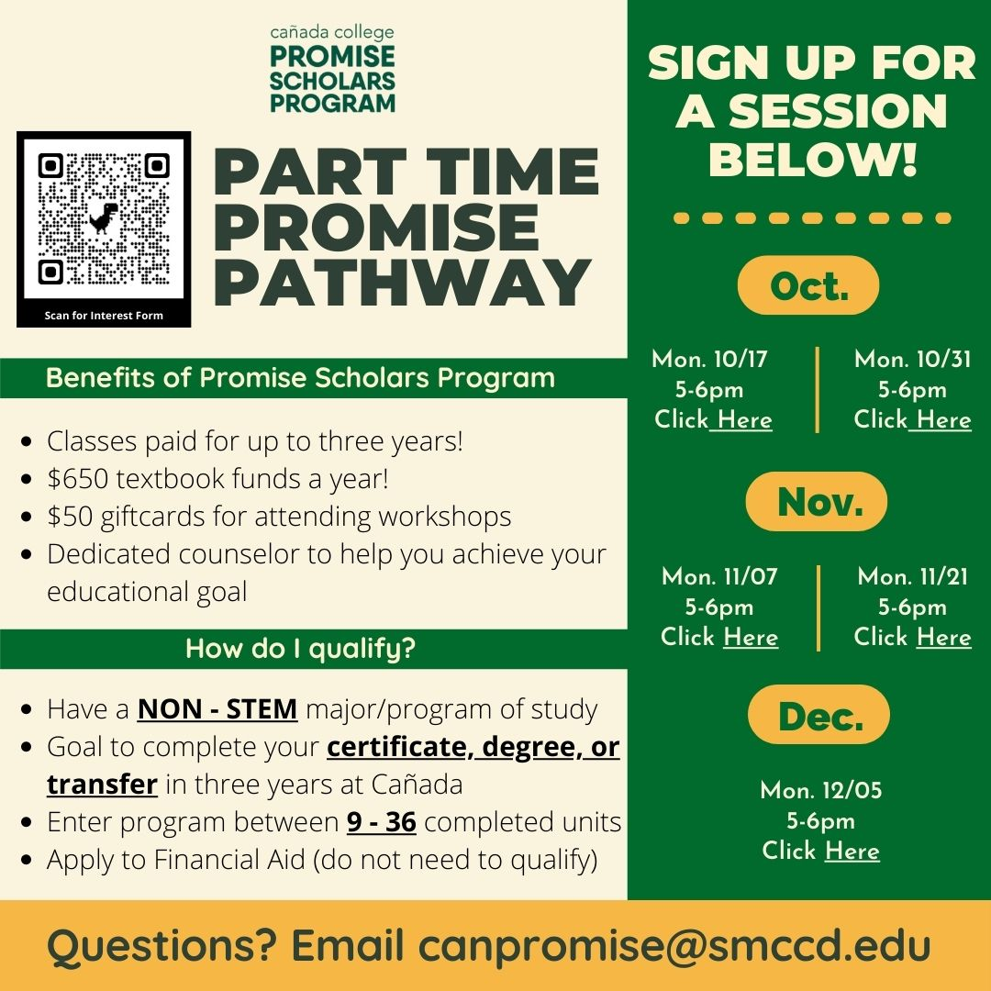
PSP Expansion- Part Time Promise Pathway
Notes:
Mayra

Slide 4
Current
Responsibilities
Director of HS Transition and Dual Enrollment
Dual Enrollment
Part Time Promise Program
Full Time Promise Program
Supporting Outreach Office
Assistant PSP Director
Notes:
Mayra

Slide 5
SMCCCD PSP Expansion
 | 2019-20 (Actuals) | 2020-21 (Actuals) | 2021-22 (Target) | 2022-23 (Target) | 2023-24 (Target)
Skyline College | 756 | 738 | 950 | 1,125 | 1,500
College of San Mateo | 737 | 665 | 950 | 1,125 | 1,500
Cañada College | 493 | 473 | 600 | 750 | 1,000
# SMCCCD Promise Students | 1,986 | 1,876 | 2,500 | 3,000 | 4,000
Notes:
Ariela

Slide 6
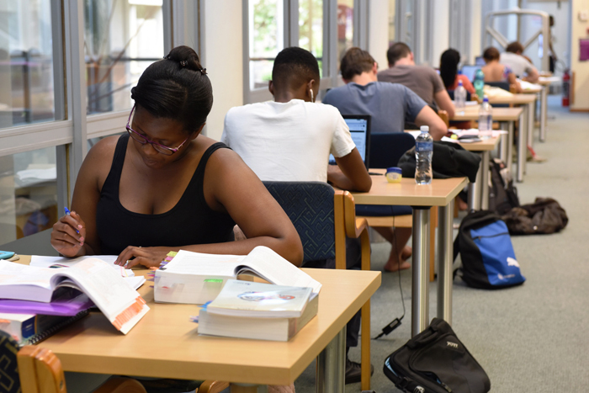
Part Time Program Focus:
Areas of Growth:
In-person attendance of counseling appointments and on campus events
Embedded Tutors
Low enrollment due to COVID
Continue expanding i.e. staff, assistant director
Students working to support their families (65% of our students work +20 hrs)
Adult scholars who may not qualify for FA due to PT status
Notes:
Ariela

Slide 7

Assistant Director
Personnel Request
Job Duties:
  Dedicated leader that will be able to work closely with the Promise team, ensuring that all students have equitable access and opportunities to pursue their educational, career, and personal goals
  Strengthen the management of the Promise Scholars team to support the anticipated growth of 1,000 students by AY 2023-2024
  Oversee matters related to planning, development, budgeting, implementation, compliance with rules and regulations, monitoring, and evaluation of programs and activities
  Support ongoing efforts to expand our Part-Time PSP Model
Notes:
Mayra

Slide 8

How does this resource request support closing the equity gap?
Manage and execute support service initiatives that support equitable access and opportunities for students in PSP
Ensure to maintain program enrollment, goals, and progress
Create and lead student-centered practices and policies that support persistence and completion efforts
Enhance our collaborative efforts with the Community Outreach office to help high school students transition into Promise and other first year learning communities such as EOPS, Dual Enrollment, STEM Center, CWA, TRIO, Puente, ¡ESO! Adelante, Athletics
Continue ongoing community building ie: Boys and Girls Club, North Fair Oaks community, feeder high schools
Aligned with the proposed district wide expansion of a 1,000 students by 2023
Notes:
Ariela and Mayra

Slide 9

Requested Allocation
Grade 27
Step 3
Annual Cost: $75636
100% Fund 1
Notes:
Mayra

Slide 10
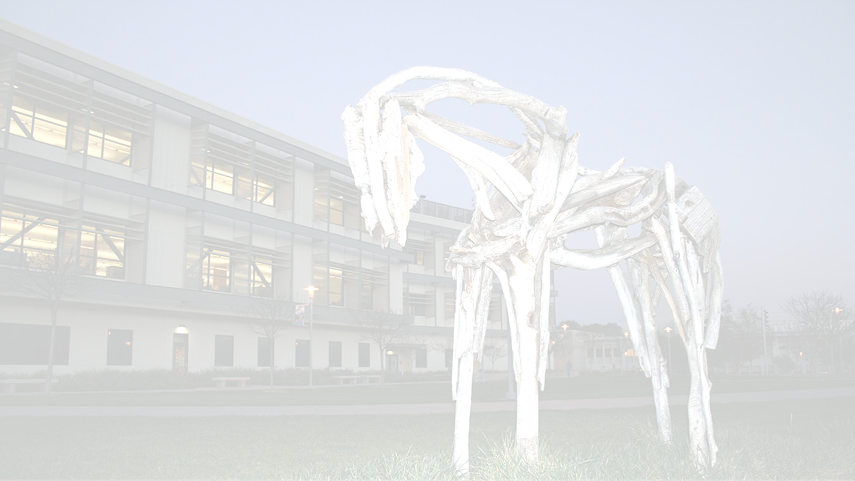
Thank You
Thank You!
Any Questions?

