Slide 1

Institution-Set Standards and College Scorecard: review of college goals, metrics, and outcomes
Presented to the Planning & Budgeting Council
December 7, 2022
(slide 11 revised to include SYNC courses on Jan 3, 2023)
By the Office of Planning, Research & Institutional Effectiveness

Slide 2
What are “institution-set standards”?
ACCJC Standard I.B.3 states: “The institution establishes institution-set standards for student achievement, appropriate to its mission, assesses how well it is achieving them in pursuit of continuous improvement, and publishes this information.”
  Standards are the “floor” or minimum acceptable outcome
  Goals are what we are stretching or aspiring to achieve

Slide 3

College Scorecard Elements
Enrollment Management
Student Momentum
Student Completion
Guided Pathways
Students Employment Outcomes

Slide 4
College Scorecard Update Needed?
Metrics derived from:
Accreditation requirements
Chancellor’s Vision for Success
2019-22 Student Equity Plan (which was just updated
2020-23 Strategic Enrollment Management Plan (which we are in the process of updating)
Metrics proposed and adopted in Fall 2020 which are difficult to operationalize/measure or might be reconsidered

Slide 5
Enrollment Management
Goal: 9.8
Goal: 11,124
Fall 2022: 8.3 avg units taken
‡ indicates years affected by the COVID-19 pandemic

Slide 6
Home Campus Students
Note: Home campus is defined as a student with the goal of earning a degree, certificate, transfer, or completing their educational goal at Cañada.

Slide 7
Enrollment Management
Goal: 1.196
Goal: 525
Goal: 109
‡ indicates years affected by the COVID-19 pandemic

Slide 8
Enrollment Management
Goal: 125
In our EMP and new MOU with Sequoia Union HSD, we have a new goal of doubling the size of Middle College to 206 by 2027.
Goal: 387
Our EMP calls for increasing dual enrollment opportunities for high school students (133 enrolled in Fall 2022!) and tripling the number of high school students on campus during the summer and on Saturdays during the academic year by 2027.
‡ indicates years affected by the COVID-19 pandemic

Slide 9
Student Momentum: Persistence
Goal: 66%
‡ indicates years affected by the COVID-19 pandemic

Slide 10
Student Momentum: Course Success
Goal: 77%
‡ indicates years affected by the COVID-19 pandemic

Slide 11
Disproportionately Impacted Students by Instructional Modality
= statistically significant differences

Slide 12
Student Momentum: transfer gateway course completion

Slide 13
Student Completion: degrees & certificates
Goal: 832
‡ indicates years affected by the COVID-19 pandemic

Slide 14
Student Completion: time to completion
‡ indicates years affected by the COVID-19 pandemic

Slide 15
Student Completion: # of online programs

Slide 16
Student Completion: transfers
Goal: 468
‡ indicates years affected by the COVID-19 pandemic

Slide 17
Guided Pathway Metric | Goal | Fall 2020 Institution-Set Standard | 2021-2022‡ | 2020-21‡ | 2019-20‡ | 2018-19 | 2017-18
# of Home Campus students |  |  | 5,486 | 5,774
# of Home Campus students in an Interest Area |  |  | 3,426 | 4,695
# of students in Art, Design, and Performance |  |  | 479 | 748
# of students in Business |  |  | 791 | 900
# of students in Human Behavior and Culture |  |  | 1,002 | 1,556
# of students in Science and Health |  |  | 1,224 | 1,592
# of students Undecided/University Transfer |  |  | 2,574 | 1,266
% supported by ONLY success teams |  |  | 29.9% | 35.9%
# of students served by Success Teams or Special Programs |  |  | 3,051 | 3,598
% of all students supported by Success Teams or Special Programs |  |  | 55.6% | 62.3%
# of students participating in non-curricular career exploration (COOP Ed, Field trips, Job Shadows, Internships) (only Coop listed here as other data is not available or not tracked centrally) |  |  | 77 | 84 | 235 | 214 | 176
% of students "touched" by outreach who apply/enroll – difficult to operationalize this metric
% of first-time students participating in First Year Experience programs |  |  | 5.0% | 5.4% | 3.7%
% of Transfer Seeking Students supported by the Transfer Center, University Center and/or Success Teams or Affinity Groups (revise?) |  |  | 100%
% of Transfer Seeking Students supported by the Success Teams or Affinity Groups (revise?)
% of Transfer Seeking Students supported by the Transfer Center, University Center (revise?) |  |  | 100%

Slide 18
Student Employment Outcomes
Goal: 89%
Source: Annual survey of Career Technical Education program graduates (CTEOS)

Slide 19
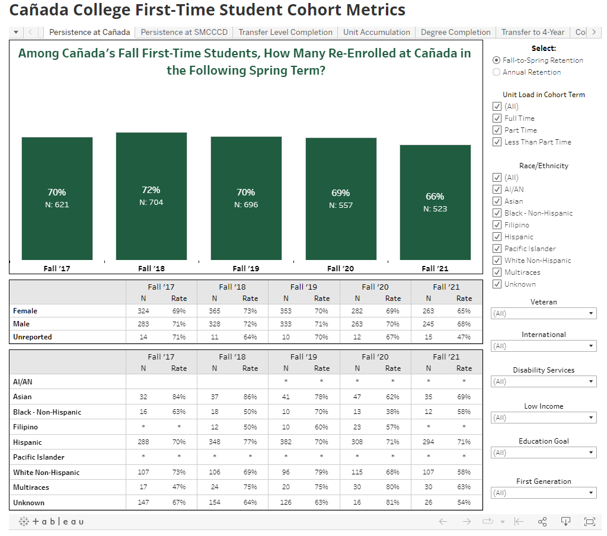
First-Time Cohort Dashboard
https://canadacollege.edu/prie/dashboards/scorecard-enrollment.php

