Slide 1
Position Proposals:
Communications Manager
and
Web & Content Promotions Coordinator

Slide 2
The Need
Mitigate declining enrollment and support retention efforts
Tells the story of who we are, how we support community and why to choose Cañada College to achieve your goals
Responding to pandemic demand for more digital content and media
Expand digital marketing services to better serve campus community needs
Supports current and future needs of Cañada’s departments, programs, students and college leadership
Ensures ongoing and effective engagement with our community including prospective students, their parents, businesses, local government leaders and partner high schools

Slide 3
Supporting District/College Goals & Strategic Initiatives
The positions align with and supports…
Collegewide Planning

Slide 4
Supporting District/College Goals & Strategic Initiatives
Positions align with and supports…
SMCCCD Board goals/strategic initiatives and District Strategic Plan
Free Community College (SB 893)
Focus on Strategies to Increase: Student Enrollment, Dual Enrollment and Promise Scholars
This is accomplished through…
Creation of current, engaging and attractive content for the college website, social media channels, multimedia and internal/external college communications

Slide 5
Supporting District/College Goals & Strategic Initiatives
Aligns with several EMP Community Connections goals to strategic initiatives:
1.1 -- Make Registration Easier
3.1 -- Update marketing and outreach to be culturally informed
3.2 -- Reach new community members in N. Fair Oaks, Belle Haven, and East Palo Alto, especially BIPOC communities
3.3 -- Utilize relevant social media and websites to ensure we reach a diverse, inclusive audience
3.4 -- Increase dual enrollment opportunities for high school students

Slide 6
18+ New & Expanded Programs/Services Over 5 Years
Guided Pathways
Basic Needs
SparkPoint
Promise Scholars Program
Free College Initiative/SB 893
CRM
Strong Workforce
Career Education
ESO Adelante
Umoja
DREAM Center
Dual Enrollment
CARES
Project Change
Expansion of services in the Wellness Center
Expansion of the service in the Learning Center
New Buildings (B1 & B23) with increased digital technology/wayfinding
Special event support and marketing- program and collegewide

Slide 7
Increase of Campus Community Service Needs
94% increase in overall marketing requests from 2019 vs 2022, specifically:
121% increase in web support
78% increase in communications assistance
23% of requestors from the college community asked to speak with someone from the Marketing Department regarding their project.

Slide 8
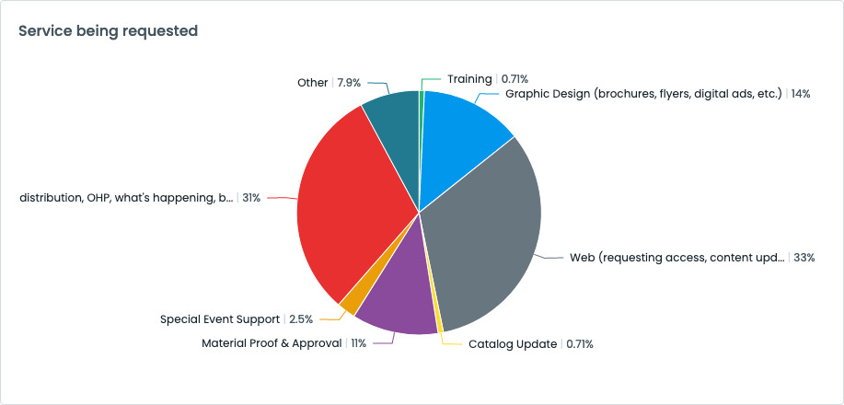
Increase of Campus Community Service Needs
Requests from January 1 – November 1, 2022:

Slide 9
Proposed Positions
Communications Manager
$91k—116k salary range + benefits
5+ years of experience
Promotions & Web Content Coordinator (CSEA represented)
$75k – 96k salary range + benefits

Slide 10
Proposed Organization Chart

Slide 11
Comparison Organization Chart

Slide 12
Communications Manager
Tells the story of who we are, how we support community and why to choose Cañada College to achieve your goals
Supports the Director with a focus on content development for community engagement, campus stories and reports
Advances social media and online marketing strategy to increase awareness and drive enrollment highlighting our programs and services available at Cañada College.
Leads digital marketing and photography
Coordinates all collegewide translation services
Responsible for story idea assignments for college content partners
Manages student assistant project assignments
Coordinates all creative efforts
Serves as back-up PIO

Slide 13
Web Promotions & Content Coordinator
Develops and deploys the College’s overall presence (including content and information architecture) for the college website
Daily review of web content on all 15,500+ pages on college website, ensuring content is current, impactful, maintains accreditation standards and aligns with college mission, collegewide plans and commitment to anti-racism
Design and manage on-campus digital monitors and signage
Events Calendar management
Supports campus with departmental webpage updates
CRM Coordination: developing template emails for matriculation and general automated communications and K-12 CRM implementation
Provide user training & documentation on Omni CMS and provide continuing support
Manage college multi-media pages (YouTube and Flickr): upload and caption video content
Supports social media, video and digital messaging

Slide 14
Without the Positions
Without a robust staff, hard to support the entire college community
Missed enrollment and promotion opportunity to connect with prospective and current students to enhance awareness of programs and services offered at Cañada College
Not responding to demand for more digital forms – Formstack, web and social media content, etc.
Work will remain primarily reactionary with minimal time for proactive, strategic marketing and communications planning to enhance our work to increase enrollment
Continued increased work load and turnaround time for existing campus requests

Slide 15
Questions?
Sample Text in Franklin Gothic Book
Border is in Yellow. Copy picture and right-click -> replace picture

