Slide 1

Program Review
New Position Request Presentation
Position: Financial Aid PSC-Promise
Requested by: Mayra Arellano

Slide 2

San Mateo County Community College District's Promise Scholars Program (PSP) helps first time, full time students earn certificates and associates degrees within two to three years by providing comprehensive financial, counseling, and academic supports. Students receive dedicated academic counseling, personalized career development, tutoring, enrollment fee waivers, textbook assistance, and transportation assistance to support their enrollment, completion, and transfer/career goals.
Mission

Slide 3
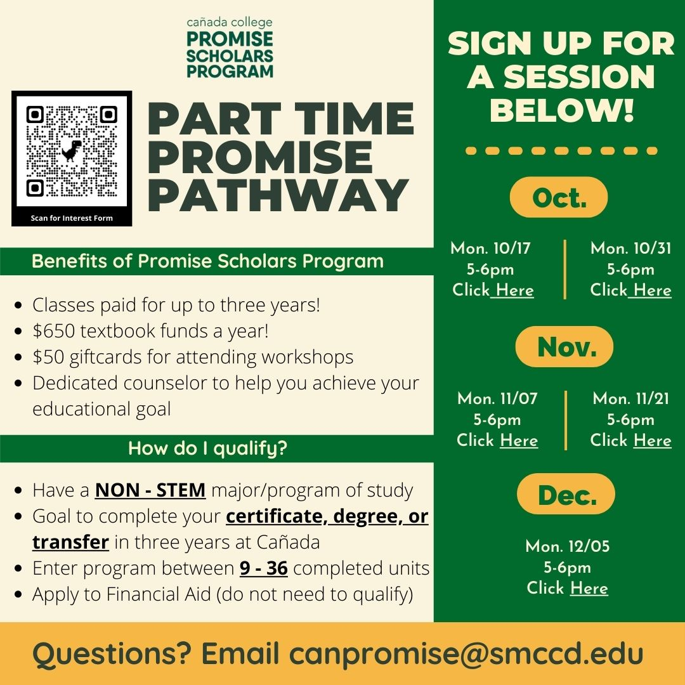
PSP Expansion- Part Time Promise Pathway
Notes:
Mayra

Slide 4
SMCCCD PSP Expansion
 | 2019-20 (Actuals) | 2020-21 (Actuals) | 2021-22 (Target) | 2022-23 (Target) | 2023-24 (Target)
Skyline College | 756 | 738 | 950 | 1,125 | 1,500
College of San Mateo | 737 | 665 | 950 | 1,125 | 1,500
Cañada College | 493 | 473 | 465 | 750 | 1,000
# SMCCCD Promise Students | 1,986 | 1,876 | 2,500 | 3,000 | 4,000

Slide 5

Financial Aid Program Services Coordinator
Personnel Request
Job Duties:
Develop and execute a plan aimed at increasing FA awareness-focus on minoritized students
Serve as liaison for FA and PSP to support campus-wide FA campaign
Provide one-on-one financial aid support for prospective students, continuing students and transfer-bound students
Develop and present workshops on FAFSA and CADAA to high school partners and the larger community
Cash For College, "I Can Afford College."
Create and facilitate scholarship workshops
Continuing students and FA annual renewals
Collaboration with other support programs such as EOPS, TRIO, DRC, Sparkpoint, Dream Center, Transfer Center, etc
Maintain a variety of FA files, records, and databases; prepare reports and correspondences
Notes:
Ariela

Slide 6

Student Access, Success and Completion
Supporting our EMP Goals
"Cañada College ensures student access to relevant and transformative student services and instructional programs that are inclusive, diverse, equitable, and antiracist. As an institution, Cañada contributes to the financial stability of students to empower them to pursue personal, academic, professional, and civic goals. Cañada College continuously assesses processes and removes barriers to student access, success, and completion."
Student-centered practices and policies that support persistence and completion efforts
Reduce financial barriers by assisting students in completing their financial aid application annually

Slide 7

How does this resource request support closing the equity gap?
Removing systematic and financial barriers
Continuation of Antiracist work to provide support to minoritized students
Intentional one-on-one assistance to our communities of color
Increasing capacity to serve prospective PSP students
Aligned with the proposed district wide expansion of a 1,000 students by 2023

Slide 8

Community Connections
College Goal #3
"Cañada College establishes equity-minded partnerships with other educational institutions, employers, governments, and community-based organizations that result in seamless pathways for high school students transitioning to college, college students transitioning to university, and all community members pursuing career, and lifelong educational opportunities."
Coordination of FA campaign and outreach/in-reach efforts.
Representation at College Fairs, “I Can Afford College” and “Cash for College Nights," and bilingual FAFSA and CA Dream Act workshops.
Strengthen partnerships with student services on campus such as EOPS, CARE, DRC, Dream Center, CalWORKS, CWA, SparkPoint, Transfer Center, and other groups as needed.

Slide 9
Accessible Infrastructure and Innovation
College Goal #4
"College financial resources are well managed in support of the College’s values and to provide accessible physical and virtual spaces that promote continuous innovation and excellence in teaching and learning. Cañada’s investments in physical, technological and transportation infrastructure create sustainable, equitable access to the College and support equitable educational outcomes across the diverse members of the community we serve."
The Promise Scholars Program primarily accepts students who are low income, former foster youth, or AB540 students. As such, many of our marginalized students work either part time or full time to provide for themselves or their family. The hiring of a Financial Aid Program Services coordinator will be able provide intentional one-on-one assistance to our housing insecure, food insecure, and former foster youth students.

Slide 10

Requested Allocation
Grade 27
Step 1
Annual Cost: $68580
100% Fund 1

Slide 11

Thank You
Thank You!
Any Questions?

