Slide 1

Program Review
New Position Request Presentation
Position: Retention Specialist
Requested by: Mayra Arellano

Slide 2

San Mateo County Community College District's Promise Scholars Program (PSP) helps first time, full time students earn certificates and associates degrees within two to three years by providing comprehensive financial, counseling, and academic supports. Students receive dedicated academic counseling, personalized career development, tutoring, enrollment fee waivers, textbook assistance, and transportation assistance to support their enrollment, completion, and transfer/career goals.
Mission
Notes:
Mayra

Slide 3
SMCCCD PSP Expansion
Promise Scholars Program Expansion Plan
Fall and Spring on-boarding
Incoming cohort continuously growing
Support part time model
Current Staffing Model
1 retention specialist for 465 Full Time Students and Part-Time Students
Proposed Staffing Model
1 first year student retention specialist to support expansion
1 continuing student retention specialist
 | 2019-20 (Actuals) | 2020-21 (Actuals) | 2021-22 (Actuals) | 2022-23 (Target) | 2023-24 (Target)
Skyline College | 756 | 738 | 950 | 1,125 | 1,500
College of San Mateo | 737 | 665 | 950 | 1,125 | 1,500
Cañada College | 493 | 473 | 465 | 750 | 1,000
# SMCCCD Promise Students | 1,986 | 1,876 | 2,500 | 3,000 | 4,000
Notes:
Mayra

Slide 4
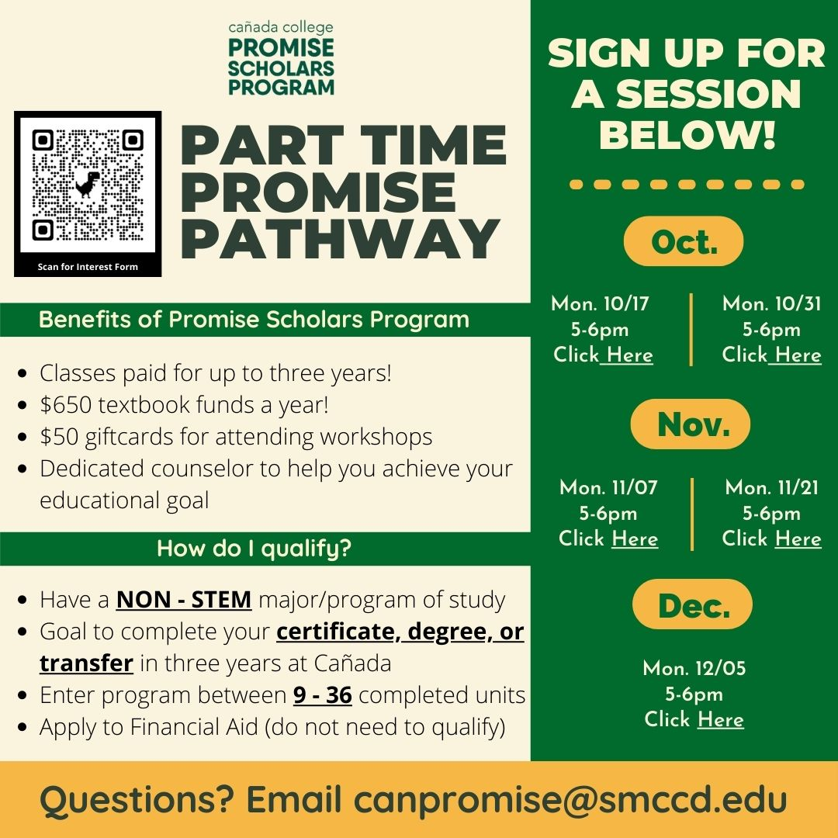
PSP Expansion- Part Time Promise Pathway
Notes:
Mayra

Slide 5
Retention and Persistence Data
Fall 2018
88%
72%
Fall 2019
85%
70%
Fall 2020
95%
80%
Cohort
Fall to Spring Retention
Fall to Fall Retention
Percentage on Academic Dismissal
Percentage on Academic Probation
7.2%
27%
4%
8.5%
6%
6.6%
Fall 2021
8%
88%
71%
4%
Notes:
Mahitha
Since the start of the Promise Scholars Program, the addition of a retention specialist to our team has increased our Fall to Spring and Fall to Fall retention rates for all of our scholars. To increase persistence and completion rates amongst our students, the retention specialist has been able to conduct early alert and probation student interventions, host academic coaching sessions with students individually upon evaluating, and support counselors in caseload management through collecting data in collaboration with the PRIE department.

Slide 6
Supporting the College's Vision and Values
Cañada College Goal #1 – Student Access, Success, and Completion
Education Master Plan Under (2022-2027) Goal 1, Part 3
Hiring a Retention Specialist allocated to our first year cohort will increase successful course completion and semester to semester persistence.
Meeting benchmarks
Completion and persistence of first semester through academic coaching
Foster college success skills to navigate college in their first semester
Retention of High Need students and Part-Time Students
College Goal #2 – Equity-Minded and Antiracist College Culture
The Promise Scholars Program (PSP) contributes to anti-racism at Cañada College through programming, collaboration, data-driven inquiry, and staff professional development. In addition to program collaboration, Promise engages in data inquiry and reporting.
With the support of the PRIE department, PSP receives daily enrollment reports for our incoming and continuing students.
This helps our caseload management and allows us to collaborate with our counselors and other student services programs to identify our students of color who need intrusive counseling and retention efforts. Through disaggregating this data, we are actively practicing anti-racist work.
College Goal #3 - Community Connections
Outreach efforts with off-campus community partners and high schools
On campus collaboration
Resource sharing with student service programs on campus to provide extra support for our incoming students
College Goal #4 - Accessible Infrastructure and Innovation
Onboarding incoming students (first year experience)
Early Alert and interventions with cohort professors
Participating in campus-wide Community of Practice meetings
Support CRER 401: College Success Summer Bridge Course
Notes:
To support the expansion of the Promise Scholars program, the addition of another retention specialist will align with the College's vision and values, and will align with our replication model of supporting students in completing their educational goal. This retention specialist will be focused on our students first year experience, as we will see an increase in our incoming students over the next few years. Smaller, intentional caseloads for our 2 retention specialists will provide more opportunity to foster college success skills and help students navigate their first semester of college. In addition, as we onboard new students each semester, with the additon of the retention specialist we will be able to strengthen the relationship between the program and cohort faculty, support our CRER 401 College Success Summer Bridge Course, and collaborate with both on campus students services and off campus community partners
Mahitha
Retention of High Need students
Probation students
Transfer students
No engagement student
Boys and Girls Club
Fairs Oaks Community Center
Sequoia High School District and other feeder high schools in the area

Slide 7

Requested Allocation
Grade : 24​
Step : 1
Annual Cost: ​$63,840
100% Fund 1
Notes:
Mayra

Slide 8

Thank You
Thank You!
Any Questions?

