Slide 1

Position Request Presentation
November 15, 2023
Position: Admissions & Records Assistant III
Requested by Admissions & Records:
Maria Lara-Blanco, Registrar and
Dr. Bennani, Dean of Enrollment Services

Slide 2
Request
Permanent Full-Time Admissions & Records Assistant III will…
  Support our students more efficiently
  Increase student access and success
  Support Cañada’s goal to build and expand our Dual Enrollment team
  Manage projects more effectively
  Provide more support to special programs
  Participate in more outreach and in-reach events
  Improve the A&R response time to requests from the campus community
  Ensure the college is compliant with Title 5, the California Education Code and all state regulations and federal laws related to the functions of the A&R office.
Notes:
Student Support Services have increased over the years which require assistance from the Admissions Office, however, the staffing has remained the same

Slide 3


Slide 4

WEAKNESSES
Slow response times
Less flexibility due to inadequate staffing
Minimal outreach

Slide 5
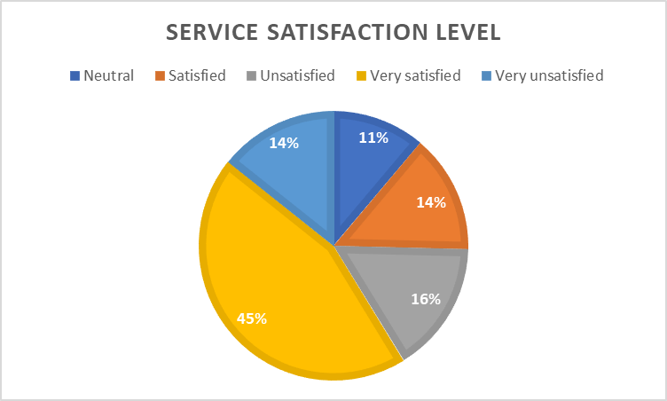
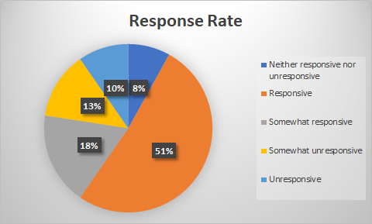
SAO: As a result of the implementation of “ContactUS form” students will be aware of the services provided by A&R. By using the "ContactUS" form, students will be more satisfied with A&R services.
SAO Student Survey Outcome
Were your satisfied with the overall quality of service you received from the Admissions and Records Office at Cañada College?
  2022: Around 30% Not Satisfied
  2023: Around ??
How responsive were the Admissions and Records staff when you interacted with them?
  2022: Around 30% Unresponsive
  2023: Around ??

Slide 6

Increased Workload for 2021-2023
Reviewed/Processed over 19,300 New & Returning Students
  Both College and Concurrent Enrollment
Processed over 2,688 registration related petitions:
  Residency Reclassification
  Extenuating Circumstance
  Late Add
  Course Overlap
  Course Repeat
  Prerequisite Challenge & Equivalency
  Student Records Merge
  6 Unit or Less Non-Res Fee Waiver
4,017 “ContactUs” inquiries
Received roughly over 200k emails and phone calls
Evaluated 1,800 Grad Petitions
Awarded 1,476 Degrees & Certificates
Processed over 250 Enrollment Verifications
Processed over 100 Credit-by-Exam
Processed over 8,500 transcript requests & 350 CSU GE/IGETC Certifications
Processed over 200 final grade changes
Scanned over 900 incoming transcripts
Proofread over 1,800 student names for both Class 2022, 2022

Slide 7
SMCCD Dual Enrollment Expansion
Admissions & Records Assistant III position will support Cañada College’s goal to build and expand our Dual Enrollment team. Scanned over 1,600 incoming transcripts
The Admission & Records Assistant III is critical to the college’s efforts to expand the implementation of our local and statewide initiatives for Early College, specifically Assembly Bill 30 for College and Career Access Pathways (CCAP), California Community College Linked Learning Initiatives (CCCLLI), and SMCCCD initiatives for the expansion of Dual Enrollment and Early College opportunities for San Mateo County
Projection for 58 enrollment increase every year beginning in 2023-2024
Anticipated Growth
 |  |  |  | 2021-22 | 2022-23 | 2023-24
Cañada College |  |  |  | 250 | 377 | 960
SMCCCD |  |  |  | 3,600 | 5,000 | 7,000
% of San Mateo County 11th & 12th Graders |  |  |  | 24% | 34% | 48%

Slide 8
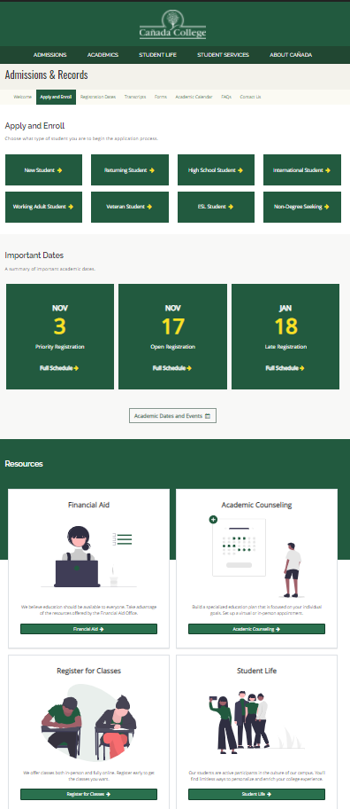
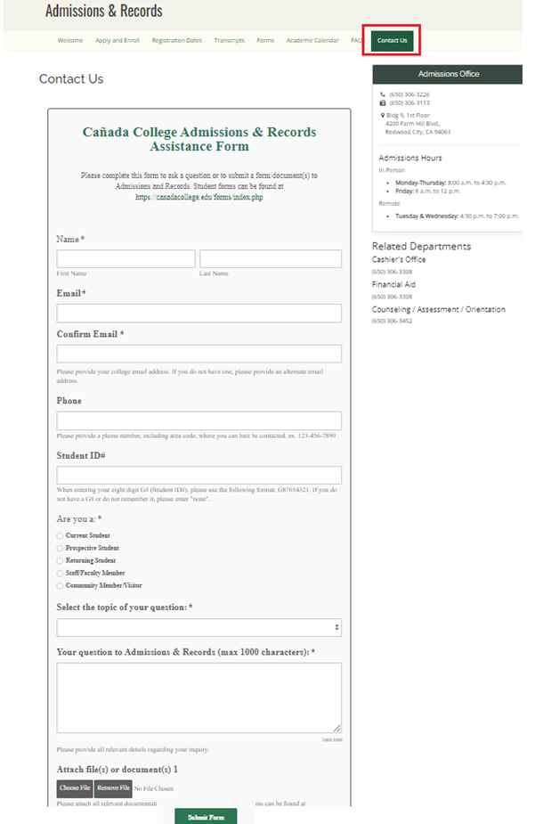
Rebranding A&R
Updated our Admissions & Records Website
  Spanish website coming soon
Implemented a new A&R communication/petition submission process through "Contact Us" form
Implemented a new “In-person” check-in for data
Created five "How to Videos" both in Spanish/English in Spring 2022
More visible at on/off campus student events
Partnered with Parchment for the printing and mailing of our diplomas, including digital diploma
Collaborated with the SSL K-12 new process
Implemented “Peak” extended hours in addition to our Late Registration evening hours

Slide 9

Rebranding A&R (Con’t)
Implemented the 6 unit or Less Non-Resident Fee Waiver
Currently involved in the 1.1 Make Registration Easier Task Group
Collaborated on the SB 893 Fee Waiver for SMC Residents SOP
Collaborated & implemented the VA Student SSL in CRM
Sent out the “ContactUs” and “In-person” customer service student survey
Improve A&R Services communication
Participated in providing extended evening office hours for “College de Noche”

Slide 10

Collaborate & Support Special Programs
Promise Scholars Program
Dual Enrollment, & Middle College
Eso Adelante Program
DREAM Center
Outreach/Dual Enrollment
SparkPoint
EOPS, CARES, CalWorks
TRIO Upward Bound
Foster Youth Success
College for Working Adults
Umoja & Puente

Slide 11

Impact on Marginalized students
Supports College mission & strategic goals:
Student-first philosophy when working with our marginalized student population
Fostering student confidence to engage in academic and career training
Making the admissions process informative, accessible, inclusive and supportive
Streamlining the A&R process for our ESL students
Supporting and collaborating Student Services Programs
  Promise Scholar, Dual Enrollment, Middle College, EOPS, CARE, CalWORKs & FFYSI, TRiO, DRC, Umoja, Puente, etc.
A&R Liaison to Financial Aid, SparkPoint, VROC, Dreamers
Enacting our college commitments, as described in our college's Antiracist Framework (PBC, Adopted, 4/21/2021)

Slide 12

How does supporting Dual Enrollment close the equity gap?
Removing systematic barriers by providing onboarding support with a dedicated A&R III Assistant
  CCCApply support, technological support, navigational support, processing Forms,
  Supports with enrolling students in CCAP classes and sharing a final roster with Dual Enrollment staff; drops students from CCAP classes when advised by Dual Enrollment PSC
Continuation of Antiracist work to provide support to minoritized students
  Intentional one-on-one assistance to our communities of color
  Assist students and parents with completing additional documentation required by A&R, such as guardianship and change of information documents.
Increasing capacity to serve prospective CAN students from underserved communities
  i.e. first-gen, undocumented students, low-income students, former foster youth, homeless students

Slide 13
How does this position close the equity gap?
Equity Gap
A&R liaison to Financial Aid, SparkPoint, Dreamers
Enacting our college commitments, as described in our college's Antiracist Framework (PBC, Adopted, 4/21/2021)
Increased outreach to our underserved communities
Faster processing times for A&R forms
Streamlining the admissions and registration process for our ESL students
Making the admissions process informative, accessible, inclusive and supportive

Slide 14

If filled…
Help our marginalized students and communities by providing services in a timely manner
    Directly address student inequities
    Less roadblocks
Support our students more efficiently
Less student complaints
Strengthen our relationship with students, and both campus/off campus community
Remain Title V compliant and stay current with our prior records
A&R website, how-to-videos, and social media up to date
Assist the Dual Enrollment team with the SMCCD anticipated growth

