Slide 1

Program Review
New Position Request Presentation
Position: Instructional Aide II (PT) - 2
Requested by: Fashion Design Dept.

Slide 2
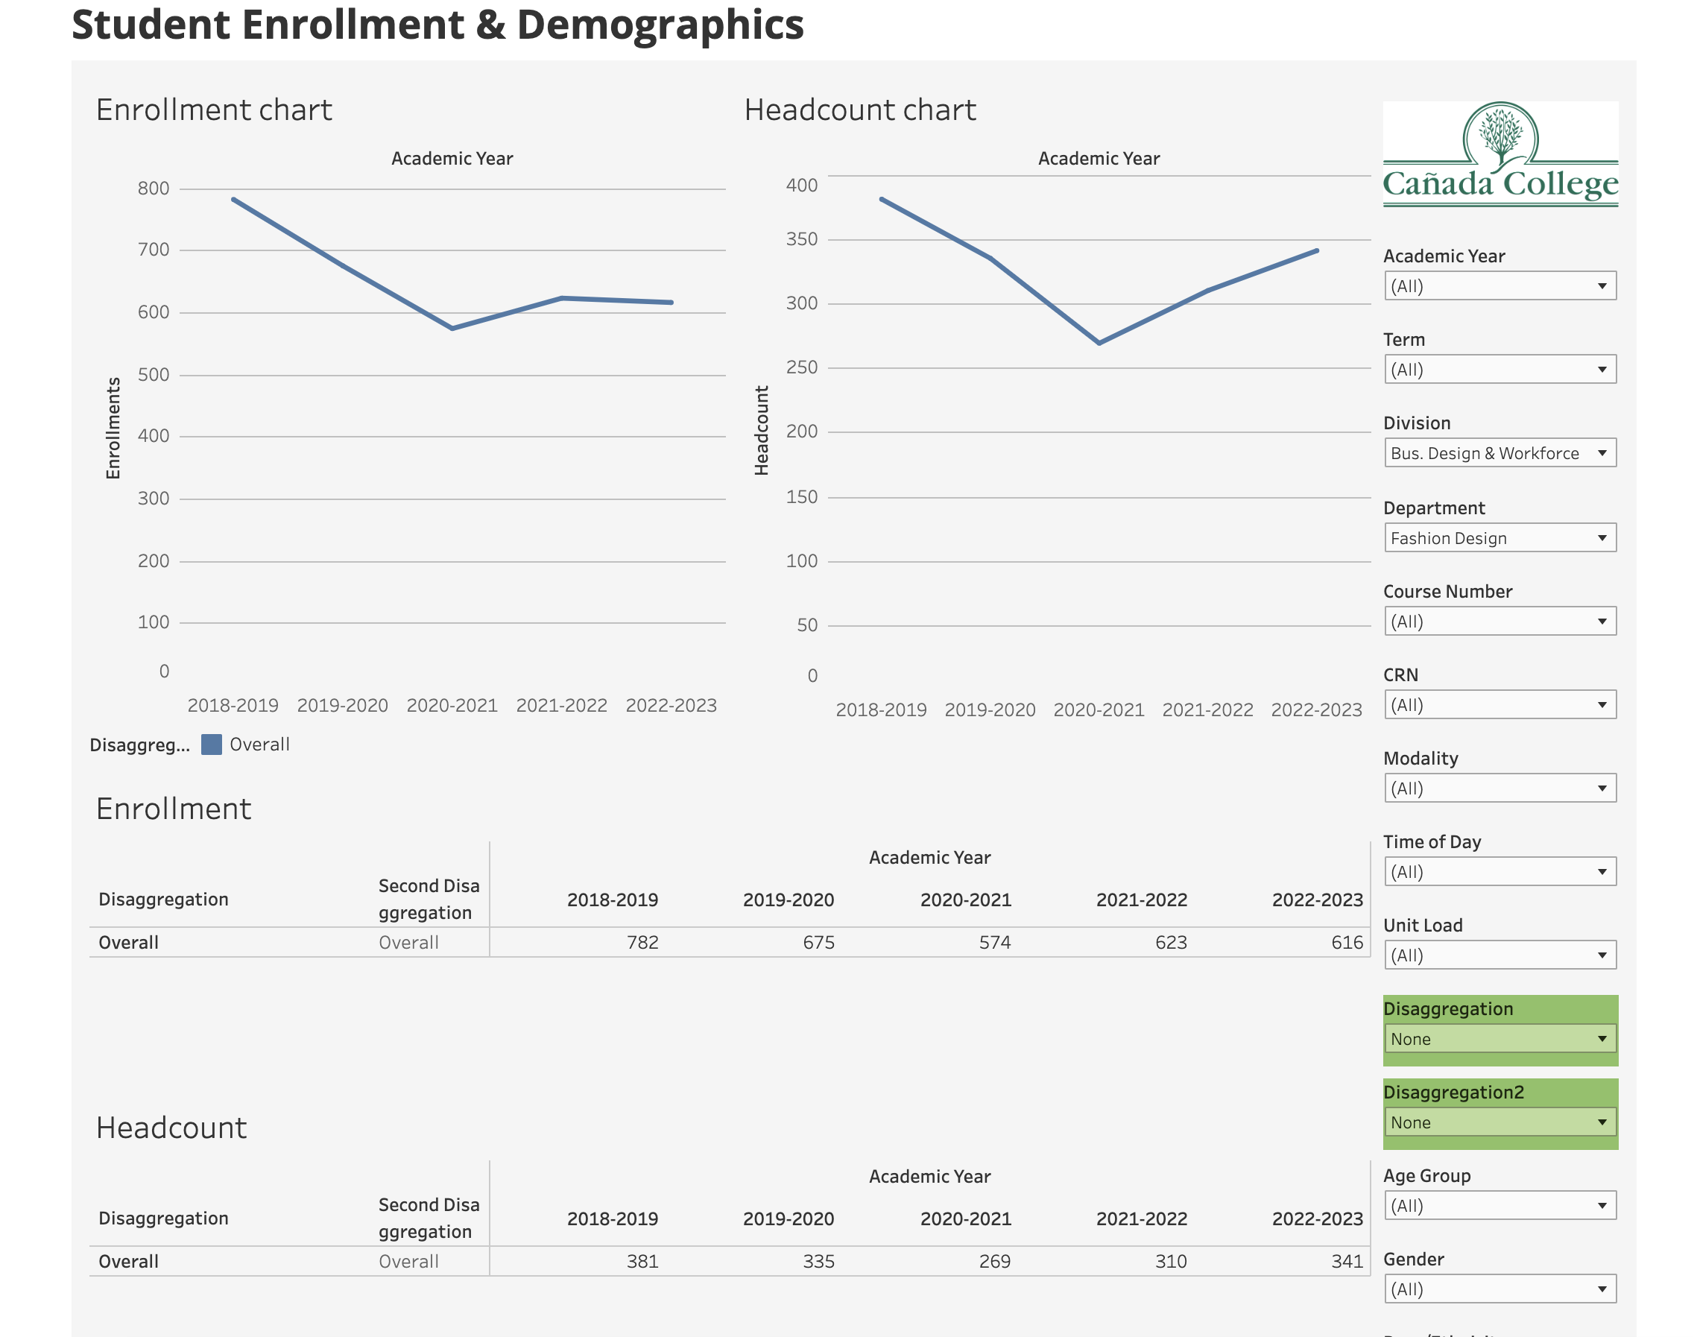
Enrollments have recovered since the worst of COVID
New PT Classified Positions (2) – replacing existing FT Position

Slide 3
Cost of 2 PT 10 month positions vs. 1 FT 12 month position
New PT Classified Positions (2) – replacing existing FT Position
IA II Cost comparison: 2 PT 10 month vs 1 FT 12 month (step 3 example)
 | Salary 12 month | Benefits | Total
1 FTE | $ 75,168.00 | $ 44,010.86 | $ 119,178.86
 | Salary 10 months | Benefits | Total
0.5 FTE | $ 31,320.00 | $ 18,416.16 | $ 49,736.16
 | Salary 10 months | Benefits | Total
0.5 FTE | $ 31,320.00 | $ 18,337.86 | $ 49,657.86
Total 2 positions | $ 62,640.00 | $ 36,754.02 | $ 99,394.02

Slide 4
The FASH instructional aide position has existed for more than a decade
New PT Classified Positions (2) – replacing existing FT Position
  Instructional aides are vital to the Fashion program because not only are they the only way we can offer labs to students who may not have their own sewing machines and other equipment, but they assist the students with the equipment during class. In the same way a woodworking class could never let students use band saws without close supervision, a qualified and knowledgeable individual is necessary for the safety as well as instruction of students in the Fashion Design program.
  In the past, in addition to the FT 12 month Instructional Aide II position held by Peggy Perruccio, there were multiple short-term temporary instructional aides to help provide support and lab access to students. These were grant funded positions.

Slide 5
Converting one FT 12 month position into two PT 10 month positions
New PT Classified Positions (2) – replacing existing FT Position
The existing FT 12 month Instructional Aide II position for Fashion Design & Merchandising was vacated August 2023.
In prior years, we had been able to supplement the FT position with short-term temporary grant funded positions to be able to serve the night students. Short-term positions were never meant to go on indefinitely, but our students need both day and evening access to labs. This FT 12 month vacancy offers us the opportunity to convert it to 2 PT positions, which would better serve the programmatic and student needs.
Student Lab Use Sign-in Sheets Sept. 1 - Nov 8 2023
 | Sept. | Oct. | Nov. | Totals
Day M-Th 8:30am - 5pm | 81 | 155 | 44 | 280
Night T/Th 5 - 9pm | 20 | 46 | 12 | 78

Slide 6
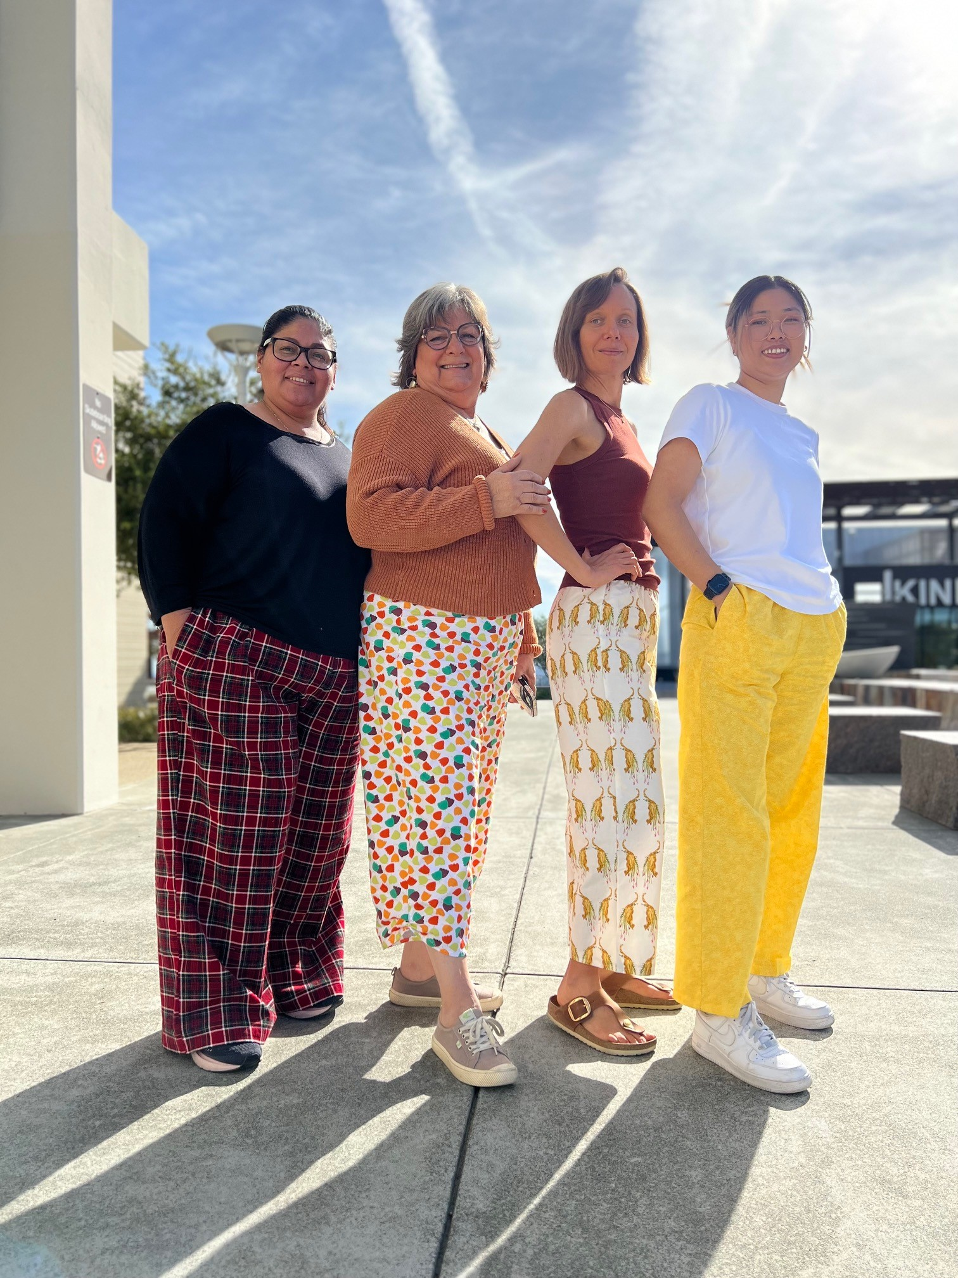
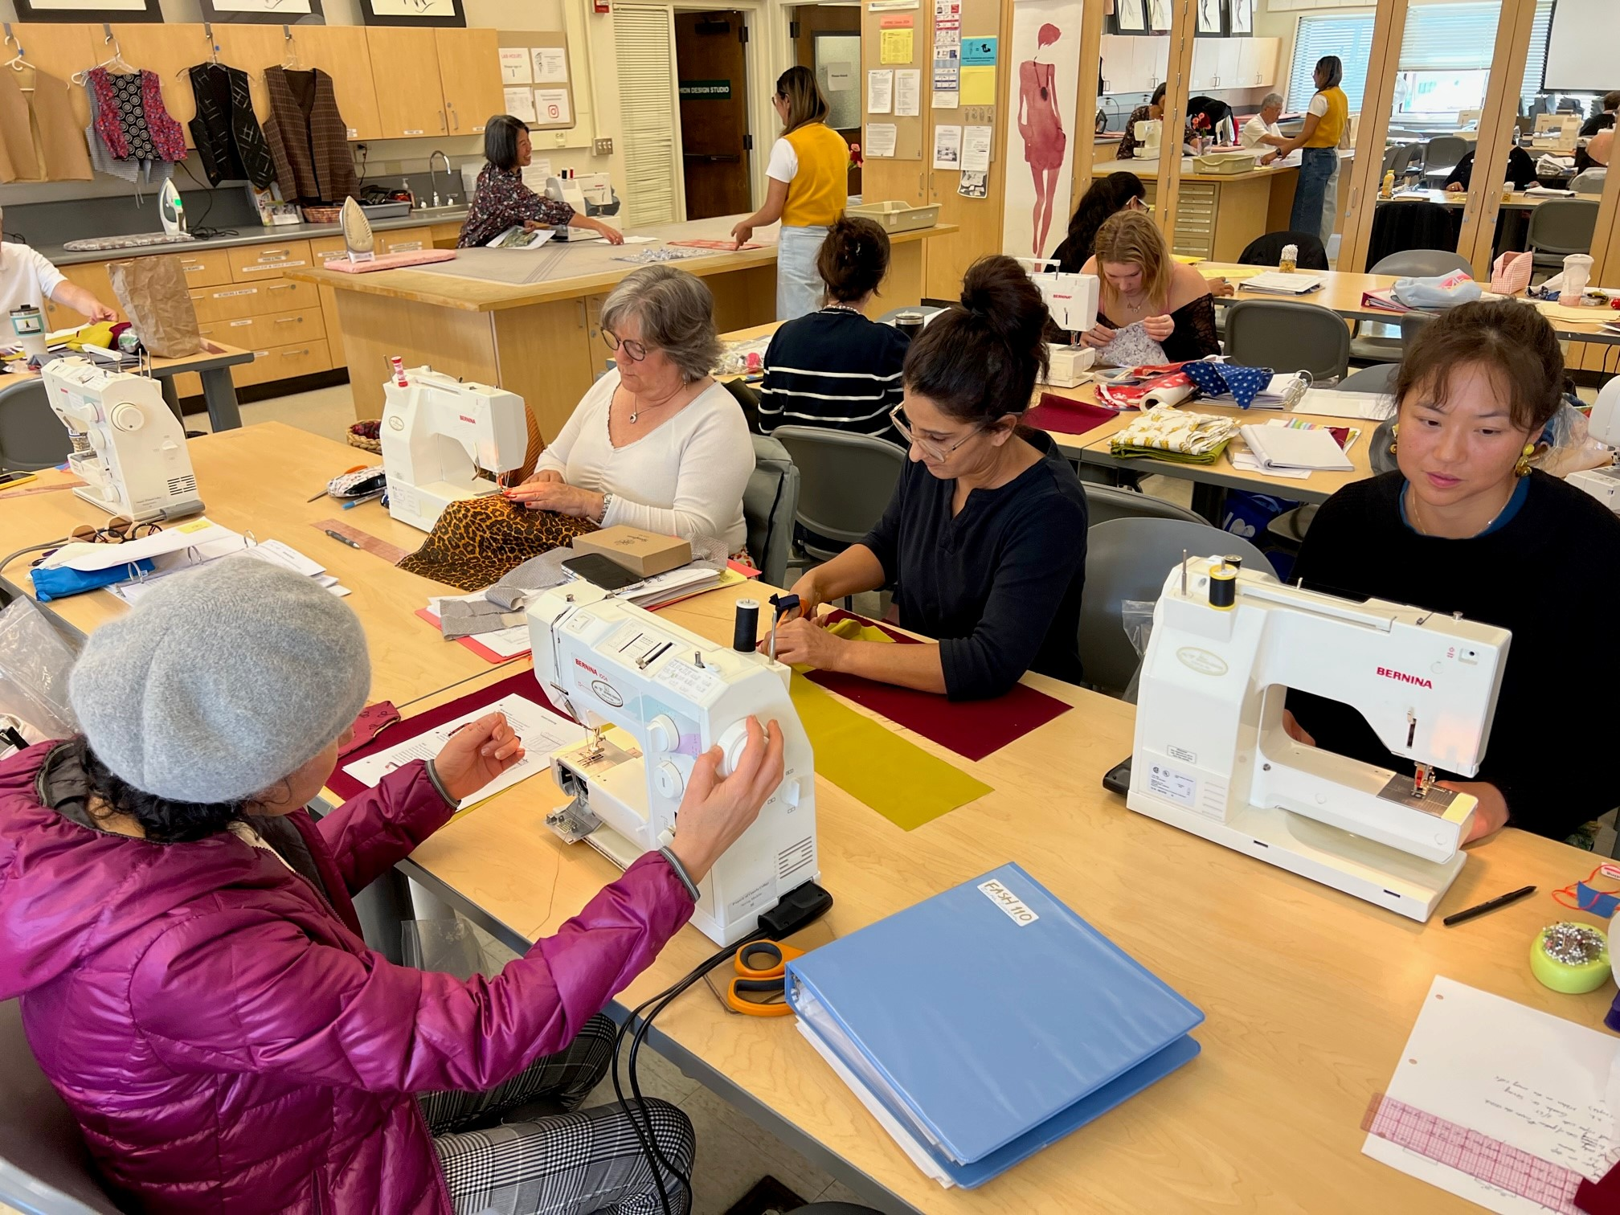
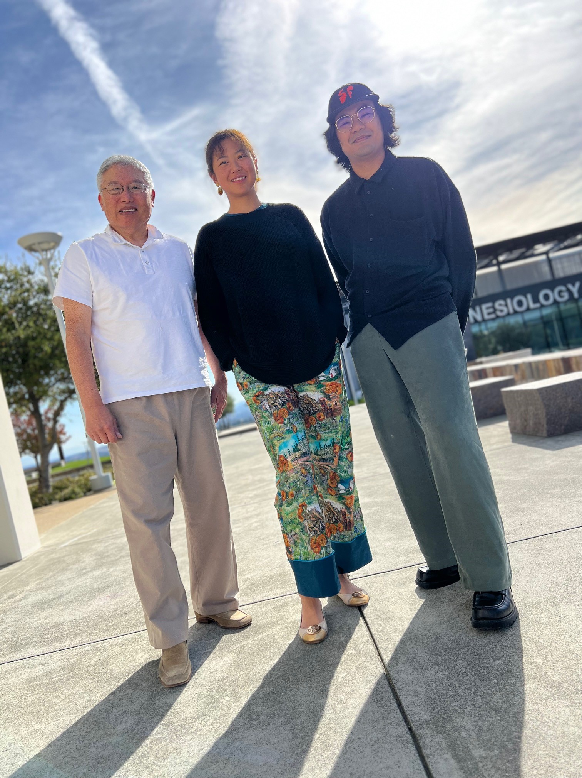
Students are making use of the lab!
New PT Classified Positions (2) – replacing existing FT Position

