Slide 1

Program Review
New Position Request Presentation
TEMPLATE
Position: .48 Library Support Specialist
Requested by: ASLT/Library

Slide 2
Expected Duties
Maintain and update technology devices (Google Chromebooks, PC laptops, calculators, Wi-Fi hotspots, and more)
Set up and maintain detailed statistical, financial, and other records for technology device loans
Collect and document the payment of fees
Teach and assist students in using library loaned technology
Provide individualized troubleshooting for technology problems, including printing and technology loan items
Communicate with students about technology loan guidelines
Prepare reports and statistics
Recruit, hire, train, and supervise student assistants
Supervise Library Circulation desk
Maintain and support a safe space for students in the Library
Marketing and outreach to the campus community

Slide 3
Title V Mandates
Colleges with FTES between 1,001 and 3,000 should have 4.5 Support Staff.
We have 2.9 support staff.
College Size ​ | Type of Staff​
(FTES)​ | Faculty Librarian​ | Support​
< 1,000​ | 2.0​ | 3.0​
1,001-3,000​ | 3.0​ | 4.5​
3,001-5,000​ | 4.0​ | 6.5​
5,001-7,000​ | 5.0​ | 9.0​
Each Additional 1K​ | 0.5​ | 1.0​
Notes:
Currently, there is only 1 LSS to monitor and supervise the circulation desk during evening hours. In cases of illness or vacation there is no coverage for this major section of the college Library, resulting in early closing of Library services. An additional part-time Library Support Specialist will provide this coverage in these cases in addition to providing support for the full-time LSS on duty in the evening.

Slide 4
SMCCCD Board Goals or Strategic Initiatives
Free Community College: Assembly Bill 893, was signed by the state governor, further expanding the demand for student technology loans.
OER/ZTC:
Provide library loan technology
Provide reliable wi-fi access through portable hotspots
Preparing, cataloging, and maintaining physical textbooks as part of the Reserves Collection
Notes:
SMCCCD Board goals or strategic initiatives: Has the Board of Trustees recommended that we create or expand initiatives? For example: Free Community College (SB 893 -eliminate fees, support student basic needs such as; transportation, textbooks & materials, technology, food, healthcare, emergency housing), Focus on Strategies to Increase Student Enrollment, Dual Enrollment, Promise Scholars, and OER-ZCT.

Slide 5
Support for the 2022-2027 Educational Master Plan’s strategic initiatives
Student Access, Success and Completion:
Provides equitable access by ensuring that staffing is present during Cañada de Noche and on Saturdays. This is vital to our underserved students and closes the equity gap for those who are unable to attend classes and access campus services during the daytime hours.
Equity-Minded and Antiracist College Culture:
Increases our ability to provide technology and one-on-one assistance to students, particularly:
Students from Black, Latinx, and AANAPISI groups
Students with various levels of digital literacy
Students with various learning and physical disabilities.
Accessible Infrastructure and Innovation:
Ensure uninterrupted and equitable access to the Library’s resources and services, especially library technology.
An additional .48 Library Support Specialist ensures that the Library’s technology loan program remains sustainable and accessible to all students.

Slide 6
Current Workload of LSS
Often more than 10 minutes for each transaction
Check student’s registration status
Check status of technology
Look for missing peripherals (power cord, charger, etc.)
Explain the technology policies
Preparing equipment, keeping equipment maintained, and troubleshooting issues takes a minimum of two months work
Preparing reports on damaged/missing equipment takes time due to recovery process for Overdue/Lost status equipment
Contacting students about returns takes many hours away from the LSS’s normal duties
Notes:
Do the program or student service area’s workload metrics (e.g., the volume of students served), in accordance with college strategic planning, justify the addition or replacement of the position.

Slide 7
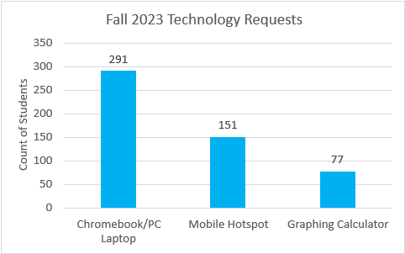
Technology Workload By the Numbers
Technology Added by Library Support Specialists
Year | Technology Added
Aug 2020 - Jul 2021 | 333
Aug 2021 - Jul 2022 | 273
Aug 2022 - Jul 2023 | 430
Circulation for Technology
Year | Chromebooks/Dells | Wi-Fi Hot Spots
Aug 2020 - Jul 2021 | 507 | 761
Aug 2021 - Jul 2022 | 549 | 1010
Aug 2022 - Jul 2023 | 1073 | 1805

Slide 8
Workload Continued
Due to the high demand for technology and digital literacy instruction, other vital library services and resources have been neglected. Including:
Preparing new materials for circulation
Collection maintenance and development
Reinitiating resource sharing with the public libraries
Student assistant hiring and training
Updating and growing reserves for faculty
Outreach to the campus and wider community
Contribution to College Participatory Governance.
Circulation of Books and Reserves
Year | Books | Reserves
Aug 2020 - Jul 2021 | 326 | 102
Aug 2021 - Jul 2022 | 4173 | 465
Aug 2022 - Jul 2023 | 5689 | 919
Notes:
Do the program or student service area’s workload metrics (e.g., the volume of students served), in accordance with college strategic planning, justify the addition or replacement of the position.

Slide 9
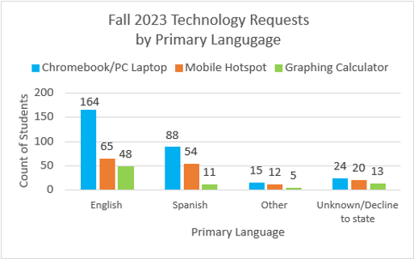
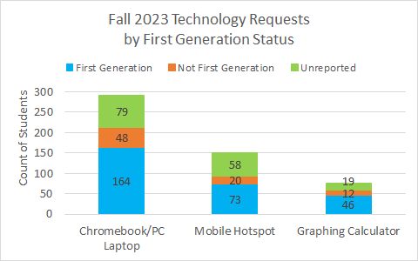
Equity and Technology Loans
Most of our students who request technology include students whose primary language is something other than English, as well as First Generation students. (PRIE, Fall 2023)
Having technology available to these students allows them to enroll in at least one course the same year they apply. (Cañada's Educational Master Plan)

Slide 10
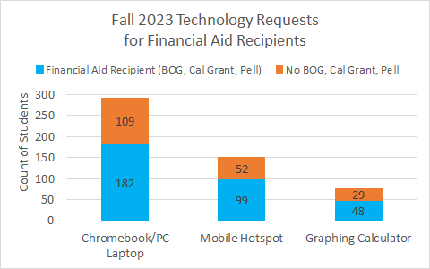
How does this resource request support closing the equity gap?
The vast majority of students who borrow technology are financial aid recipients.
This request reduces the equity gap by giving students' access to these items who otherwise would not have them due to low socio-economic status or other circumstances. (PRIE, Fall 2023)

Slide 11
How does this resource request support Latinx and AANAPISI students?
70% of library technology loans borrowed by Latinx students
20% borrowed by other students of color
With more demand for technology, LSS need to be available to prepare, deploy and retrieve equipment that is vital to Latinx and AANAPISI students' academic success.​

Slide 12
Explain How this Work will be Accomplished if the Position is not Filled
Library services will continue to be negatively impacted by lack of staffing
Reserves cataloging, collection development, outreach, participation in campus committees, etc. will be second priority
When there is a staffing shortage due to illness/absence, the library will have to close
Students will not have access to vital library services (research support, technology, reserve textbooks, etc.) that support their academic success
Departmental representation will still be lacking

