Slide 1

Program Review New Position Request Presentation
Position: 1. Full time Instructional Faculty
2. Instructional Aid II - (2)
Requested by- Dr. Ritu Malhotra
Faculty and Program coordinator for Medical Assisting Program

Slide 2

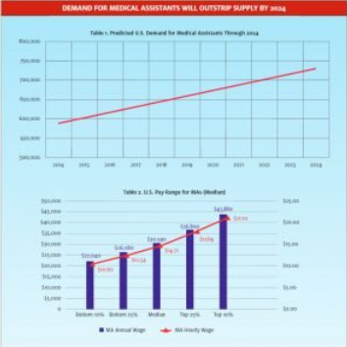

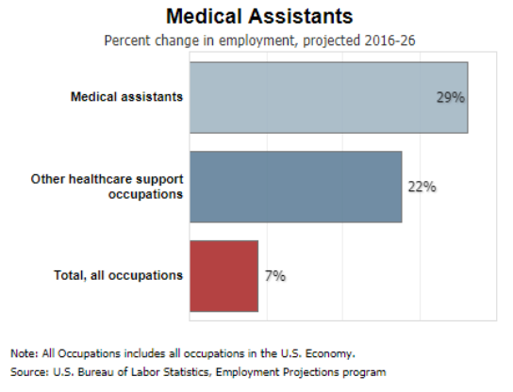

Demand for Medical Assistants
DEMAND FOR MEDICAL ASSISTANTS WILL OUTSTRIP SUPPLY BY 2024
Medical assistants (MAs) are the core of urgent care’s clinical support workforce.
According to the Bureau of Labor Statistics, the job outlook for Medical Assistants is estimated to increase by 19% which is much faster than the average occupation from 2021-2031

Slide 3
Value of the medical assisting graduates to the community
Community Needs –
Strategies implemented to mitigate challenge-
Medical assistants are imperative for lowering costs, improving patient quality of care, and achieving better patient outcomes and overall community well-being.
Several interconnected factors contribute to the rising demand for our graduating medical assistants such as
aging population,
implementation of healthcare reforms,
expansion of insurance coverage and more individuals are seeking medical care,
shift towards preventative and primary care
technological advancements and navigation to EHR and data entry
widespread adoption of electronic health records (EHRs)
Our Program at Cañada demonstrated remarkable resilience and adaptability by evolving especially during the pandemic ,while maintaining the academic standards as well as prioritizing the well-being and safety of our students.
Ours was” one” of the only other healthcare program that continued to offer in person lab classes on campus to support our students and facilitate successful completions .
We adapted the instructional delivery and assessment methods required in healthcare courses to blended learning models, incorporating online instruction with in-person clinical experiences by methods like-
innovative teaching methods( online and hybrid; synchronous and non synchronous )
telehealth training,
virtual learning resources
simulation-based training

Slide 4
Value of the medical assisting program to the students and prospective graduates
In essence, the medical assisting program at Cañada College is not just about education; it's about transformation. It transforms students into skilled professionals who can earn a livelihood while finding profound satisfaction in their work.
We take pride in saying: WE CHANGE LIVES! Our program doesn't just shape careers; it shapes futures filled with purpose and accomplishment.
We serve a diverse student body, including many first-generation students, single mothers, Hispanic and other ESL students ,a wide age range of new/ returning students spanning from 20 to 60 years.
The Medical Assisting Program serves as an invaluable entry point for these students into a healthcare career providing long term stable careers options.
Graduates from the program can work in a variety of healthcare settings, including clinics, hospitals, physician offices, and specialty practices. This versatility provides opportunities to explore and pursue different aspects of healthcare.
A medical assisting degree can serve as a stepping stone for individuals interested in pursuing further education in healthcare such nursing, healthcare administration, or related fields.
Being an It allows for many students to be independent and care for their family and get off welfare.

Slide 5
Medical assisting adjunct faculty turn over and staffing challenges
The Medical Assisting Program has encountered significant staffing challenges. The effects have been twofold, impacting both turnover in medical assisting educators and the subsequent difficulties in recruiting and integrating new faculty members.
Teaching medical assisting courses requires specific skills and training more challenging to find qualified educators. The sudden shift to online and remote teaching created challenges for educators unfamiliar with digital platforms and pedagogy has made it even more difficult.
This transition, coupled with the broader impact on mental health has prompted some educators to reconsider their roles, leading to departures.
Currently, our Medical Assisting Program is led by one full-time faculty member. Relying heavily on adjunct faculty to supplement staffing needs poses challenges. This situation is not only demanding on the existing faculty but also complicates the process of identifying, training, and integrating new adjunct faculty, particularly in the context of online teaching modalities.
The loss of two professors - billing and coding professor ( retired ) and pharmacology ( departed)had created difficulties in hiring a qualified replacement. This had a cascading effect, affecting the teaching of critical courses like billing and coding and pharmacology.

Slide 6
One person led career tech program-challenges
Currently, our Medical Assisting Program is led by one full-time faculty member. Relying heavily on adjunct faculty to supplement staffing needs poses challenges. Some challenges faced are-
Overwhelming workload including teaching responsibilities, administrative tasks, maintaining student records, student advising and counseling, externship documentation placement and evaluation, site visits etc.
I am also the program coordinator with responsibilities including but not limited to curriculum updates, outreach and community partnership establishment, externship contract establishment, NOVA reporting , plan and schedule advisory board meetings, participate in health care fairs and workshop.
The difficulty in hiring, training, and retaining qualified adjunct faculty is a multifaceted challenge, further complicated by the necessity of managing course schedules that accommodate their availability since they have a second/ another full time job.
Inadequate time for outreach efforts, including community engagement and student support services. Collaborative efforts and interdisciplinary approaches are vital in healthcare education.

Slide 7
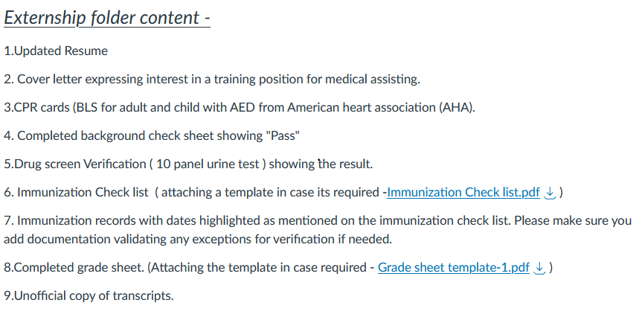
Samples of documents to be collected for externship placements
file:///C:/Users/malhotrar/Downloads/annotated-combinepdf%20(5).pdf
KAISER EXTERNSHIP PACKET
https://smccd.instructure.com/courses/52413/files/9961095/download?download_frd=1
file:///C:/Users/malhotrar/Downloads/annotated-combinepdf%20(5).pdf

Slide 8
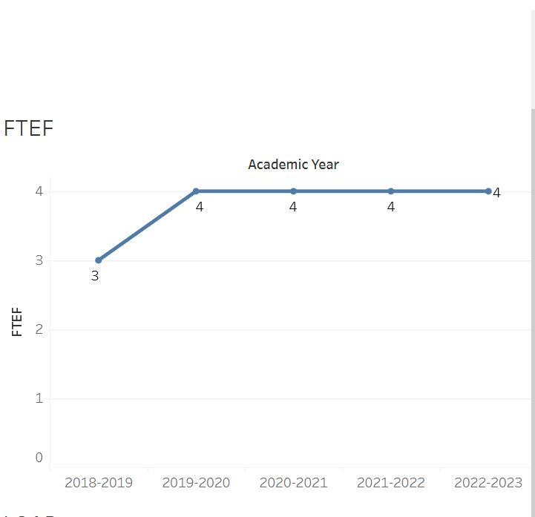
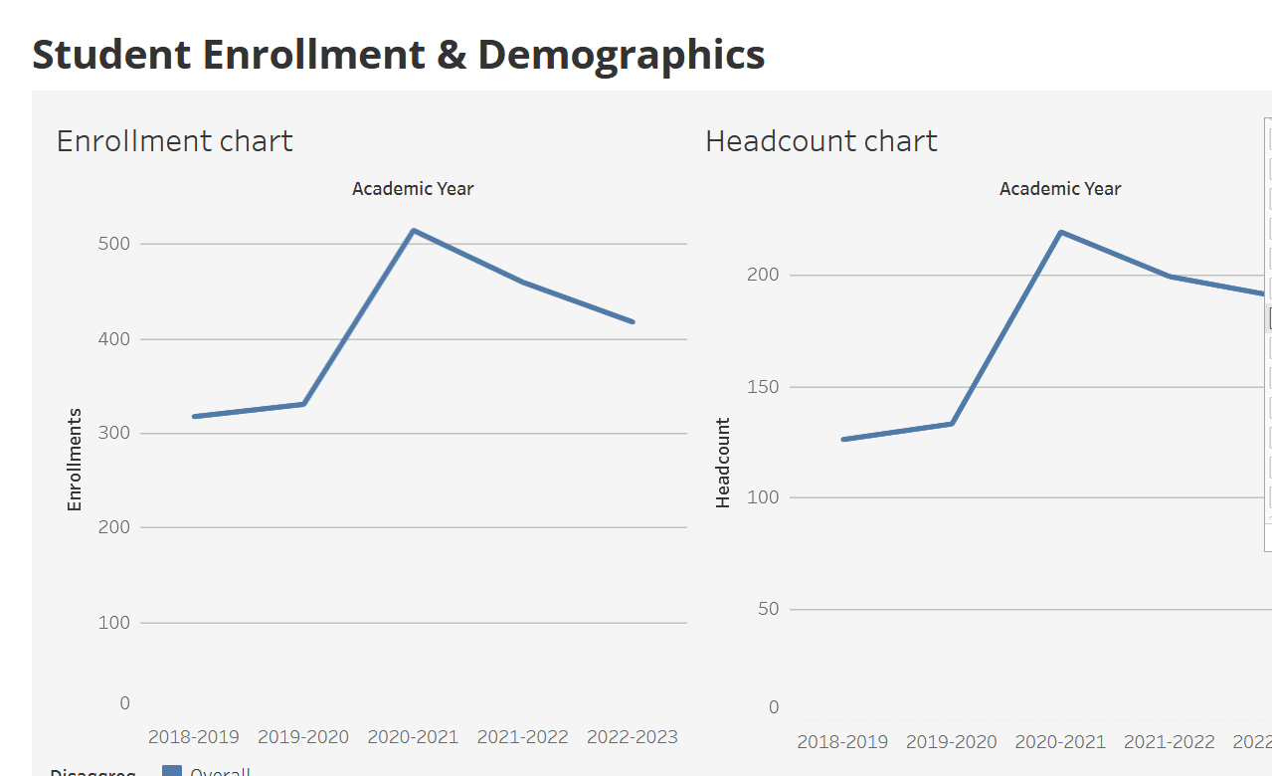
Program’s enrollment trends
The program's enrollment has exhibited a notably strong upward trend since 2018, signifying sustained interest and demand among students for medical assisting education. The spikes observed during the pandemic are plateauing into normal curves now but we want to grow the program and increase class offerings and provide equitable access to students during evening and Saturdays .
Impressive Growth in Headcount: The program has experienced an almost 35% increase in enrollment rates since 2018. This reflects a growing interest in medical assisting as a career choice among students.
Notable Increase in Headcount: In terms of headcount, there has been an impressive increase of almost 52% since 2018. This surge in headcount underlines the program's ability to attract and retain students over the years.

Slide 9
Request and funding for the position
Requesting –
1. Full time instructional faculty.
2. Two Part time Instructional Aid II
Vision and planning -
Flexible Scheduling: We propose expanding our scheduling options to include evening and weekend classes, accommodating students with work and other commitments during traditional hours.
Accelerated Programs: Move towards consideration of accelerated programs that cater to students seeking a shorter timeframe to complete their medical assisting training.
Increased Partnerships: More time for coordinator to spend on strengthening and maintain continuous partnerships with local institutions and employers to amplify program visibility and enhance students' access to job placement opportunities upon graduation.
Enhanced advising, mentoring, and support services
Funding -
Strong workforce and Perkins

Slide 10
Question ??
Thank you.

