Slide 1

Program Review
Position: Program Services Coordinator
Requested by: Promise Scholars Program
Presented By: Ariela Villalpando and Mayra Arellano

Slide 2
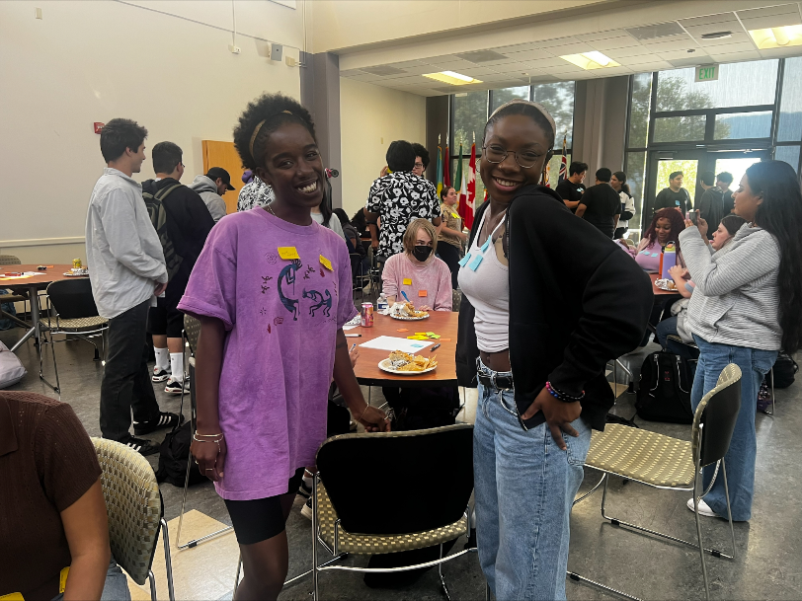
Why We Need a Permanent PSC?
600 + students in our full-time and part-time pathways
Execute the Promise onboarding
Successfully complete college matriculation, enroll in classes, complete FA
Planning/coordination of events
Foster sense of belonging, enhances student experience, keeps students engaged
Info sessions
Promote Promise, assist students in completing PSP application
Promise Orientation
Welcome incoming cohorts, ensuring seamless transition i.e. resource sharing, campus tours, textbook distributions
Community Building Events
Workshops, events, socials
Program coordination/organization
Distribution of incentives, textbooks, handles inquiries about student accounts, holds, outstanding balances, produces reports
District-wide expansion of 1,000 students for AY 2024-2025

Slide 3

Alignment w/ EMP & District Initiatives
EMP Priorities
Create and sustain an inclusive, antiracist, and equity-minded campus culture
Coordinating intentional culturally responsive programming, collaboration, and data collection
Expand programs and opportunities to new community members in N. Fair Oaks, Belle Haven, and East Palo Alto, especially BIPOC communities
Micro to Macro Level of connections through community building, collaborations with other groups on campus, and outreach efforts
Strengthen transfer support services to increase transfers
Coordinate more field trips to 4 year universities
Host more transfer panels
Expand collaboration with COLTS-U Center
Tap into alumni network
Reimagine how we support students’ accessing career opportunities
Support counseling faculty in creating career workshops
Career benchmark data disaggregation
Collaborate with Career Center to promote Career & Internship Fair
Support students in creating a LinkedIn Profile, Resume and Cover Letter

Slide 4




Closing Equity Gaps
Student First Approach PSP Liaison Programming and Events
Support for a Growing Program

Slide 5

Grade 27 Step 6 Annual Cost: $98,304 Fund 1
Requested Allocation

Slide 6
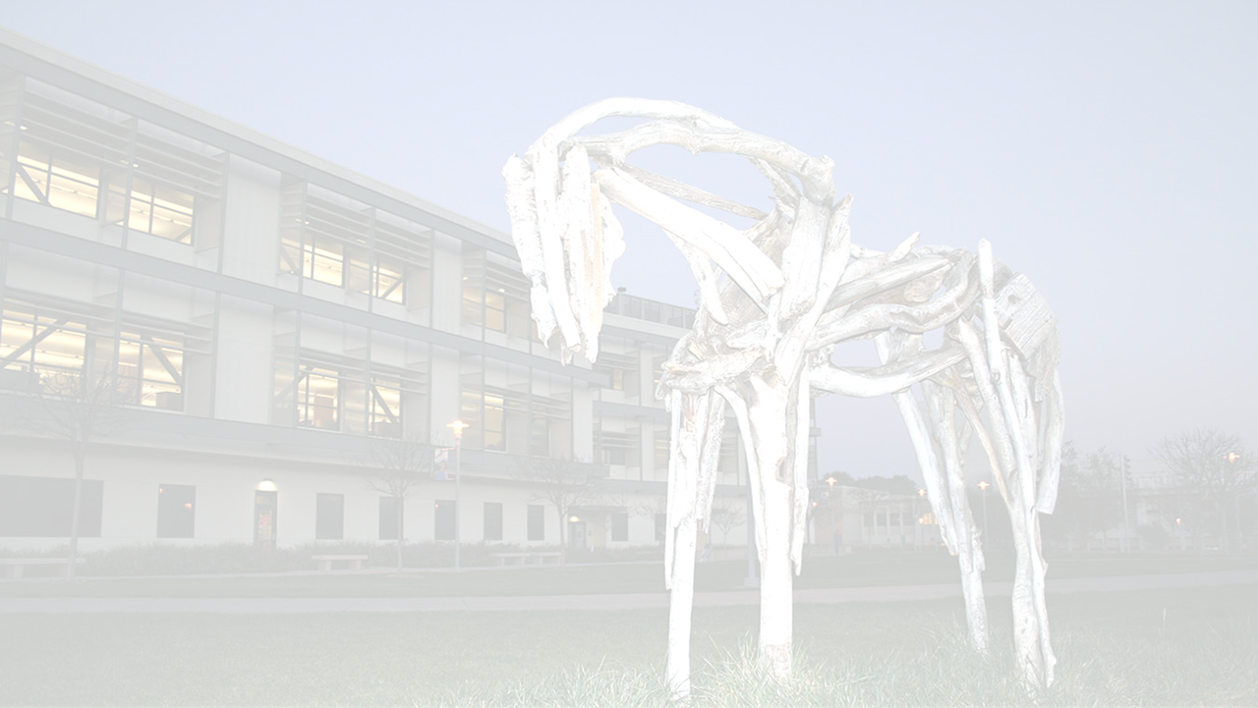

Thank You
Thank You!
Any Questions?

