Slide 1

Program Review
New Position Request Presentation
Position: Tenure Track Promise Counselor
Requested by: Mayra Arellano

Slide 2

San Mateo County Community College District's Promise Scholars Program (PSP) helps first time, full time students earn certificates and associates degrees within two to three years by providing comprehensive financial, counseling, and academic supports. Students receive dedicated academic counseling, personalized career development, tutoring, enrollment fee waivers, textbook assistance, and transportation assistance to support their enrollment, completion, and transfer/career goals.
Mission
Notes:
Mayra

Slide 3
SMCCCD PSP Expansion
 | 2019-20 (Actuals) | 2020-21 (Actuals) | 2021-22 (Actuals) | 2022-23 (Actuals) | 2022-23 (Actuals) | 2024-2025 (Target)
Skyline College | 756 | 738 | 642 | 754 | 1,018 | 1,500
College of San Mateo | 737 | 692 | 740 | 928 | 930 | 1,500
Cañada College | 497 | 464 | 387 | 465 | 617 | 1,000
# SMCCCD Promise Students | 1,986 | 1,876 | 1,769 | 2,500 | 2,565 | 4,000
Notes:
Ariela

Slide 4
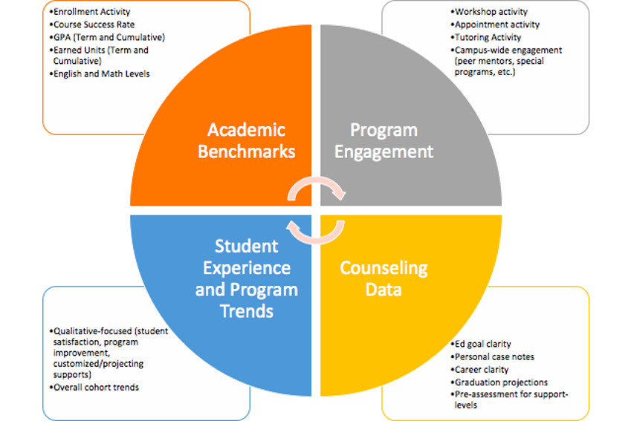
Caseload Management
Notes:
Ariela

Slide 5
Caseload Management for Counselors
Need based, student-centered approach
Data driven
Emphasis on retention and engagement
Specific benchmarks (i.e career, transfer, financial, etc.)
Culturally responsive programming
Low Need
(1 counseling contact per semester)
Medium Need
(2 counseling contacts per semester)
High Need*
(4 counseling contacts per semester)
Notes:
Ariela

Slide 6
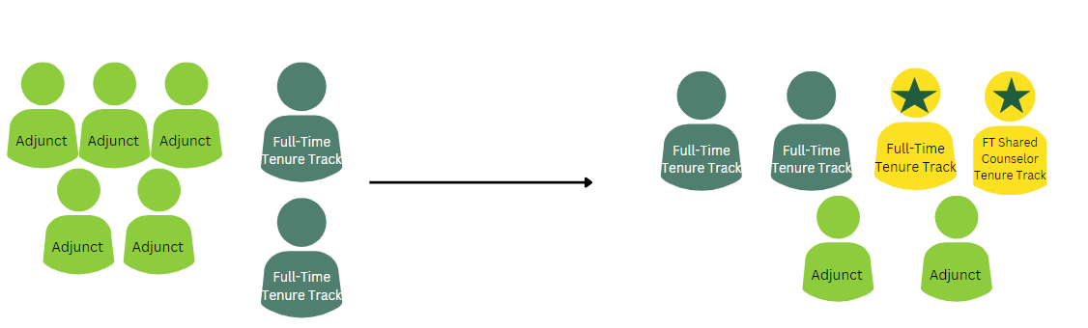
Current Model:
617 Promise Scholars
Counseling Team Models
Proposed Model:
700 Promise Scholars
FT ratio 1:150
FT ratio with teaching 1:130
Adjunct ratio 1:80
Notes:
Mayra

Slide 7



Current Counseling Models at Sister Colleges
3 Full-Time Tenure Track Counselors
2 Non – Tenure Full Time Counselors (In the process of requesting Tenure Track counselors)
2 Shared EOPS/Promise
1 Shared Puente
2 Shared TRI)
1 Adjunct Counselors​
5 Full-time Tenure Track Counselors
1 Shared EOPS/Promise Counselor
1 Adjunct​ Counselors
2 Full – Time Tenure Track Counselors
4 Adjunct Counselors​
2 Shared EOPS/Promise
Notes:
Mayra

Slide 8
Goals for FT Tenure Track Counselors
    Increase caseloads per FT counselor
    Offer more cohort classes ie: CRER 137 , CRER 110
    Continue ongoing community building: Boys and Girls Club, North Fair Oaks, feeder high schools ​
    Increase Summer bridge PSP program ie: CRER 401​
    Offer more workshops/group counseling sessions​
      probation students, DRC students, transfer students, minoritized students
    Expand on collaborative efforts on campus ie: Umoja, Transfer Center, ESO Adelante, STEM, Puente, EOPS, etc
    Representation in meetings to share best practices
      More availability to attend team meetings, GC meetings, Districtwide PSP meetings, and partnership CUNY ASAP meetings
    Onboarding support for adjunct counselors- check-ins, training, counselor meetings​
    Consistency
      Build rapport, relationship building to meet the needs of our students for 3 years
Notes:
Mayra

Slide 9

How does this resource request support closing the equity gap?
Increasing capacity to serve prospective PSP students
Scale culturally relevant programming that center student’s lived experience and interests
Aligned with the proposed district wide expansion of a 1,000 students by 2024-2025
Support the longevity and sustainability of PSP to serve our continuing students
Participate and contribute to the anti-racist and social justice initiatives on campus: CARES , Anti-racist committees, DREAM Center, Sparkpoint, etc.
Notes:
Ariela

Slide 10
Connection to EMP Focus Areas
Priority #2: Expand Programs and Opportunities
(in NFO, BH, EPA w/emphasis on BIPOC communities)
  EMP 3.6: Triple the number of high school students on campus during the summer and on Saturdays during the academic year
Continue to support our Outreach and Dual Enrollment Programs to share the benefits of being part of the PSC Program
Continue collaborating with TRIO,EOPS, Umoja and Puente Programs.
Continue to serve our highest-need students, including former foster youth, low-income, and first-generation students.
Notes:
Ariela

Slide 11
Connection to EMP Focus Areas
Priority #3: Strengthen K-16 pathways and transfer
  Increase the percentage of first-time, transfer-seeking BIPOC students in completing transfer-level math and English classes
  Increase the percentage of BIPOC students transferring to a four-year institution
  Support our expansion of our Part-Time Program to increase the percentage of BIPOC students transferring to a four-year
Priority #4: Reimagine how we support students’ accessing career opportunities
  Facilitate career workshops to support students in creating a LinkedIn Profile, Resume and Cover Letter
  Teach our Cohort Career Classes: CRER 401(College Success), CRER 137 (Life and Career Planning) and CRER 110 (Transfer Essentials)
Notes:
Ariela

Slide 12
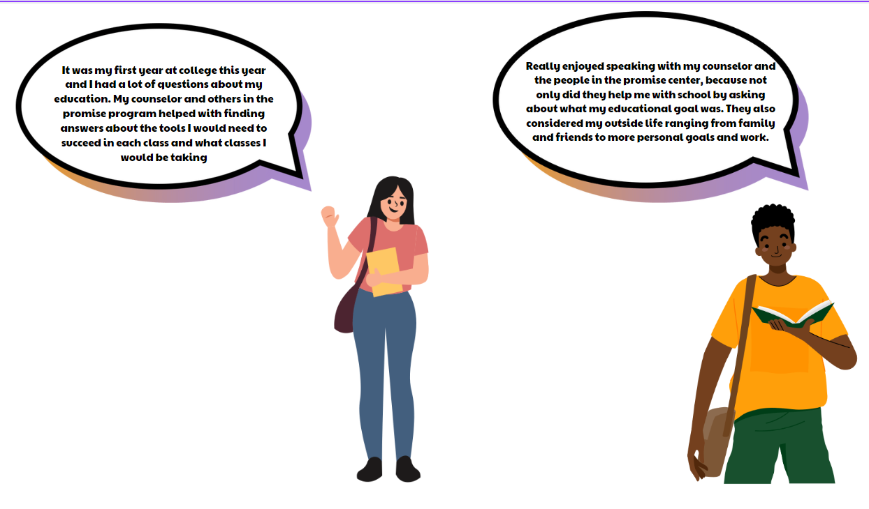
Student Testimonials

Slide 13

    $142,830 for 1 FT, Tenure Track Counselor
    100% Fund 1
Requested Allocation
Notes:
Mayra

Slide 14
