Slide 1

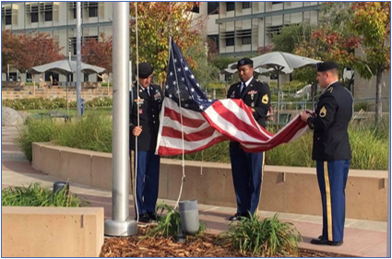

Mission
VROC
Coordinator – 0.5 FTE to 1.0 FTE
2023-2024 New Position Proposals
November 15, 2023
Presented by Juan Vera and Adolfo Leiva
Photo Credit: Peter Tam

Slide 2
VROC’s Request
  Increase of the current VROC Coordinator from 0.5 FTE to 1.0 FTE
  Grade 21, Annual Salary ~ $126K – 161K incl. benefits and COLA
    The current position is a 50% VROC Coordinator / 50% Probation Dismissal position
    Increase support for Service Members, Veterans and Families (SMVFs)
    Expand professional development workshops and events to support SMVFs
    Build VROC services and resources and create welcoming environment for SMVFs
    Align 1.0 FTE VROC Coordinator role across the District.

Slide 3
The Need
SMVFs are considered a ”disproportionately impacted community.”
SMVFs often experience:
Difficulty transitioning from military to civilian (academic) life
Mental health issues (PTS, anxiety, suicide… etc)
Challenges with accessing their VA benefits (living allowance while studying)
Veteran stigma around receiving support

Slide 4
Opportunities to support Veterans
VROC would like to increase how many and how we support veterans!
Cañada certifies 35 SMVFs but serves 185 SMVFs
VROC has outgrown the current 0.50 FTE position
  Juan Vera’s current role is only 50%
CAÑ does not compensate (BHA) SMVFs at the same rate as SKY/CSM
  Veterans receive $300 less at Cañada than at CSM or Skyline ($4300 vs. $4600 /mo)
  Cañada belongs to Santa Clara’s VA vs. San Francisco’s VA
Opportunity to build and strengthen community partnerships

Slide 5
California State Mandates
The CCCCO minimum standards for Veterans Resource Centers
    Minimum standards around physical space, services and staffing established
    We are required to certify eligible SMVFs who have Cañada as their home campus
    We are required to support eligible SMVF with accessing benefits
    Support for all SMVFs regardless of home campus
We have to do it!

Slide 6
Alignment with SMCCCD Board
  District Strategic Plan
    Measure the impact of new and existing College efforts to increase success and equity for all students. Close gaps that result in inequitable outcomes.
    Continually explore and implement interventions that benefit all students, with particular emphasis on students with high potential and limited resources
    Support the Colleges by providing resources for teaching and support innovations that are designed to increase student success.

Slide 7
Cañada’s EMP Alignment / Strategic Initiatives
  Student Access, Success and Completion, Equity Minded & Antiracist College Culture, Community Connections
    1.1 – Make registration easier - MRE
    1.16 – Create a campus culture that supports transfer within 3 years - Belonging
    1.14 – Strengthen and scale student affinity programs and other student support programs - Belonging
    2.7 – Provide comprehensive orientation and on-boarding for all new staff - Equity/Antiracism
    3.1 – Transform how we share the story as an HSI and AANAPISI institution- Share CAN offers
    3.2 – Reach new community members (NFO, BH and EPA), especially BIPOC Communities - Share CAN Offers
    3.10 – Centralize and coordinate College relationships with community partners to expand partnerships - Employ

Slide 8
Intentionality and Service Delivery
Serving underrepresented and racially minoritized students
  Emilio Gallegos, US Marine Corp combat veteran shared his ”Spoken Word”
  Emilio’s presentation reflected our veteran diversity, destigmatized the veteran experience and provided insight into the veteran experience
Student retention
  SMVFs were disproportionately impacted by virtual learning. With the return to face-to-face learning and in person support, retention has increased.
What delivery method does your program utilize to best serve veterans?
  VROC serves veterans in both an in-person and virtual modality with staff being on email and Canvas as well.
On-campus and off-campus community partnerships
  NorCal SMVF, VA Medical Outreach, SMC Veterans Service Office, Region 3 CC Quarterly Meetings, County Veterans Administration (VA) Offices.

Slide 9
Addressing Equity Gaps / Antiracism
  Of the SMVFs served at Cañada College
    31% are female
    29% are LatinX
    34% are AANAPISI
    11% are Mixed race
    3% are Black
    29% are ages 18 – 25
    23% are 35 and older
  2023 events highlighted diversity, inclusion and celebration
Notes:
Make registration easier & increase the number of students applying for financial aid + Basic Needs
Create a student-first course schedule (and a campus culture that supports completion in 3 years)
Create a hub for evening and weekend students
Reach new community members in N. Fair Oaks, Belle Haven and East Palo Alto, especially BIPOC communities
Develop a College Cultural Center

Slide 10
Key Takeaways
The CCCCO mandates colleges to support SMVFs
Alignment with District and College goals and plans
Supports equity and access to higher education
Not all veterans identify themselves, but they should all be supported!
VROC seeks to expand visibility on campus but has outgrown the 50% position
Align Veterans support services across the District – CSM and SKY have a 1.0 FTE Coordinator
This increase will:
                Increase veteran support and visibility – mental health, financial education, academic, coverage
                Provide staff with PD on how to properly support veterans – Flex Day, Veterans Day, workshops
                Create / expand on college external partnerships to support SMVFs – VA, County, community

Slide 11
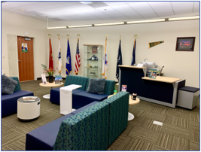
Questions

