Slide 1

REDWOOD CITY, CA
Counseling Division Position Vacancies

Slide 2
Header in Franklin Gothic Book
Position | Are there any special regulations such as law, Title 5, Education Code, Student Success Initiative or accreditation standards, etc. for the position? | Does the request support the goals of the Educational Master Plan or other strategic plans? | Do the data indicate a demonstrated program need?
Career Resource/Counseling Aid (Welcome Center/Career Center) | No | EMP Goal 1.1 Make Registration Easier, EMP Goal 3.11 Create and expand career exploration experiences | During our drop in period alone (including Super Saturday) the Welcome Center has seen over 500 students!
Retention Specialist (EOPS) | No | EMP Goal 1.14 Strengthen and scale student affinity programs | While we have seen the number of students in the EOPS program drop with the increase of students in Promise, EOPS students continue to be a high touch students population that strongly benefit from a permanent employee in this role.

Slide 3
Position | Are there any special regulations such as law, Title 5, Education Code, Student Success Initiative or accreditation standards, etc. for the position? | Does the request support the goals of the Educational Master Plan or other strategic plans? | Do the data indicate a demonstrated program need?
Student Life and Leadership Manager (Student Life and Leadership Office) | Yes | EMP Goal 2.10 Reimagine and transform college participatory governance | Despite being the smallest college in our district we have consistently had the most student events year over year.
Program Supervisor (Colts U Transfer Center) | Yes | EMP Goal 1.16 Create a campus culture that expects and supports students’ completion, EMP Goal 3.8 Strengthen transfer support services, EMP Goal 3.9 Facilitate the transfer process by implementing the provisions of AB 111 and 928 | According to our 22-23 fast facts 67% of students have a transfer goal. 3 of our top 4 degrees are transfer degrees.

Slide 4
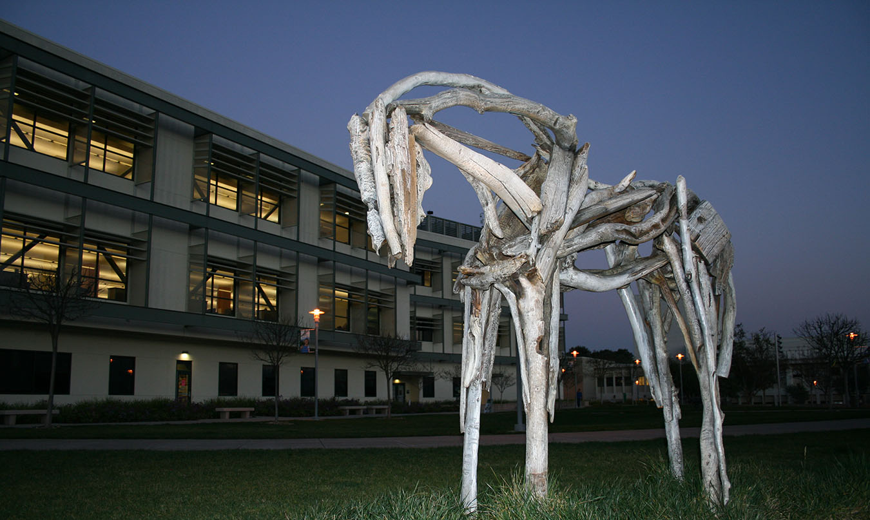
Thank you

