Slide 1

Expanding in East Palo Alto, Belle Haven, and North Fair Oaks, with an emphasis on Black, Indigenous, and People of Color communities
EMP Priority 2, Goal 3.6
PBC Meeting - Wednesday, December 6, 2023

Slide 2
Cañada College
Educational Master Plan
THE FOCUS:
EMP 3.6 - Triple the number of high school students on campus during the summer and on Saturdays during the academic year.
THE PRIORITY:
Expanding in EPA, BH, and NFO with an emphasis on BIPOC communities
Notes:
Manuel

Slide 3
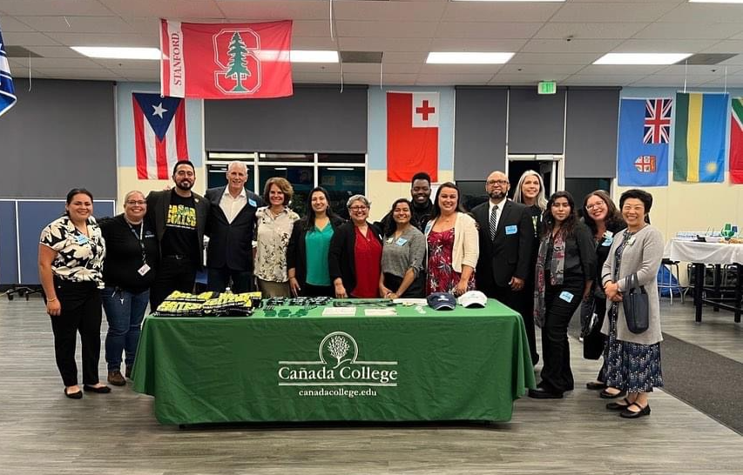
Our Team
Alicia Aguirre
James Aganon
Mayra Arellano
Wissem Bennani
Olivia Cortez-Figueroa
Estela Garcia
Manuel Alejandro Pérez (Chair)
Mahitha Rao
Stephen Redmond
Kat Sullivan-Torrez
Lesly Ta
Our Mtg Schedule
Oct 25, Nov 7, Nov 28, Dec 8

Slide 4
Cañada College
Educational Master Plan – Baseline Data
BGCP MOU
Summer Dual Expansion
Outreach Camps
On-campus BGCP Advising
Living the Promise MOU
SUHSD
Ravenswood
Data Dashboard – Equity & Disproportionate Impact: https://canadacollege.edu/prie/dashboards/disproportionate-impact.php
Antiracism Resources at the College Since 2020 https://canadacollege.edu/antiracism/
August 2023 EMP Leadership Retreat
https://docs.google.com/document/d/1XIDS-lBAxmOYQFqfQpD8rxw6eEup_PukWLNtqsVVlHM/edit?usp=drive_link
Notes:
Manuel

Slide 5
Nov 7 Meeting - Waterfall Exercise Prompts & Feedback
          Overview: Chair reads a specific prompt to the zoom room and invites zoom participants to note their immediate reaction, impression, a word, a phrase, or a sentence in the chat but refrain from hitting “enter”. Instead, once participants are ready, the chair invites all participants to hit “enter” at the same time, thus creating a waterfall of responses and impressions at the same time.
PROMPT: “Students within our service area and region are opting to attend Foothill.”
PROMPT RESPONSES: See Saved Chat File (timestamp 09:35:28 – 09:35:34)
PROMPT: “Black students are enrolling at Foothill because they do support Black students there.”
PROMPT RESPONSES: See Save Chat file (timestamp 09:40:30 – 09:42:45)

Slide 6
Recommendation #1
Highlights
One meeting per semester
Agendas should have clear purpose and call-in for key expertise and experience
Need to distinguish between President’s Advisory Council
Meetings should include action plan and follow-up timeline
(Re)establish a community advisory council specific to Belle Haven, East Palo Alto and North Fair Oaks

Slide 7
Recommendation #2
Highlights
Actively support and resource job boards for and/or by Black community (e.g., https://a2mendjobs.com/)
Invest in increased funding for partnerships with Middle Schools, High Schools and community partners on campus (e.g., BSU High School Outreach Programs on campus, host HSI and AANAPISI aligned events on campus, invite parents and families to college events)
Develop unique resources to (re)develop trust with our Black community, with our Ohlone Tribal community, and with our people of color communities

Slide 8
Recommendation #3
Highlights
Re-establish a fresh connection to local public transportation board for increased/enhanced routes
Explore options for hosting pick-up sporting events and activities in the community and on-campus
Explore options for expanding off-campus community events and programming (e.g., Super Saturday, Job Train offerings)
Expand existing transportation resources and/or develop a strategic action plan for expanding instruction and services in the BH, EPA, NFO community

Slide 9
Recommendation #4
Highlights
Data should inform new program and resource development
Engage the community to inform new program and resources the college might offer in East Palo Alto in our partnership with JobTrain
Host community listening sessions with a plan for implementation/action based on the feedback (e.g., host focused sessions on specific topics)
All recommendations and plans should be data-informed.

