Slide 1
EMP 3.2 Community Listening Sessions

Slide 2
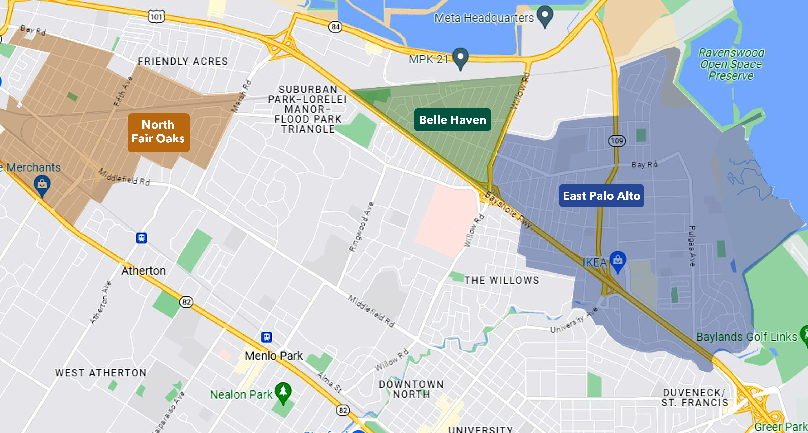
Notes:
Mayra

Slide 3
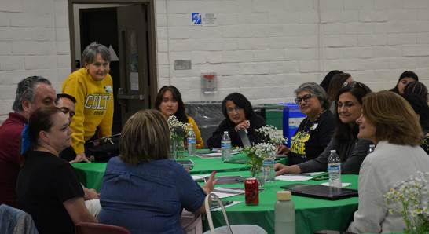
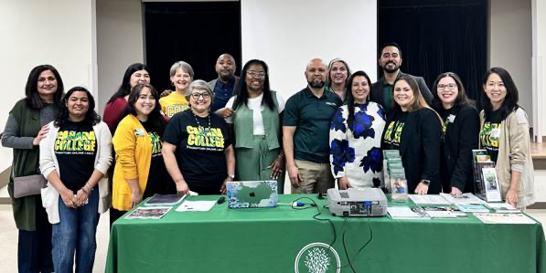
NFO Listening Session, April 30, 2024
Educational Master Plan 3.2
Transform where we share what Cañada has to offer by identifying and reaching new outreach audiences that help strengthen our ties to BIPOC communities (particularly those communities our recruitment maps indicate might be underserved, such as North Fair Oaks, Belle Haven, and East Palo Alto). Recruit more BIPOC students, including more students who identify as Black / African American.

Slide 4
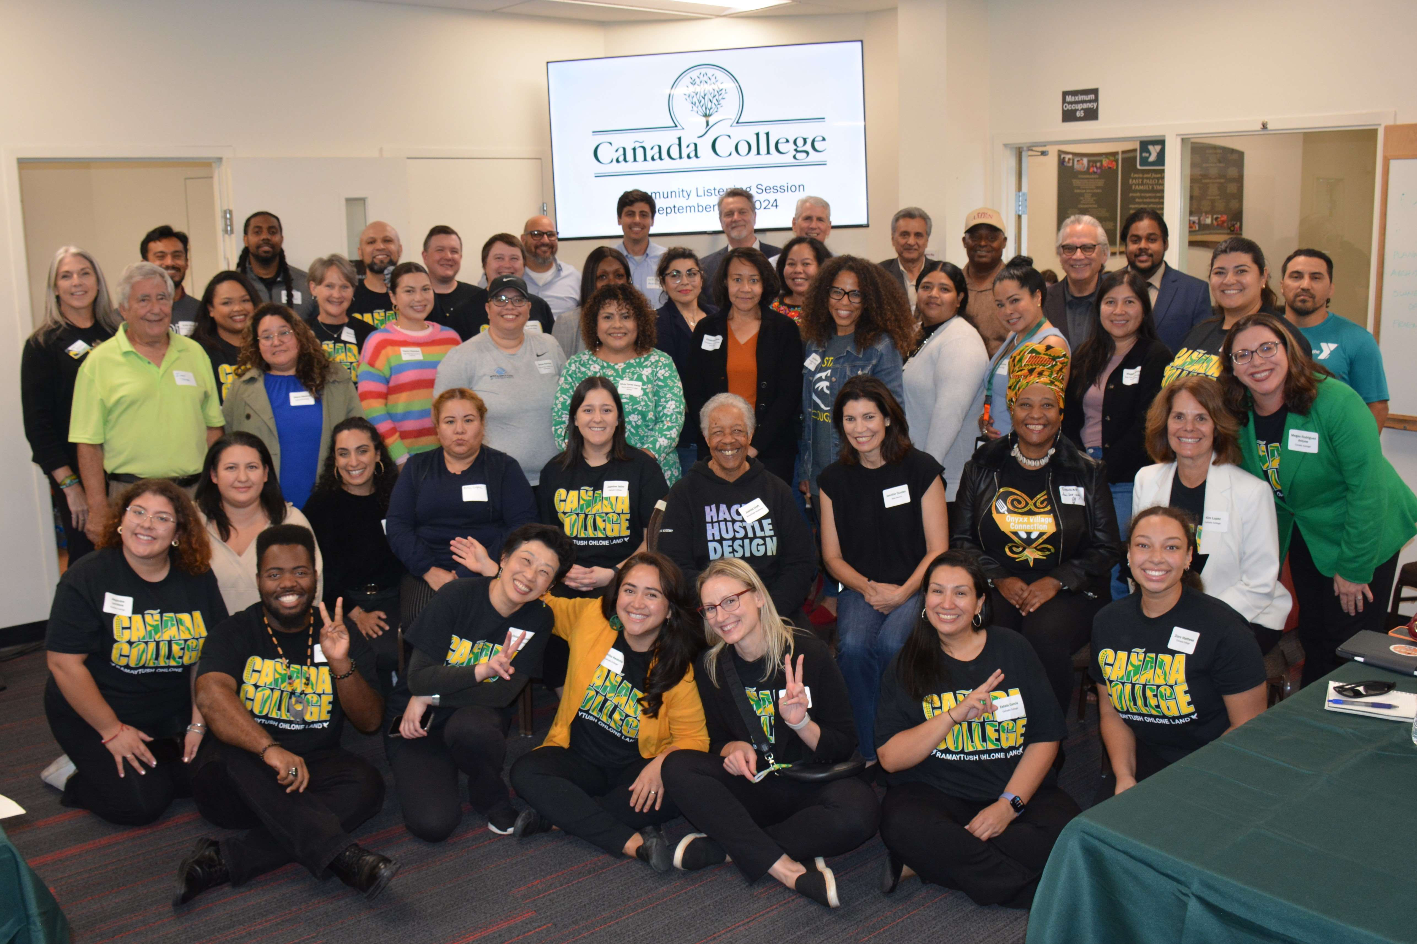
Community Listening Session, September 19, 2024
Strengthen our ties to our Black, Indigenous, People of Color (BIPOC) community in North Fair Oaks, Belle Haven and East Palo Alto.
Increase the number of degree and certificate programs and general education courses at the Menlo Park site and/or other off-campus locations (East Palo Alto) to help students access needed courses and support services closer to home.

Slide 5
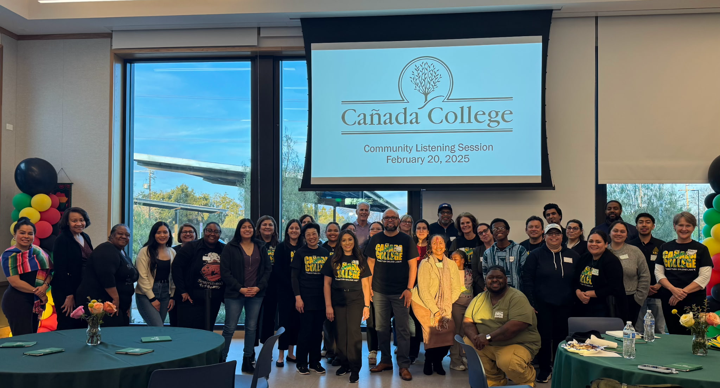
Community Listening Session February 20, 2025
Strengthen our ties to our Black, Indigenous, People of Color (BIPOC) community in Belle Haven, East Palo Alto and North Fair Oaks.
Increase the number of degree and certificate programs and general education courses at the Menlo Park site and/or other off-campus locations to help students access needed courses and support services closer to home.

Slide 6
North Fair Oaks Community Suggestion
Establish Trust Through Long-Term Commitment and Transparency:
Develop and implement transparent accountability measures,
Invest in long-term community partnerships
Actively address historical injustices through concrete actions.
Expand Equitable Access to Resources and Services:
Provide services at accessible times and locations,
Offer culturally and linguistically appropriate programs,
Address transportation barriers to ensure equitable access to education
Invest in Comprehensive Youth Support and Empowerment Programs:
Create mentorship programs,
Provide mental health and substance abuse support,
Offer educational and recreational opportunities that empower youth, with a focus on early intervention and engagement with younger children.
Prioritize Authentic Community Engagement and Collaborative Partnerships:
Establish open lines of communication,
Create feedback mechanisms
Partner with trusted community organizations to ensure community voices are actively heard and integrated into decision-making processes, also
Go into the community to meet the people where they are.

Slide 7
East Palo Alto Community Suggestion
Increased Access to Education:
Expand dual enrollment programs and other pathways to college.
Offer vocational training and short-term certificate programs.
Provide support services, including tutoring, counseling, and career guidance.
Community Partnerships:
Collaborate with local organizations, schools, and businesses to address community needs.
Offer community-based programs and events.
Support local entrepreneurship and job creation.
Mental Health and Well-being:
Increase access to mental health services, including counseling and support groups.
Promote mental health awareness and reduce stigma.
Integrate mental health support into educational programs.
Economic Development:
Advocate for affordable housing policies.
Support job training and creation programs.
Encourage local businesses and entrepreneurship.

Slide 8
Belle Haven Community Suggestions
Community-Based Services and Events:
Utilize community spaces in Belle Haven for events and services.
Host information sessions at the community campus.
Offer financial literacy workshops and programs.
Provide "Why College" workshops and transfer workshops.
Organize all-day campus visits with transportation, childcare, and resources.
Bring resources like application, counseling and registration to the community center regularly.
Educational Support:
Offer ESL courses.
Educate families about free college opportunities.
Share student testimonies from Belle Haven students.
Provide access to technology, including extended laptop loans.
Offer project/program management training.
Accessibility and Transportation:
Address transportation challenges to schools, organizations, and colleges.
Partnerships and Outreach:
Collaborate with community partners to improve accessibility.
Develop strategies to reach prospective students who find other colleges

