Slide 1
Reassigned Time: Process, Decisions, & Resources
Overview for Planning & Budget Committee (PBC) | March 5, 2025
Presented by Dr. Chialin Hsieh, VPI
For detailed process information, visit: canadacollege.edu/ipc/reassignment-process.php

Slide 2
Reassigned Time Workflow--2024-2025
Key process overview:
Application Submission: Oct–Nov 2024
Review & Feedback: Nov–Dec 2024
Final Decisions: Dec 2024–Mar 2025
Appeals/Out-of-Cycle Requests: Jan 2025
Deadline-Driven Process: Faculty input → IPC review → VP approval.

Slide 3
Key Dates for Reassignments
Critical Deadlines
October 15, 2024: Applications open.
November 15, 2024: Faculty submission deadline.
December 13, 2024: VPI approval/denial of the positions.
March 3, 2025: Final assignments determined.
Key Note: Out-of-cycle requests require IPC approval.

Slide 4
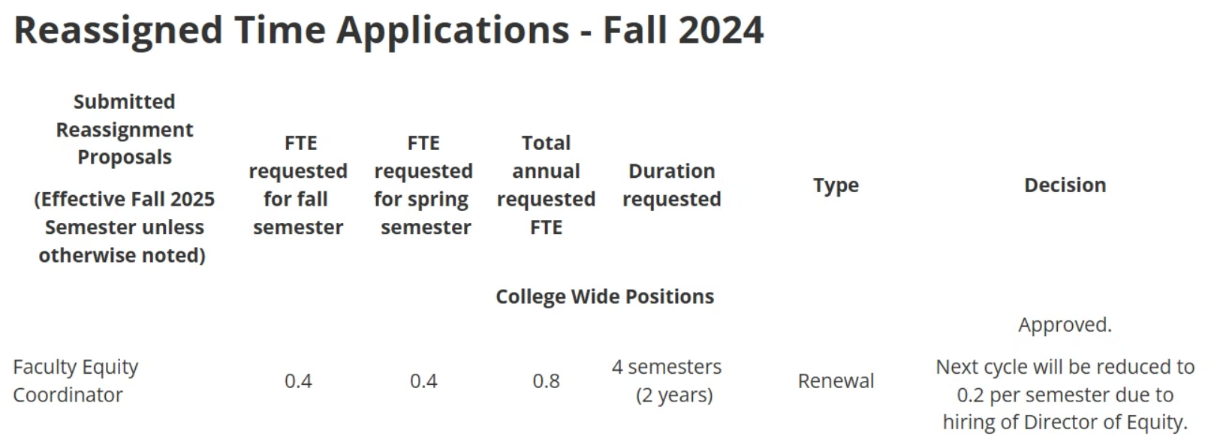
Decision for 2025 Reassignments
Reassigned Time Applications - Fall 2024 | Instructional Planning Council | Cañada College

Slide 5
Reassigned Time Costs—Cañada College
Financial Overview (2024-2025)
This table shows the reassigned time costs for Cañada College, including FTEF, total costs,
and the percentage for each category.
Estimation of the FTEF Calculation
Grade 3 Step 10: 1.0 FTEF
$60,850
Grade 3 Step 10: 0.1 FTEF
$6,085
Grade 3 Step 10: 0.2 FTEF (3 units)
$12,170

Slide 6
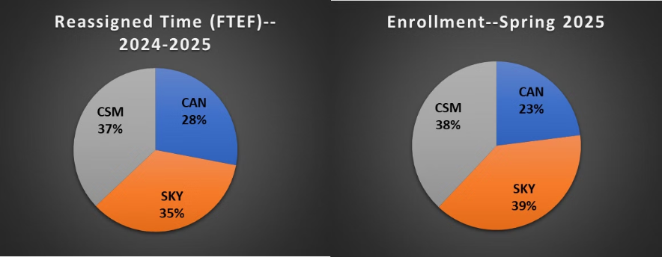
Reassigned Time Costs—District
Financial Overview (2024-2025)
This table shows the reassigned time costs for each college
in 2024-2025, including FTEF, total costs, the percentage of
district spending, and enrollment.
Note: FTEF = Full-Time Equivalent Faculty
Pie chart comparing total expenses and total enrollment
across colleges

Slide 7
Next Steps & Recommendations
Potentially showcase reassigned time work
Implement continuous oversight of new reassigned time positions to
ensure fiscal sustainability
Optimize renewal reassigned time positions through dynamic
FTEF adjustments

Slide 8
Questions and Discussion

