Slide 1

Orientation to
Participatory Governance at
Cañada College
For Planning and Budgeting Council (PBC)
and other participatory governance committee members and prospective members
by
Dean of Planning, Research and Institutional Effectiveness (PRIE), Karen Engel
Vice President of Administrative Services, Graciano Mendoza
August 23, 2019

Slide 2
Agenda
Mission, Vision, and Values of the College
College Organizational Chart
What is Participatory Governance?
The Law
Roles and Responsibilities of Council Members
Program Review, Priority Setting and Resource Allocation
Integrated planning and budgeting cycle
Measuring and monitoring our effectiveness

Slide 3
Mission
Cañada College provides our community with a learning-centered environment, ensuring that all students have equitable opportunities to achieve their transfer, career education, and lifelong learning educational goals. The College cultivates in its students the ability to think critically and creatively, communicate effectively, reason quantitatively, and understand and appreciate different points of view within a diverse community.

Slide 4
Vision
Cañada College is committed to being a preeminent institution of learning, renowned for its quality of academic life, its diverse culture and practice of personal support and development, extraordinary student success, and its dynamic, innovative programs that prepare students for the university, the modern workplace, and the global community.

Slide 5
Values
Transforming Lives
High Academic Standards
Diverse and Inclusive Environment
Student Success in Achieving Educational Goals
Community, Education, and Industry Partnerships
Communication and Collaboration
Engaging Student Life
Accountability
Sustainability
Transparency

Slide 6
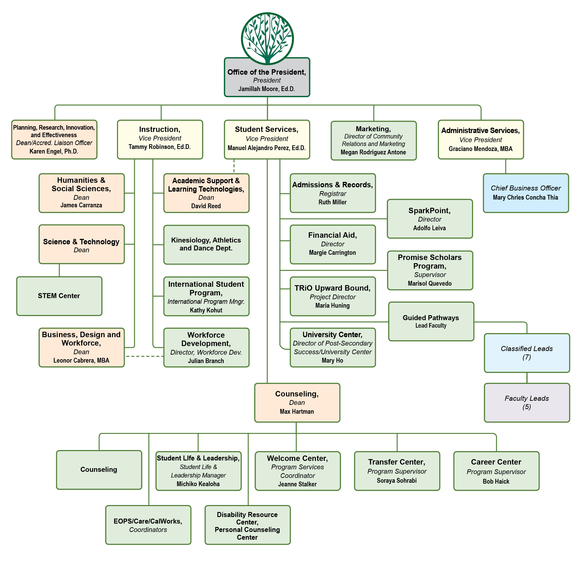

Slide 7

What is participatory governance?

Slide 8
Students Faculty Staff Administrators

Slide 9
Students Faculty Staff Administrators
Working Together for Student Success!

Slide 10
Participatory Governance
“ … not a simple process to implement – goodwill, thoughtful people, a willingness to take risks and the ability to admit problems exist – can go far toward establishing a positive environment…
The central objective should be creation of a climate where energy is devoted to solving crucial educational tasks and not to turf battles over governance.”
CCCT/CEOCCC Policy Paper, December 1989

Slide 11
Participatory Governance: the law
Board of Governors shall establish "minimum standards" and local governing boards shall "establish procedures not inconsistent" with those standards to ensure:
Faculty, staff and students the right to participate effectively in district and college governance and
The right of academic senates to assume primary responsibility for making recommendations in the areas of curriculum and academic standards.
Education Code Sections 70901 and 70902

Slide 12
Participatory Governance: Academic Senates
(a) The governing board shall adopt policies for appropriate delegation of authority and responsibility to its academic senate.
…providing at a minimum the governing
board or its designees consult collegially with the academic senate when adopting policies and procedures on academic and professional matters.
Title 5 §53203
uic k Time ™ a n d a d ec o mp re s so r
a re n ee d e d to s ee this pic tur e .

Slide 13
Academic Senates “10+1”
Academic and professional matters means the following policy development and implementation matters:
Degree and certificate requirements
Curriculum, including establishing prerequisites and placing courses within disciplines
Grading policies
Educational program development
Standards or policies regarding student preparation and success
District and college governance structures, as related to faculty roles
Faculty roles and involvement in accreditation processes, including self study and annual reports
Policies for faculty professional development activities
Processes for program review
Processes for institutional planning and budget development, and
Other academic and professional matters as mutually agreed upon between the governing board and the academic senate. Title 5 §53200

Slide 14
Academic Senates “10+1”
Academic and professional matters means the following policy development and implementation matters:
Degree and certificate requirements
Curriculum, including establishing prerequisites and placing courses within disciplines
Grading policies
Educational program development
Standards or policies regarding student preparation and success
District and college governance structures, as related to faculty roles
Faculty roles and involvement in accreditation processes, including self study and annual reports
Policies for faculty professional development activities
Processes for program review
Processes for institutional planning and budget development, and
Other academic and professional matters as mutually agreed upon between the governing board and the academic senate. Title 5 §53200

Slide 15
Staff
Faculty
Students
Administrators

Slide 16

SMCCD Board of Trustees
Participatory Governance Structure
As of 11.7.18
Chancellor
President
PBC
Staff
Faculty
Students
Admini-strators
ASCC
(students)
Academic Senate (faculty)
ClassifiedSenate (staff)
Cabinet
(VPs, all Deans, Marketing)
Staff
Faculty
Students
Administrators
Staff
Faculty
Students
Administrators
Staff
Faculty
Students
Administrators
APC
IPC
SSPC
Key:
= recommendations
= decisions
Programs
Program Review, Resource Requests, Staffing Requests
Deans
College Mission

Slide 17
College Committee Reporting Structure
President
Academic Committee for Equity and Success (ACES)
Strategic Enrollment Management Committee
Report to the Planning & Budgeting Council (PBC)
PBC
Staff
Faclty
Students
Admin
ASCC
(students)
Academic Senate (faculty)
ClassifiedSenate (staff)
Curriculum Committee
Subcommittees of the Academic Senate
Staff
Faculty
Students
Administrators
Staff
Faculty
Students
Administrators
Staff
Faculty
Students
Administrators
APC
IPC
SSPC
Environmental Sustainability Committee
Professional Learning Committee
Safety Committee
Report to the Administrative Planning Council (APC)
Honors Transfer Program Committee
Distance Education Advisory Committee
Technology Committee
Report to the Instructional Planning Council (IPC)

Slide 18
Roles & responsibilities of Council members
Communicating
Representing your constituency while keeping your “college-wide” hat on - wearing multiple hats!
Responsibility for the overall well-being of the College as a whole
Ultimately: recommendations to President

Slide 19
PBC Responsibilities
PBC advises and makes recommendations to the President on matters pertaining to:
prioritizing expenditures to advance the College goals
planning
governance issues
Serve as the Accreditation Oversight Committee
issues regarding college facilities, maintenance, and operations
issues regarding campus climate
any other issue affecting the well-being of the College at large

Slide 20
PBC Responsibilities
The PBC reviews College and District policies and develops procedures to implement policy; provides accreditation oversight; establishes ad hoc work groups and subcommittees to address college planning needs and priorities.

Slide 21
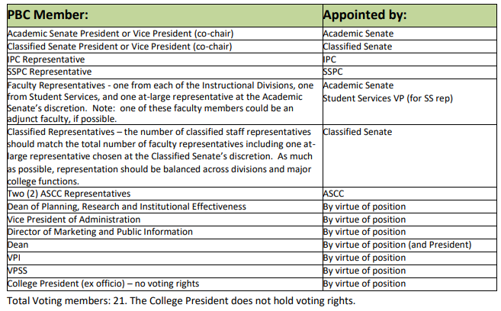

Slide 22
Expectations of Service
Members will commit to attend and prepare for Planning & Budget Council (PBC) meetings
Members will notify co-chairs if unable to attend scheduled meetings
Meetings will start on time
Members will provide information to and solicit feedback from constituent groups.
Members may be removed or asked to resign by consensus of the other members, after three (3) absences in one semester.

Slide 23
Program Review, Priority Setting and Resource Allocation

Slide 24
Program Review
PURPOSE: Program review is the process through which constituencies (not only faculty) on a campus take stock of their successes and shortcomings and seek to identify ways in which they can meet their goals more effectively.
A candid self-evaluation supported by evidence
Guides internal decision making
Provides external accountability (accreditation)
Connects program review with the college mission, planning, and budgeting
Faculty describes and documents what they do and why they do it
Faculty led: at Cañada the Academic Senate delegates responsibility to IPC

Slide 25
August
November
December
February
March
April
May
October
September
January
Program Review Timeline
Oct. 30 – Nov. 1 Position Justification Presentations
Divisions provide information about prior‐ year grant‐funded positions
December 1
Validation concludes; PRIE & Budget Office provide information and rubric to PBC for prioritization
Dec - January
President announces approved positions
(contingent on funding)
Mid-April
Budget Office notifies Programs of approved requests funded for following year
August 1
Data Packets Available;
TracDat Open
Late Jan – Early Feb
IPC Program Review Presentations
Aug – Oct. 10
Departments conduct reviews
Deans provide feedback
Feb - April
VPA presents budget scenarios to PBC
November
IPC, SSPC, APC & PBC give Peer Review feedback in joint meeting
October
Cabinet reviews resource requests
November
Academic Senate prioritizes faculty position requests
October 11
DUE
Programs submit complete program reviews and all resource requests
November 8
Deans, VPs and President submit prioritized Division or Department resource requests
December 5
PBC prioritizes requests and presents President with prioritized list.
Mid-January
VPA presents 3-year revenue and expense projections to PBC
Mid-February
VPA returns to PBC with funding proposal
Late March
VPA & Deans discuss budget augmentation requests
Early June
VPA authorizes Divisions to make purchases
August Flex Day
Workshops
Approved by PBC on February 6, 2019

Slide 26
Planning for the Future
The Cycle
  Forward Planning –for FY 2020-21
    One-time requests
    On-going (recurring) requests

Slide 27
Resource Request Prioritization Rubric
Safety Concern? (If yes, …provide to your Dean ASAP)
Resource Type:
  Personnel
  Information Technology
  Facilities
  Equipment
  Instructional Materials
  Supplies
  Subscriptions/Memberships
  Other

Slide 28
Budget Development & Program Review Timeline

Slide 29
PBC Role in Resource Allocation
Program Review
  Prioritize requests according to established criteria (including college ability to achieve mission and goals
  Accept Academic Senate prioritization of faculty positions and consider that in the Council’s recommendation to the President

Slide 30
Integrated Planning & Budgeting

Slide 31


Slide 32
Canada Ed. Master Plan Goals:
Student Completion/Success
To provide educational and student services programs that help students meet their unique academic goals; minimize logistical and financial barriers to success; and highlight inclusivity, diversity and equity.
Community Connections
To build and strengthen collaborative relationships and partnerships that support the needs of, reflect and enrich our diverse and vibrant local community.
Organizational Development
To invest institutional resources on the structures, processes and practices that focus on a diverse student and staff population, promote excellence, equity, inclusion and transformative learning.

Slide 33
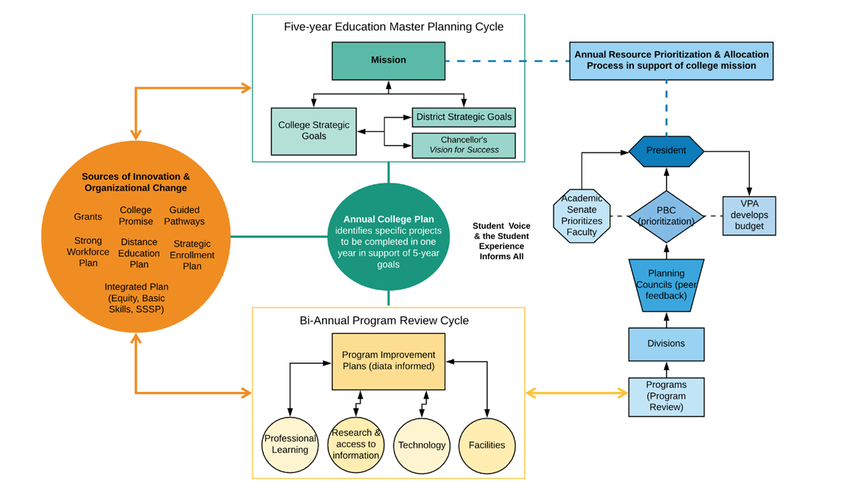

Slide 34
District Strategic Plan (Goals)_
Chancellor’s Office
Cañada College Goals
ACCJC
Vision for Success (Goals)
Education Master Plan
Institution-set Standards
Annual
Strategic Plan
Student Equity
Annual Goals (new)
Guided Pathways
Assessment of Progress
All other college plans
Distance Education
Facilities
Professional Learning
Research
Strategic Enrollment Management
Sustainability
Technology
Quality Focus Essay
Strong Workforce

Slide 35
Cañada College Planning Calendar
Year: 2017 2018 2019 2020 2021 2022 2023 2024 2025 2026 2027
ISER 2019
Mid-Term Report
ISER 2026
ACCJC Annual, Mid-term, and ISER Report Cycle
5-year Education Master Plan Cycle
5-year Education Master Plan Cycle
Annual Plan
Annual Plan
Annual Plan
Annual Plan
Annual Plan
Annual Plan
Annual Plan
Annual Plan
Annual Plan
Annual Plan
Distance Education Plan
Facilities Master Plan
Guided Pathways Plan
Professional Learning Plan
Research Plan
Strategic Enrollment Plan
Strong Workforce Plan
Student Equity Plan
Sustainability Plan
Technology Plan

Slide 38
Measuring our effectiveness

Slide 39
Institution-set Standards: student achievement

Slide 40
Institution-set Standards: programmatic achievement

Slide 41
Institution-set Standards: operational metrics

Slide 42
ACCJC
Quality Focus Essay
Guided Pathways
(scale essential practices)
Strong Workforce (outcomes based)
ACCJC Annual Goals
Successful Enrollment |  |  | Access: successful enrollment | Help students choose and enter a program pathway | Increase students enrolled in programs leading to high-demand, high-wage jobs
Learning Progress | Course completion rate | Course completion rate |  |  |  | Course completion rate
 |  |  |  | Map pathways to student end goals
Momentum | Unit Accumulation | Unit Accumulation | Persistence: fall to sprg | Keep students on path
 | Completion of Transfer-Level English & Math in one year (AB 705) | Completion of Transfer-Level English & Math in one year (AB 705) | Completion of Transfer-Level English & Math in one year (AB 705)
Success | Completion (degrees & certificates) | Completion (degrees & certificates) | Completion (degrees & certificates) | Ensure that students are learning |  | Completion (degrees & certificates)
 | Transfer | Transfer | Transfer |  | Transfer | Transfer
 |  |  |  |  | Improve program quality so more students succeed
 |  |  |  |  |  | Licensure exam pass rates
Employment | Students employed in their field | Students employed in their field |  |  | More students employed in their field
Earnings |  |  |  |  | Improve student earnings
Equity | Close achievement gaps in all of the above | Close achievement gaps in all of the above | Close achievement gaps in all of the above
Vision for Success (Goals)
Student Equity

Slide 43
Important Information
PBC Website
PBC Co-Chairs: Jeanne Stalker and Diana Tedone-Goldstone
PBC Bylaws
Participatory Governance Manual
Compendium of Committees
PBC Agenda Planning Team Members: Co-Chairs plus President Moore, VPA Mendoza ,and Dean of PRIE, Engel

Slide 44
Questions & Answers

