Slide 1
New Biology Faculty
investing in non-majors

Slide 2
We have the VISION

Slide 3
Strategic Directions
Educational Master Plan
Improve entry by identifying clear student pathways for basic skills, career/technical, general transfer, specific majors, and courses/programs.
Student Engagement Plan
Focused - Every student who enrolls to pursue a certificate, degree, or who plans to transfer will work with college personnel to create a Student Success Pathway – A Roadmap to Completion.
Sustainability Plan
Utilize different pathways to integrate sustainability in the curriculum.

Slide 4
GE Thematic Pathways
Sustainability & Social Justice
BIOL 100: Intro to Life Sciences
BIOL 110: General Principles of Biology
HSCI 100: General Health Science
HSCI 116: Women’s Health

Slide 5
Honors
Current
BIOL 130: Human Biology
BIOL 250: Human Anatomy
Future
BIOL 100: Intro to Life Sciences
BIOL 110: General Principles of Biology
HSCI 100: General Health Science

Slide 6
Growth Opportunities
ADT in Nutrition and Dietetics
ADT in Biology
ADT in Kinesiology
Online - intro to life sciences
Online - nutrition

Slide 7
We have the need

Slide 8
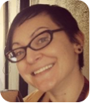


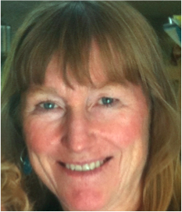
?
Allied Health
Non-Majors
Majors
Notes:
No dedicated FT faculty to non-majors

Slide 9
Reflection & Innovation
Courses without a dedicated FT faculty often lack consistent SLO analysis & subsequent experimentation in pedagogy

Slide 10
% CRNs taught by PT
67%
Notes:
22 of 33 sections are taught by PT (last semester 60% taught by PT)
2/3rd of sections have no FT faculty to drive innovations in teaching and learning

Slide 11
% CRNs taught by PT
Two-thirds of sections have no FT faculty to drive innovations to improve success
Notes:
22 of 33 sections are taught by PT

Slide 12
We are primarily not STEM
93% of sections do not directly benefit from STEM grant-funded support
Notes:
2 sections of 30 (biol+hsci) are majors

Slide 13
We are primarily not STEM
efforts to improve retention and success fall solely upon current faculty

Slide 14
We have the capacity

Slide 15
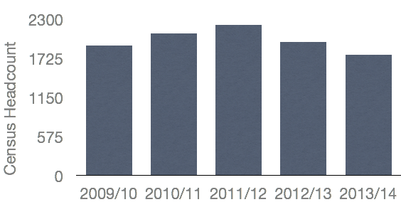
Enrollments
5-year low
20% fewer sections

Slide 16
but even at these historic lows…

Slide 17
Staffing
8.48 Total FTEF
-3.26 Full Time
5.22 Part Time
5 year average: 9.45 FTEF
4FT + 12 PT faculty
Notes:
Over 4.0 FTEF worth of load to fund 1 FT position
3.16 in 100-level courses

Slide 18
Staffing
could support 4-5 additional full time faculty
3 FTEF available in 100-level courses
Notes:
3.16 FTEF in 100-level courses

Slide 19
Fill Rate
86%
5 year average: 88%
College average: 78%
Notes:
College 5-year average: 78%

Slide 20
LOAD
545
College 5-year average: 546

Slide 21
Summary

Slide 22
A new FT Biology faculty…
will contribute to GE thematic pathways and honors program
will focus on improving students success in f2f and online non-majors courses
is supported by more than 4 FTEF of available workload
is an efficient use of college resources

