Slide 1
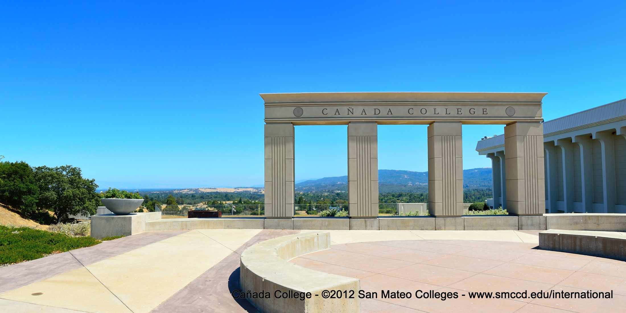
Cañada College
From here you can go anywhere
International Student Center
Supinda Sirihekaphong ● sirihekaphongs@smccd.edu ● 1-650-304-3440

Slide 2
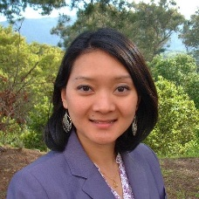
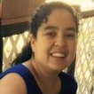
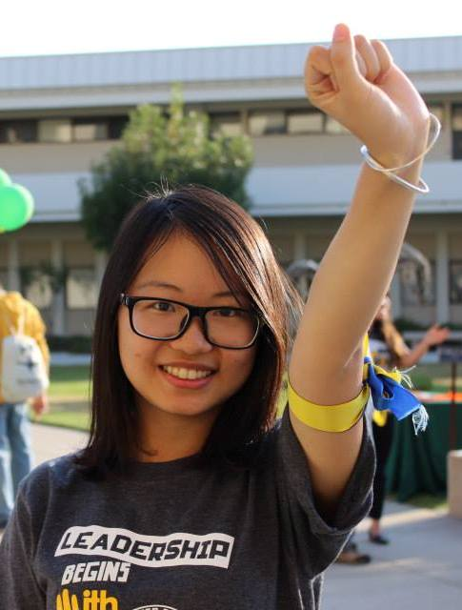

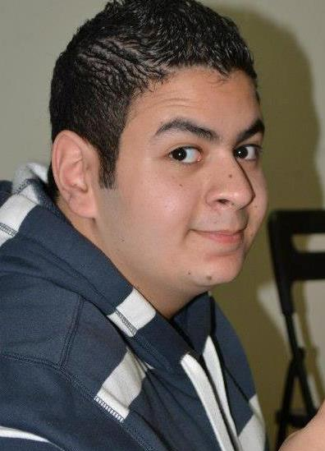
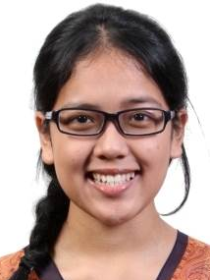
Staffing Request
Full-time Classified Program Services Coordinator
  Same position at Skyline (169 students) and
  CSM (418 students; add’l Office Assistant and Retention specialists)
  Current staffing 1 full-time Manager, 1 part-time Program Services Coordinator, 4 Student Ambassadors, 20 hours total (116 students)
Responsibilities:
  Process international student admission and comply with immigration regulations in SEVIS
  Provide international student support services including implementing orientation and workshops, referrals to other student services
  Recruit international students through outreach to ESL partner schools

Slide 3
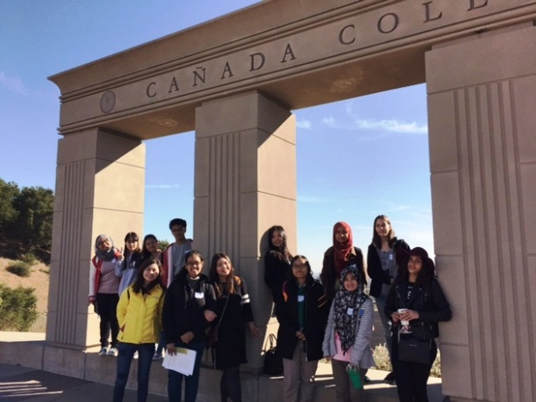
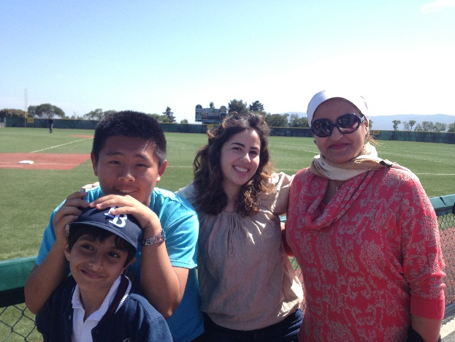
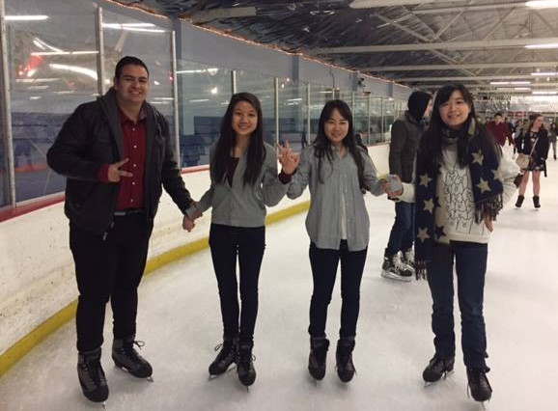
Mission Statement
Provide individualized services to students, so they can achieve their personal, educational, and professional goals.
Promote understanding and respect for community engagement and cultural exchange.

Slide 4
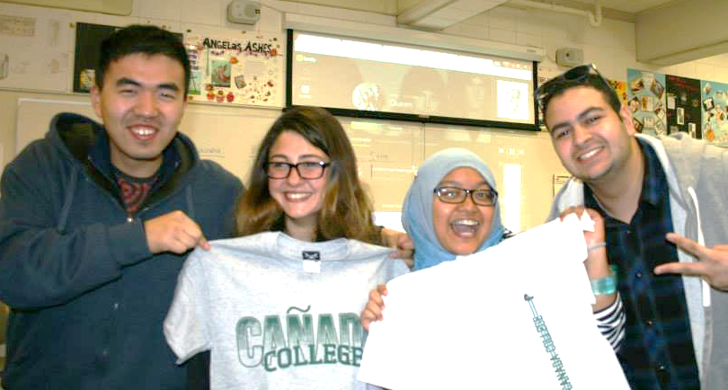
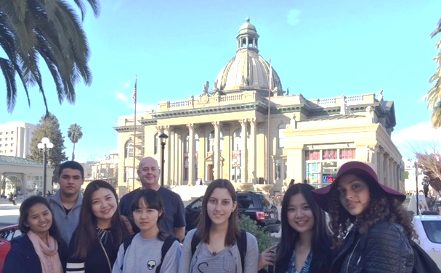
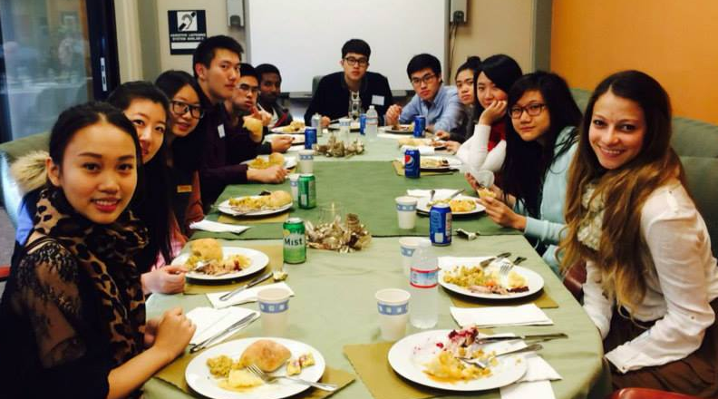
Student Learning Outcomes
1. Understand and maintain their F-1 immigration rights and responsibilities.
2. Increase knowledge of services and tools available to reach their education goal (complete a program of study or transfer to a 4-year university).
3. Become an active member of the Canada College community. ISC must help international students understand the importance of engagement in achieving their education goals.

Slide 5
Admissions Application Trends

Slide 6
International Enrollment Trends

Slide 7
International Services Trends

Slide 8
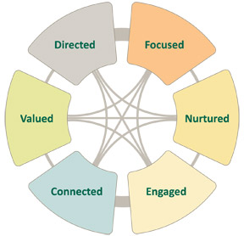
Staffing Justification
Student Success (Re)defined
Orientation, Transfer,
Class Participation, Employment Workshops,
Referrals to other student services/workshops/events
Mid-term Progress Reports
Weekly Enrollment Checks
Bi-weekly Newsletter
Open Door Policy
Student Ambassadors/ New Student Mentees
Birthday Cards
End of Semester Party
Social activities/media
(orientation, bowling, ice skating)
MAP Club & other clubs, ASCC, on campus employment, etc.
SMCCD has committed an additional $700,000 toward international student recruitment.

Slide 9
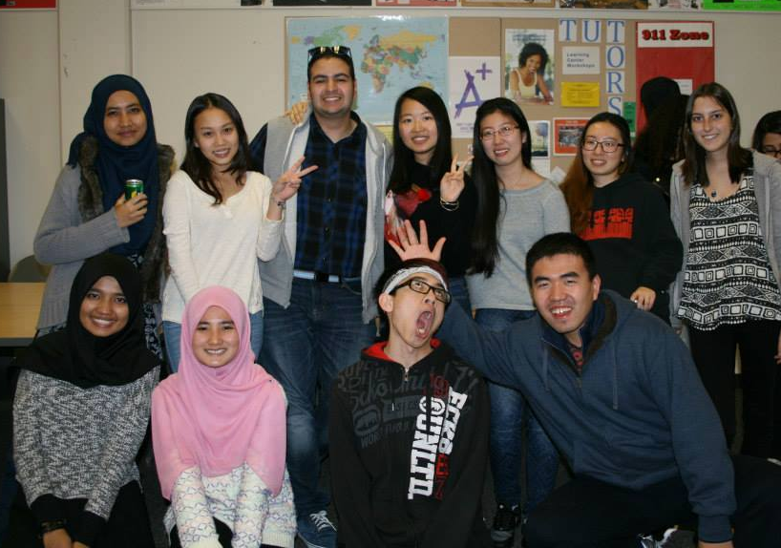
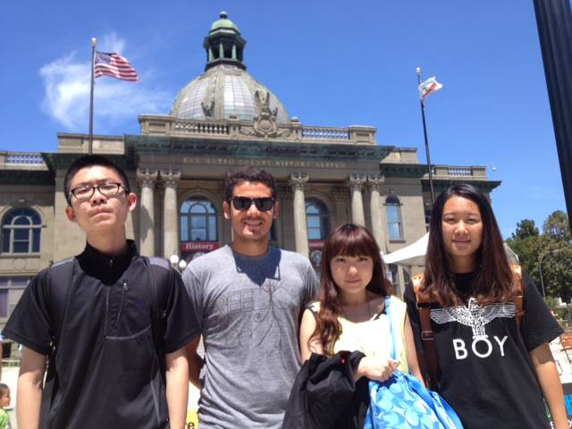
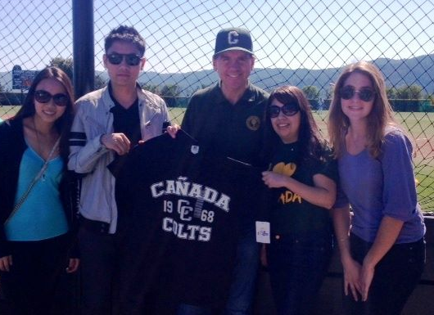
Questions?
Thank You.

