Slide 1
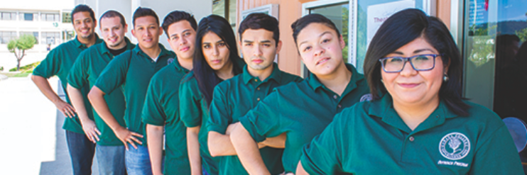
Program Services Coordinator
Hiring Justification - Outreach, Financial Aid & SparkPoint
Prepared by: Maggie Baez, Margie Carrington & Adolfo Leiva
October 21, 2015

Slide 2
Outreach, Financial Aid & SparkPoint Request
Outreach Program Services Coordinator (FT)

Slide 3
Cañada College Outreach Mission
Be the ‘face’ of Cañada College
Encourage students and community members to pursue a college education
Provide underserved populations avenue to reach their career and life goals

Slide 4
Outreach Pillars – Connecting Students
Provide accurate and timely information that is understandable for our diverse community
Deliver outreach efforts for both on and off-campus activities
Coordinate informational events across multiple campus departments
Strengthen student service connections across departments

Slide 5
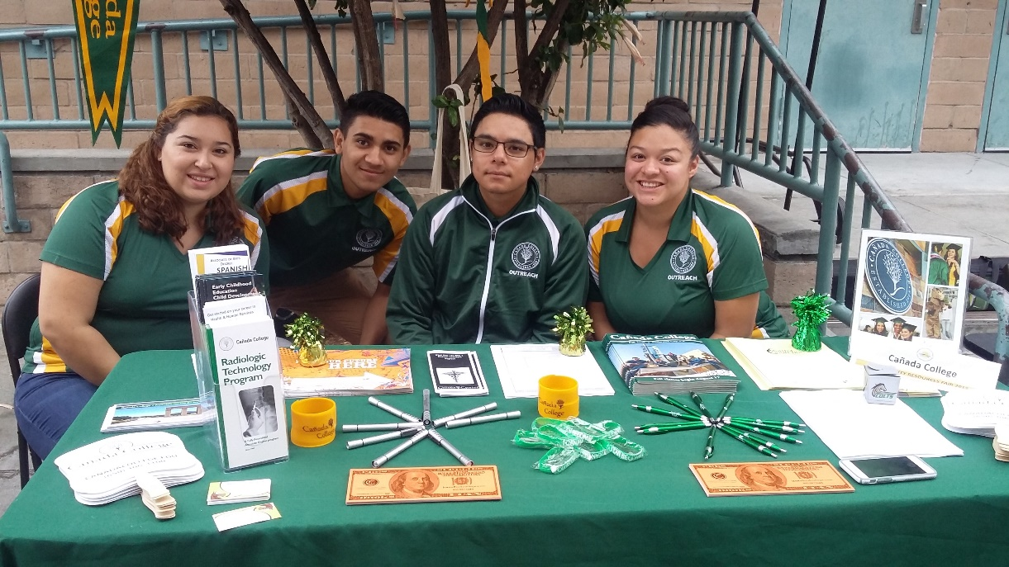
Alignment with Strategic Plan Objectives
1.4
2.1
2.3
2.4
2.5
3.1

Slide 6
Outreach …
Presents to high school students, parents, and the greater community
Conducts application and Financial Aid workshops
Schedules high school visits & attends college/educational Fairs
Coordinates campus tours
Promotes campus programs and services
Plans, collaborates & participates in campus-wide events

Slide 7
High School Outreach
2013 – 2014
11 High Schools
  SUHSD
  Pescadero H.S.
  Half Moon Bay H.S.
  Aragon H.S.
  Hillsdale H.S.
  San Mateo H.S.
2015 and Beyond
23 High Schools
  SUHSD
  SMUHSD
  SSFUHSD
  JUHSD
  Coastside
200% Increase

Slide 8
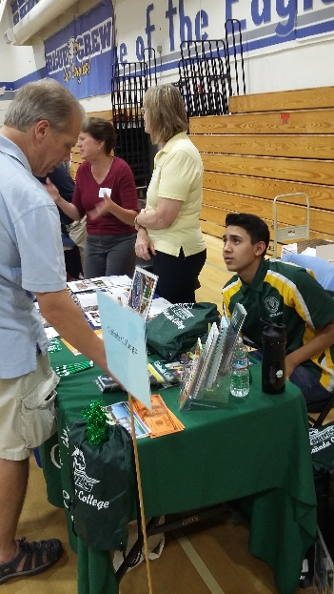
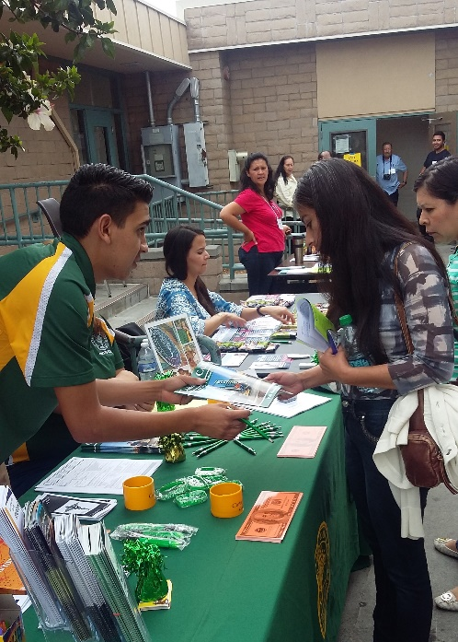
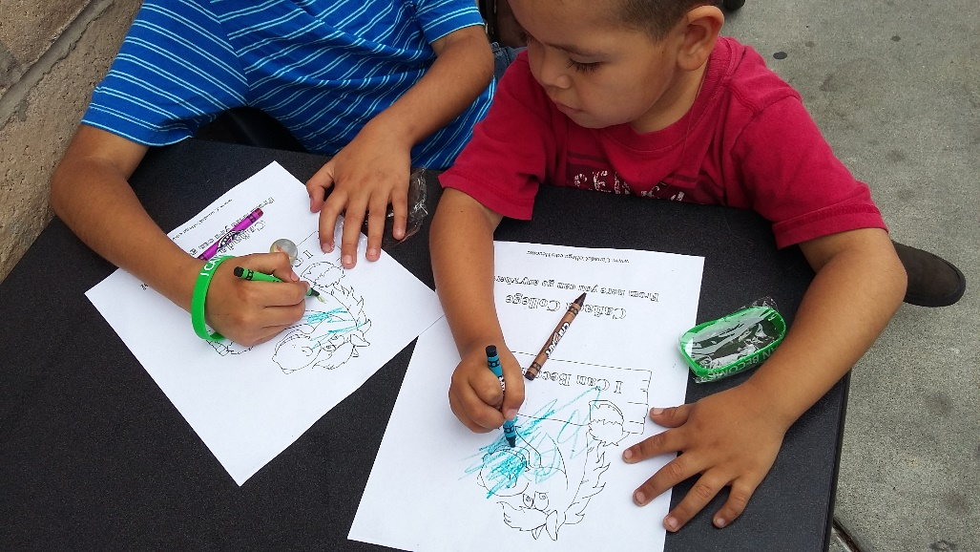
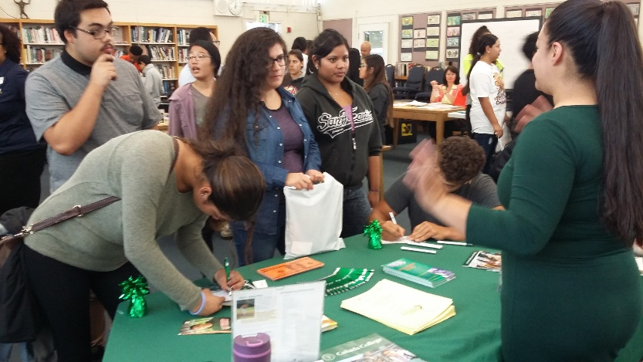
Off Campus Activities in the Community

Slide 9
Community Outreach
2013 – 2014
7 Major Events
  North Fair Oaks Community Festival (NFO)
  3 college nights
  2 college days
  OYE – Youth Educational Conference (NFO)
2015 and Beyond
21 Total Major Events
  2013–14 Major Events &
  Sequoia H.S. Dreamers Conference
  2 RWC festivals
  7 College presentations (non-profit orgs)
  Special populations
300% Increase

Slide 10
On Campus Outreach
2013 – 2014
Major Activities
  Career & Technical Education (CTE) Career Day
  Spring Priority Enrollment Program (PEP) for seniors
  On-going H.S. tours
2015 and Beyond
Major Activities
  CTE Career Day
  Spring PEP
  On-going H.S. tours
  Connect to College Night
  Multiple Special PEP (targeted for at-risk, high need students by H.S.)
  Fiesta Cañada
  Noche de Familia
  COLTS Academy
200% Increase

Slide 11
Current Outreach Staffing
1.0 FTE
College Recruiter

Slide 12
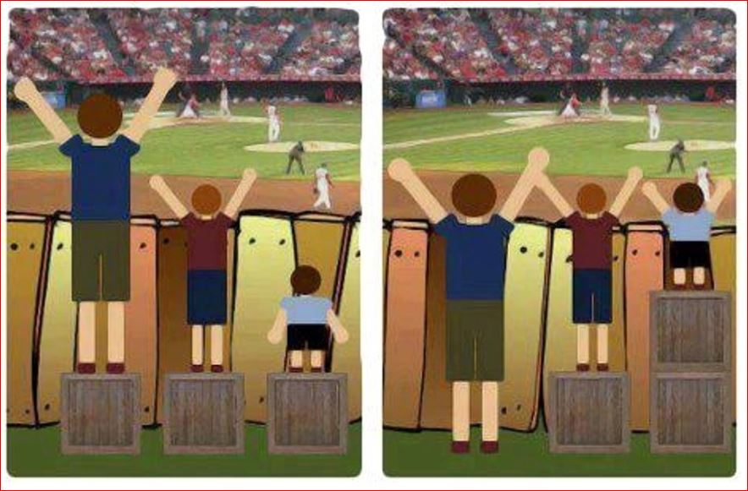
Equity

Slide 13
Equity. The Need is…
Increasing outreach presence on and off campus
Connecting previously underserved populations to campus resources
Closing the achievement gap
Mitigating the social and educational imbalance for our students
Effectively utilizing limited college resources

Slide 14
Benefits
Strengthen and expand our community partnerships
Serve as a bridge to connect underserved and disproportionately impacted students to Cañada College and YOUR programs
Meet the unmet social imperative for financial education and literacy needs of the community
Provide increased inter-departmental coordination and cost savings

Slide 15
The Need is…
An Outreach Program Services Coordinator

Slide 16
Questions?
Thank you!

