Slide 1
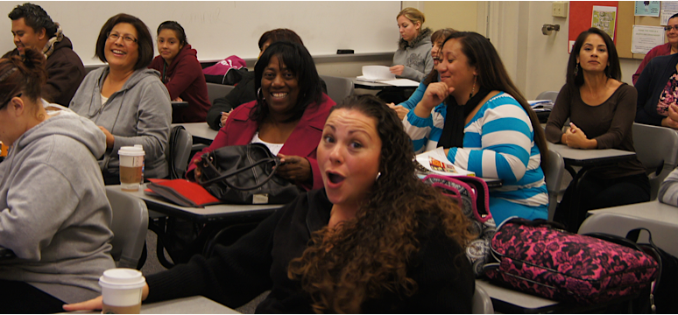
College for working adults counselor
Presenters: Kristen Parks & Nadya Sigona

Slide 2
Who we are…
The ONLY evening/weekend transfer program on the Peninsula
A track record of student success
A permanent, institutionalized program
Notes:
Created in 2011

Slide 3
CWA Enrollment
Continued demand for the program
Notes:
You can see how much the program has grown over the past 5 years.
Back in 2011…
We offered only 2 degrees
We had only 26 students
We offered only 5 classes
Although other colleges offer evening classes, students who work all day find it difficult to access all the courses they need for degree completion at night. As a result, if this program did not exist, these students would not otherwise be enrolled at any college at all.
The American School Counselor Association recommends a student to counselor ratio of 250:1. Canada has about 600:1, but our program’s ratio is half that.

Slide 4
Completion & Transfer
90% of CWA grads transfer to a four-year college or university!
Academic Year | Graduates | Degrees Awarded
2013-2014 | 11 | 21
2014-2015 | 26 | 50
2015-2016 | 43 | 86
Total | 80 | 157
Notes:
The CWA program also has a successful record of degree completion and transfer.

Slide 5
CWA dedicated Counselor
One-hour appointments for new students
Comprehensive educational plans
Continuing students meet with counselor at least once per semester
Notes:
Access to evening counseling is an equity issue!
Case management
Academic and personal counseling--From semester 1 to transfer (similar to Puente)
New students have one hours appointments to create comprehensive SEPs
Most students enter program with units from at least one prior institution – preliminary transcript evaluation
Counsels around English/math placement using Multiple Measures
Our own version of proactive registration in one-on-one appointments
Some need reinstatement or probation
Collaborate with faculty and staff on Early Alert and intervention
Most students complete multiple degrees and transfer
Demanding role requires consistency and rapport/trust/relationship

Slide 6
A brief history…
2011-2012
2012-2013
2013-2014
2014-2015
2015-2016
2016-2017
PART-TIME
FULL-TIME
*Non-tenure track
Notes:
High Turnover of the position
We have had 5 academic counselors in 5 years!
All left CWA position for the opportunity to secure a Full Time Tenure Track position.

Slide 7
WHAT WE BELIEVE…
Students deserve high quality, consistent services
Tenure creates experienced leaders w/ an incentive to innovate
Notes:
TENURE CONTRIBUTES TO INSTITUTIONAL STABILITY

Slide 8
What we propose…
A permanent counselor for a permanent program
Position status change to tenure-track
A fully funded position with zero impact to Fund 1
Notes:
CURRENT FUNDING: 75% INNOVATION, 25% SSSP. Both are renewable for the foreseeable future.
Other Fulltime tenure-track Categorical Faculty Counselors (2): EOPS/CARE Counselor & EOPS/CalWORKs Counselor

