Slide 1

EOPS
COUNSELOR

Slide 2
Mission

Slide 3
EOPS helps educationally disadvantaged Cañada students acquire the academic, social and cultural capital needed to succeed in college

Slide 4
Background

Slide 5
Spring 2011
EOPS Counselor took on director responsibilities
-----------------------------------------
50% EOPS Counseling, 50% EOPS & CARE
(e.g. 2008)
50% EOPS Counseling & 50% CalWORKs (e.g. 2012)
1 adjunct 6 hours a week
1 adjunct 18 hours a week (e.g. 2016)

Slide 6
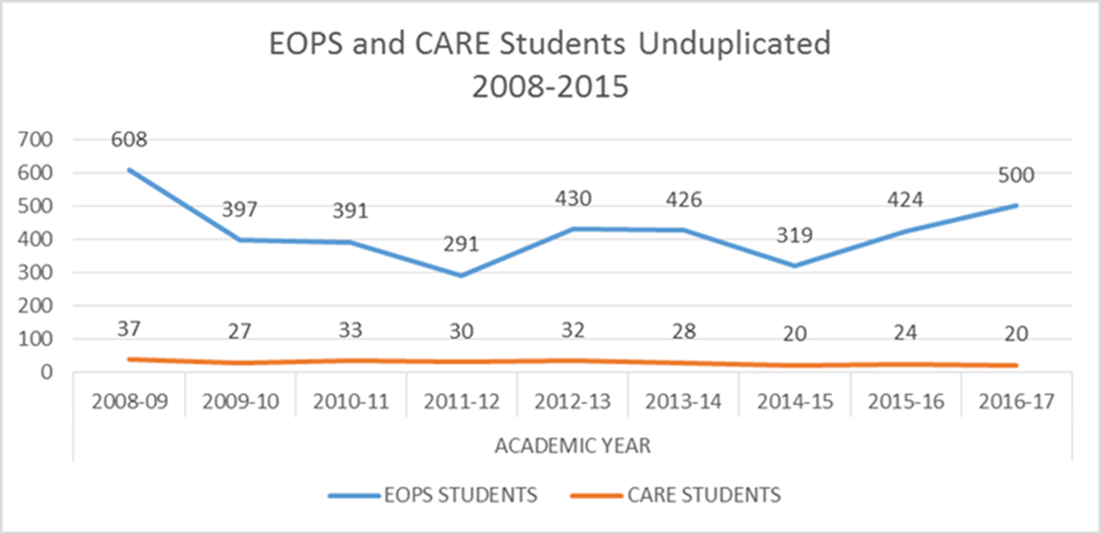

Slide 7
Program goals

Slide 8
Increase
EOPS enrollment

Slide 9
Expand programming

Slide 10
Provide more stability to the program and students

Slide 11
Funding request

Slide 12
EOPS – 25%
SSSP – 35%
Fund 1 – 40%

Slide 13
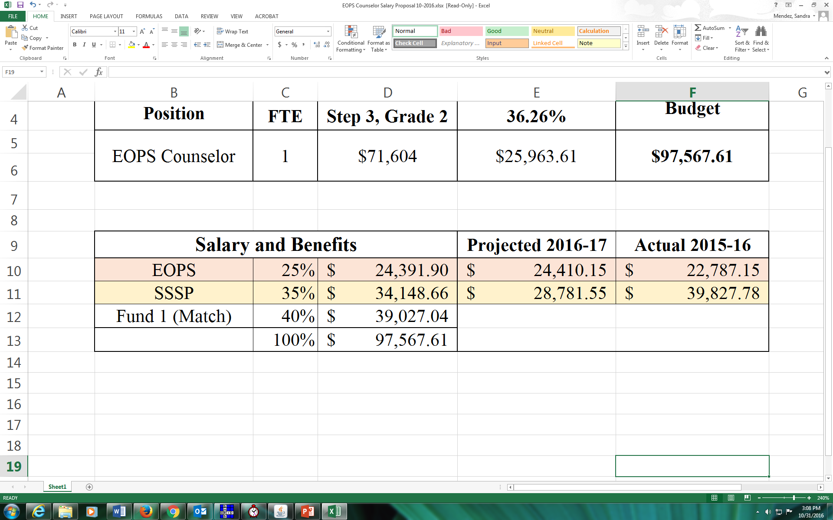

Slide 14
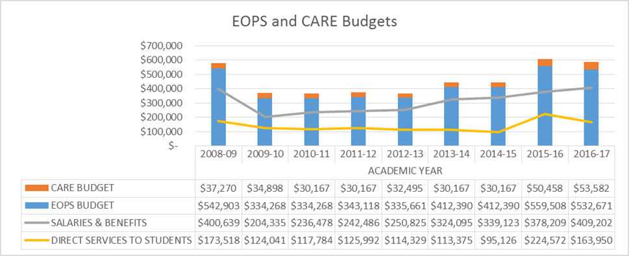

Slide 15
Comprehensive Counseling

Slide 16
Crisis intervention
Follow up
Academic
Financial
EOPS COUNSELOR
Career
Foster Youth
Dreamers
Personal
Goal setting

Slide 17


