Slide 1

Financial Aid Assistant
Improving student access, success and completion….

Slide 2



Need
Permanent fulltime Financial Aid Assistant who….
  Professionalizes service provided to our students
  Addresses diverse student needs and challenges – particularly those unique to Bay Area
  Translates complex eligibility and regulatory requirements for families
  Listens, encourages and finds common ground
  Works as part of a larger team of support staff and can triage and refer students to other programs and services

Slide 3
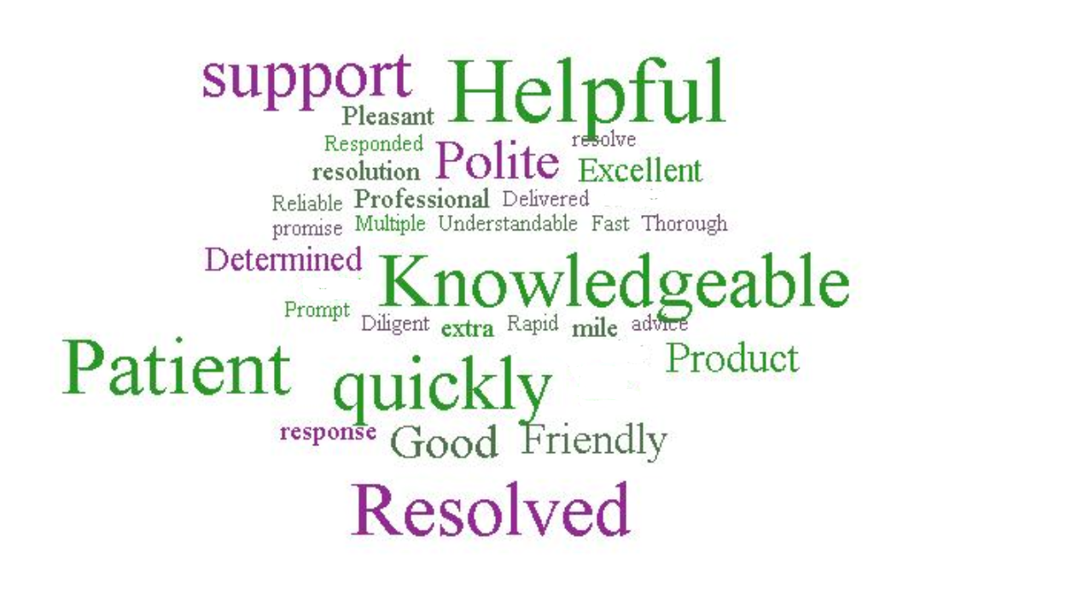


Provides Excellent Customer Service
  Elevates expectations
  Excellent interpersonal skills
  Culturally competent & social justice frame of reference
  Consistent, accurate and complete information
Compassionate and sensitive to circumstances
Builds trust, removes barriers and expedites processing
Case manages, triages and refers
Supports retention efforts

Slide 4
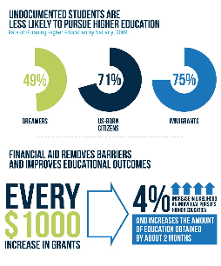
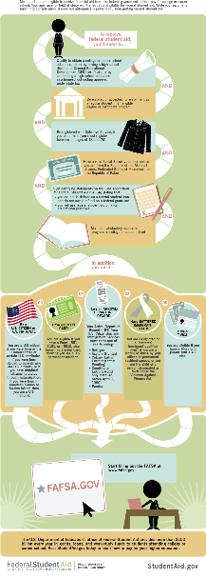
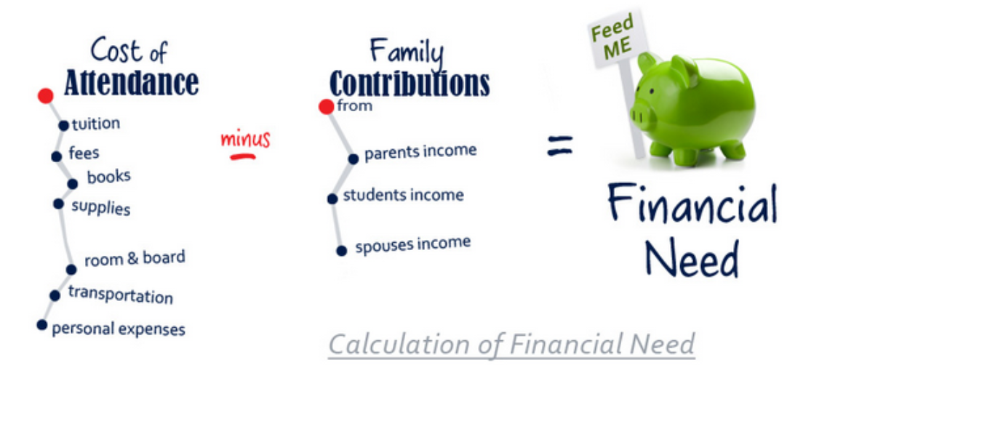

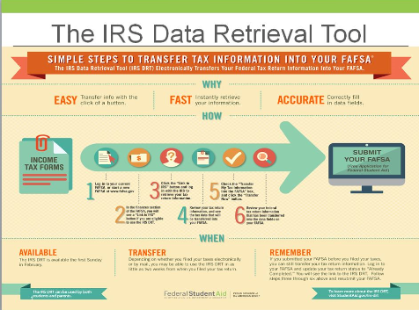

Complicated Processes
Need professional staff as first/main point of contact
    Over 7,900 visits to office last year
    Manage email and phone inquiries
    Unsustainable/inappropriate overreliance on students to fill gap
  Requires training, expertise, ethics
    IRS Regulations, Foster & Homeless Youth. SAP, Loss of BOGFW, DACA/AB 540, Appeals, Extenuating Circumstances
Ability to de-escalate stressful situations, debunk myths, and clarify procedures
Provides more targeted student follow-up

Slide 5

Expands Financial Aid Reach & Service
Off Campus
  Community and High School Financial Aid Nights and College Fairs
  Cash for College Workshops
On Campus
  COLTS Academy, PEP, ESL, Proactive Registration
  Student and staff trainings
  Dreamers Task Force & Dream Center
  EOPS, CARE, CalWORKs & FFYSI, TRiO, DRC, others…
  FAFSA, & Dream Application Workshops
  Support HSI and NSF-STEM Grant funded initiatives and collaboration with Retention Specialists
  SparkPoint & Financial Literacy
NEW! FATV Implementation
  GetAnswers 24/7 tool, GetSAP, BOGFW & Enrollment Priorities

Slide 6
Questions?
Financial Aid Mission:
To aid students and prospective students in their understanding, application, and timely receipt of all eligible financial aid resources they need to reduce the significant barriers the costs of higher education present.
Our Philosophy:
Everyone is deserving of an education and we support this entitlement through education, compassion and respect.

