Slide 1
Math Position Justification
November 9th, 2016

Slide 2
Mostly Part-time
FTEF is 12.7
48% of units taught by FT faculty
FT instructors concentrated at higher levels:
2 out of 12 sections of pre-transfer level math (16%)
3 out of 10 sections of statistics

Slide 3
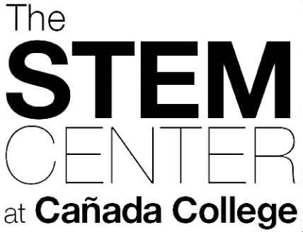
Stable, High enrolment in Calculus Path

Slide 4
Math is important, required … and a gatekeeper.

Slide 5
Success Rates

Slide 6
We are proactive:
PATHWAYS -> Key Equity initiative
Path to Stats
Path to Calulus
Math Jam
Grant Opportunitis
MSEIP

Slide 7
Growing Statistics Pathway

Slide 8
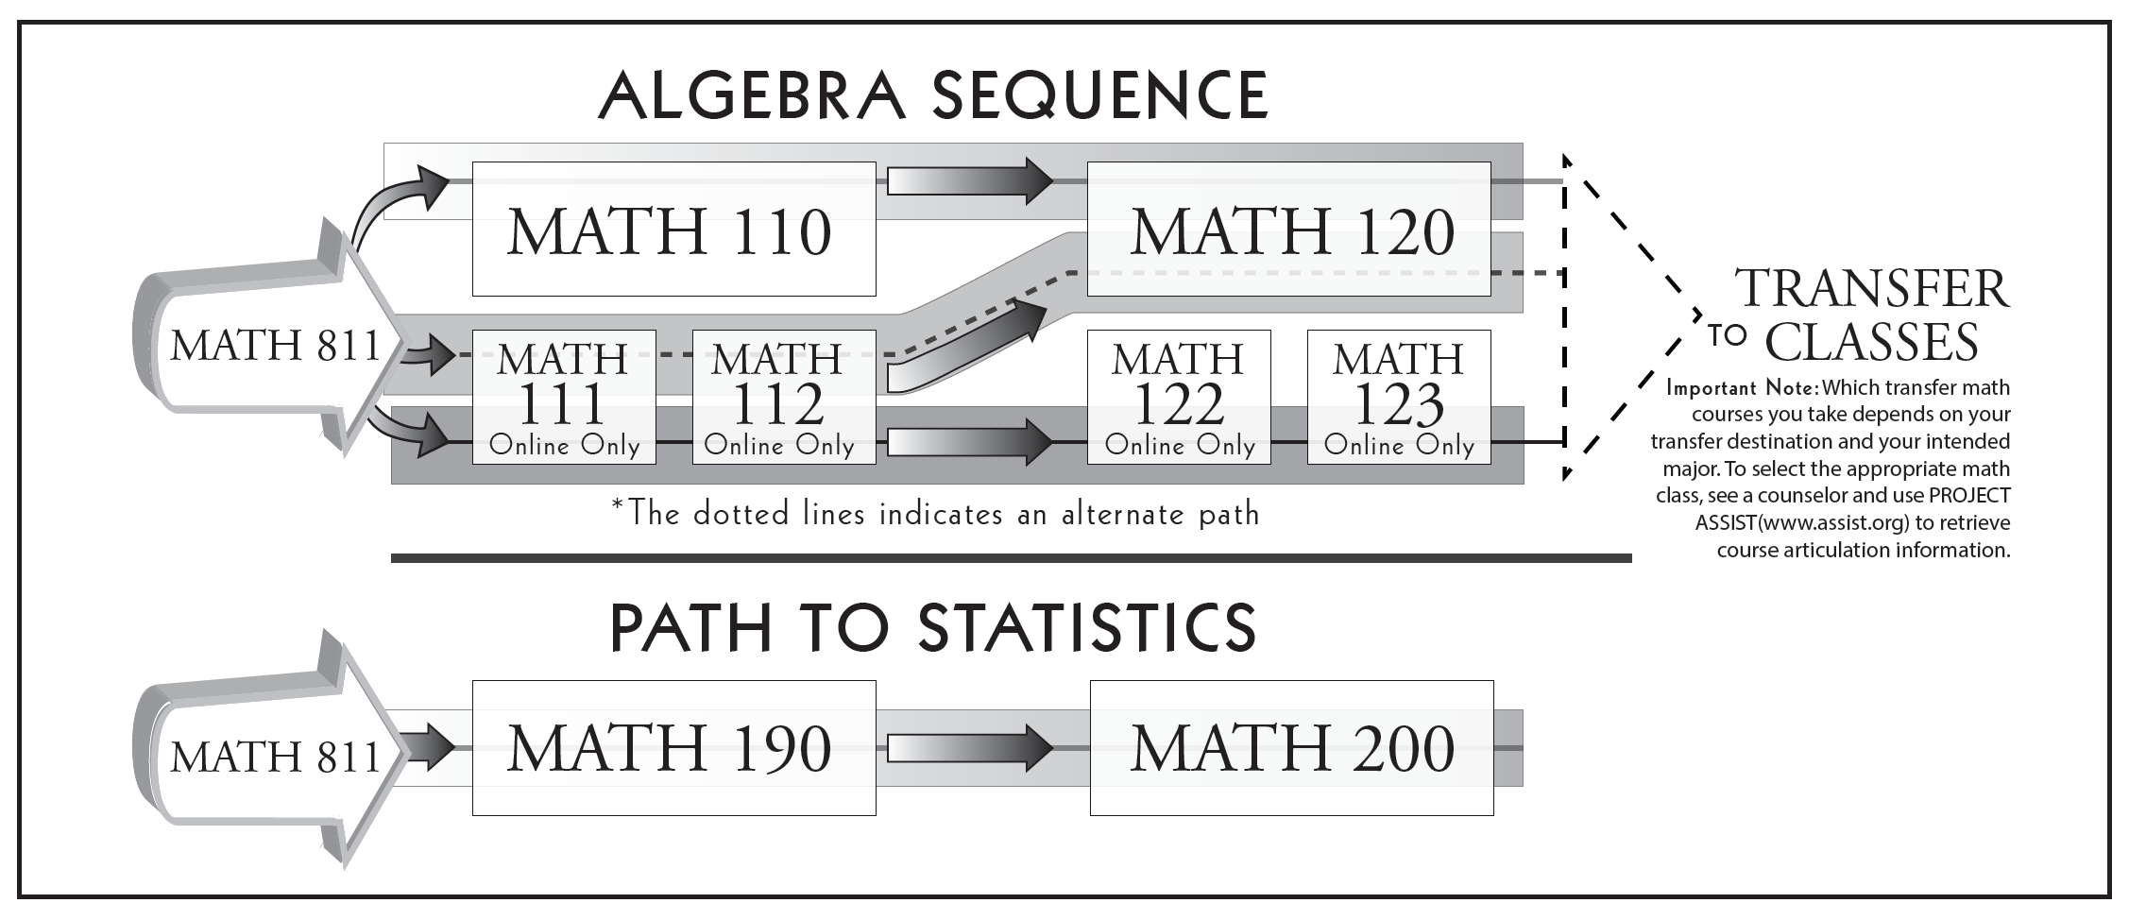
Cohort Comparison:
Students Beginning in Algebra 1 vs. Pre-Stats
Fall 2013-Spring 2015
100% (N=930)
4.5% Take Stats
w/ 55% pass rate
100% (N=162)
40% Take Stats
w/ 65% pass rate
Notes:
Reducing exit points improves completion rates! This is a structural fact.
Co-requisite Models will improve these rates…
8

Slide 9
Summary
To improve we need stable, collaborative work
This requires investment
There are a LOT of opportunities, but few bodies to coordinate and lead, on top of teaching the load.
We have plans for incorporating new faculty into a culture of collaboration and improvement.
Quality teaching in Math is a SERIOUS Equity issue.

Slide 10
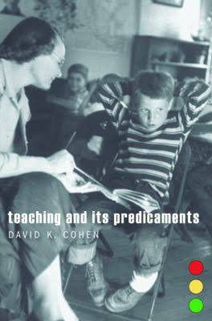
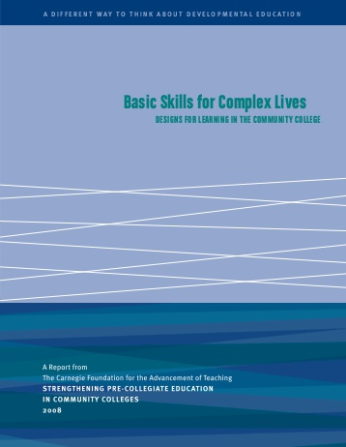
Effective Professional Learning
Collaborative
Sustained over time
Focused on Evidence About Student learning
Coherent: Train people for the specific content they teach.
Produces Social Resources for Instruction
(SPECC 2008, Cohen 2011, Garet et al 2001 )

Slide 11
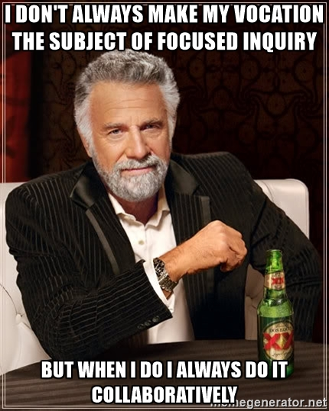
This (individualistic) view of teaching is, among other things, profoundly unprofessional, even anti-professional … it effectively precludes any possibility of improvement of instruction at scale… and makes it impossible to treat human skill and knowledge as the main instrument of improvement.
--Elmore, 2008, p. 50
Notes:
When attempting anything new or risky, it is helpful to have peers who are aware of, support and encourage one’s progress in part because of the emotional and logicitcal support such peers can provide, and in part because peers assert some social accountability for continuing to move forward.
Emotional and logicistical support

Slide 12
Effective Model: Teaching Communities
Led by experienced (or enthusiastic) teacher
A curriculum of readings and discussions to introduce new teaching practices
Meet every week/other week:
Discuss readings on new pedagogy
Reflect and Prepare Classes
Plan “Lesson-Study” on Research Lessons for one key topic per instructional unit.
Develop and Revise Shared Lesson Plans
Los Medanos College Developmental Education Program
Guide to Facilitating a Teaching Community (2009)

Slide 13
Summary
To improve we need stable, collaborative work
This requires investment
There are a LOT of opportunities, but few bodies to coordinate an lead, on top of teaching the load.
We have plans for inco

Slide 14

California Acceleration Project (CAP) Design Principles:
Backward Design from Transfer-Level Courses
Relevant, Thinking-Oriented Curriculum
Just-in-Time remediation (Stop Frontloading!)
Intentional support for students’ affective needs
Low Stakes Collaborative Practice
Notes:
What made this CAP so effective?

Slide 15
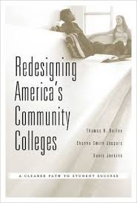
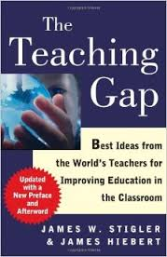
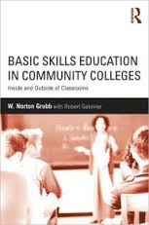
Community College Math TeachING
Cultural: Learned Implicitly (Hiebert, Stigler 2009)
Remedial Pedagogy (Grubb & Gabriner, 2013)
Difficult to Change!(AtD 2013)
Reinforced by external forces and course sequences (Bailey, Jaggars, Jenkins 2015)
Notes:
Hess & Azuma:
Quick & Snappy vs. Slow and Sticky We have difficulty letting people struggle (Impolite)
They also argue: Every society solves the problem of motivation in a different way.
Also: US teachers think teaching math is easy; Japanese teachers think it’s hard!

Slide 16
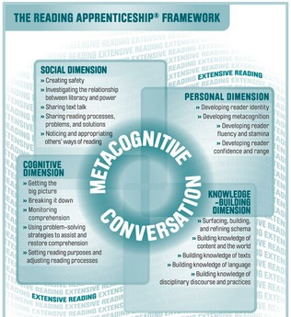
Reading Apprenticeship
Lecture
Intentional Modeling of Cognitive Strategies
Engaging with Student Knowledge
Formative Assessment
Uncovering Expert Blind Spots

Slide 17
Socialization of US Students into Mathematics
Young children: concepts and counting, linked together
Some insist that math make sense, with or without teacher’s help
May become mathematicians/scientists
SCHOOL:
Practicing procedures & memorizing rules
Good memorizers, memorize their way through algebra
Success, but never really “get” mathematics
Poor memorizers have difficulty
All comes crumbling down
Community College Developmental Math
Stigler & Givvins 2014
Notes:
View math as rules/procedures to be memorized; can’t “figure it out”
When students were asked, “What does it mean to be good at math?” 77% gave answers like these:
“Math is just all these steps.”
“In math, sometimes you have to just accept that that’s the way it is and there’s no reason behind it.”
“I don't think [being good at math] has anything to do with reasoning. It's all memorization.”

Slide 18
