Slide 1
New biology Faculty
Investing in General education

Slide 2
Four Full-time faculty
Dani Behonick
Doug Hirzel
Carol Rhodes
Nathan Staples

Slide 3
Three strands of courses
% of enrollment
Notes:
enrollment in each strand
current FTmers do teach GE but aren’t solely focussed on them

Slide 4
One vision
To add one additional full-time faculty member who will focus on enriching our general education course offerings and sustaining our involvement in pathways that support student success.
Biology Faculty

Slide 5

Pathways

Slide 6
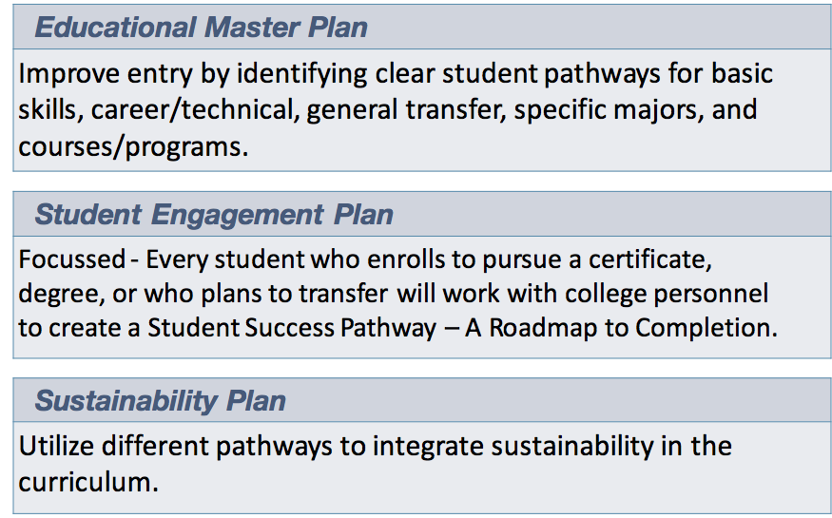

Slide 7


Sustainability:
BIOL 100/110
BIOL 130/132
BIOL 250
GE honors?
Social Justice:
HSCI 100

Slide 8
support for pathways
80% of pathway sections are taught by PT faculty
consistency?
sustainability?
institutionalization?

Slide 9
Reliance on Pt faculty
60% of all sections in the program have no FT faculty to drive long-term innovations to improve success
60% of all sections in the program have no FT faculty to drive long-term innovations to improve success

Slide 10
Annual Enrollment

Slide 11
Causes of Enrollment decline
Discontinuance/banking of 10 non-core courses
Softness in nursing labor market demand
Reduced demand from career-changers due to record low unemployment

Slide 12
discontinued courses
BIOL | HSCI
103 Native Plants and Wildflowers | 104 Nutrition and Physical Fitness
380/1 Travel Study | 105 Communicable Diseases
 | 115 Healthcare Professions
 | 116 Women’s Health
 | 430 First Aid
 | 432 CPR
 | 480/1 Phlebotomy
 | 665 Environmental Health

Slide 13
GE Enrollment is stable
allied health
GE non-majors
majors

Slide 14
We have the capacity
8.4 Total FTEF
- 4.0 Full Time
4.4 Part Time
Notes:
2.5-3 FTE within GE courses

Slide 15
We Are efficient
LOAD: 529
College: 483

Slide 16
We Are efficient
Fill Rate: 91%
Program 5-year average: 88%
College average: 78%

Slide 17
Student demand will increase

Slide 18
2012-2022 Forecast
Healthcare practitioners will increase 15% in SMC
Approximately 600 new and over 800 replacement positions every year in SMC!
Registered Nurse ranks 14 in list of occupations with the highest number of total projected job openings in SMC
Notes:
http://www.labormarketinfo.edd.ca.gov/data/employment-projections.html
RN: 96% as many as the number of openings for system software developers (need the same number of RN as system developers)
RN: 66% as many as the number of openings for software application developers (need two-thirds as many RNs as application developers)
RN: 132% as the number of openings for lawyers! (need 32% more RNs as new lawyers)

Slide 19
growth opportunities
AS-T in Biology
AS-T in Nutrition and Dietetics
AA-T in Kinesiology
AS in Neurodiagnostic Technology with UCSF
Health Science-Human Services collaborative in Public Health

Slide 20
Questions?

