Slide 1
Part-Time Library Support Specialist
Notes:
-email jeanne
-Implementing: Equity plan, the Basic Skills plan, the district strategic plan “Strategic Goal #1: Develop and strengthen educational offerings, interventions, and support programs that increase student access and success .....” as well as ESO- Start Strong, Stay strong, finish strong.

Slide 2
Justification Needs
We need someone to supervise the library front desk including student assistants, supporting full-time Library Support Specialists.
Currently none of our staff members are in this role during the day.
Assist Library Support Specialists and allow them to focus on their main duties (reserves, cataloging, budgeting, processing, TLC, etc.)
Extending outreach efforts to departments such as ESL, CTE, STEM, and Basic Skills

Slide 3
Justification Needs Continued...
Currently about 55% of help librarians provide consists of circulation, directional questions, and printing help, duties that would be better done by student workers and Library Support Specialists.
Existing Library Support Specialists spend a total of 5.5 hours of their work day directly interacting with patrons (students, staff, and faculty).
Assist our Library Support Specialists to grow our TLC (semester-length loan textbook, graphing calculator, and laptop lending collection)
Notes:
three Library Support Specialists spend a total of 5.5 hours of their work day directly interacting with patrons (students, staff, and faculty). This leaves them little time to work on important projects such as processing new materials, the TLC collection, managing library payments, keeping track of the library budget, and expanding our technology resources.
This position would make day-to-day library functions more efficient and seamless.

Slide 4
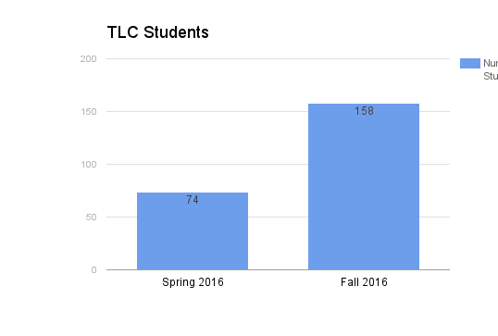
Stats
 | Math Basic Skills College | Math Basic Skills TLC
Retention | 74.89% | 85.71%
Pass Rate | 54.83% | 74.29%
Circulation stats: 4,400 in 2015
Reserve stats: 6,815 in 2015
TLC fall 2016:
158 Students
12 Dreamers
 | ESL General | ESL TLC
Retention | 85.11% | 93.75%
Pass Rate | 71.25% | 87.50%
Notes:
We will have more students in spring with the addition of MESA/STEM
We would like to ensure that every student on campus has access to textbooks and needed technology, adding a part-time position will give us the staffing needed to ensure that we are closer to reaching our goal.
By providing students with library resources such as textbooks, laptops, graphing calculators, and wi-fi hotspots, we empower them to be successful in their studies.
This position will allow our full-time library support specialists to continue their work on projects like TLC.

Slide 5
Morning “Front Desk” Library Support Specialist
Supervise student assistants
Handle sensitive information regarding student accounts, fines, etc.
Work with evening staff to recruit, hire, evaluate and train student assistants
Handle complaints, policy & procedures, and other customer service issues
Ensure a safe and respectful environment

Slide 6
How does this Help the College?
This position allows us to increase services and resources for faculty and students
Increases our TLC Program (Semester-length Textbook, Calculators, and Laptops program)
Increases resources for students, staff and faculty
Increases efficiency in the library
Notes:
physical library collection

Slide 7
How it Helps our Students
Having a supervisor LSS to answer questions in the morning
Resolving issues that may come up quickly
More efficient and effective service in the morning
Increase technology help and instruction
Notes:
Students often need help with creating powerpoint presentations, formatting papers for printing, etc.

Slide 8
What happens if we don’t get this position?
Potential expansion of programs such as TLC and TLC STEM will be severely limited
Current projects to increase the collection and services will be greatly delayed or canceled
Current Library Support Specialists will continue to be stretched thin
Quality and quantity of services to students could potentially decrease

